Slide 1

Unit 4: Community Services
Lesson 1.3: Pronunciation & Speaking
Page 30

Slide 2



LESSON OUTLINE
Consolidation

Slide 3

By the end of this lesson, students will be able to…
- talk about how to organize charity events, using should, Let’s or How about.
- practice pronouncing compound nouns.

Slide 4

WARM-UP

Slide 5

Work in pairs.
Choose the word whose main stress is placed
differently from the others.
A. flower B. zorbing C. parade D. comic
2. A. reply B. service C. candy D. plastic
3. A. noodles B. seafood C. visit D. police
/ˈflaʊər/
/ˈzɔ:rbɪŋ/
/pəˈreɪd/
/ˈkɑ:mɪk/
/rɪˈplaɪ/
/ˈsɜːrvɪs/
/ˈkændi/
/ˈplæstɪk/
/ˈnu:dlz/
/ˈsi:fu:d/
/ˈvɪzɪt/
/pəˈliːs/

Slide 6
Work in pairs.
Choose the word whose underlined part is
pronounced differently from that of the other words.
A. tray B. day C. bag D. cake
2. A. sons B. arts C. tips D. checks
3. A. shirt B. kind C. time D. child
/treɪ/
/deɪ/
/keɪk/
/bæɡ/
/sʌnz/
/ɑ:rts/
/tɪps/
/tʃeks/
/ʃɜːrt/
/kaɪnd/
/taɪm/
/tʃaɪld/

Slide 7
Work in pairs, match the events to the appropriate activities.
Events | Activities
Car wash | Sell paintings
Fun run | Make cupcakes
Bake sale | Sell comics
Craft fair | Wash cars
Book fair | Sell tickets
Art show | Make cards
Talent show | Sell drinks

Slide 8

Work in pairs.
Which event do you like best? Why?
I like the book fair best because I love reading.

Slide 9



Slide 10
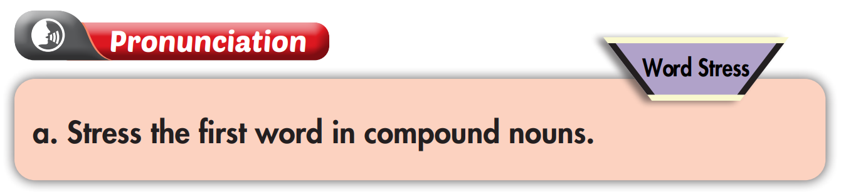
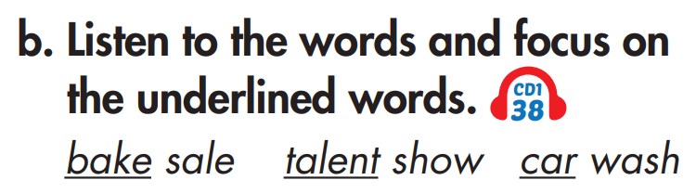


Slide 11
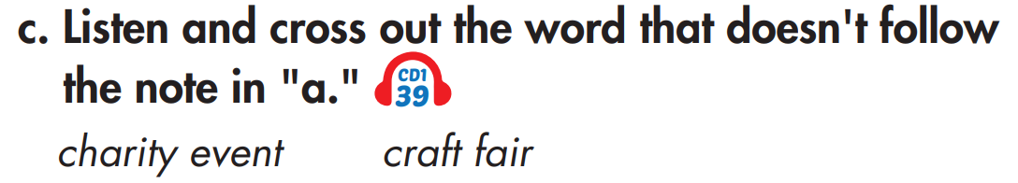
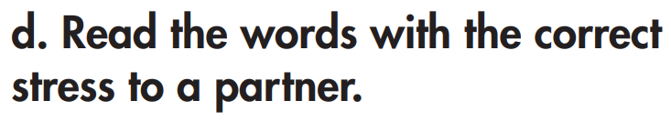

Slide 12
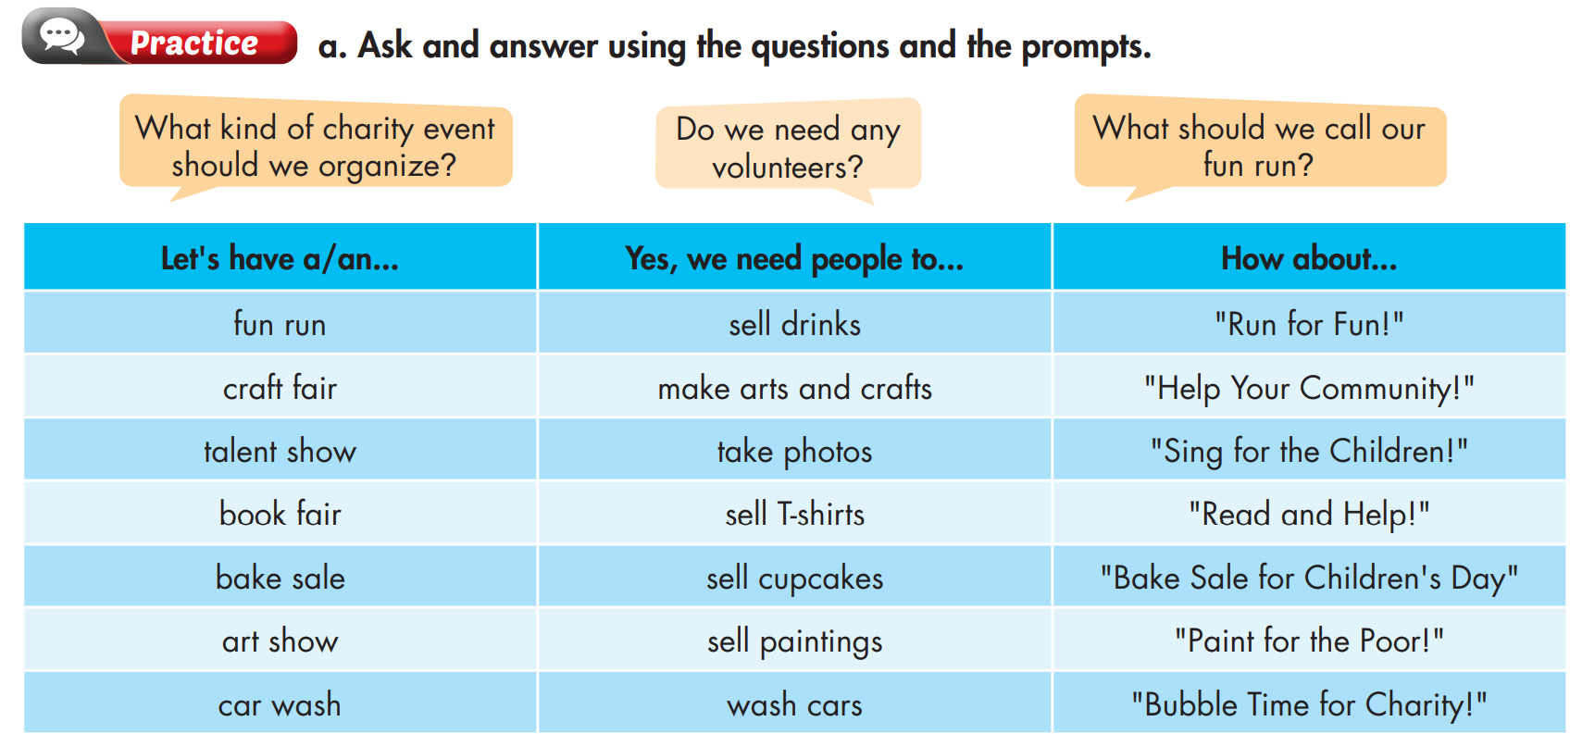

Slide 13

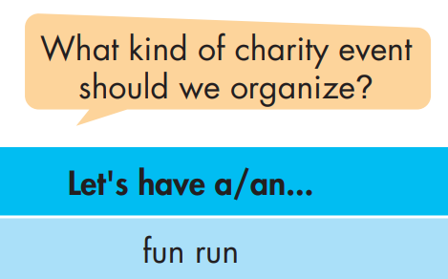
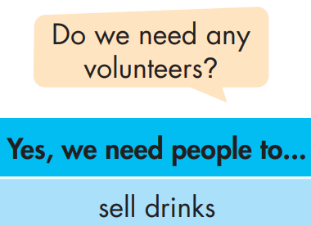
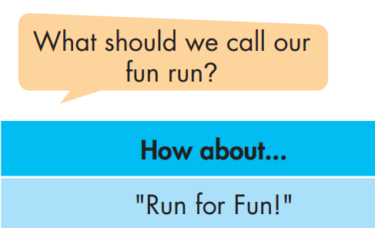

Slide 14
What kind of charity event should we organize?
Do the same
Fun Run | Sell drinks | “Run for Fun”
Craft Fair | Make arts and crafts | “Help your Community”
Talent Show | Take photos | “Sing for the Children”
Book Fair | Sell T-shirts | “Read and Help”
Bake Sale | Sell cupcakes | “Bake Sale for Children Day”
Art Show | Sell paintings | “Pain for the Poor!”
Car Wash | Wash cars | “Bubble Time for Charity”
Let's have a Craft Fair.
Do we need any volunteers?
Yes, we need people to make arts and crafts.
What should we call our Craft Fair?
How about “Help your Community”?

Slide 15
What kind of charity event should we organize?
Do the same
Fun Run | Sell drinks | “Run for Fun”
Craft Fair | Make arts and crafts | “Help your Community”
Talent Show | Take photos | “Sing for the Children”
Book Fair | Sell T-shirts | “Read and Help”
Bake Sale | Sell cupcakes | “Bake Sale for Children Day”
Art Show | Sell paintings | “Pain for the Poor!”
Car Wash | Wash cars | “Bubble Time for Charity”
Let's have a Talent Show.
Do we need any volunteers?
Yes, we need people to take photos.
What should we call our Talent Show?
How about “Sing for the Children”?

Slide 16
What kind of charity event should we organize?
Do the same
Fun Run | Sell drinks | “Run for Fun”
Craft Fair | Make arts and crafts | “Help your Community”
Talent Show | Take photos | “Sing for the Children”
Book Fair | Sell T-shirts | “Read and Help”
Bake Sale | Sell cupcakes | “Bake Sale for Children Day”
Art Show | Sell paintings | “Pain for the Poor!”
Car Wash | Wash cars | “Bubble Time for Charity”
Let's have a Book Fair.
Do we need any volunteers?
Yes, we need people to sell T-shirts.
What should we call our Book Fair?
How about “Read and Help”?

Slide 17
What kind of charity event should we organize?
Do the same
Fun Run | Sell drinks | “Run for Fun”
Craft Fair | Make arts and crafts | “Help your Community”
Talent Show | Take photos | “Sing for the Children”
Book Fair | Sell T-shirts | “Read and Help”
Bake Sale | Sell cupcakes | “Bake Sale for Children Day”
Art Show | Sell paintings | “Pain for the Poor!”
Car Wash | Wash cars | “Bubble Time for Charity”
Let's have a Bake Sale.
Do we need any volunteers?
Yes, we need people to sell cupcakes.
What should we call our Bake Sale?
How about “Bake sale for Children Day”?

Slide 18
What kind of charity event should we organize?
Do the same
Fun Run | Sell drinks | “Run for Fun”
Craft Fair | Make arts and crafts | “Help your Community”
Talent Show | Take photos | “Sing for the Children”
Book Fair | Sell T-shirts | “Read and Help”
Bake Sale | Sell cupcakes | “Bake Sale for Children Day”
Art Show | Sell paintings | “Paint for the Poor!”
Car Wash | Wash cars | “Bubble Time for Charity”
Let's have an Art Show.
Do we need any volunteers?
Yes, we need people to sell paintings.
What should we call our Art Show?
How about “Paint for the Poor!”?

Slide 19
What kind of charity event should we organize?
Do the same
Fun Run | Sell drinks | “Run for Fun”
Craft Fair | Make arts and crafts | “Help your Community”
Talent Show | Take photos | “Sing for the Children”
Book Fair | Sell T-shirts | “Read and Help”
Bake Sale | Sell cupcakes | “Bake Sale for Children Day”
Art Show | Sell paintings | “Pain for the Poor!”
Car Wash | Wash cars | “Bubble Time for Charity”
Let's have a Car Wash.
Do we need any volunteers?
Yes, we need people to wash cars.
What should we call our Car Wash?
How about “Bubble Time for Charity”?

Slide 20

What kind of charity event should we organize?
Let's have a …
Do we need any volunteers?
Yes, we need people to …
What should we call our …?
How about …?

Slide 21
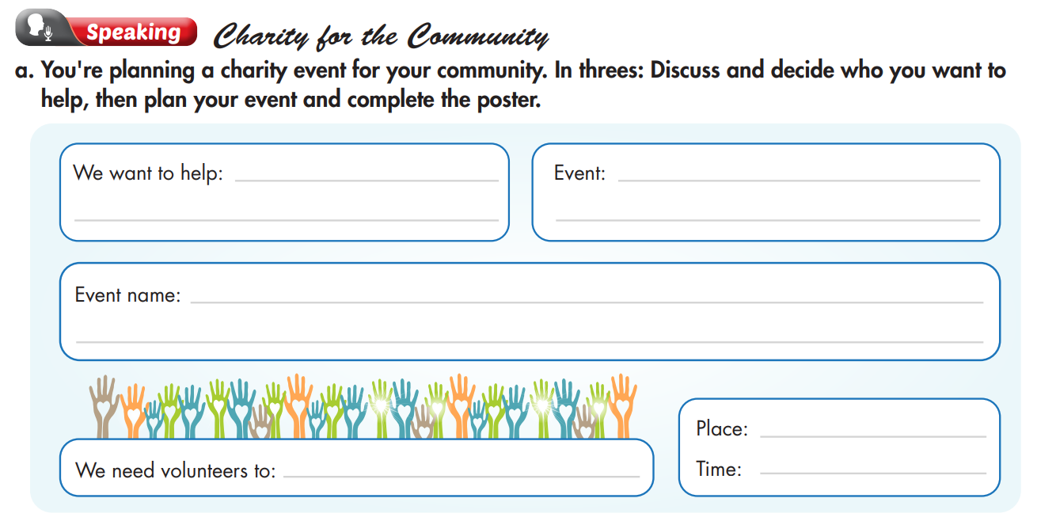

Slide 22
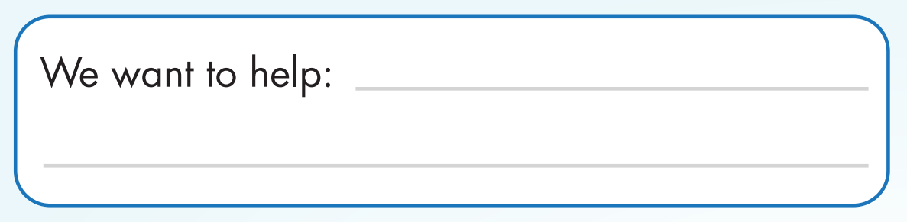
Who should we help?
I think we should help the poor students in our school.
poor students in our school

Slide 23
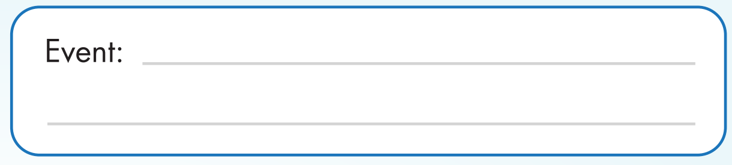
What do you think we should do to help?
Let’s have a Food Fair.
Food Fair

Slide 24
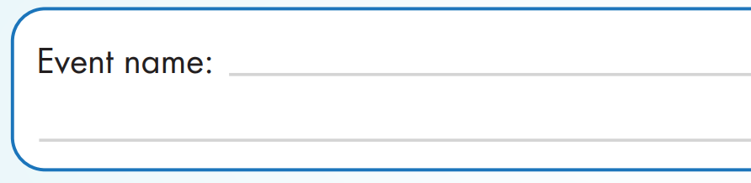
What should we call our Food Fair?
How about “Eat and Help”?
Eat and Help

Slide 25

Do we need volunteers?
Yes, we need people to cook and sell food.
cook and sell food

Slide 26
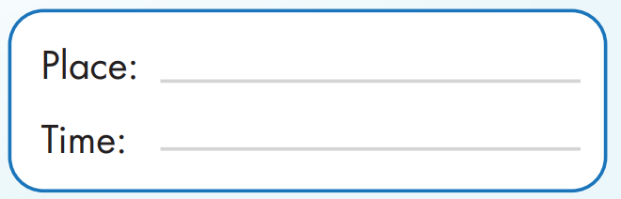
Where and when should we have the event?
I think we should have the event in our schoolyard next weekend.
schoolyard
next weekend

Slide 27

We are going to have a Food Fair to raise money for the poor students in our school. Our event name is “Eat and Help”, so you can come to enjoy delicious food and help your friends. We also need volunteers to cook and sell food at the event. Please join us to make it successful. The event will happen in our schoolyard next weekend. Hope to see you there.

Slide 28

CONSOLIDATION

Slide 29
Write a paragraph introducing the charity event you have shared with the class. Write about 70 words.

Slide 30

WRAP-UP

Slide 31
Today’s lesson
Speaking:
Talk about how to organize a charity event.
Practice pronouncing compound nouns.

Slide 32
Homework
Practice pronouncing compound nouns.
Redo the writing exercise on page 21 WB.
Review the vocabulary and grammar notes in Tiếng Anh 7 i-Learn Smart World Notebook (pages 22 & 23).
Prepare the next lesson (page 31 SB).
Play the consolidation games in Tiếng Anh 7 i-Learn Smart World DHA App on www.eduhome.com.vn.

Slide 33

Lesson 3
Stay positive and have a nice day!

