Slide 1

Unit 6: Education
Lesson 1.2: Grammar
Page 45

Slide 2


LESSSON OUTLINE
Consolidation

Slide 3

By the end of this lesson, students will be able to…
- practice and use have to in Present Simple correctly.

Slide 4

WARM-UP

Slide 5



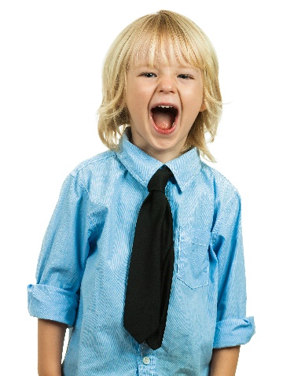

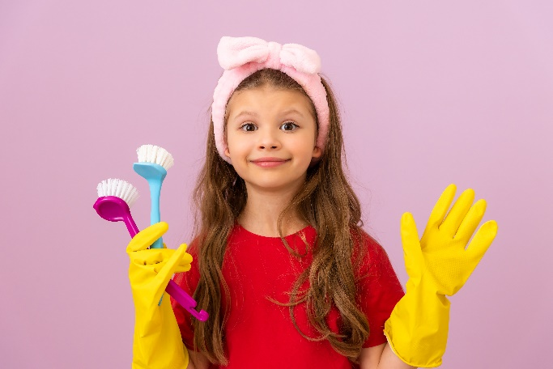
Look at the pictures and name the activities:
study for a test, work together, wear a tie, clean your room, give a presentation, take a test
work together
study for a test
give a presentation
wear a tie
take a test
clean your room

Slide 6

PRESENTATION
Have to/ has to…..
Don’t have to/ doesn’t have to…….

Slide 7
Look at four sentences and complete the form.
I have to do my homework.
They have to finish the project.
Alan has to study for a test.
He has to write a book report.
I/ They/…………/……... + have to + ………..…………..
Alan/ He/………….. + has to + ……………………..
We
You
bare infinitive
She
bare infinitive

Slide 8
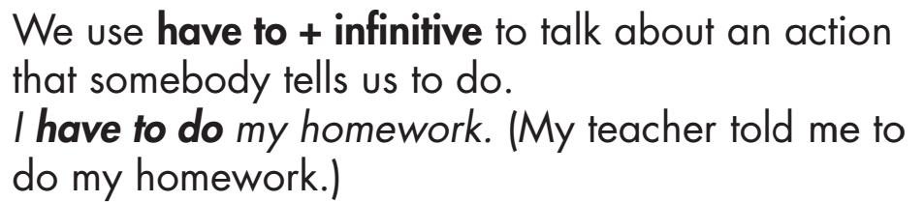
Usage:

Slide 9

Look at the sentences:
It’s Sunday. They don’t have to go to school.
Her teacher doesn’t give homework. She doesn’t have to do homework today.
Complete the rules: don’t have to or doesn’t have to
don’t have to
They/ We/ You/ I + …………………………….… + bare infinitive
He/ She/ Alan + ………………………………. + bare infinitive
doesn’t have to

Slide 10
Questions with “have to”
Look at the sentences:
Do you have to study on Sunday?
Does he have to do her homework today?
Complete the rules: Do or Does
…………….. you/ we/ they have to + bare infinitive?
…………….. she/ he have to + bare infinitive?
Do
Does

Slide 11


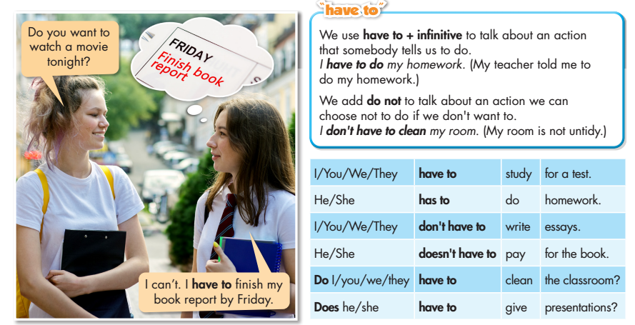
Click on the icon to hear the sound

Slide 12

PRACTICE

Slide 13
Sentence re-ordering
1. doesn’t early have to He on Sundays get up
He doesn’t have to get up early on Sundays.
2. The have to boys hard study
The boys have to study hard.
3. clean have to Do your room you
Do you have to clean your room?

Slide 14
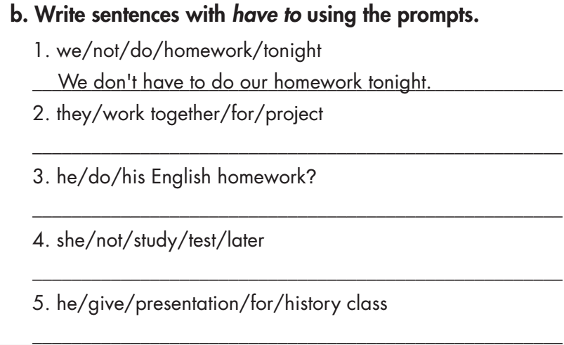
They have to work together for a project.
Does he have to do his English homework?
She doesn't have to study for a test later.
He has to give a presentation for his history class.

Slide 15
Work in pairs, fill in the blanks with have to, has to, don’t have to, or doesn’t have to and give reasons for your answers.
1. I ________________ do my homework now. I did it already.
2. My sister ________________ write a book report. It's for her English class.
3. Ellen ________________ give her presentation tomorrow. The teacher allowed her to do it next week.
4. Stephen and Jane ________________ study for their test. They need to get good grades.
5. He ________________ work in a group for this project. He can work on his own.
don’t have to
has to
doesn’t have to
have to
doesn’t have to

Slide 16
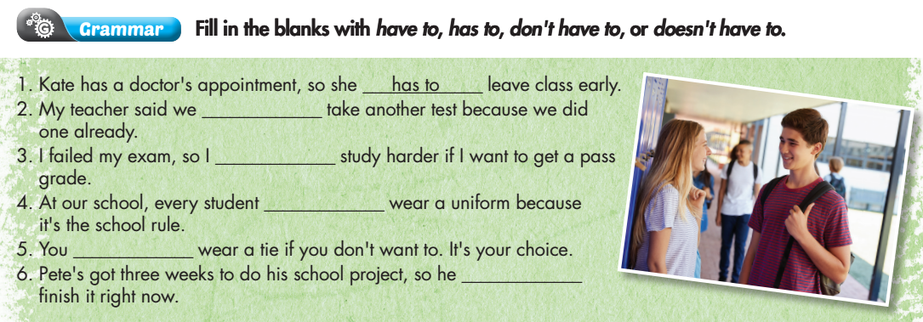
Extra Practice
WB p. 33
don’t have to
have to
has to
don’t have to
doesn’t have to

Slide 17
Complete the following sentences, using “have to/ don’t have to/ has to/ doesn’t have to” and your own idea.
Every day, I …………………………………
Every day, I ………………………………… (negative)
After class, I ……………………………….
Every Sunday, I ………………………….. (negative)

Slide 18
PRODUCTION

Slide 19
Work in pairs
Take turns to ask and answer about what you have to/ don’t have to do at home / at school.
I have to clean my room at home. At school, I have to take a test.
What things do you have to at home/ at school?
What things don’t you have to at home/ at school?
At home, I don’t have to cook. At school, I don’t have to write an essay.

Slide 20
Report about what your friend has to do / doesn’t have to do.
Hi, my name is……. My friend is…………. He/ She has to…………….at school/ at home. He/ She doesn’t have to………….at school/ at home.

Slide 21

CONSOLIDATION

Slide 22
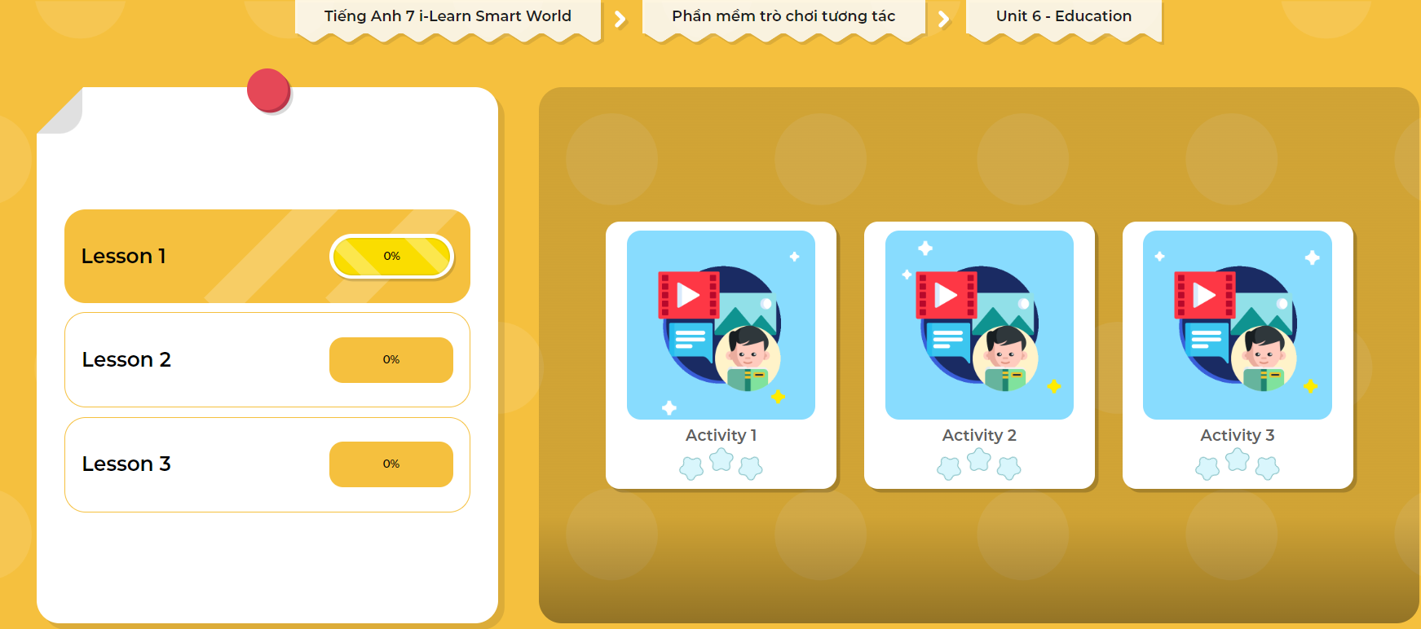
LET’S PLAY!
Click here to play the games

Slide 23
Write five sentences on what you have to/ don’t have to do next week, using the structures you learned today. (about 50 words)

Slide 24

WRAP-UP

Slide 25
Today’s lesson
Grammar
I/ We/ You/ They + have to/ don’t have to + bare infinitive.
He/ She + has to/ doesn’t have to + bare infinitive.
Do + I/ we/ you/ they + have to + bare infinitive?
Does + he/ she + have to + bare infinitive?

Slide 26
Homework
Review the grammar point and make sentences using it.
Do the exercises in Tiếng Anh 7 i-Learn Smart World Workbook (page 32).
Complete the grammar notes in Tiếng Anh 7 i-Learn Smart World Notebook (page 37).
Prepare the next lesson (page 46 SB).
Play the consolidation games in Tiếng Anh 7 i-Learn Smart World DHA App on www.eduhome.com.vn

Slide 27

Lesson 3
Stay positive and have a nice day!

