Slide 1

Unit 8. The World around Us
Lesson 3.2. Reading, Speaking and Writing
Page 69

Slide 2
Lesson Outline
Warm-up
Pre-Writing: Reading
Pre-Writing: Speaking
Writing
Consolidation
Wrap-up

Slide 3
Objectives
By the end of this lesson, students will be able to…
Reading: Read for specific information.
Speaking: Talk about a place, and be well-prepared for the writing activity.
Writing: Write a postcard.

Slide 4

WARM-UP

Slide 5
Memory game
I want to go rafting.
You shouldn’t go hiking today. It’s raining very hard.
You should go by train.
We shouldn’t take the bus. It’s too slow.
You can go kayaking.
The weather is very nice and sunny.
Notes:
GV cho sv nhìn 20 giây sau đó GV yêu cầu SV sẽ ghi lại hoặc nói lại

Slide 6

Writing

Slide 7

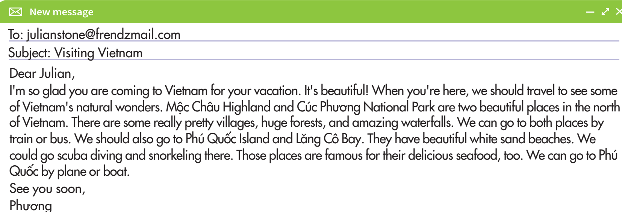
Pre-Writing
a. Read the email and underline the natural wonders of Vietnam.

Slide 8
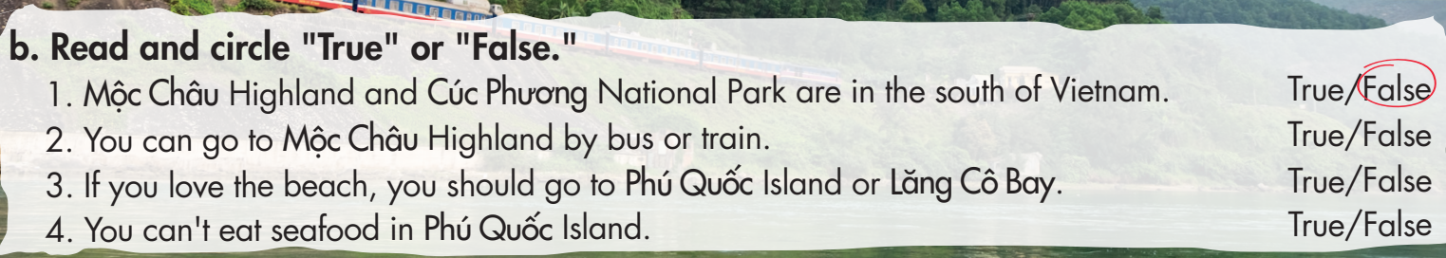
Dear Julian,
I'm so glad you are coming to Vietnam for your vacation. It's beautiful! When you're here, we should travel to see some of Vietnam's natural wonders. Mộc Châu Highland and Cúc Phương National Park are two beautiful places in the north of Vietnam. There are some really pretty villages, huge forests, and amazing waterfalls. We can go to both places by train or bus. We should also go to Phú Quốc Island and Lăng Cô Bay. They have beautiful white sand beaches. We could go scuba diving and snorkeling there. Those places are famous for their delicious seafood, too. We can go to Phú Quốc by plane or boat.
See you soon,
Phương

Slide 9

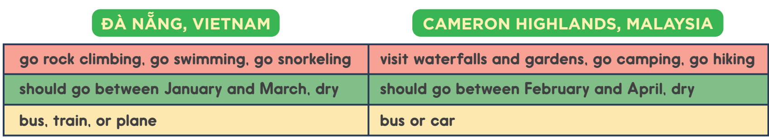
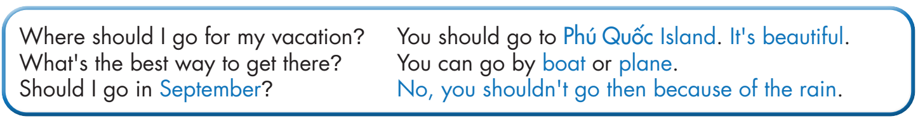
Pre-Writing
a. You want to visit some natural wonders. Read the information about the places below. Student A, answer Student B's questions about Đà Nẵng. Swap roles and repeat with Cameron Highlands.

Slide 10
Place 1
Place 2
Activities
Time
How to get there

Slide 11

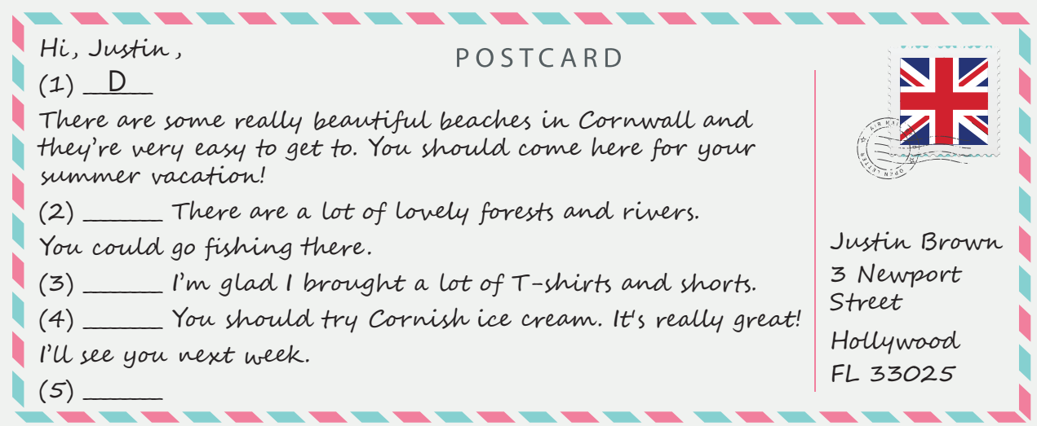
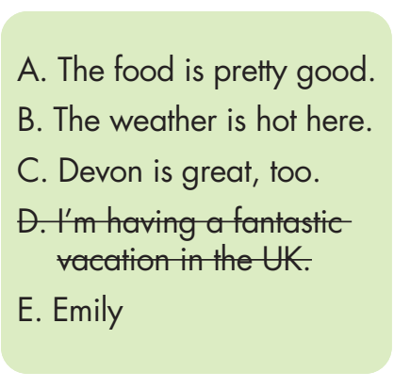
While-Writing
a. Read the postcard and fill in the blanks using the sentences (A–E).
C
B
A
E

Slide 12
Post-Writing
b. Answer the questions, then write a postcard to give advice about a place in your country. Write 50 to 60 words.
Where should your friend visit for their next vacation?
2. What can you do there?
3. How’s the weather there?
4. How’s the food there?

Slide 13
Hi, Phương,
For your next vacation you should visit Côn Đảo Island. There are many beautiful beaches here. You can also go on a boat trip to a smaller island to see turtles!
The weather is very nice and sunny. The food is okay. There aren’t many great restaurants here. We often have seafood.
See you soon!
Nhung

Slide 14

CONSOLIDATION

Slide 15
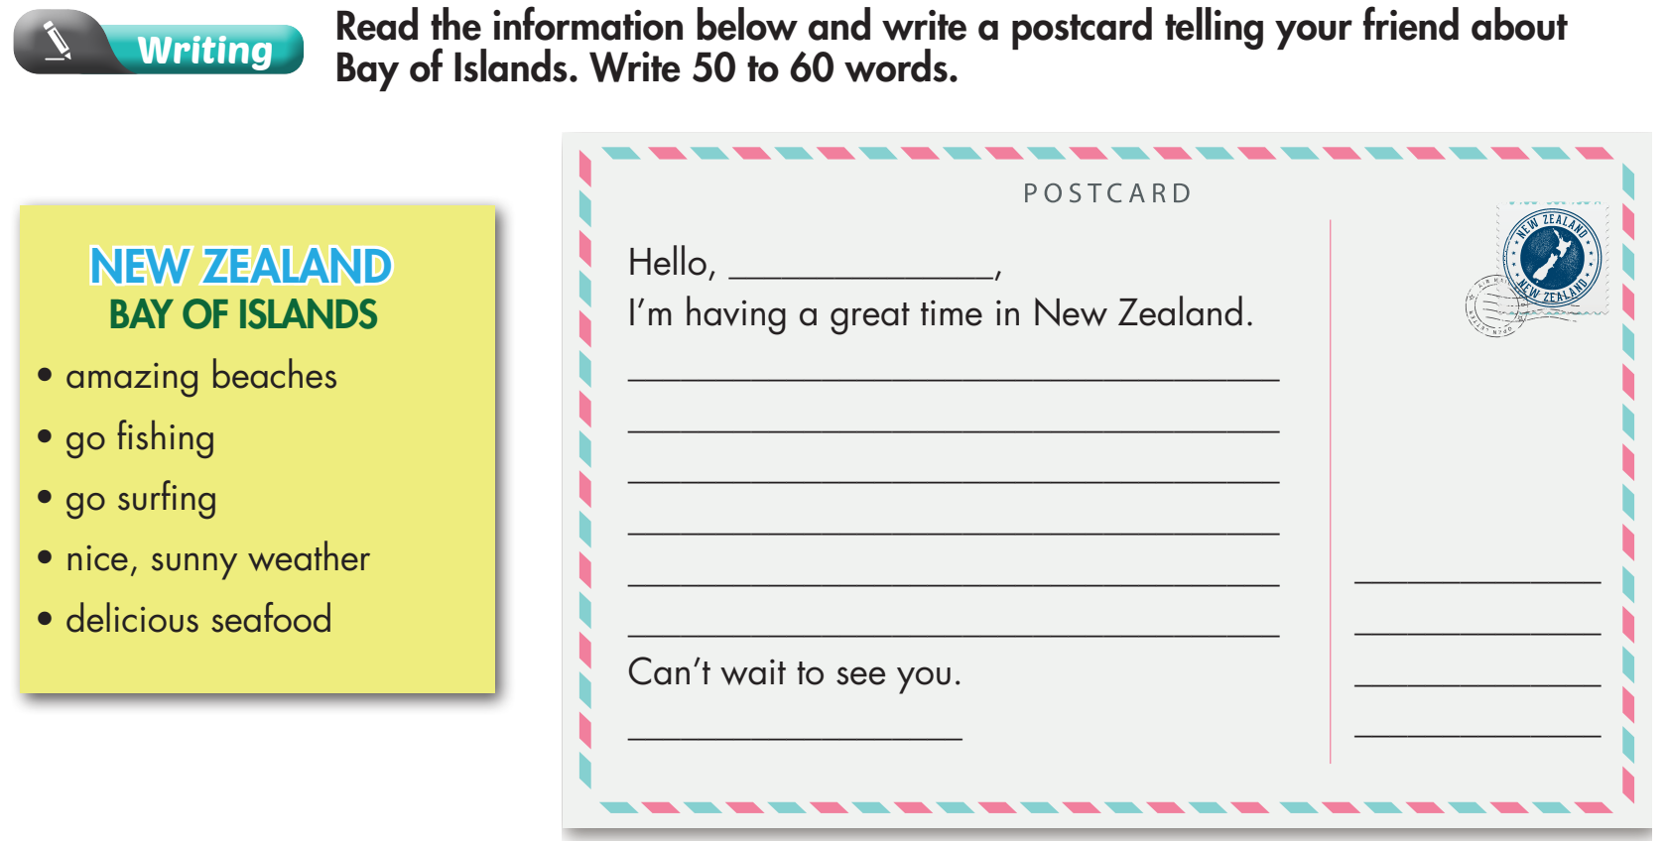

Slide 16
Key
Hello, Liam,
I’m having a great time in New Zealand. It's beautiful! When you're here, we should travel to see some of New Zealand's
natural wonders.
The Bay of Islands has amazing beaches. We can go fishing and surfing. The weather is very nice and sunny.
The seafood is really delicious. You should try it when you come here.
Can't wait to see you.
Paul

Slide 17
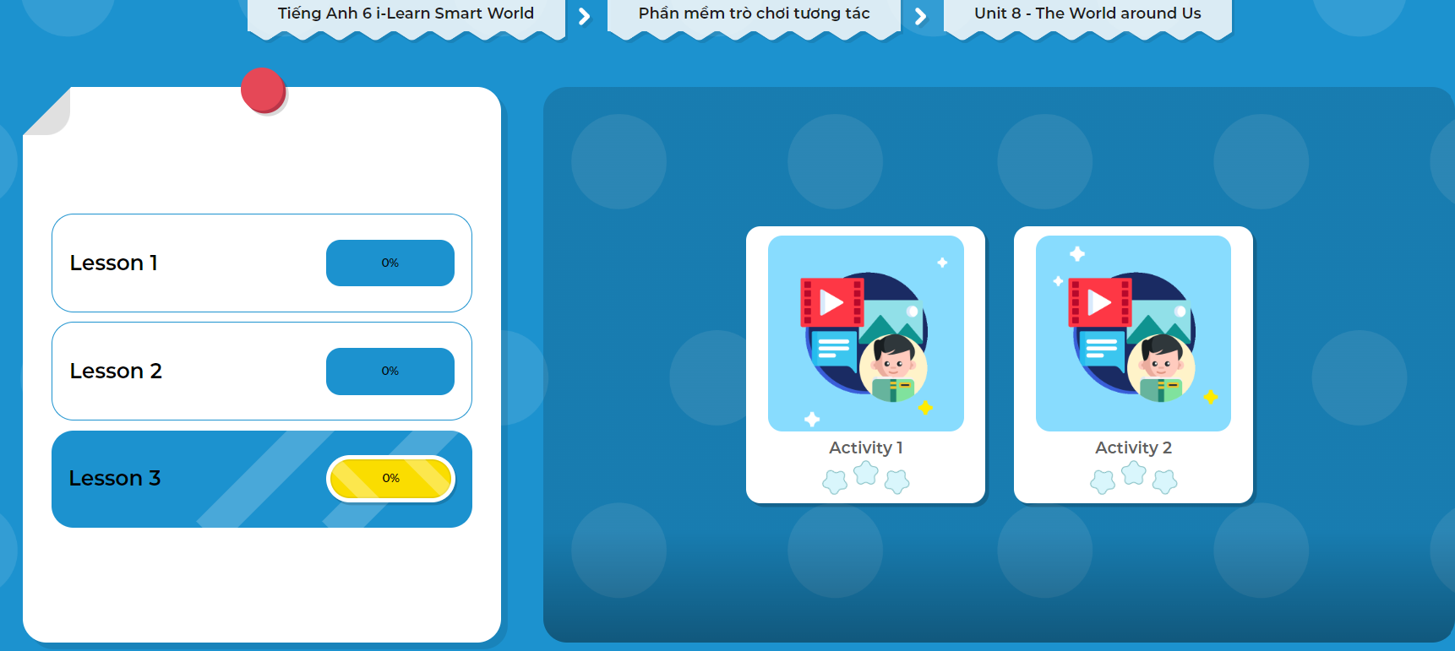
Extra Practice
DHA App
LET’S PLAY!
Click the picture below to play the games!

Slide 18

WRAP-UP

Slide 19
Today’s lesson
Reading: Read for specific information.
Speaking: Talk about a place, and be well-prepared for the writing activity
Writing: Write a postcard

Slide 20
Homework
Learn by hearts vocabularies and make sentences using them.
Complete the writing notes in Tiếng Anh 6 i-Learn Smart World Notebook on page 51.
Prepare the next lesson (pages 100 & 101 - SB).
Play the consolidation games in Tiếng Anh 6 i-Learn Smart World DHA App on www.eduhome.com.vn

Slide 21

Lesson 3
Stay positive and have a nice day!

