Slide 1

Unit 8: Food
Lesson 1.1
Page 110

Slide 2
Lesson Outline
Warm-up
Vocabulary
Structure
Consolidation
Wrap-up

Slide 3
Objectives
By the end of this lesson, students will be able to…
Vocabulary: Pronounce and use the words related to the topic properly: apple, banana, carrot, cupcake, donut
Structure: Use There is an apple/There is a banana/There are eight cupcakes.

Slide 4

WARM UP

Slide 5
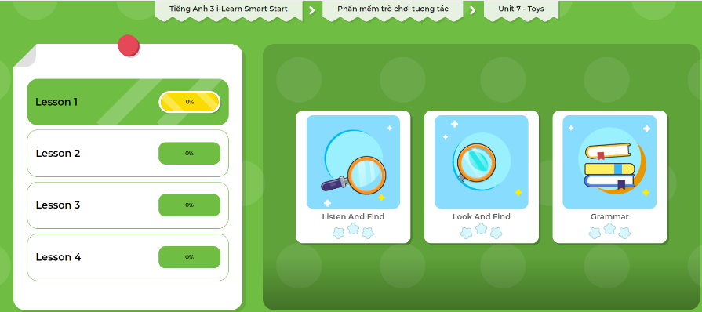
Extra Practice
DHA App
LET’S PLAY!
Click here to play the games

Slide 6
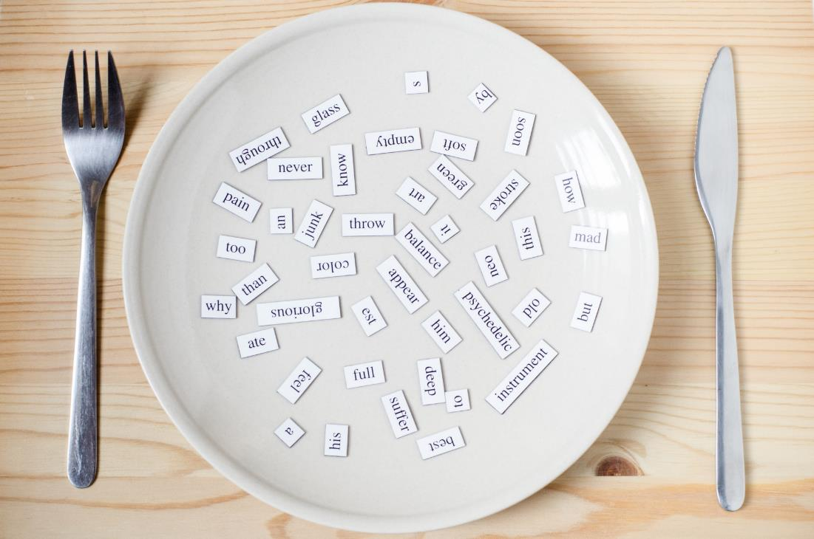
New words
apple
banana
carrot
cupcake
donut

Slide 7
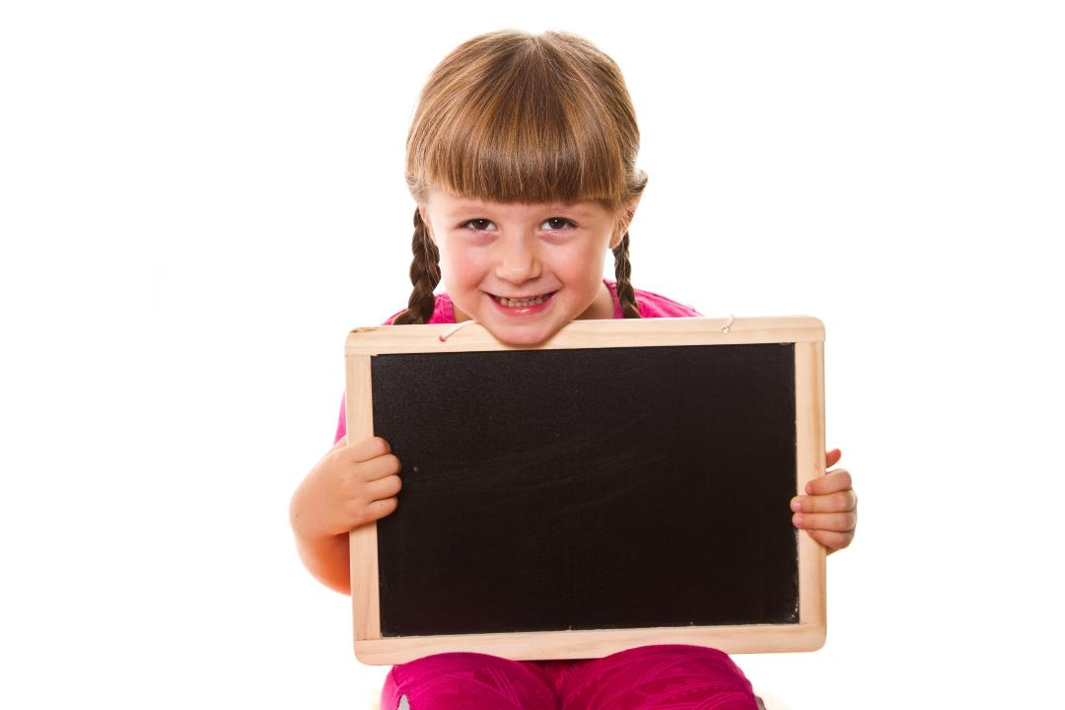
Presentation

Slide 8


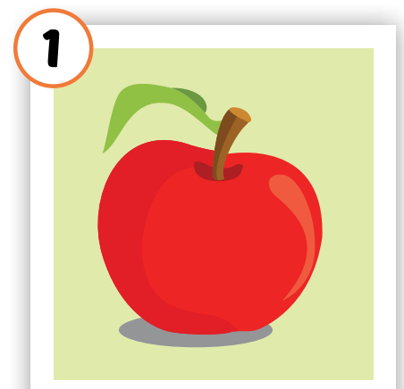

Click on each picture to hear the sound.
/ˈæpl/
quả táo
Notes:
Click vô từng hình để nghe tiếng

Slide 9
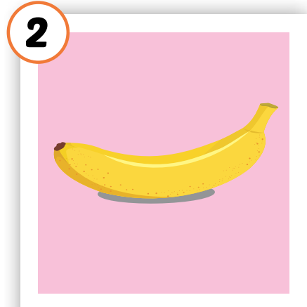

Click on each picture to hear the sound.
/bəˈnænə/
quả chuối
Notes:
Click vô từng hình để nghe tiếng

Slide 10
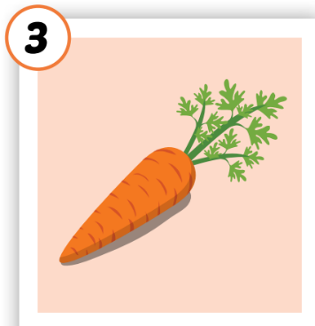

Click on each picture to hear the sound.
/ˈkærət/
củ cà rốt
Notes:
Click vô từng hình để nghe tiếng

Slide 11
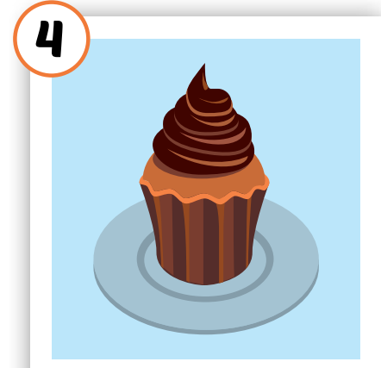

Click on each picture to hear the sound.
/ˈkʌpkeɪk/
bánh nướng nhỏ
Notes:
Click vô từng hình để nghe tiếng

Slide 12
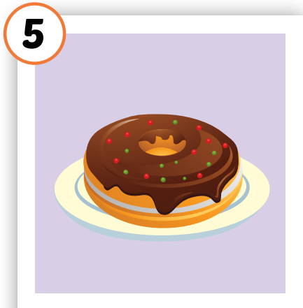

Click on each picture to hear the sound.
/ˈdəʊnʌt/
bánh vòng
Notes:
Click vô từng hình để nghe tiếng

Slide 13
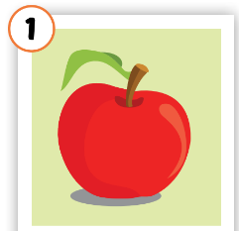
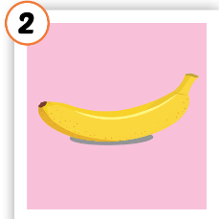
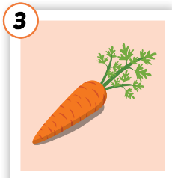



Click on each picture to hear the sound.
/bəˈnænə/
quả chuối
/ˈkærət/
củ cà rốt
/ˈkʌpkeɪk/
bánh nướng nhỏ
/ˈdəʊnʌt/
bánh vòng
/ˈæpl/
quả táo
Notes:
Click vô từng hình để nghe tiếng

Slide 14

Click A to hear the sound
Notes:
Click vào hình A. 1. Listen and point. Repeat để cho cả audio full chạy

Slide 15
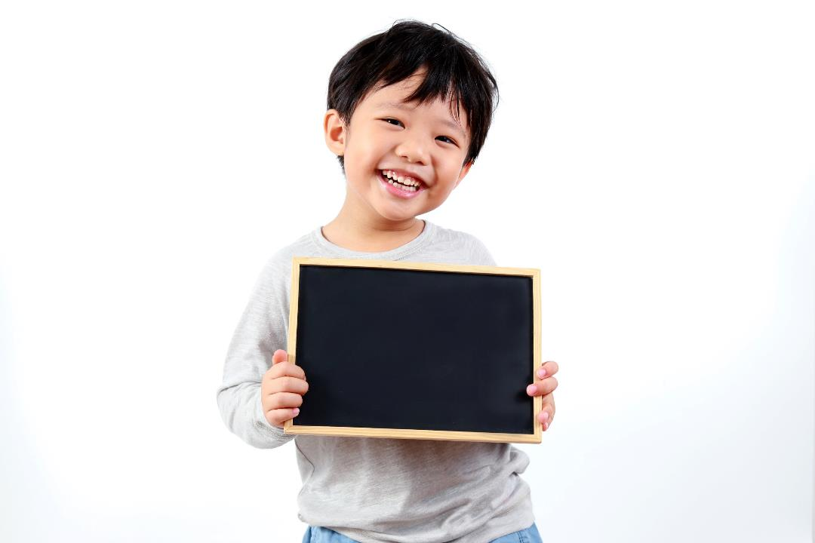
Practice

Slide 16
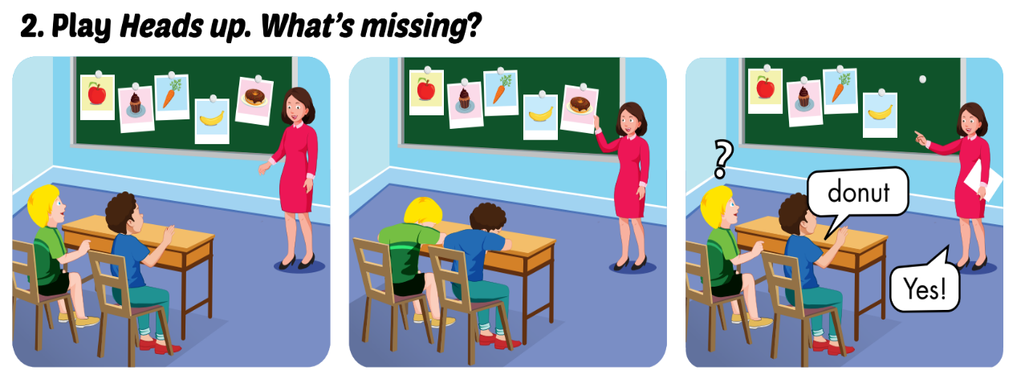

Slide 17
LOOK AND WRITE
o
carr_t
n
do_ut
e
appl_
b
_anana
c_pcake
u

Slide 18
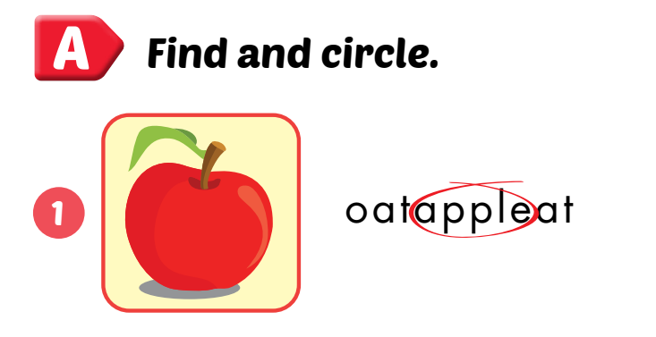
Extra Practice
WB, P. 78

Slide 19
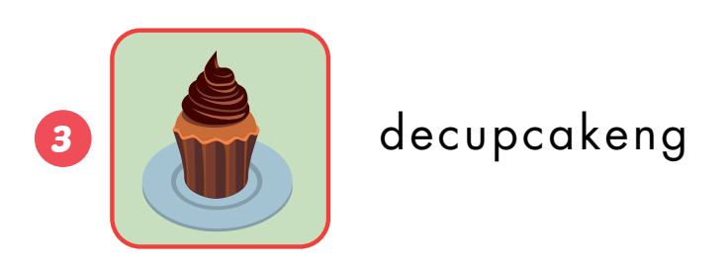
Extra Practice
WB, P. 78

Slide 20
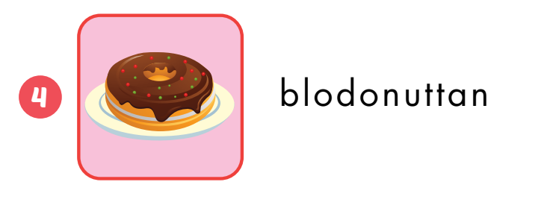
Extra Practice
WB, P. 78

Slide 21
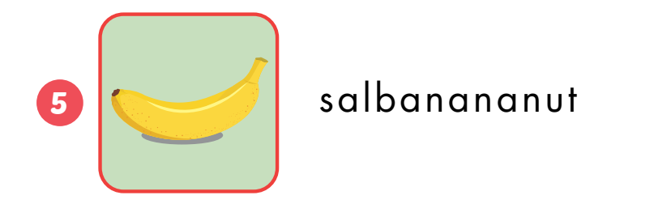
Extra Practice
WB, P. 78

Slide 22
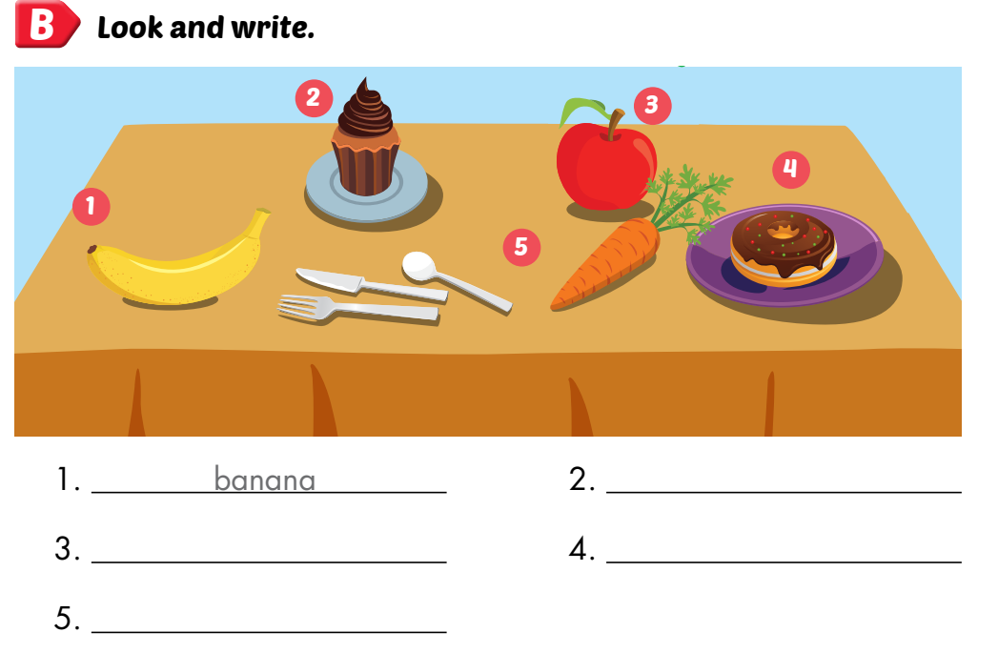
Extra Practice
WB, P. 78
cupcake
apple
donut
carrot

Slide 23
Let’s find
the food!
c
u
p
c
a
k
e
a
p
p
l
e
t
e
b
a
n
a
n
a
a
c
a
r
r
o
t
c
Click on the first letter of each word to see the name of food
d
o
n
u
t
u
u

Slide 24
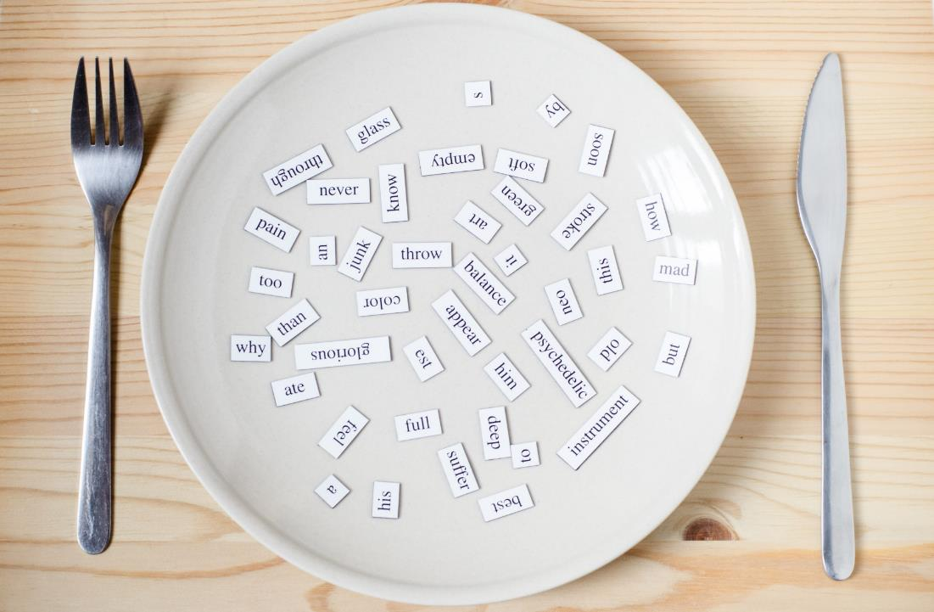
Structures
There is an apple.
There is a banana. There are eight cupcakes.

Slide 25
Presentation

Slide 26


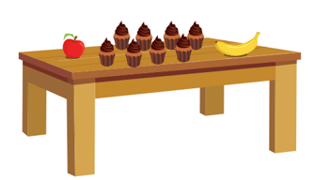
There is an apple.
There is a banana.
There are eight cupcakes.
Click on each sentence to listen

Slide 27
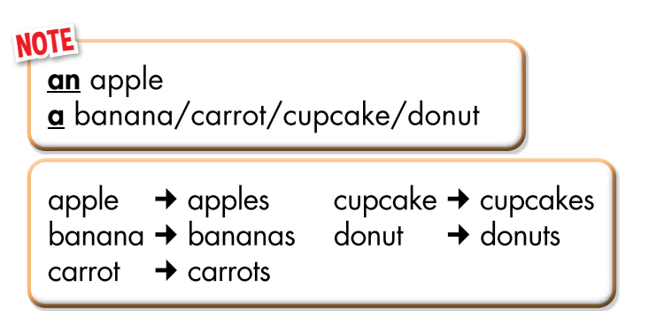

Slide 28
Practice

Slide 29
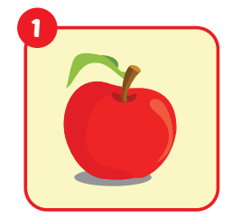
_______an apple.
There is

Slide 30
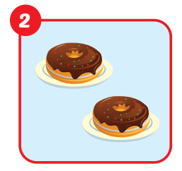
There are
_______two donuts.

Slide 31
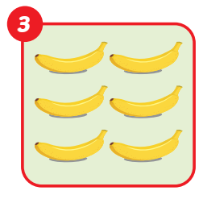
There are
_______six bananas.

Slide 32
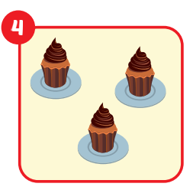
There are
_______ three cupcakes.

Slide 33
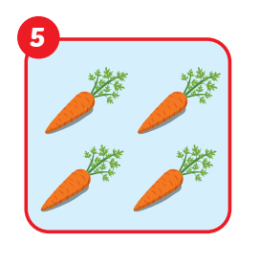
There are
_______ four carrots.

Slide 34
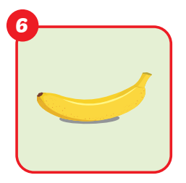
There is
_______ a banana.

Slide 35
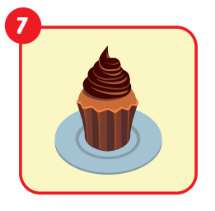
There is
_______ a cupcake.

Slide 36
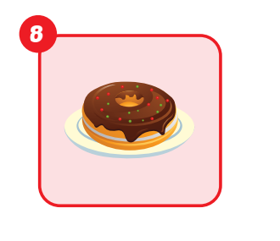
_______ a donut.
There is

Slide 37
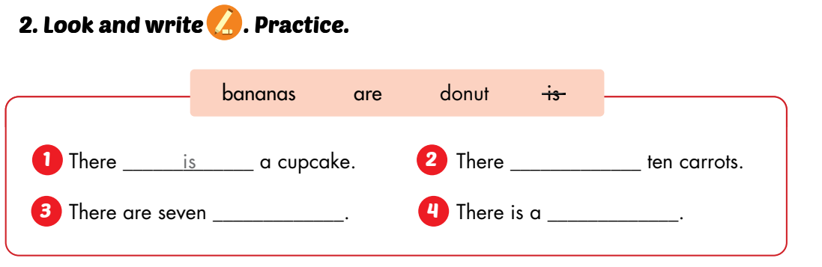
are
bananas
donut

Slide 38

CONSOLIDATION

Slide 39
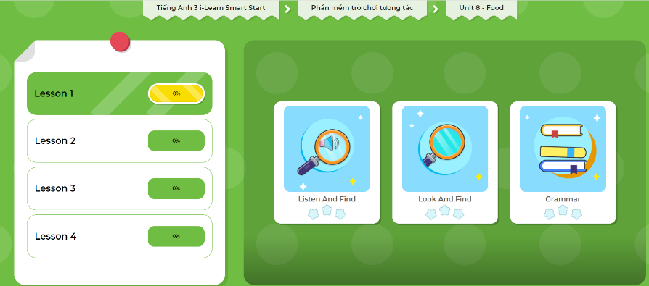
Extra Practice
DHA App
LET’S PLAY!
Click here to play the games

Slide 40

Production

Slide 41
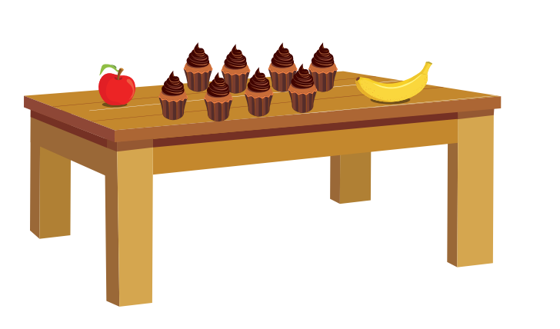
Describe the picture

Slide 42
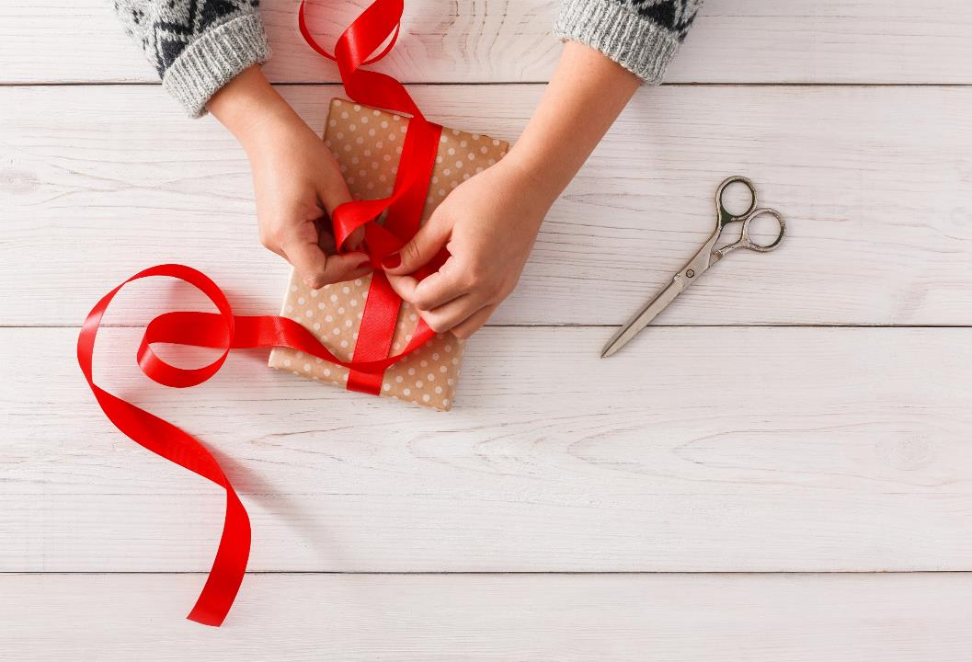
WRAP-UP

Slide 43
Lesson 3
Today’s lesson
Vocabularies
apple, banana, carrot, cupcake, donut
Structures/ Sentence patterns
There is an apple/There is a banana/There are eight cupcakes.

Slide 44
Lesson 3
Homework
Practice vocabularies and structure. Make sentences using them.
Practice the vocabulary and structure in Tiếng Anh 3 i-Learn Smart Start Notebook (page 52)
Do the exercises in Tiếng Anh 3 i-Learn Smart Start Workbook (page 78)
Play the consolidation games in Tiếng Anh 3 i-Learn Smart Start DHA App on www.eduhome.com.vn
Prepare the next lesson (page 111)

Slide 45
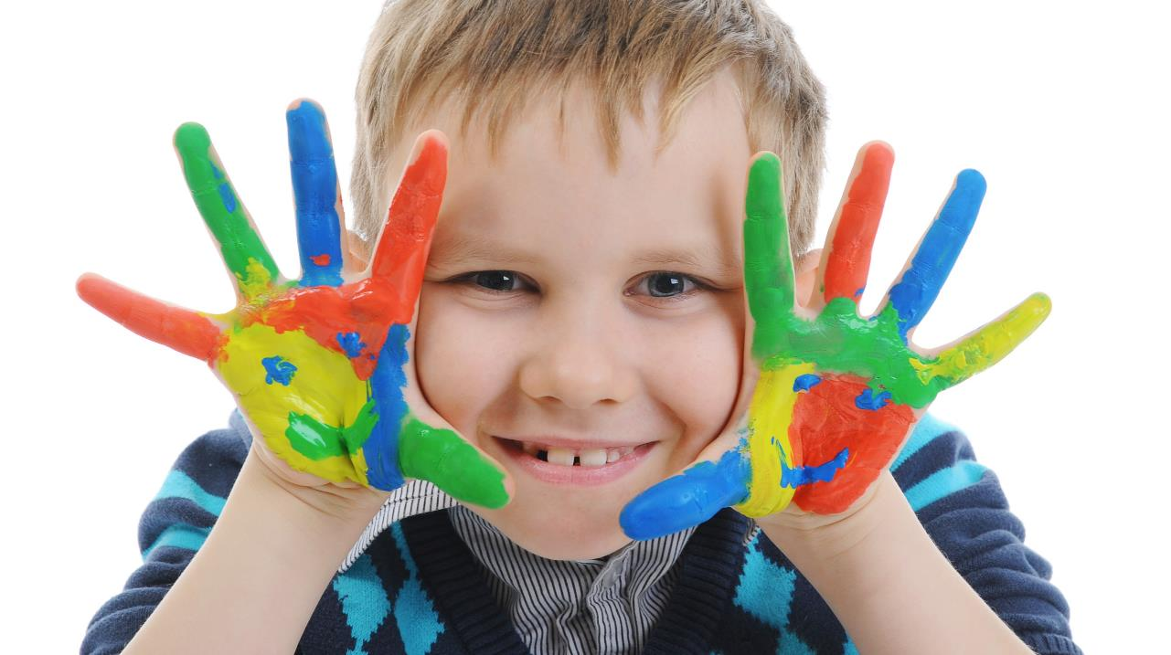
Enjoy your day!

