Slide 1
Check up:
I. Complete the sentences with the suitable words
written
traditional
important

Slide 2
Check up:
II. Write the words with the sounds:
/ sk/ , /sp/, /st/
/ sk/ | /sp/ | /st/

Slide 3
Warm up
When
Why
What
How
WH- WORDS
Where
Who
Which

Slide 4
*Review Wh-words: -What is used for a thing: What is it? -Who is used for a person. + Whose has the same meaning but it is always followed by a noun: Who were you talking to? Whose car is that? -Why is used for a reason: Why were you late? -When is used for a time or date: When did you start working here? -Which is used for a choice: Which do you prefer, tea or coffee? -Where is used for a place: Where do you live? - How is used for an amount or the way: How much does it cost? How do I get to the Han River?

Slide 5
UNIT 3: Peoples of Viet Nam
Period 20: A closer look 2

Slide 6
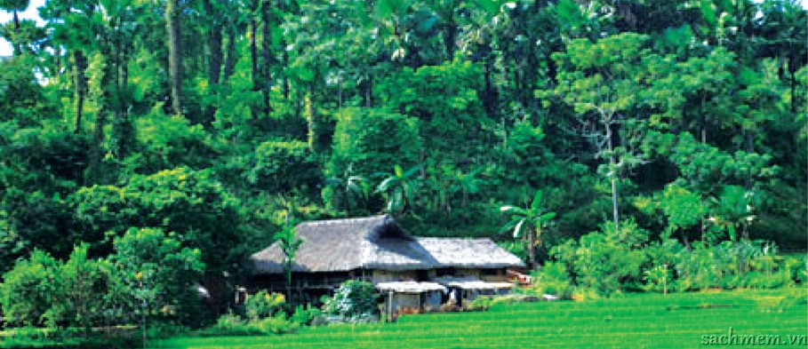
I. grammar
Questions: review
Activity 1.
Read the passage.
In a small village in the north, there is a stilt house. In the house, a Tay family are living together: the grandparents called Dinh and Pu, the parents called Lai and Pha, and three children called Vang, Pao and Phong. Every day the grandparents stay at home to look after the house. Mr Lai and Mrs Pha work in the fields. They grow rice and other plants. Mrs Pha goes to the market twice a week to buy food for the family. Mr Lai sometimes goes hunting or cutting wood in the forests. Pao and Phong go to the primary school in the village, but Vang studies at the boarding school in the town about 15 kilometres away. He goes home at the weekend The family live simply and they enjoy their way of life. There are a few difficulties of course. But they say they live more happily in their stilt house than in a modern flat in the city.

Slide 7
Activity 2. Now write questions for these answers.
Example: Answer → In the north.
Question → Where is the small village?
Answers:
1. A Tay family.
→ ______________________________________________________?
2. Three children.
→ ______________________________________________________?
3. Yes, they stay at home to look after the house.
→ ______________________________________________________?
4. Twice a week.
→ ______________________________________________________?
5. It is about 15 kilometres.
→ ______________________________________________________?
6. At the weekend.
→ ______________________________________________________?
7. They live happily.
→ ______________________________________________________?
8. No. They like living in their stilt house.
→ ______________________________________________________ ?

Slide 8
Lucky number
Lucky number
1
2
3
4
5
6
7
8
9
10

Slide 9
1. A Tay family.
Who is living in the house?

Slide 10
2. Three children.
How many children do they have?

Slide 11
3. Yes, they stay at home to look after the house.
Do the grandparents stay at home?

Slide 12
4. Twice a week.
How often does Mrs Pha go shopping?

Slide 13
5. It is about 15 kilometres.
How far is Vang’s boarding school ? / How far is the town?

Slide 14
6. At the weekend.
When does Vang go home (every week)?

Slide 15
Lucky Number

Slide 16
8. No. They like living in their stilt house.
Would they like to live (in a modern flat) in the city?

Slide 17
7. They live happily.
How do they live?

Slide 18
Activity 2. Now write questions for these answers.
Example: Answer → In the north.
Question → Where is the small village?
Answers:
1. A Tay family.
→ __________________________________________________________________?
2. Three children.
→ __________________________________________________________________?
3. Yes, they stay at home to look after the house.
→ __________________________________________________________________?
4. Twice a week.
→ __________________________________________________________________?
5. It is about 15 kilometres.
→ __________________________________________________________________?
6. At the weekend.
→ _________________________________________?
7. They live happily.
→ __________________________________________________________________?
8. No. They like living in their stilt house.
→ _________________________________________________________________ ?
Who is living in the house
How many children do they have
Do the grandparents stay at home
How often does Mrs Pha go shopping
How far is Vang’s boarding school ? / How far is the town
When does Vang go home (every week) ?
How do they live
Would they like to live (in a modern flat) in the city ?

Slide 20
Activity 3. Complete the questions using the right question words.
Who
A: _________ is the class monitor?
B: Dan is.
A: __________is the biggest house in this village?
B: The communal house (nha rong) is.
A: _________do you think is the most interesting museum in Ha Noi?
B: The Museum of Ethnology.
A: _________ is more colourful, the Nung’s or the Hoa’s costume?
B: The Hoa’s, of course.
A: _________ is the waterwheel used for?
B: It is used to get water to the fields.
Which
Which
Which
What

Slide 21
Activity 4. Work in pairs. Make questions and answer them.
Who/ do/ shopping/ your family?
____________________________________________________________
Who/ principal/ our school?
____________________________________________________________
Which subject/ like better/ English/ Maths?
____________________________________________________________
What/ most important festival/ Viet Nam?
____________________________________________________________
Which ethnic group/ larger population/ Khmer/ Cham?
____________________________________________________________
Who does the shopping in your family?
Who is the principal of our school?
Which subject do you like better, English or Maths?
What is the most important festival in Viet Nam?
Which ethnic group has a larger population, the Khmer or the Cham?

Slide 22
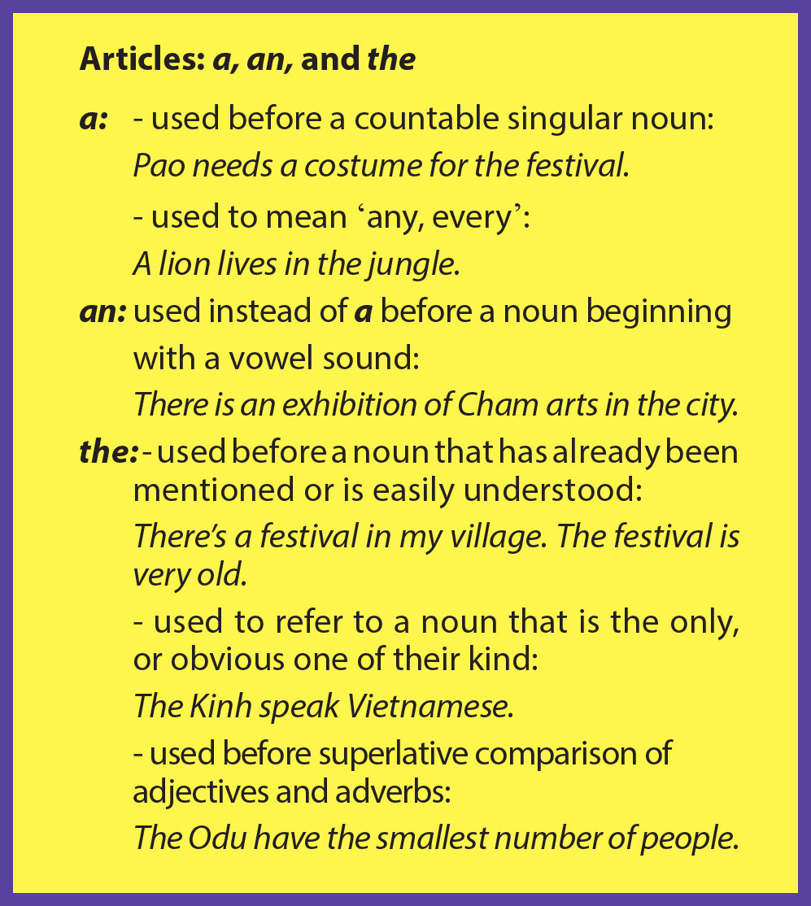

Slide 24
Activity 5. Circle the correct article to finish the sentences.
Viet Nam is a / an / the multicultural country with 54 ethnic groups.
Among the ethnic minorities, a / an / the Tay have the largest population.
A / An / The ethnic minority people in the village are very friendly.
The Lao are one of a / an / the many Thai-speaking peoples.
The Lolo women’s dress is among a / an / the most striking styles of clothing worn by ethnic peoples.
The Yao have a / an / the rich culture of folk literature and art, with tales, songs, and poems.

Slide 25
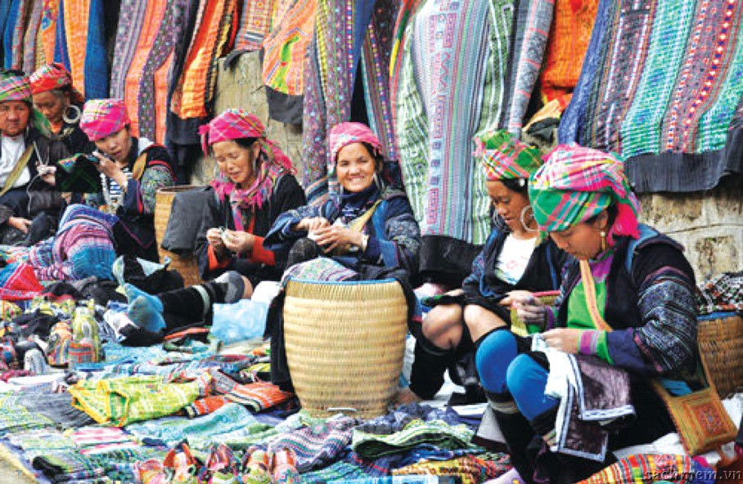
Activity 6. Insert a, an or the in each gap to finish the passage.
When you travel to a north-west mountainous region and you want to have (1) ___ great time, you can go to (2) ______ local open-air market.(3) ___ sight there is beautiful. Local people in colourful clothing are smiling as they sell or buy their local products. The goods there are diverse. You can buy all kinds of fruit and vegetables, which are fresh and cheap. You can also buy a nice costume of (4) _______ ethnic group you like. If you don’t want to buy anything, just go round and enjoy looking. You can also taste some specialities of (5) ___ local people sold right there at the market. I am sure you will have (6) ___ unforgettable time.
a
a / the
The
an / the
the
an

Slide 26
HOMEWORK
- Review the grammar and vocabulary.
- Make more example sentences using the articles.
- Prepare “Communication”

