Slide 1

Unit 6: Education
Lesson 3.2: Writing
Page 51

Slide 2


Lesson 3.2
LESSON OUTLINE
Consolidation

Slide 3

By the end of this lesson, students will be able to…
- write a paragraph about studying abroad, using subordinating conjunctions (however, although) to show contrast.

Slide 4

WARM-UP

Slide 5

Work in pairs.
Do you want to study abroad? Why or why not?
Do you want to study in Australia? Why or why not?

Slide 6


It’s writing time….

Slide 7
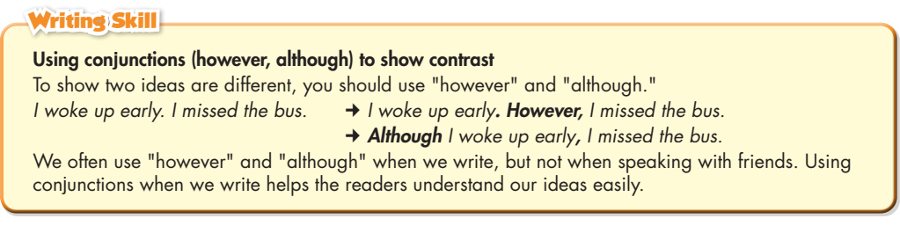
Pre - writing
a. Read about using conjunctions. Then, read Anna's paragraph again and underline the ideas linked with conjunctions.

Slide 8
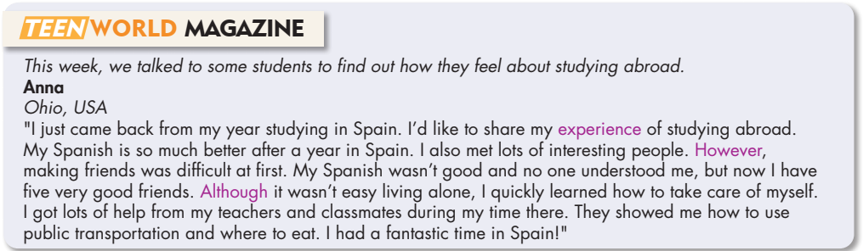

Slide 9
S+V. However, S+V.
Anna
Ohio, USA
"I just came back from my year studying in Spain. I’d like to share my experience of studying abroad.
My Spanish is so much better after a year in Spain. I also met lots of interesting people. However, making friends was difficult at first. My Spanish wasn’t good and no one understood me, but now I have five very good friends. Although it wasn’t easy living alone, I quickly learned how to take care of myself. I got lots of help from my teachers and classmates during my time there. They showed me how to use public transportation and where to eat. I had a fantastic time in Spain!"

Slide 10
Although S+V, S+V.
Anna
Ohio, USA
"I just came back from my year studying in Spain. I’d like to share my experience of studying abroad.
My Spanish is so much better after a year in Spain. I also met lots of interesting people. However, making friends was difficult at first. My Spanish wasn’t good and no one understood me, but now I have five very good friends. Although it wasn’t easy living alone, I quickly learned how to take care of myself. I got lots of help from my teachers and classmates during my time there. They showed me how to use public transportation and where to eat. I had a fantastic time in Spain!"

Slide 11
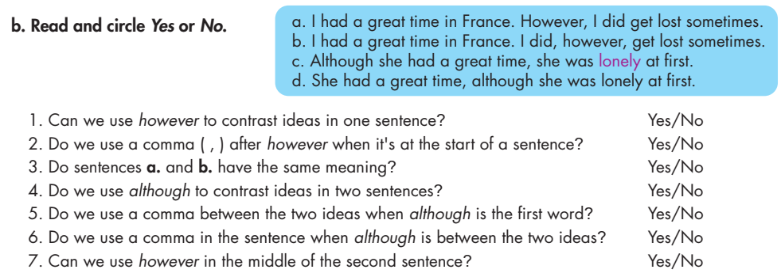

Slide 12
While - writing
c. Underline and correct the mistakes. Then, rewrite the correct sentences with however and although in your notebook.
1. I want to study abroad. Although, it is very expensive.
2. Although she could speak French. Her writing was bad.
3. However, he liked Italy, he was lonely.
4. Ben wanted to study in France however his French was bad.

Slide 13
c. Underline and correct the mistakes. Then, rewrite the correct sentences with however and although in your notebook.
1. I want to study abroad. Although, it is very expensive.
I want to study abroad. However, it is very expensive. /
I want to study abroad, although it is very expensive.

Slide 14
c. Underline and correct the mistakes. Then, rewrite the correct sentences with however and although in your notebook.
2. Although she could speak French. Her writing was bad.
Although she could speak French, her writing was bad. /
She could speak French. However, her writing was bad.

Slide 15
c. Underline and correct the mistakes. Then, rewrite the correct sentences with however and although in your notebook.
3. However, he liked Italy, he was lonely.
Although he liked Italy, he was lonely. /
He liked Italy. However, he was lonely.

Slide 16
c. Underline and correct the mistakes. Then, rewrite the correct sentences with however and although in your notebook.
4. Ben wanted to study in France however his French was bad.
Ben wanted to study in France. However, his French was bad. /
Ben wanted to study in France, although his French was bad.

Slide 17
• Where did you go?
• What positive experiences did you have?
• What problems did you have?
• What did you like most about it?

Slide 18
Pairwork
Where did you go? What positive experiences did you have?
I went to Australia. I had a wonderful time there. I made a lot of friends from different countries.

Slide 19
Pairwork
What problems did you have? What did you like most about it?
My English was not good. People didn’t understand me, but some friends helped me a lot. I liked the food in Australia because they were so delicious.

Slide 20
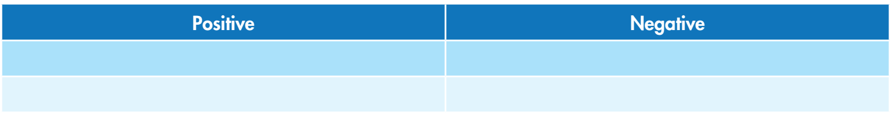
b. Now, talk about two positive and two negative experiences when you studied abroad. Then, fill in the table.
Improve my English a lot
Cost a lot of money
Become more independent
Feel lonely

Slide 21
b. Now, talk about two positive and two negative experiences when you studied abroad. Then, fill in the table.
Meet new people
Miss my family
Have new experiences
Feel scared

Slide 22

While - writing
Now, write a paragraph about studying abroad. Use the Feedback form to help you. Write 60 to 80 words.
Sample answer:
I want to tell you about studying abroad in Australia. Studying abroad helped me improve my English. I could practice speaking with people every day. However, it was difficult at first. I was lonely because people didn’t understand me. Although it cost a lot of money, my university helped me find a part-time job. That helped a lot. I think studying abroad is very helpful for everyone.

Slide 23
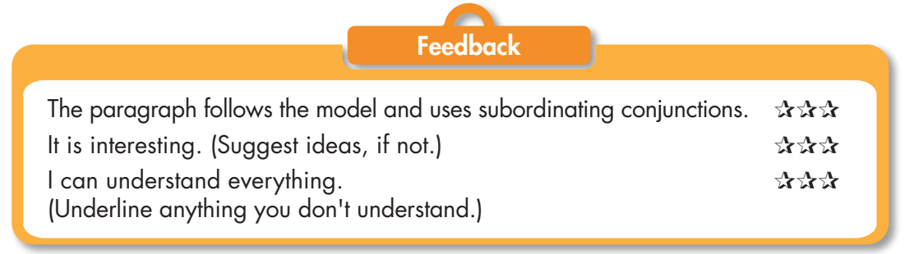

Slide 24

CONSOLIDATION

Slide 25
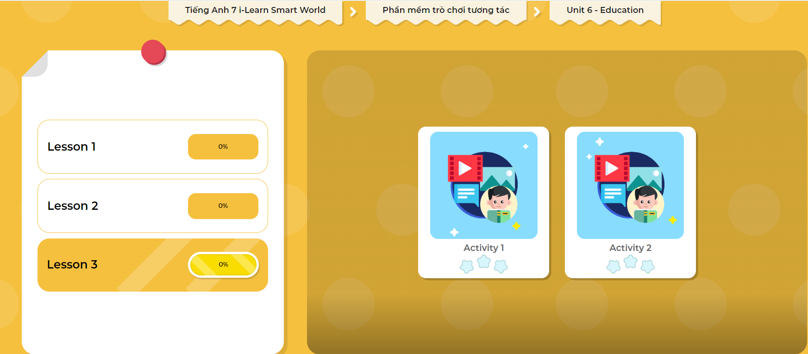
LET’S PLAY!
Click here to play the games

Slide 26

WRAP-UP

Slide 27
Today’s lesson
Writing:
- Understand how to use conjunctions although and however.
- Practice writing a paragraph about studying abroad.
Speaking:
- Talk about two positive and two negative experiences when you studied abroad.

Slide 28
Homework
Do the Writing skill in Tiếng Anh 7 i-Learn Smart World Workbook (page 37).
Complete the writing notes in Tiếng Anh 7 i-Learn Smart World Notebook (page 41).
Prepare Review Unit 6 (pages 100 & 101 SB).
Play the consolidation games in Tiếng Anh 7 i-Learn Smart World DHA App on www.eduhome.com.vn

Slide 29

Lesson 3
Stay positive and have a nice day!

