Slide 1

Unit 8: Food
Lesson 2.1
Page 113

Slide 2
Lesson Outline
Warm-up
Vocabulary
Structure
Consolidation
Wrap-up

Slide 3
Objectives
By the end of this lesson, students will be able to…
Vocabulary: learn and practice onion, tomato, egg, potato, lime
Structure: learn and practice
Are there any…?
- Yes, there are (some…) / No, there aren’t.
Is there…?
- Yes, there is (a/an…) / No, there isn’t.

Slide 4

WARM UP

Slide 5





2
1
apple | banana | carrot
cupcake | donut | apple
banana | carrot | carrot
carrot | donut | cupcake
2
3
4
5
6
7
8
9
10
11
12

Slide 6

It’s time to learn …

Slide 7
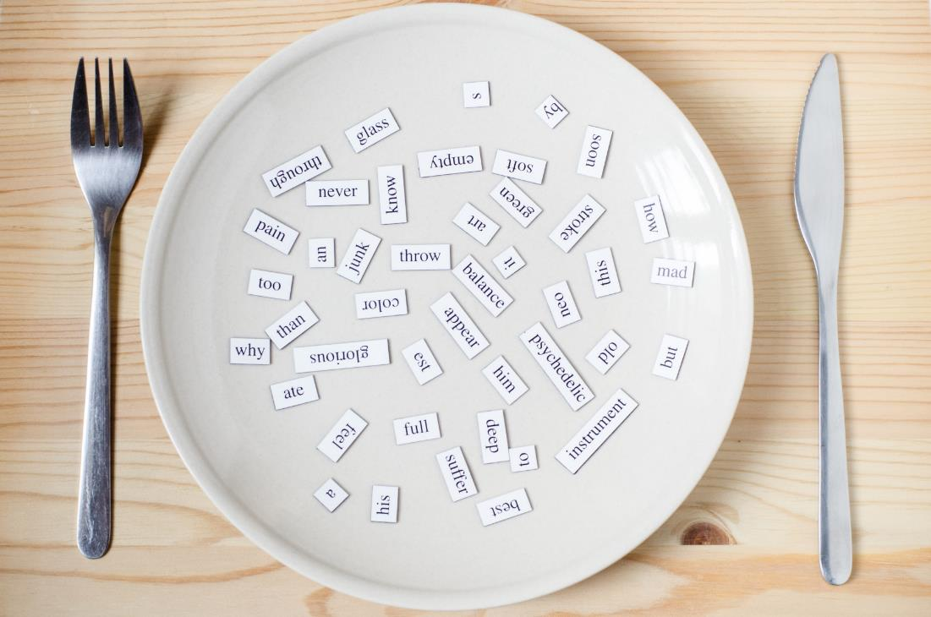
New words
onion, tomato, egg, potato, lime

Slide 8

Presentation

Slide 9



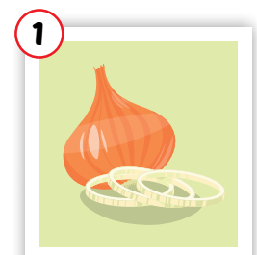
Click each word to hear the sound.
onion
/ˈʌnjən/
củ hành tây
Notes:
Click chữ nghe đọc

Slide 10
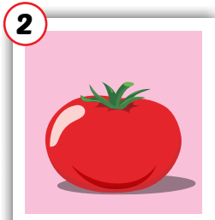
Click each word to hear the sound.
tomato
/təˈmeɪtəʊ/
cà chua
Notes:
Click chữ nghe đọc

Slide 11
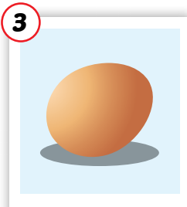
Click each word to hear the sound.
egg
/eɡ/
trứng
Notes:
Click chữ nghe đọc

Slide 12
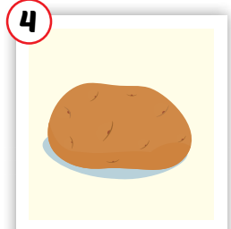
Click each word to hear the sound.
potato
/pəˈteɪtəʊ/
khoai tây
Notes:
Click chữ nghe đọc

Slide 13
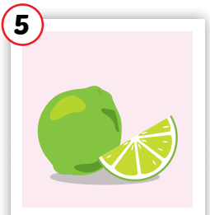
Click each word to hear the sound.
lime
/laɪm/
quả chanh(xanh)
Notes:
Click chữ nghe đọc

Slide 14
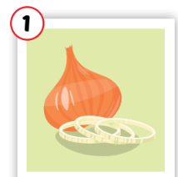


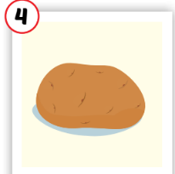

Click each word to hear the sound.
onion
tomato
egg
potato
lime
/ˈʌnjən/
củ hành tây
/təˈmeɪtəʊ/
cà chua
/eɡ/
trứng
/pəˈteɪtəʊ/
khoai tây
/laɪm/
quả chanh(xanh)
Notes:
Click chữ nghe đọc

Slide 15

Practice

Slide 16
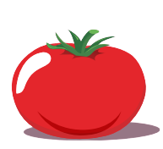
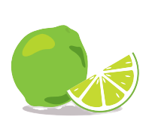
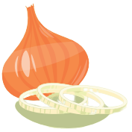
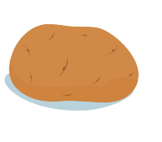
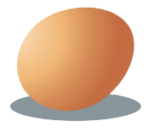


Sound here
Listen and choose the correct picture
Click each number to check the answer.
1
2
3
4
5
Notes:
Click vào hình headphone để nghe âm thanh. click vào số để thấy trả lời đúng

Slide 17
Sound here
Listen and choose the correct picture
Click each number to check the answer.
1
2
3
4
5
Notes:
Click vào hình headphone để nghe âm thanh. click vào số để thấy trả lời đúng

Slide 18
Sound here
Listen and choose the correct picture
Click each number to check the answer.
1
2
3
4
5
Notes:
Click vào hình headphone để nghe âm thanh. click vào số để thấy trả lời đúng

Slide 19
Sound here
Listen and choose the correct picture
Click each number to check the answer.
1
2
3
4
5
Notes:
Click vào hình headphone để nghe âm thanh. click vào số để thấy trả lời đúng

Slide 20
Sound here
Listen and choose the correct picture
Click each number to check the answer.
1
2
3
4
5
Notes:
Click vào hình headphone để nghe âm thanh. click vào số để thấy trả lời đúng

Slide 21
Sound here
Listen and write
p_t_to
potato

Slide 22
Listen and write
Sound here
e_ _
egg
Notes:
Click vào hình headphone để nghe âm thanh

Slide 23
Listen and write
Sound here
_om_to
tomato
Notes:
Click vào hình headphone để nghe âm thanh

Slide 24
Listen and write
Sound here
o_io_
onion

Slide 25
Listen and write
Sound here
l_m_
lime
Notes:
Click vào hình headphone để nghe âm thanh

Slide 26

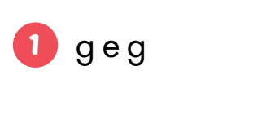
Workbook page 80
egg

Slide 27
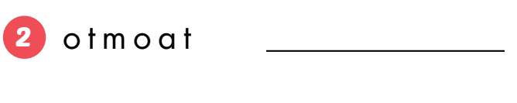
tomato

Slide 28
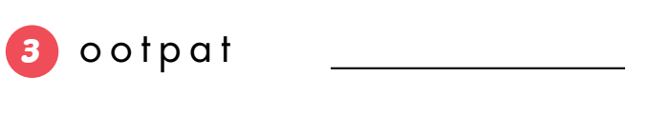
potato

Slide 29
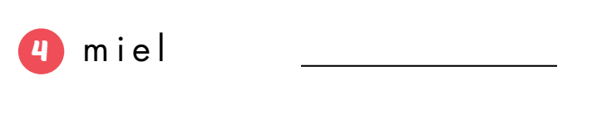
lime

Slide 30
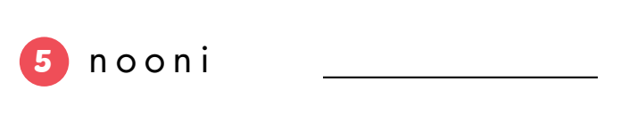
onion

Slide 31

Early Production

Slide 32
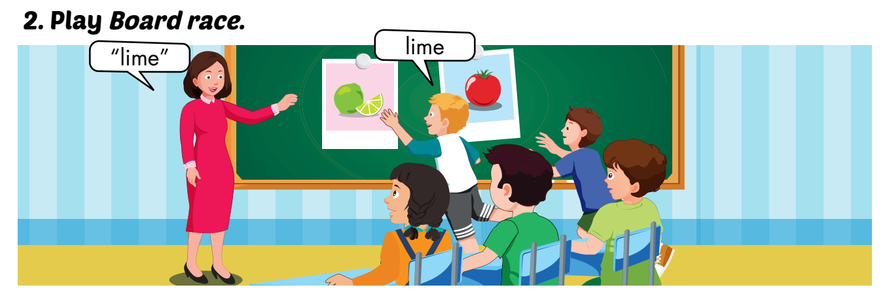

Slide 33
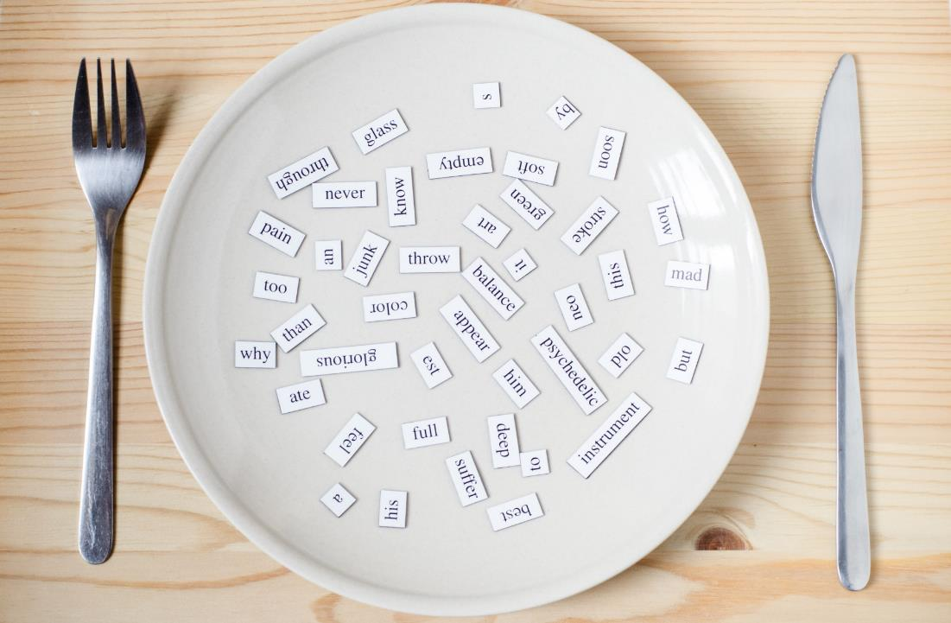
Structures
Are there any…?
- Yes, there are (some…)/ No, there aren’t.
Is there…?
- Yes, there is (a/an…)/No, there isn’t.

Slide 34
Presentation

Slide 35



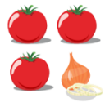
Click on each sentence to listen
- Yes, there are (some tomatoes)
- No, there aren’t.
Are there any tomatoes?
- Yes, there is (an onion).
- No, there isn’t.
Is there an onion?

Slide 36
Practice

Slide 37
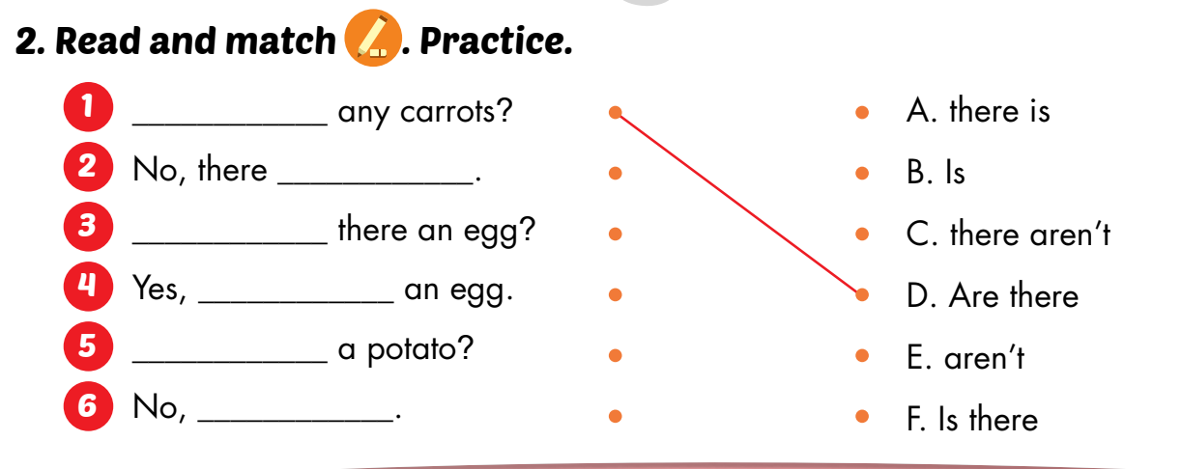

Slide 38
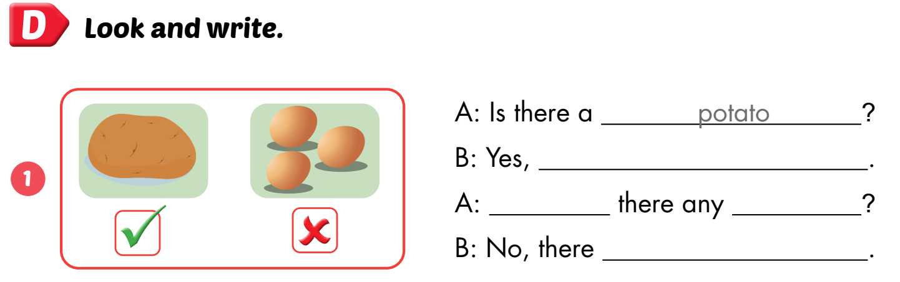
Workbook page 81
there is
Are
eggs
aren’t

Slide 39
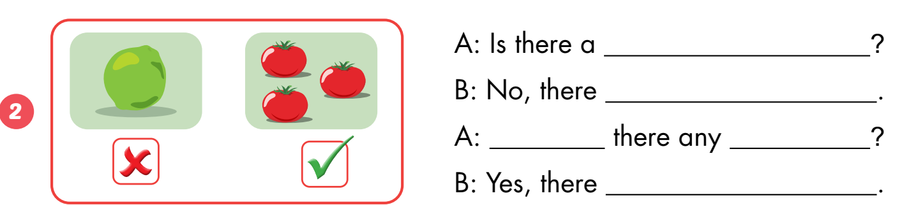
lime
isn’t
Are
tomatoes
are

Slide 40
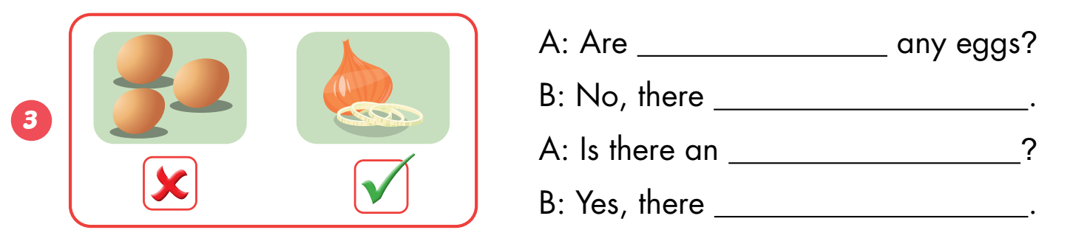
there
aren’t
onion
is

Slide 41
Look at the picture and make sentences.
tomatoes
Are there any_________________?
Yes, _____________________
there are

Slide 42
Look at the picture and make sentences.
potatoes
Are there any_________________?
No, _____________________
there aren’t

Slide 43
Look at the picture and make sentences.
lime
Is there a _________________?
No, _____________________
there isn’t

Slide 44
Look at the picture and make sentences.
onion
Is there an_________________?
Yes, _____________________
they is

Slide 45

CONSOLIDATION

Slide 46
Early Production

Slide 47
Draw your favorite food on the paper and talk with your friend.
Are there any ….?
Is there a / an ….?
Yes, there ……..
No, there ……..

Slide 48
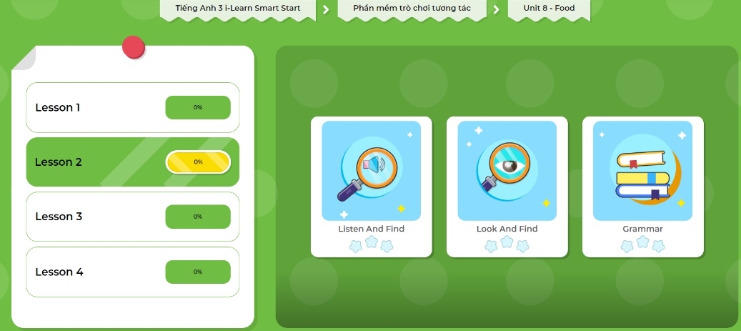
Extra Practice
DHA App
LET’S PLAY!
Click here to play the games

Slide 49

WRAP-UP

Slide 50
Today’s lesson
Vocabularies
onion, tomato, egg, potato, lime
Structures/ Sentence patterns
Are there any…?
- Yes, there are (some…)/ No, there aren’t.
Is there…?
- Yes, there is (a/an…)/No, there isn’t.

Slide 51
Homework
Practice the vocabularies and structure; and make sentences using them.
Do the exercises in Tiếng Anh 3 i-Learn Smart Start WB (page 80)
Do the exercises in Tiếng Anh 3 i-Learn Smart Start Notebook on page 53
Prepare the next lesson (page 114 SB)
Play the consolidation games in Tiếng Anh 3 i-Learn Smart Start DHA App on www.eduhome.com.vn

Slide 52

Enjoy your day!

