Slide 2
Unit 6
Artificial Intelligence
LESSON I
GETTING STARTED
A visit to a high-tech centre

Slide 3
LESSON I
GETTING STARTED
WARM-UP
Crossword
PRESENTATION
Vocabulary
Task 1: Listen and read.
Task 2: Answer the questions
Task 3: Find words with the following meanings.
Task 4: Complete the sentences with words or a phrase
PRACTICE
PRODUCTION
Role-play
CONSOLIDATION
Wrap-up
Homework

Slide 4
WARM-UP
CROSSWORD

Slide 5
WARM-UP
Rules
- Teacher divides the class into four teams.
- Teacher gives each team a handout of a crossword for them to solve.
- The first team to finish the task and get the correct key word will be the winner of the game.

Slide 6
WARM-UP
1
 |  |  |  | A | R | T | I | F | I | C | I | A | L
T | E | C | H | N | O | L | O | G | Y
 |  |  | L | A | B | O | R | A | T | O | R | Y
 |  | A | U | T | O | M | A | T | I | C
 |  |  | I | N | T | E | L | L | I | G | E | N | C | E
 |  |  |  |  | S | C | I | E | N | T | I | S | T
2
3
4
5
6

Slide 7
WARM-UP
1. not real , made or produced to copy something natural
2. scientific knowledge used in practical ways in industry, for example in designing new machines
3. a room or building used for scientific research, experiments, testing, etc
4. having controls that work without needing a person to operate them
5. the ability to learn, understand, and make judgments or have opinions that are based on reason
6. a person who studies or is an expert in one or more of the natural sciences

Slide 8
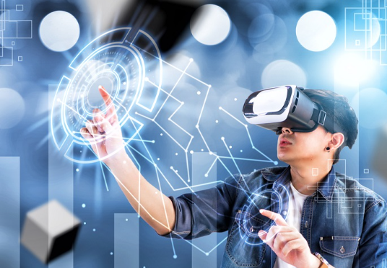

PRESENTATION
virtual (adj)
/ˈvɜːtʃuəl/
made to appear to exist by the use of computer software, for example on the internet

Slide 9
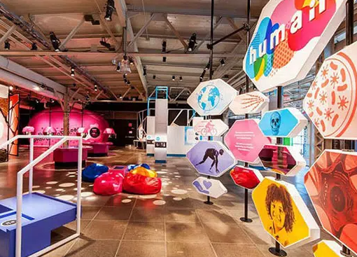
PRESENTATION
exhibition (n)
/ˌeksɪˈbɪʃn/
a collection of things, for example works of art, that are shown to the public

Slide 10
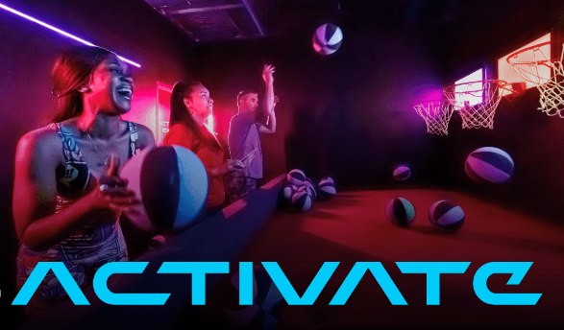
PRESENTATION
activate (v)
/ˈæktɪveɪt/
to make something such as a device or chemical process start working

Slide 11
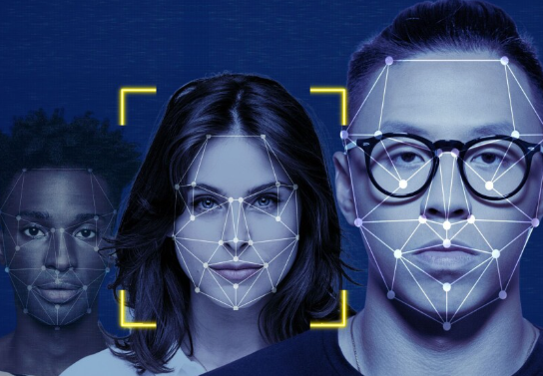
PRESENTATION
facial recognition
/ˌfeɪʃl rekəɡˈnɪʃn/
technology that allows a computer to identify a person by their face

Slide 12
PRESENTATION
Form | Pronunciation | Meaning | Vietnamese equivalent
1. virtual (adj) | /ˈvɜːtʃuəl/ | made to appear to exist by the use of computer software, for example on the internet | ảo
2. exhibition (n) | /ˌeksɪˈbɪʃn/ | a collection of things, for example works of art, that are shown to the public | triển lãm
3. activate (v) | /ˈæktɪveɪt/ | to make something such as a device or chemical process start working | kích hoạt
4. facial recognition (n) | /ˌfeɪʃl rekəɡˈnɪʃn/ | ​technology that allows a computer to identify a person by their face | nhận diện khuôn mặt

Slide 13
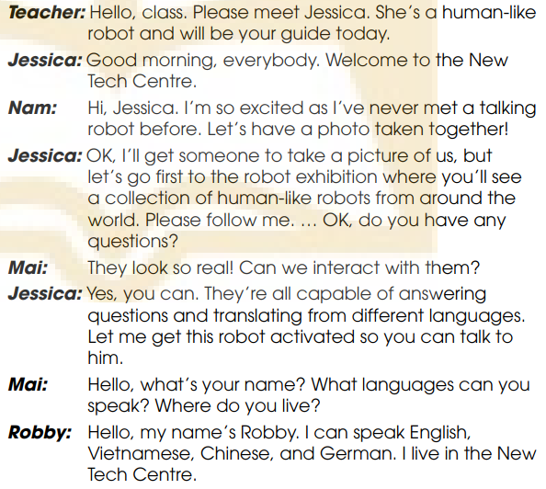
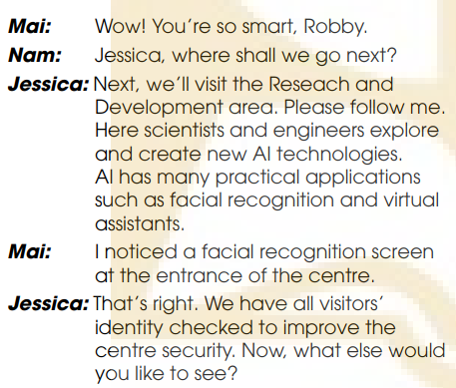
PRACTICE
1
Listen and read.

Slide 14
PRACTICE
2
Read the conversation again and answer the questions.
1. Why is Nam excited?
2. What can human-like robots do?
3. What are some examples of AI applications?
4. Where did Mai see a facial recognition screen?
Because he has never met a talking robot before.
He can answer questions and translate from different languages.
Facial recognition and virtual assistants.
At the entrance of the centre.

Slide 15
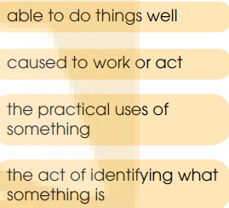
PRACTICE
3
Find words and a phrase in Task 1 with the following meanings.
1. capable
2. recognition
3. activated
4. applications

Slide 16
PRACTICE
4
Complete the sentences with words or a phrase from Task 1
1. Let’s have a photo _________ together.
2. I’ll get someone _________ a picture of us.
3. Let me get this robot _________, so you
can talk to him.
4. We have all visitors’ identity _________ to
improve the centre security.
taken
take
activated
checked

Slide 17
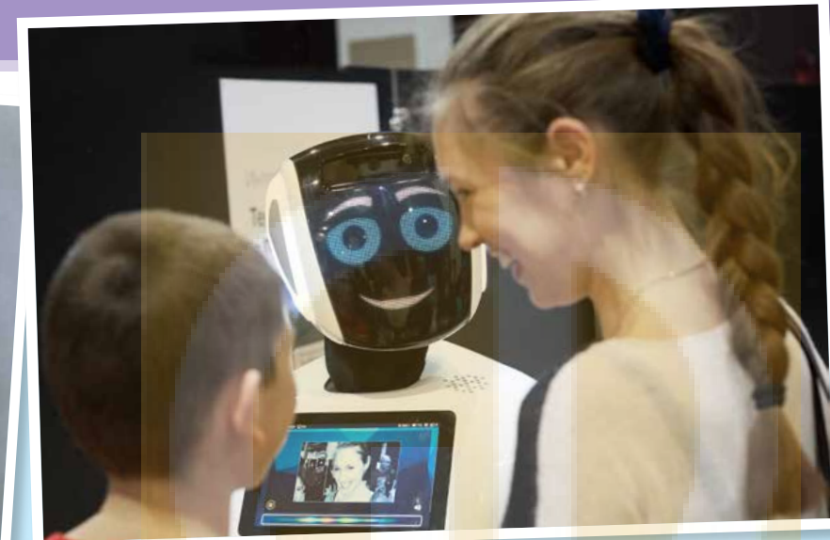
PRODUCTION
Role-play: Jessica - the AI robot
Some questions to ask Jessica:
+ Which special abilities do you have?
+ What are your strengths and weaknesses?
+ Which AI technology will be popular in the future?

Slide 18
CONSOLIDATION
1
Wrap-up
What have you learnt today?
Some lexical items about robots and AI;
Reading for specific information
Past simple and Past continuous

Slide 19
CONSOLIDATION
2
Homework
Do exercises in the workbook.
Prepare for the project in Lesson 8.

Slide 20
Website: hoclieu.vn
Fanpage: facebook.com/www.tienganhglobalsuccess.vn

