Slide 1


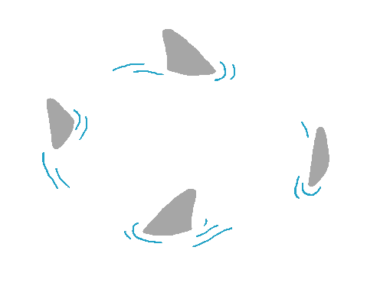




1
3
Iceberg
GAME
Design by TRO GIANG
youtube.com/trogiang
2
play

Slide 2

1
Question 1
answer
2
Next

Slide 3
3
Question 2
answer
1
2
Next

Slide 4

3
Question 3
answer
1
2

