Slide 1

Unit 5: Travel & Transportation
Progress Check (Cont.)
Page 93

Slide 2
Lesson Outline
Warm-up
Reading
Writing
Wrap-up

Slide 3
Objectives
By the end of this lesson, students will be able to…
practise test-taking skills (Reading, Writing).

Slide 4

WARM-UP

Slide 5
Choose the word whose underlined part is pronounced from that of the others. Practise saying them.
1. A. bank B. way C. van D. tram
/bæŋk/ /weɪ/ /væn/ /træm/
2. A. chemist B. chicken C. children D. teacher
/ˈkemɪst/ /ˈtʃɪkɪn/ /ˈtʃɪldrən/ /ˈtiːtʃər/
3. A. tomb B. rock C. top D. shop
/tuːm/ /rɒk/ /tɒp/ /ʃɒp/

Slide 6
Choose the word whose main stress is placed differently from that of the others. Practise saying them.
1. A. butcher B. bookshop C. florist D. hotel
/ˈbʊtʃər/ /ˈbʊkʃɒp/ /ˈflɒrɪst/ /həʊˈtel/
2. A. tourist B. landmark C. journey D. report
/ˈtʊərɪst/ /ˈlændmɑːk/ /ˈdʒɜːni/ /rɪˈpɔːt/
3. A. expensive B. delicious C. popular D. impatient
/ɪkˈspensɪv/ /dɪˈlɪʃəs/ /ˈpɒpjələr/ /ɪmˈpeɪʃənt/

Slide 7

Work in pairs
If you can travel around Vietnam for 10 days, what are the destinations you want to visit?

Slide 8

It’s time to learn …

Slide 9

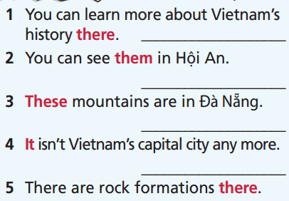
Read the instruction quickly. Underline the key words. What are we going to do?
Pre-Reading

Slide 10
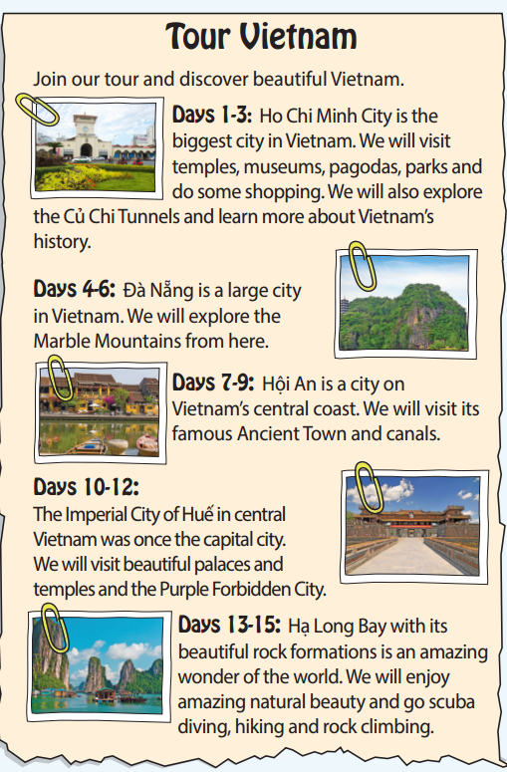
While-reading
in Củ Chi tunnels
canals
The Marble Mountains
The Imperial City of Huế
in Hạ Long Bay

Slide 11
Read the text and decide whether the following statements are True, False, or Doesn’t say:
Extra Practice
The order of places in the tour is Ho Chi Minh City, Đà Nẵng, Hội An, Huế, Hạ Long Bay.
Hội An Ancient Town is more famous than Đà Nẵng.
The Marble Mountains are in Hạ Long Bay.
The Purple Forbidden City is in Hội An.
If tourists love scuba diving, they should go to Hạ Long Bay.

Slide 12
Now, read again to check the answers.
The order of places in the tour is Ho Chi Minh City, Đà Nẵng, Hội An, Huế, Hạ Long Bay.
True

Slide 13
Now, read again to check the answers.
2. Hội An Ancient Town is more famous than Đà Nẵng.
Doesn’t say

Slide 14
Now, read again to check the answers.
3. The Marble Mountains are in Hạ Long Bay.
False

Slide 15
Now, read again to check the answers.
4. The Purple Forbidden City is in Hội An.
False

Slide 16
Now, read again to check the answers.
If tourists love scuba diving, they should go to Hạ Long Bay.
True

Slide 17
Post-reading
Look back at the reading text in Task 6,
choose the places you want to visit the most. Explain.
Where do you want to travel the most?
I want to visit Hạ Long Bay the most because it’s very beautiful. I can take part in many exciting activities like scuba diving and rock climbing.

Slide 18
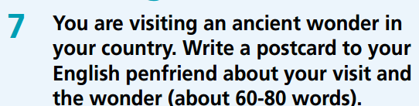
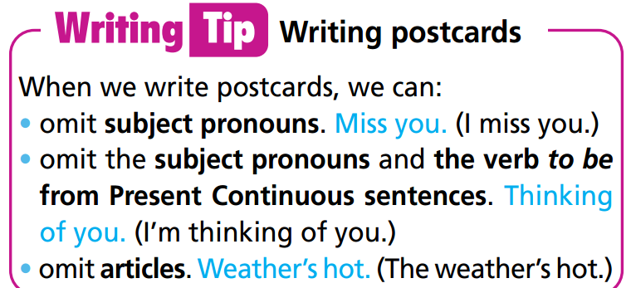
Think about the following information:
Where you are
Information about wonder
When are you coming back

Slide 19
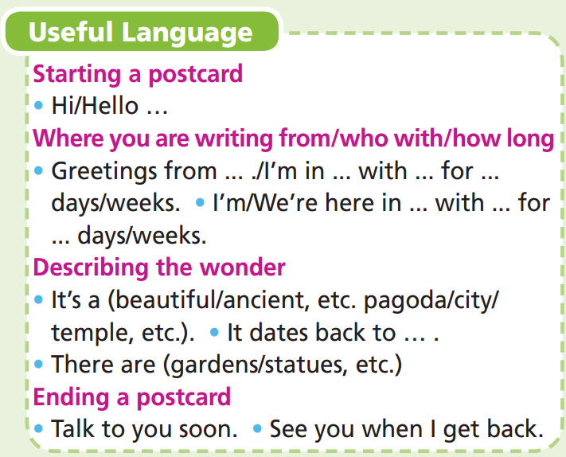
You can use the phrases from the Useful
Language box to write your postcard.

Slide 20
Sample answer:
Hi Tony,
Greeting from Huế, Vietnam. Today I’m visiting Hiển Nhơn Gate, a popular tourist attraction in Huế. Huế used to be the capital city of Vietnam and Hiển Nhơn Gate is one of the gates to the Imperial City of Huế. They built it around 1805, under the reign of Emperor Gia Long. It's ancient and colourful. I took lots of photos of it.
Talk to you soon.
David

Slide 21
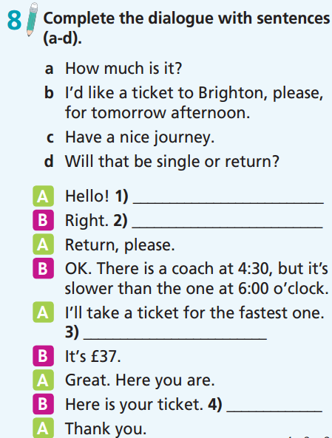
b
d
a
c

Slide 22
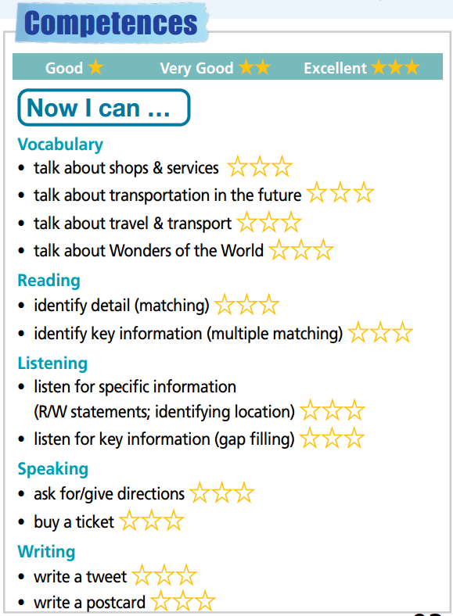

Slide 23

WRAP-UP

Slide 24
Today’s lesson
practise test-taking skills (Reading, Writing).

Slide 25
Homework
Prepare the next lesson (page 94 SB)
Do Test 2 in Bài Tập Bổ Trợ TA 7 Right on (pages 46 – 49)

Slide 26

Enjoy your day!

