Slide 1

Unit 5: London Was Great!
Lesson 5c: Vocabulary
Page 92

Slide 2
Lesson Outline
Warm-up
Vocabulary
Consolidation
Wrap-up

Slide 3
Objectives
By the end of this lesson, students will be able to…
- learn and use vocabulary related to the topic “animal”: beak, big, body, fur, leg, mane, neck, pet, sharp, thick, trunk, wild, wing.
- describe an animal to their friends.

Slide 4

WARM-UP

Slide 5

Can you guess the animals by looking at their eyes?
A parrot

Slide 6

Can you guess the animals by looking at their eyes?
A cat

Slide 7
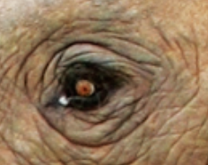
Can you guess the animals by looking at their eyes?
An elephant

Slide 8

Can you guess the animals by looking at their eyes?
A lion

Slide 9
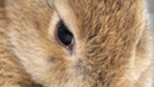
Can you guess the animals by looking at their eyes?
A rabbit

Slide 10

Can you guess the animals by looking at their eyes?
A snake

Slide 11

It’s time to learn …

Slide 12
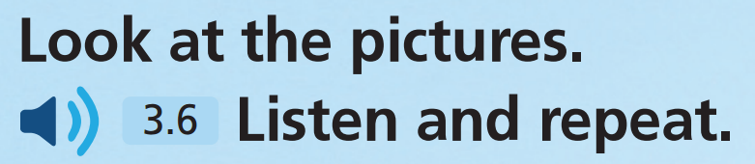
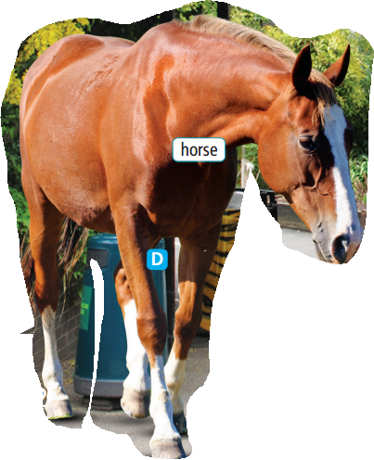
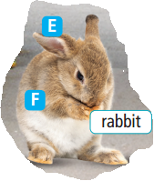
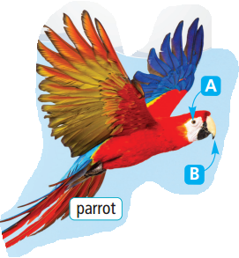
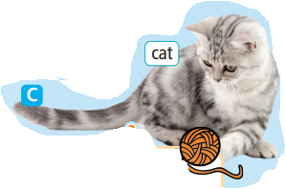


Slide 13
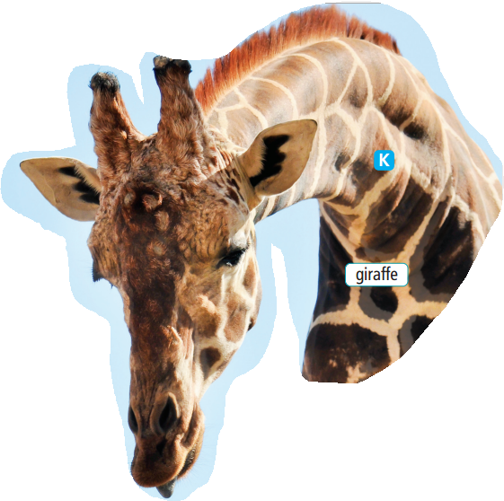
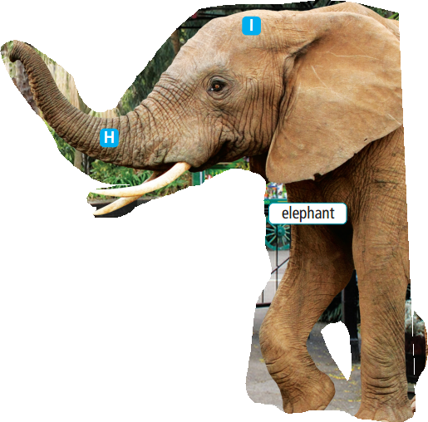
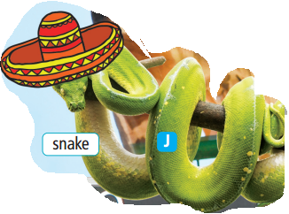
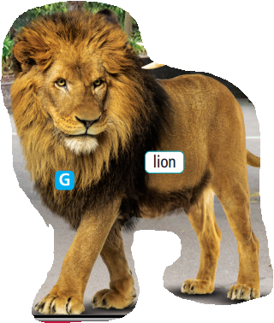
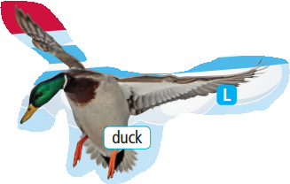

Slide 14
Animal names: T has all students sit/stand in a circle. Use a ball (or a pencil case) and toss it to one student. T must say one animal word as T passes. The student then throws to another student and says a different animal word. If the student drops it, he/she is out. If the student can't think of an animal word within a few seconds, he/she is out. The game continues until there is one winner. Losers will have to sing a song/ dance…….

Slide 15
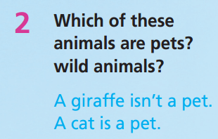
PET | WILD ANIMALS
cat
lion
horse
elephant
snake
giraffe
Which animal can you see in the zoo?
Which animal do you want to have at home?
parrot
snake
rabbit
parrot
duck

Slide 16
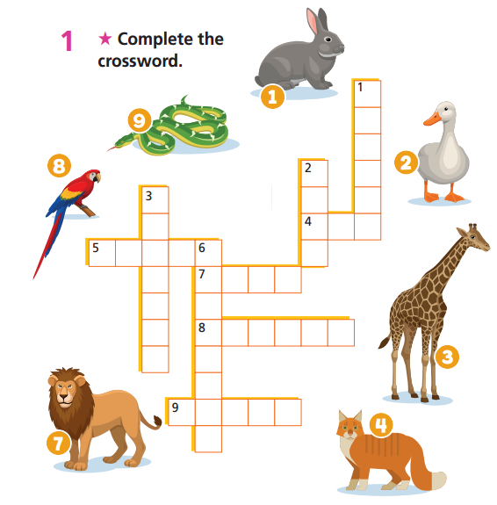


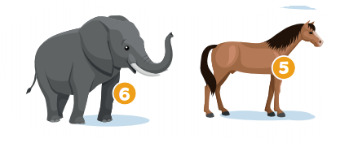



Extra-practice
WB-p .46

Slide 17


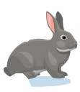

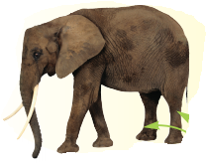

3
rabbit | parrot | Duck
snake | elephant | elephant
parrot | snake | rabbit
lion | duck | lion
1
2
Find the correct pairs of animals.
4
5
6
7
8
9
10
11
12
Notes:
Click vào từng số để mở hình. Click vào dấu chéo đỏ để che hình lại. Nếu học sinh chọn đúng 1 cặp động vật thì k cần che hình lại nữa

Slide 18
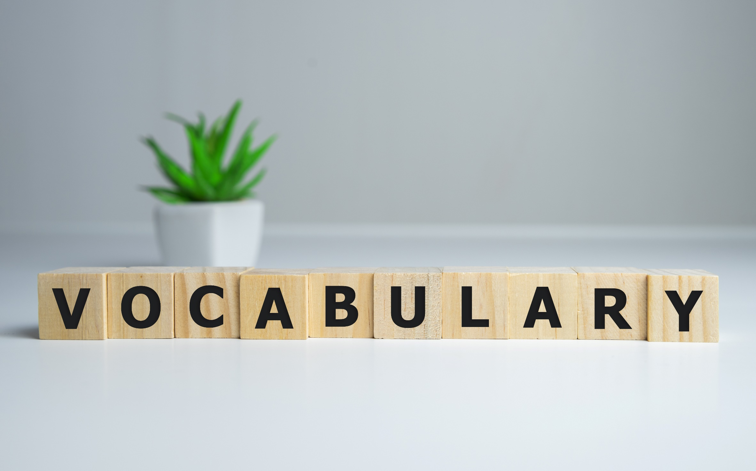


Slide 19

New words
beak
big
body
fur
leg
mane
neck
pet
sharp
thick
trunk
wild
wing

Slide 20
Listen and repeat. (Click each word to hear the sound)
beak (n) /biːk/ mỏ (chim)
big (adj) /bɪɡ/ to lớn
body (n) /ˈbɒdi/ cơ thể, thân thể, thân hình
fur (n) /fɜː(r)/ lông thú
leg (n) /leɡ/ chân
mane (n) /meɪn/ bờm (ngựa, sư tử)
neck (n) /nek/ cổ
Notes:
GV click vào từng cụm nghe âm thanh

Slide 21
Listen and repeat. (Click each word to hear the sound)
pet (n) /pet/ thú cưng
sharp (adj) /ˈʃɑːp/ sắc, nhọn
thick (adj) /θɪk/ dày
trunk (n) /trʌŋk/ vòi con voi
wild (adj) /waɪld/ hoang dã
wing (n) /wɪŋ/ cánh
Notes:
GV click vào từng cụm nghe âm thanh

Slide 22
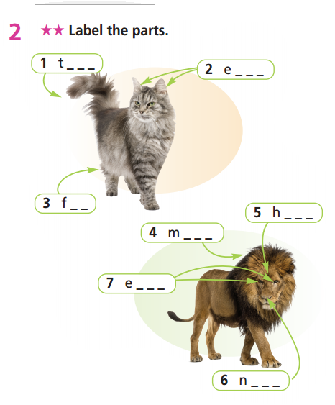
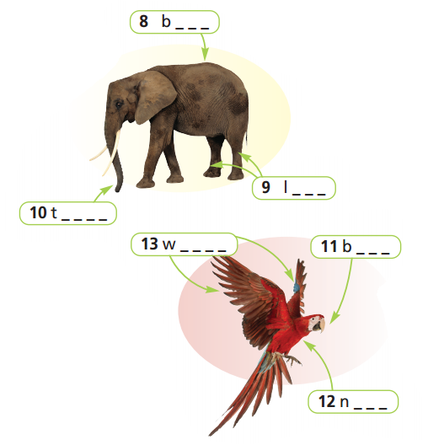
Extra-practice
WB-p.46
ail
ack
ars
egs
ur
runk
ead
ane
ings
eak
yes
eck
ose

Slide 23
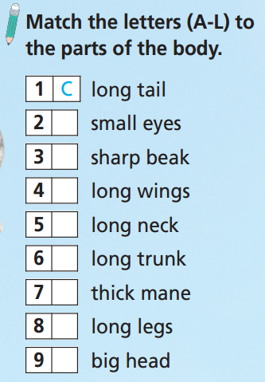
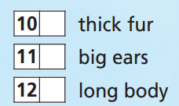
Look at your textbook, page 92.
A
F
B
L
E
K
J
H
G
D
I

Slide 24
Write the opposite of:
long
short
big
small
thick
thin
sharp
blunt

Slide 25
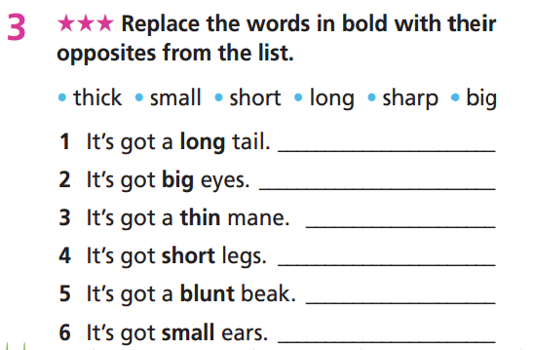
Extra-practice
WB-p.46
Can you guess what animal is it?
short
small
thick
long
sharp
big

Slide 26
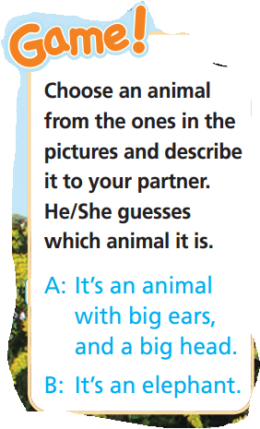
A: It’s got long wings, small eyes and a sharp beak.
B: It’s a parrot.

Slide 27
- The teacher invites 1 student to come in front of the class. The student says: “I’m thinking of an animal.” and then answers your friends’ questions about the animal with Yes/No answer only: “Yes, it is/ No, it isn’t”.
- The rest of the class will try to find out what animal your friend is thinking of by asking Yes/No questions, such as “ Is it an animal with a long tail”?
- Students who can ask the questions get bonus marks.
- Students who can guess the animal also get bonus marks.

Slide 28
Take turns to practice the conversation with a partner.
What’s your favourite animal?
My favourite animal is …
Can you describe it?
Well, it’s an animal with ….

Slide 29

CONSOLIDATION

Slide 30
Write some sentences about your favourite animal. Try to answer the following questions:
What is your favourite animal?
Where can you see it?
Do you want to have this animal in your house?
Can you describe it?

Slide 31

WRAP-UP

Slide 32
Today’s lesson
Vocabulary
beak, big, body, fur, leg, mane, neck, pet, sharp, thick, trunk, wild, wing
Speaking
Describe an animal to their friends.

Slide 33
Homework
Practise vocabulary and make sentences using them.
Do the exercises in TA 6 Right on WB (p. 46).
Do the exercises in TA 6 Right on Notebook (p. 49).
Prepare for the next lesson (p. 93 SB).

Slide 34
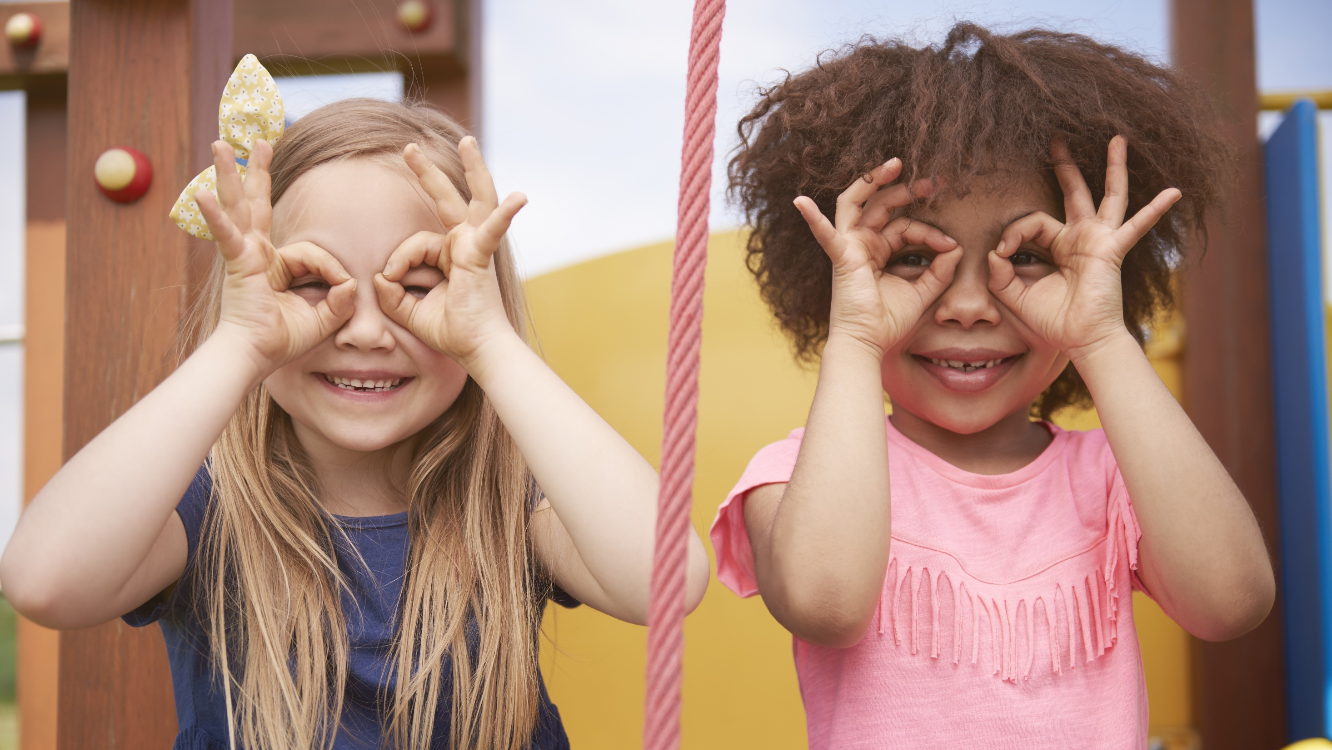
Enjoy your day!

