Slide 1
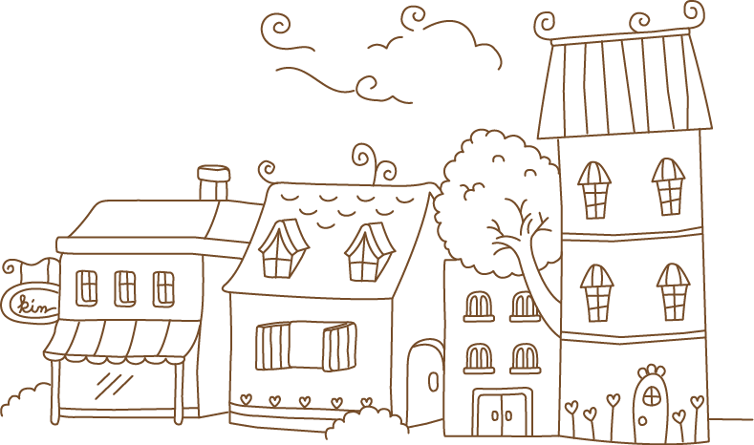

兔斯基
的
开心日常
方法
兴趣
引导
Method
Interest
Guide
幼儿英语教育
Infant English Education
汇报人 千库网；
汇报时间 XX年XX月

Slide 2
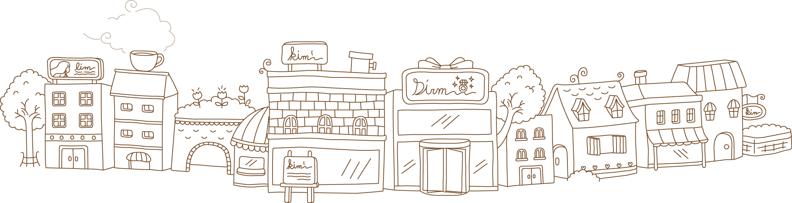
前言
PREFACE
学习英语没有什么速成的路子。但是，学英语要注意方法，靠一天到晚背书，天下的书这么多，你背得了吗？
靠埋头于题海探宝，泛滥成灾的习题书多如汙牛充栋，你做得完吗？靠起早带晚开着收音机听国外英语广播，
而不读报不看书不注意积累语音、语言知识，你能听得懂吗？
There is no quick way to learn English. However, we should pay attention to the method of learning English, relying on endorsements all day long, so many books
in the world, you can carry it back? By working on the sea treasure, the exercise book is as much as disaster caused by flooding water pollution Chongdong cattle,
you do have to end? Get up early and listen to the foreign English broadcast late on the radio,Instead of reading newspapers, reading books, and not paying
attention to the accumulation of phonetics and language knowledge, can you understand? Learning requires skill. Let's learn how to learn.

Slide 3
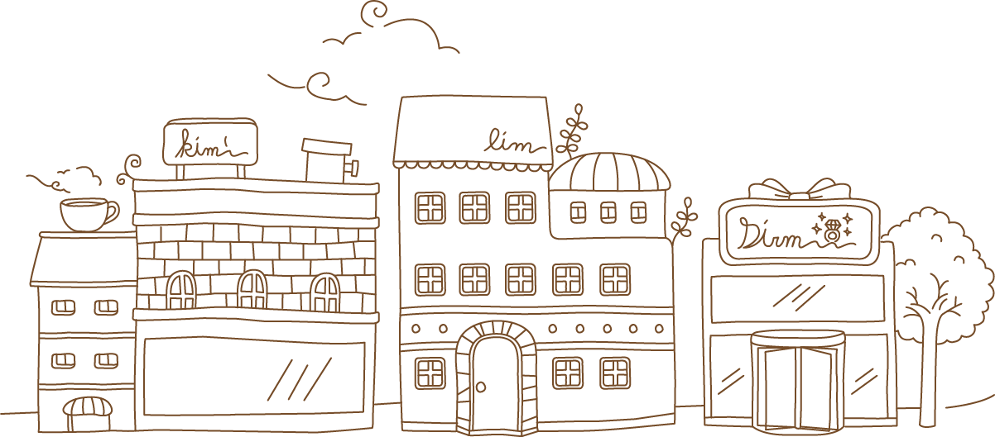
目录
CONTENTS
Part One
Part Two
Part Three
Part Four
插入文本
插入文本
插入文本
插入文本

Slide 4

第一部分
Part One
语言环境
Language Environment
语言环境即指说话时，人所处的状况和状态。
Language environment refers to the condition and state of a person when he speaks.

Slide 5


插入标题
Insert title
插入文本
Insert text
儿童学习语言的过程也是感知和理解语音和符号的过程。有声言语是以
说话人所发出的和听话人所听到的声音作为物质形式而存在的。
所以对口头言语的感知与语音的辨词作用有关。
插入文本
Children's learning of language is also a process of perceiving and understanding
sounds and symbols. Sound speech exists in the form of the voice of the
speaker and the voice of the hearer. Therefore, the perception of
spoken language is related to the phonetic function of speech.
Insert text
插入文本
Insert text
插入文本
Insert text
插入文本
Insert text

Slide 6

插入标题
Insert title
关注点❶
关注点❷
插入文本
插入文本
记忆效率
Memory Efficiency
我们的记忆或学习效率会随着任务的变化而变化，并非保持在一个水平。
Our memory or learning efficiency changes with the task, not at a level.

Slide 7

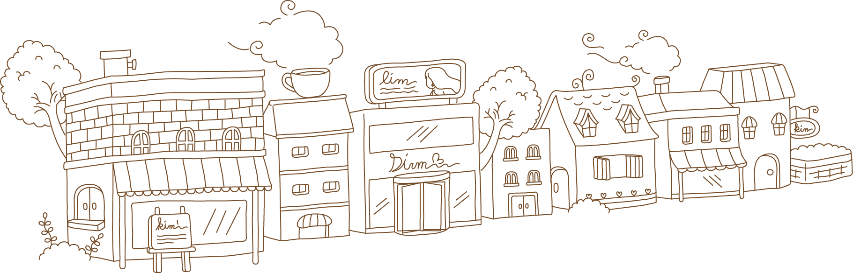
插入标题
Insert title
7-8岁之间学语言最轻松。美国哈佛大学的科学家通过核扫描发现，人大脑中有一个专门负责学习语言的区域，
即布罗卡斯区，在7-8岁时是最活跃的，此时学语言也最轻松。随着年龄增长，灵敏性呈下降趋势。 。
Between the ages of 7-8, learning the language is the easiest. Scientists at the Harvard University found that in the human brain there was
a region responsible for learning language, the Broca District, which was the most active at the age of 7-8, and was the easiest language
to learn at that time. As age increases, sensitivity decreases.
注意营养

Slide 8

第二部分
Part Two
学习方法
Learning Method
学习方法是通过学习实践总结出的快速掌握知识的方法。
Learning method is a method of quick mastery of knowledge through study and practice.

Slide 9

插入标题
插入文本
Insert title
Insert text
学习需要技巧，我们先让孩子学会如何学习。
Learning requires skill. Let's learn how to learn.
插入文本
Insert text
插入文本
Insert text

Slide 10
插入标题
Insert title
插入文本
Insert text
插入文本
插入文本
Insert text
Insert text

Slide 11

插入标题
Insert title
插入文本
Insert text
插入文本
Insert text
插入文本
Insert text

Slide 12

第三部分
Part Three
情感激励
Emotion Encouragement
是否有情感激励的学习能力水平存在着50%左右的差异。
There are about 50% differences in the learning ability of emotional motivation.

Slide 13
插入标题
Insert title
A
B
C
D
插入文本
插入文本
插入文本
插入文本
Insert text
Insert text
Insert text
Insert text

Slide 14
插入标题
Insert title
插入文本
插入文本
Insert text
Insert text
插入文本
Insert text
插入文本
插入文本
Insert text
Insert text

Slide 15
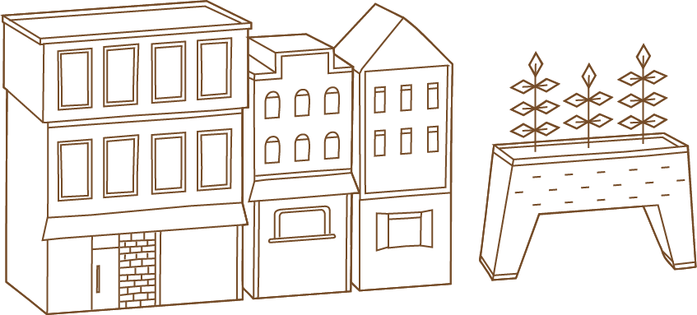
插入标题
Insert title
插入文本
Insert text
儿童学习语言的过程也是感知和理解语音和符号的过程。
有声言语是以说话人所发出的和听话人所听到的声音作
为物质形式而存在的。所以对口头言语的感知与语音的
辨词作用有关。
Children's learning of language is also a process of perceiving and
understanding sounds and symbols. Sound speech exists in the form
of the voice of the speaker and the voice of the hearer. Therefore,
the perception of spoken language is related to the phonetic function
of speech.

Slide 16

第四部分
Part Four
成功反馈
Successful Feedback
有成就感的事情，才会有动力继续
A sense of achievement, will have the power to continue

Slide 17
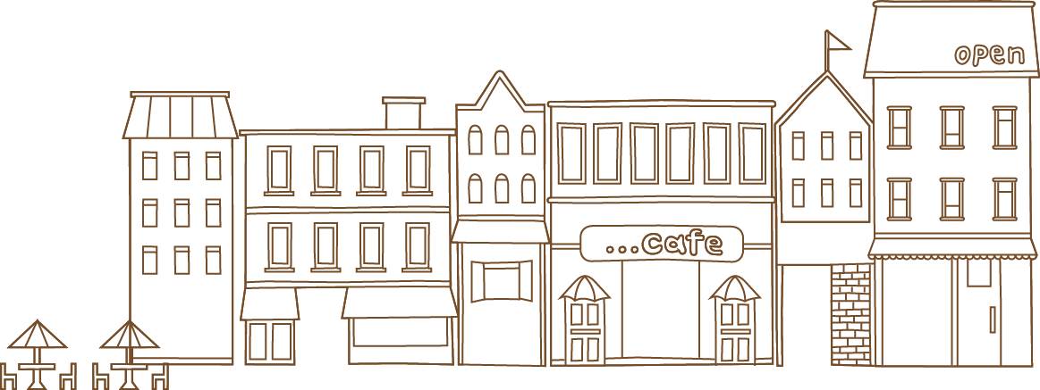
插入标题
Insert title
插入文本
插入文本
插入文本
插入文本
Insert text
Insert text
Insert text
Insert text
插入文本
Insert text

Slide 18
插入标题
Insert title
插入文本
插入文本
Insert text
Insert text
插入文本
插入文本
Insert text
Insert text

Slide 19
插入标题
Insert title
7-8岁之间学语言最轻松。美国哈佛大学的科学家通过核扫描发现，人大脑中有一个专门负责学习语言的区域，
即布罗卡斯区，在7-8岁时是最活跃的，此时学语言也最轻松。随着年龄增长，灵敏性呈下降趋势。 。
Between the ages of 7-8, learning the language is the easiest. Scientists at the Harvard University found that in the human brain there was
a region responsible for learning language, the Broca District, which was the most active at the age of 7-8, and was the easiest language
to learn at that time. As age increases, sensitivity decreases.

Slide 20
兔斯基
的
开心日常
感谢聆听

