Slide 1

Unit 7: Movies
Lesson 1.2: Grammar
Page 55

Slide 2
Lesson Outline
Warm-up
Grammar
Consolidation
Wrap-up

Slide 3

Objectives
By the end of this lesson, students will be able to use prepositions of time to say when things happen:
Use on with days and dates.
Use at with specific times.
Use in with periods of time.

Slide 4

WARM-UP

Slide 5
Work in pairs
Match the questions and the answers.
B
What time do you have breakfast?
What time do you usually go to sleep?
What is your most favorite day in the week?
When is your birthday?
When do you often go traveling?
It’s on 12th January.
At 7:30 a.m.
In summer.
At 9:30 p.m.
It’s Sunday.
D
E
A
C

Slide 6

PRESENTATION
Use prepositions of time to say when things happen

Slide 7
Look at four sentences and complete the rule for prepositions of time:
I often go swimming on Sunday.
My birthday is on 12th January.
I usually have breakfast at 7:30 a.m.
I often go on vacation in summer.
Use ______ with days and dates.
Use _______ with specific times.
Use _______ with periods of time.
on
at
in

Slide 8
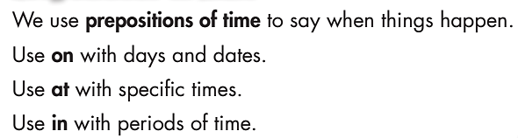
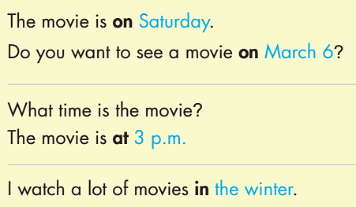
Remember:

Slide 9

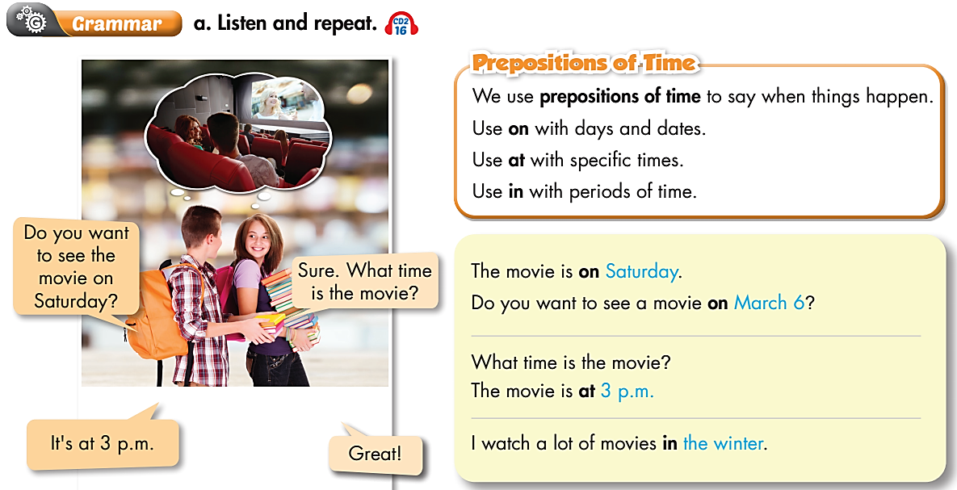

Slide 10

PRACTICE

Slide 11
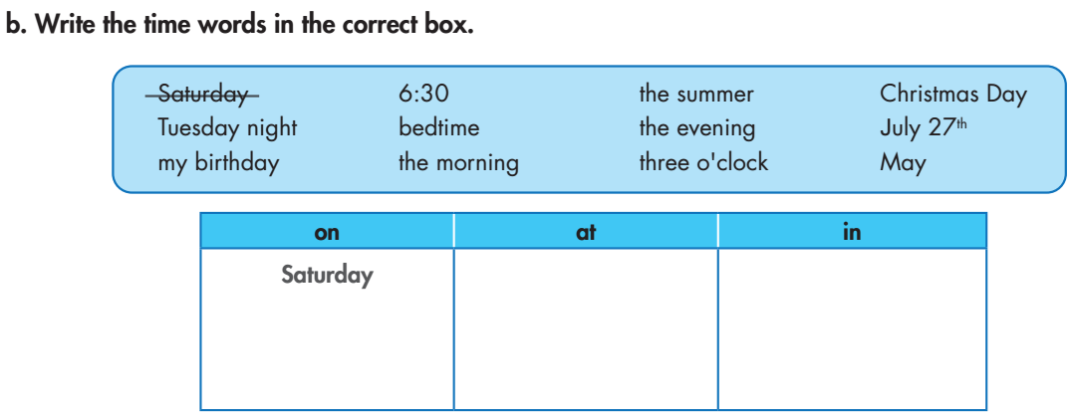
6:30
the summer
Christmas Day
the evening
Tuesday night
bedtime
the morning
my birthday
three o'clock
May
July 27th

Slide 12
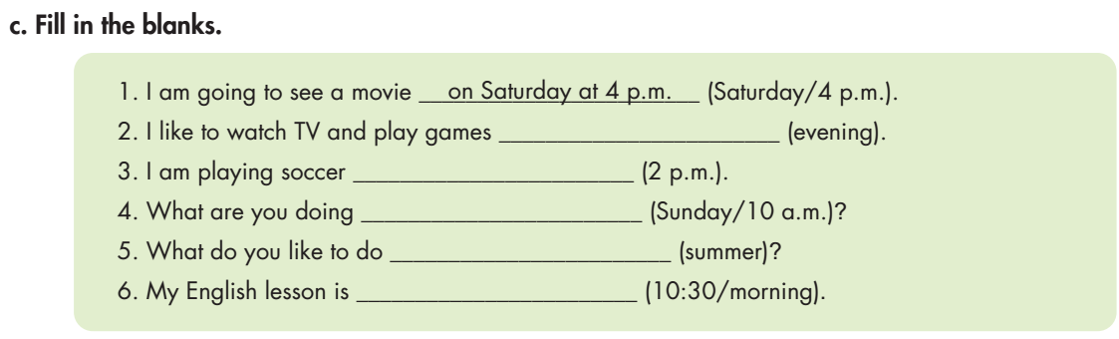
in the evening
at 2 p.m.
on Sunday at 10 a.m.
in the summer
at 10:30 in the morning

Slide 13
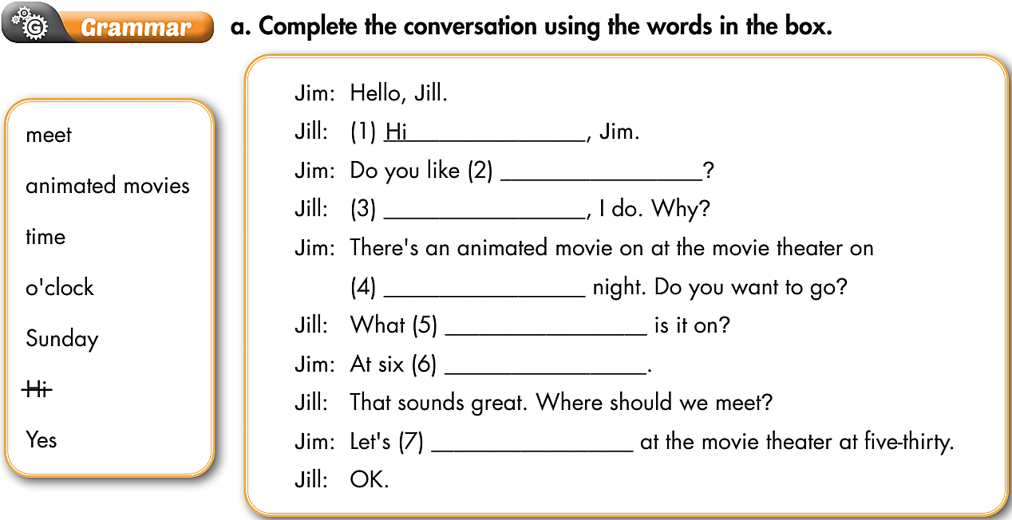
Extra Practice
WB p. 38
animated movies
Yes
Sunday
time
o'clock
meet

Slide 14
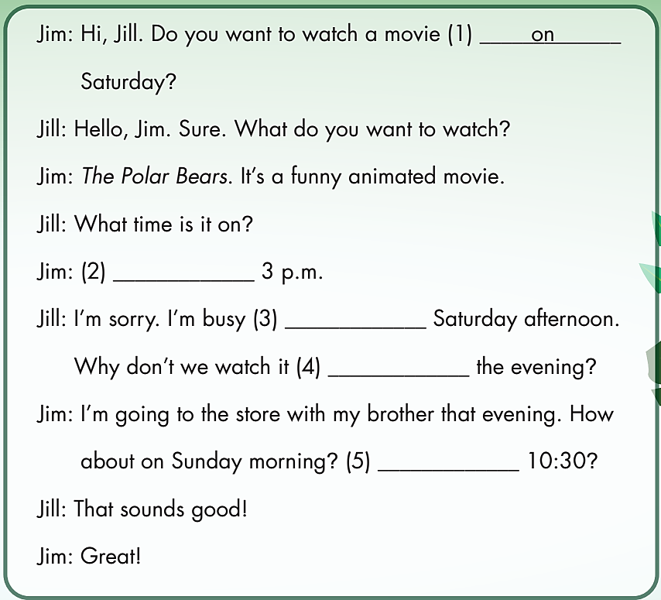
Extra Practice
WB p. 39
b. Fill in the blanks with the correct prepositions.
At
on
in
At

Slide 15
PRODUCTION

Slide 16

Work in pairs
Discuss with your friend about the plan to go out this weekend. Remember to ask for the day and time your friend is free. E.g.
A: Hey, do you want to go out with me this weekend?
B: Sure.
A: When are you free?
B: I’m free on Sunday.
A: Me too. What time shall we meet?
B: At 10 a.m. Shall we meet at the Bella coffee shop?
A: That sounds great.

Slide 17
Report about your plan to go out this weekend.
Hi, my name is…….I plan to go out with my friend on……... We are going to meet at ……. in/at ………….

Slide 18

CONSOLIDATION

Slide 19
Write at least 3 activities you do every weekday, and some special activities you do on the weekend. Remember to include the time. Please write at least 40 words.
e.g.
I usually wake up at 6 o’clock to have breakfast. Then I go to school at 6:40 a.m. I go back home at 5:00 p.m. to have a bath and watch TV. After dinner, I do my homework at 7:30 p.m. Then I go to bed at 9:00 p.m. On the weekend, I often get up late at 8:00 a.m. At 10:00 a.m., my family visits my grandparents and stays there until the afternoon. In the evening, I watch TV with my family until 9:00 p.m.

Slide 20
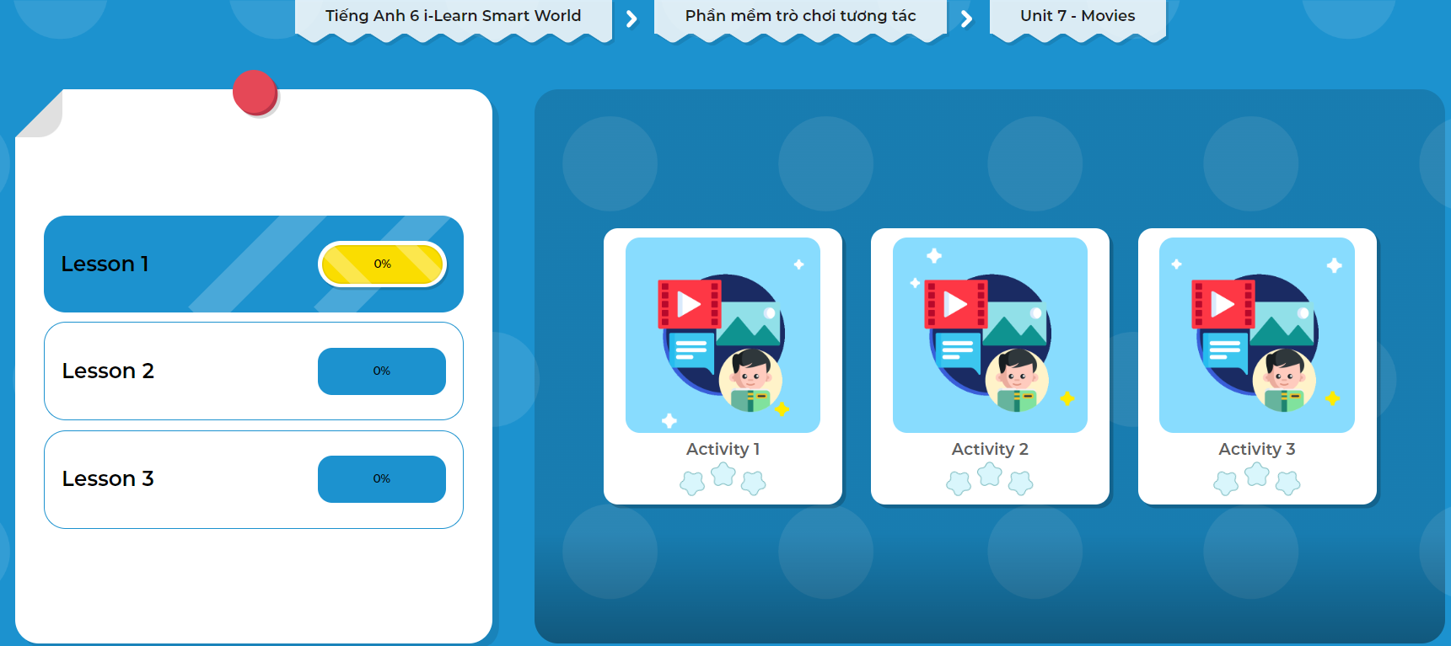
Click on the picture below to play the games!

Slide 21

WRAP-UP

Slide 22
Today’s lesson
Grammar
Use prepositions of time to say when things happen.
Use on with days and dates.
Use at with specific times.
Use in with periods of time.

Slide 23
Homework
Do the exercises on pages 39 WB.
Do the exercises in Tiếng Anh 6 i-Learn Smart World Notebook on page 41.
Prepare the next lesson (page 56 - SB).
Play the consolidation games in Tiếng Anh 6 i-Learn Smart World DHA App on www.eduhome.com.vn.

Slide 24
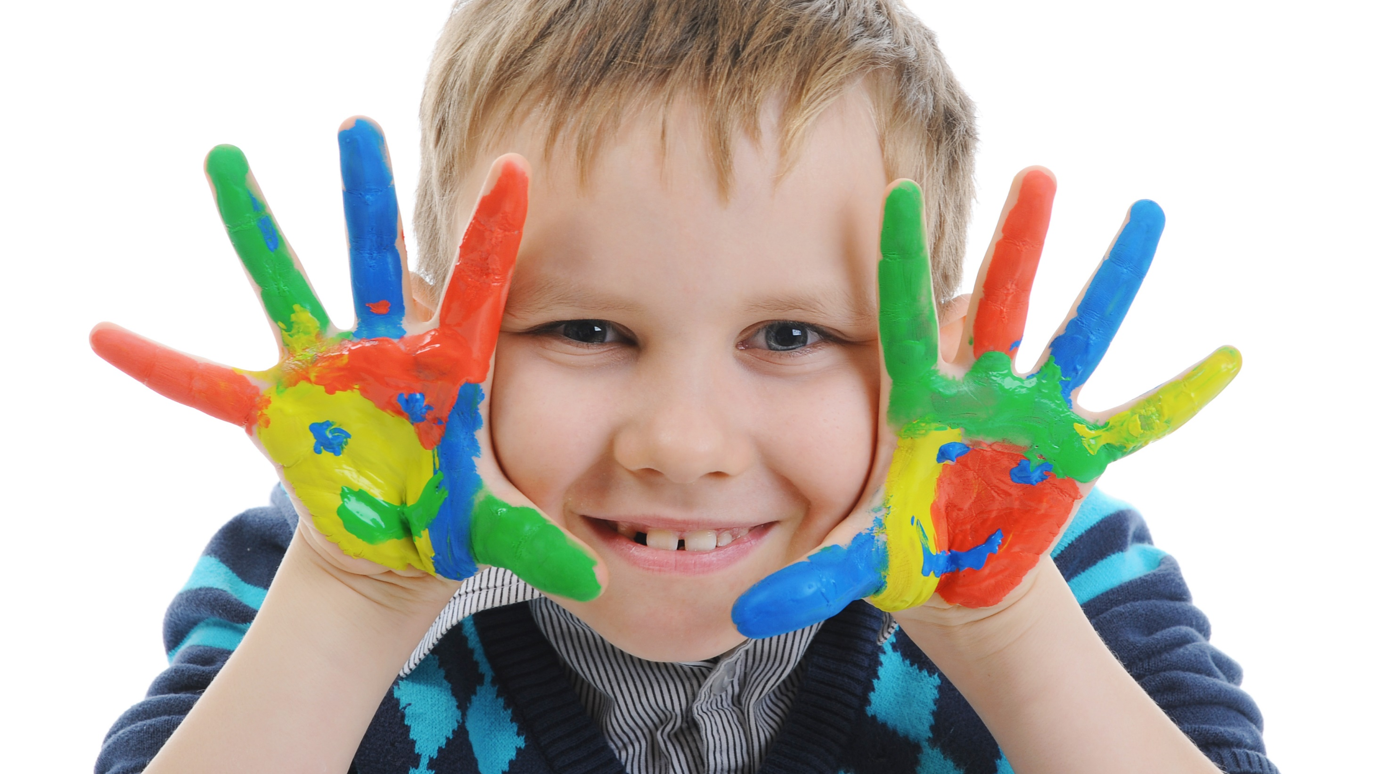
Enjoy your day!

