Slide 1


Slide 2

Unit
10
1
Unit
FAMILY LIFE
ECOTOURISM
LESSON 5
LISTENING
An ecotour in the Mekong Delta

Slide 3

Unit
1
1
FAMILY LIFE
Family Life
Unit
OBJECTIVES
Use the lexical items related to the topic ecotourism
Listen for specific information in a tour guide speech welcoming ecotourists in the Mekong Delta

Slide 4
LESSON 5
LISTENING
Unit
GETTING STARTED
WARM-UP
Answer the questions
PRE-LISTENING
Task 1: What do you think ecotourists can do there?
Task 2: Listen to a tour guide introducing the tour. Number the pictures in Task 1 in the order you hear them.
Task 3: Fill in each gap in the brochure.
WHILE-LISTENING
POST-LISTENING
Task 4: Discuss the question.
CONSOLIDATION
Wrap-up
Homework

Slide 5
ANSWER THE QUESTIONS
How many river deltas are there in Viet Nam?
2. Do you know the names of the 2 river deltas in Viet Nam?
3. Do you know another name for Cuu Long River Delta?
→ There are 2.
→ Red River Delta and Cuu Long River Delta.
→ Mekong Delta.

Slide 6
LESSON 5
LISTENING
Unit
GETTING STARTED
WARM-UP
Answer the questions
PRE-LISTENING
Task 1: What do you think ecotourists can do there?

Slide 7
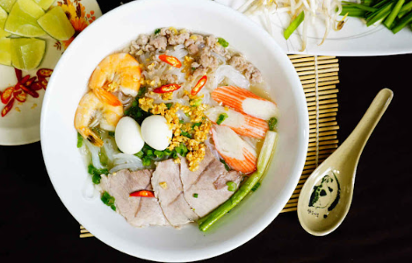
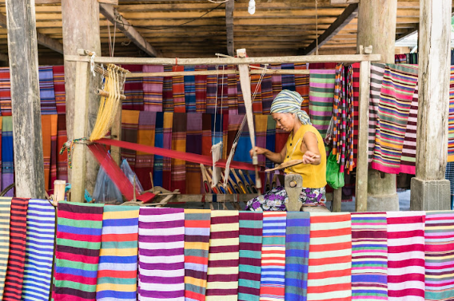
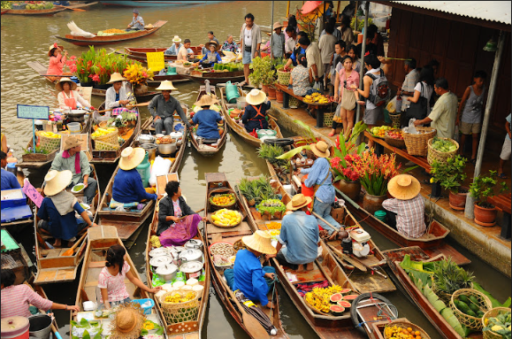
PRE-LISTENING
1
Work in pairs. Look at the photos from an ecotour in the Mekong Delta. What do you think ecotourists can do there?
Have a traditional meal / food (with a host family or at a local restaurant)
Visit a weaving village, buying traditional arts and crafts
Visit a floating market, buying fruits there

Slide 8
LESSON 5
LISTENING
Unit
GETTING STARTED
WARM-UP
Answer the questions
PRE-LISTENING
Task 1: What do you think ecotourists can do there?
Task 2: Listen to a tour guide introducing the tour. Number the pictures in Task 1 in the order you hear them.
Task 3: Fill in each gap in the brochure.
WHILE-LISTENING

Slide 9

WHILE-LISTENING
2
Listen to a tour guide introducing the tour. Number the pictures in Task 1 in the order you hear them.
1
2
b
a
3
c

Slide 10
WHILE-LISTENING
3
Listen again. Fill in each gap in the brochure below with one word.
*** Sunshine travel ***
MEKONG DELTA ECOTOUR (Day 1)
Join our (1) ______________ tour to explore the Mekong Delta:
- Cai Be Floating market: Experience the daily life of the people on the river.
- Cham River Village: Visit a weaving workshop and learn about (2) _______ people’s weaving skills.
- Arts and crafts market: Buy locally made (3) ______________.
- Evening meal: Enjoy (4) ______________ food cooked by the host family.
eco-friendly
local
souvenirs
traditional

Slide 11
LESSON 5
LISTENING
Unit
GETTING STARTED
WARM-UP
Answer the questions
PRE-LISTENING
Task 1: What do you think ecotourists can do there?
Task 2: Listen to a tour guide introducing the tour. Number the pictures in Task 1 in the order you hear them.
Task 3: Fill in each gap in the brochure.
WHILE-LISTENING
POST-LISTENING
Task 4: Discuss the question.

Slide 12
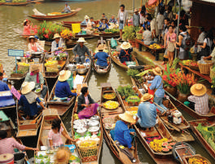
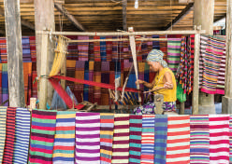
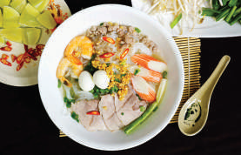
POST-LISTENING
4
Work in groups and discuss the question.
Which part of the tour do you like most?
Why?

Slide 13
LESSON 5
LISTENING
Unit
GETTING STARTED
WARM-UP
Answer the questions
PRE-LISTENING
Task 1: What do you think ecotourists can do there?
Task 2: Listen to a tour guide introducing the tour. Number the pictures in Task 1 in the order you hear them.
Task 3: Fill in each gap in the brochure.
WHILE-LISTENING
POST-LISTENING
Task 4: Discuss the question.
CONSOLIDATION
Wrap-up
Homework

Slide 14
CONSOLIDATION
1
Wrap-up
Use the lexical items related to the topic ecotourism
Listen for specific information in a tour guide speech welcoming ecotourists in the Mekong Delta

Slide 15
CONSOLIDATION
2
Homework
Prepare for the next lesson: Unit 10 – Writing
2. Do exercises in the workbook

Slide 16

Website: hoclieu.vn
Fanpage: facebook.com/tienganhglobalsuccess.vn/

