Slide 1

Unit 8: Festivals around the World
Lesson 1.1: Vocabulary & Reading
Page 60

Slide 2



LESSSON OUTLINE
Consolidation

Slide 3

By the end of this lesson, students will be able to…
- talk about festivals.
- practice reading and understanding general and specific information about a festival.

Slide 4

New words
lantern
bonfire
race
(eating) competition
sculpture
(water) fight
hot-air balloon

Slide 5

WARM-UP

Slide 6

Work in pairs
Name some festivals in your country.
When is Mid-Autumn festival?
Which festival do you like best? Why?

Slide 7



Slide 8
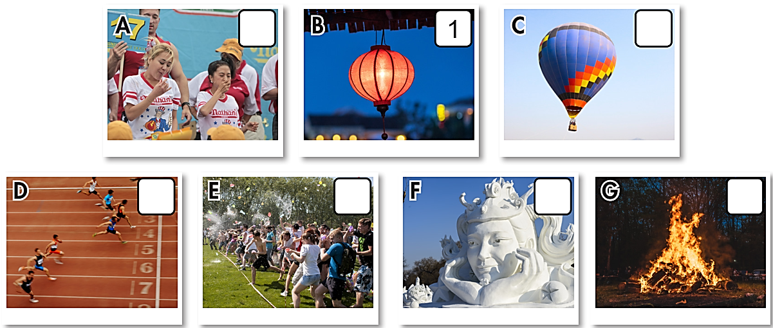
Work in pairs. What can you see in each picture?

Slide 9
a. Number the pictures.
4
7
lantern
bonfire
race
(eating) competition
sculpture
(water) fight
hot-air balloon
3
6
5
2

Slide 10

Listen and repeat. Click on each word to hear the sound
lantern (n) /ˈlæntərn/ lồng đèn
bonfire (n) /ˈbɑːnfaɪər/ lửa mừng, lửa trại
race (n) /reɪs/ cuộc đua
(eating) competition (n. phr) /'i:tiŋ ˌkɑːmpəˈtɪʃn/ cuộc thi ăn
sculpture (n) /ˈskʌlptʃər/ tác phẩm điêu khắc
(water) fight (n. phr) /ˈwaːtə faɪt/ cuộc đấu nước, té nước
hot-air balloon (n. phr) /ˌhɑːt ˈer bəluːn/ khinh khí cầu
Notes:
GV click vào từng cụm nghe âm thanh

Slide 11
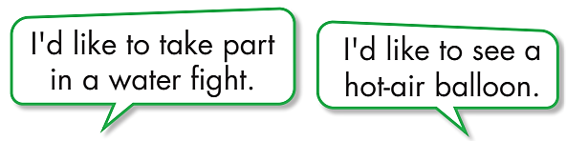
b. Work in pairs. Say which of these you’d like to see or try.

Slide 12
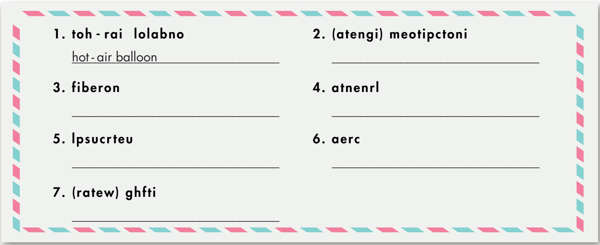
Extra Practice
WB, page 44
a. Unscramble the letters to make words and phrases.
(eating) competition
bonfire
lantern
sculpture
race
(water) fight

Slide 13
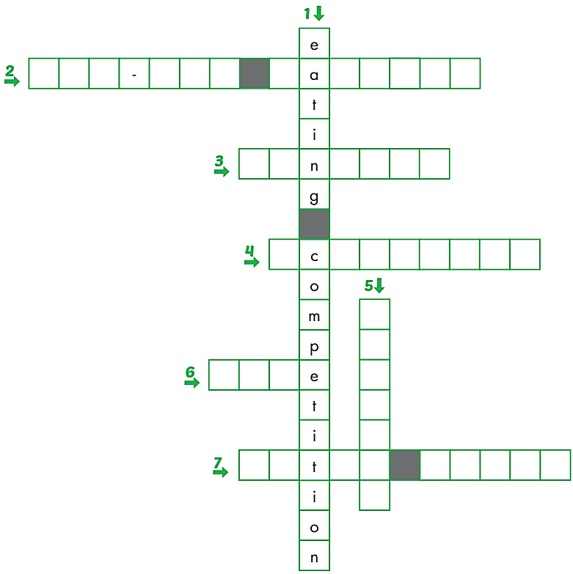
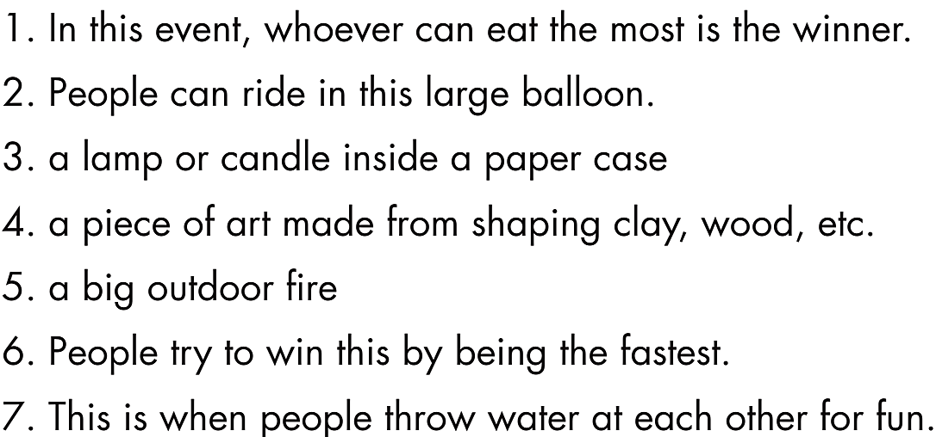
Extra Practice
WB, page 44
h o t a i r b l l o o n
b. Complete the crossword with the words and phrases from Task a.
l a t e r n
s u l p t u r e
bonf i r e
r a c
w a e f i g h t

Slide 14

It’s reading time….

Slide 15
Task a
Pre-reading
Read the instruction and the answers quickly:
Underline the key words.
What are we going to do?
Read and choose the best title.
Read the article and choose the best title.
The Best Arts Festivals around the World
The Most Interesting Festivals around the World

Slide 16
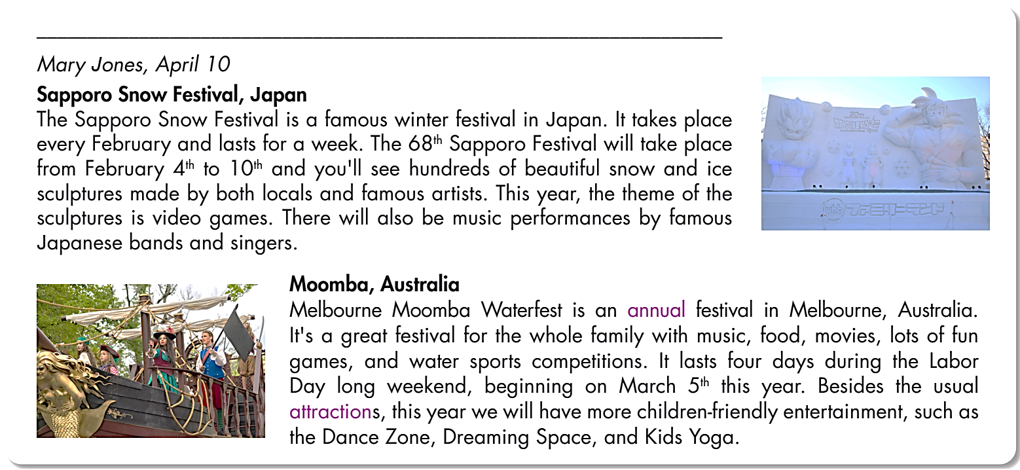
Read the article and choose the best title.
The Best Arts Festivals around the World
The Most Interesting Festivals around the World

Slide 17
Task b
Pre-reading
Read the questions and underline the key words.
What are we going to do?
Read and answer the questions.
b. Now, read and answer the questions.
1. How many days is the Sapporo Snow Festival?
2. Who will make the ice sculptures?
3. What is the topic for ice sculptures this year?
4. During which holiday is Moomba Waterfest?
5. What is special for kids this year?

Slide 18
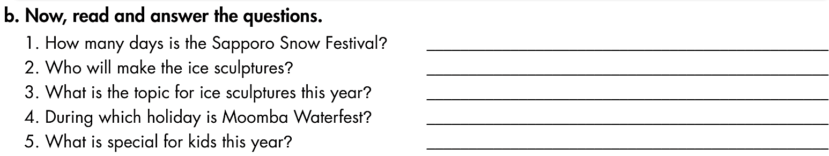
While-reading

Slide 19
1. How many days is the Sapporo Snow Festival?
2. Who will make the ice sculptures?
3. What is the topic for ice sculptures this year?
7 days.
Locals and famous artists make them.
It’s video games.
Sapporo Snow Festival, Japan
The Sapporo Snow Festival is a famous winter festival in Japan. It takes place every February and lasts for a week. The 68th Sapporo Festival will take place from February 4th to 10th and you'll see hundreds of beautiful snow and ice sculptures made by both
locals and famous artists. This year, the theme of the sculptures is
video games. There will also be music performances by famous Japanese bands and singers.

Slide 20
4. During which holiday is Moomba Waterfest?
5. What is special for kids this year?
It’s during the Labor Day.
This year they have Dance Zone,
Dreaming Space, and Kids Yoga.
Moomba, Australia
Melbourne Moomba Waterfest is an annual festival in Melbourne, Australia. It's a great festival for the whole family with music, food, movies, lots of fun games, and water sports competitions. It lasts four days during the Labor Day long weekend, beginning on March 5th this year. Besides the usual attractions, this year we will have more children-friendly entertainment, such as the Dance Zone, Dreaming Space, and Kids Yoga.

Slide 21
Post-reading
Task c
Work in pairs
Would you like to visit the Sapporo Snow Festival or the Melbourne Moomba Waterfest? Why?

Slide 22

CONSOLIDATION

Slide 23
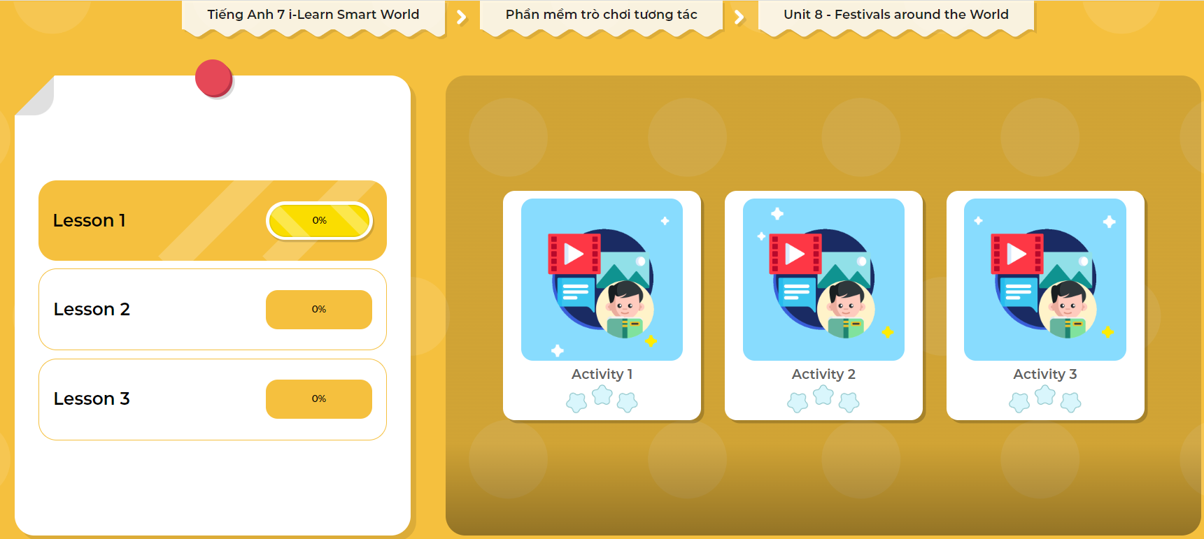
LET’S PLAY!
Click here to play the games!

Slide 24
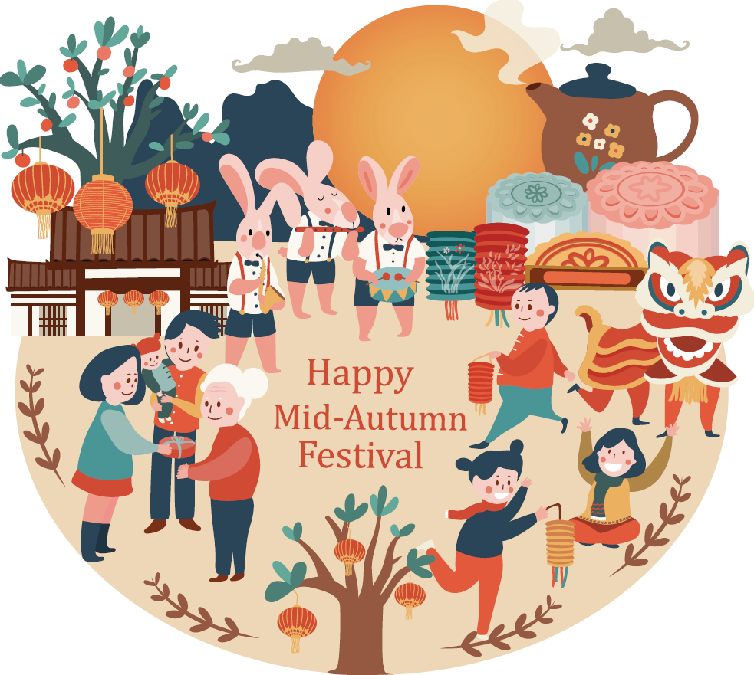
Talk to your partner about what people in your country usually do in the Mid-Autumn festival.

Slide 25

WRAP-UP

Slide 26
Today’s lesson
Vocabularies
lantern
bonfire
race
(eating) competition
sculpture
(water) fight
hot-air balloon

Slide 27
Today’s lesson
Reading:
- Understanding instructions.
Skimming and scanning for general and specific information.
Speaking:
- Talking about festivals.

Slide 28
Homework
Review the vocabularies and practice using them.
Do the exercise(s) in Tiếng Anh 7 i-Learn Smart World Workbook (page 44).
Do the vocabulary exercise in Tiếng Anh 7 i-Learn Smart World Notebook (page 48).
Play the consolation games in Tiếng Anh 7 i-Learn Smart World DHA App on www.eduhome.com.vn
Prepare the next lesson (page 61 SB).

Slide 29

Lesson 3
Stay positive and have a nice day!

