Slide 1

Unit 3: School
Lesson 2.2
Page 42

Slide 2
Lesson Outline
Warm-up
Listening
Consolidation
Wrap-up

Slide 3
Objectives
By the end of this lesson, students will be able to pronounce the sound /ɪ/ and ask what subjects people like.
Phonics: /ɪ/
Structure: Do you like (math)?
- Yes, I do./No, I don’t.

Slide 4

WARM UP

Slide 5

LET’S CHANT!

Slide 6


Slide 7

It’s time to learn …

Slide 8

Presentation

Slide 9
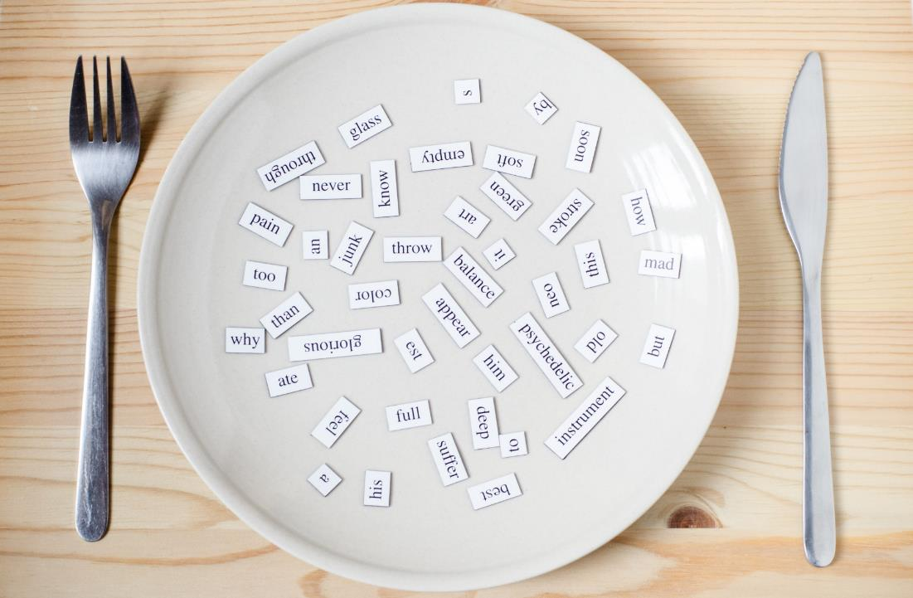
Phonics
/ɪ/

Slide 10
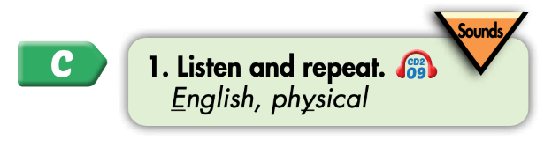

Click on the icon to hear the sound
Click on each word to hear the sound
English
physical
/ɪ/
/ɪ/

Slide 11

Practice

Slide 12
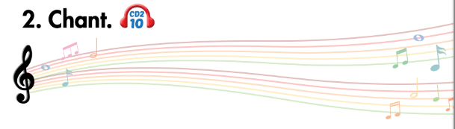
Listen and point
Listen and clap
Listen and chant

Slide 13
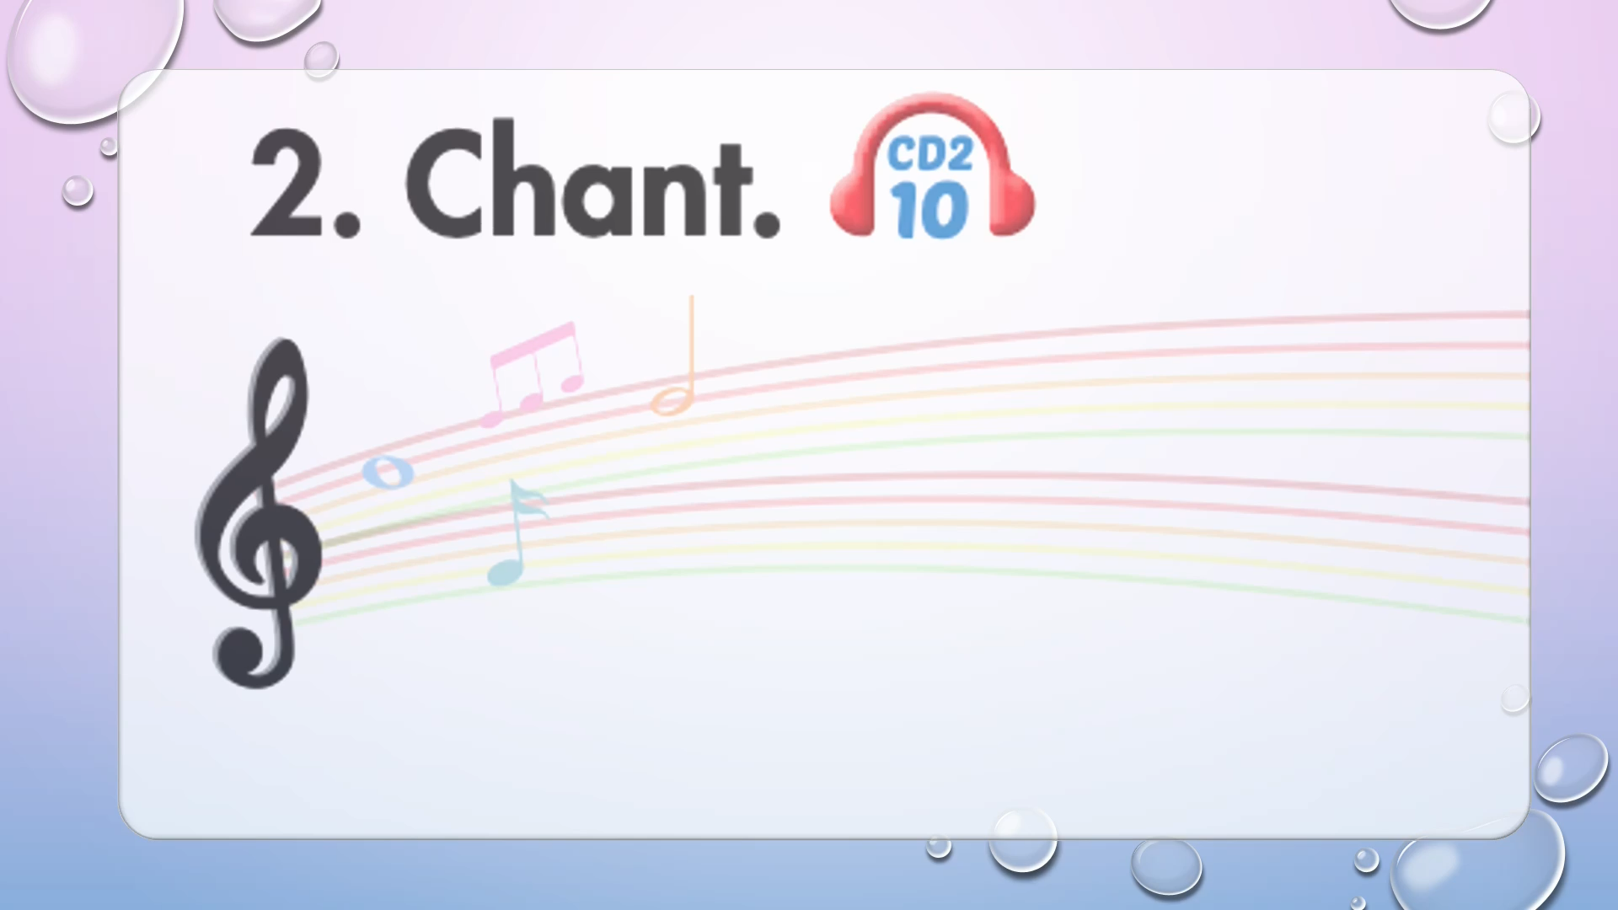

Slide 14

Listening

Slide 15
Pre-Listening
Look at the pictures and answer these questions.

Slide 16
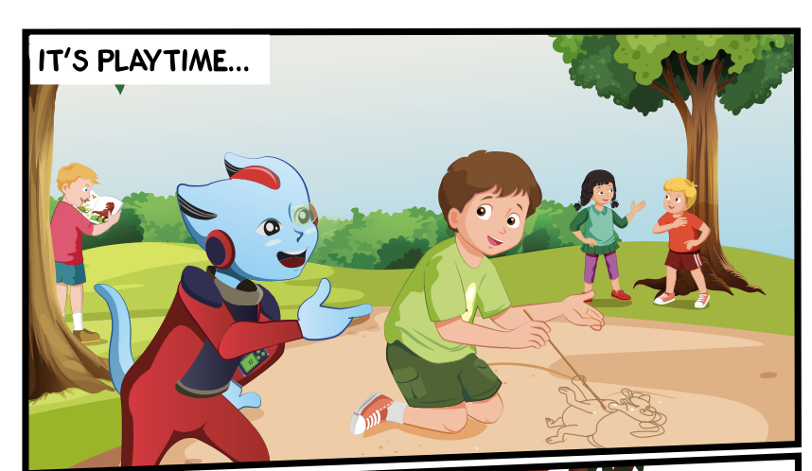
Who can you see?
What are they doing?
Where are they?

Slide 17

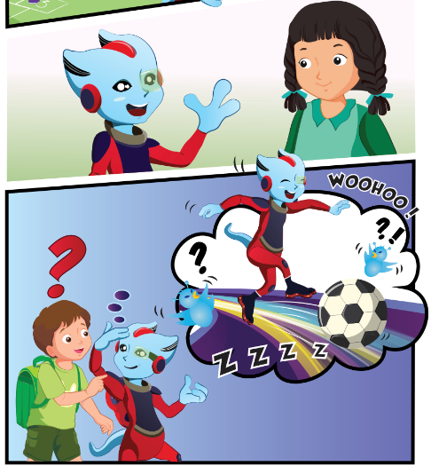

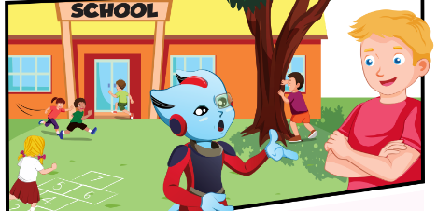
While-Listening
Click on the icon to hear the sound
3.
1.
4.
2.

Slide 18

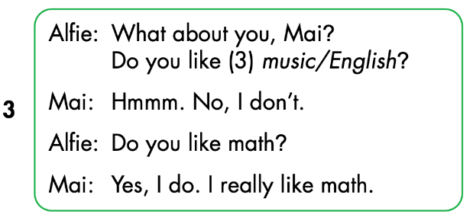
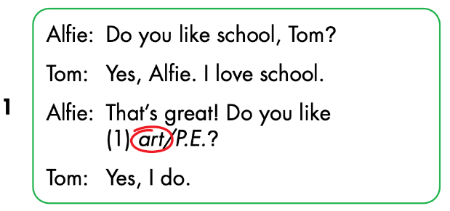
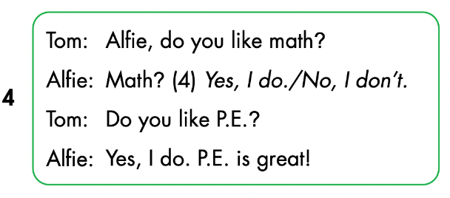
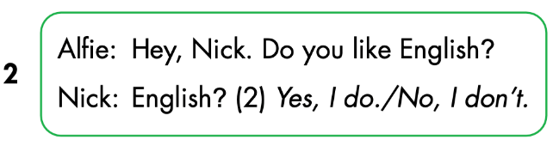
Click on the icon to hear the sound

Slide 19
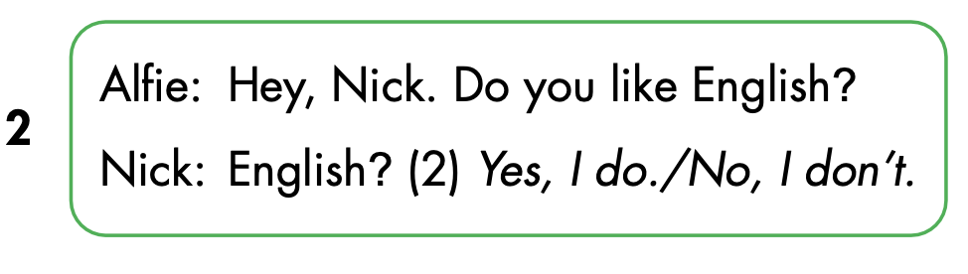
Let’s check!

Slide 20
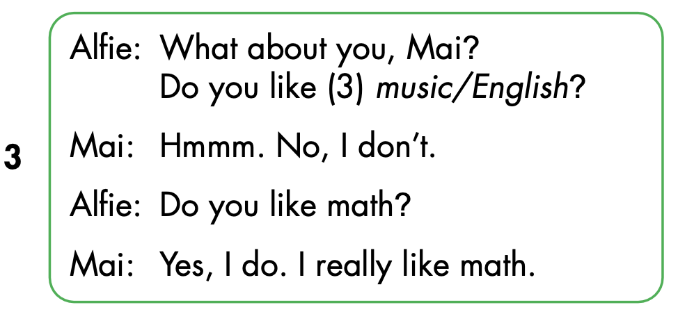

Slide 21
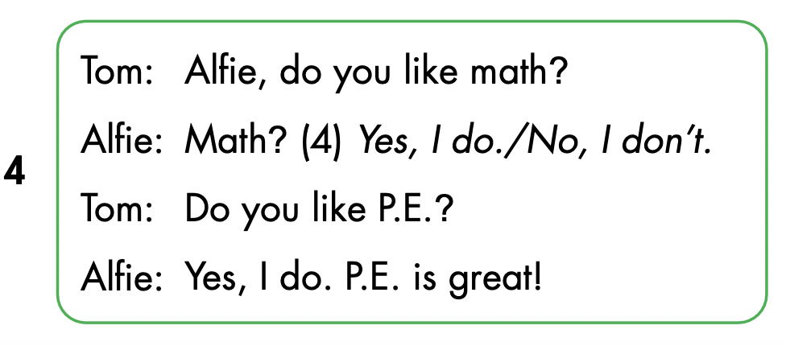

Slide 22

Speaking

Slide 23



Slide 24
Let’s play!

Slide 25


School subjects

Slide 26
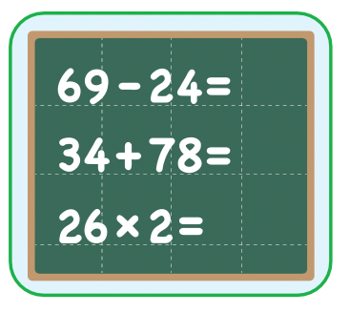


Do you like math ?
GREAT
Yes, I do.
math
No, I don’t.

Slide 27
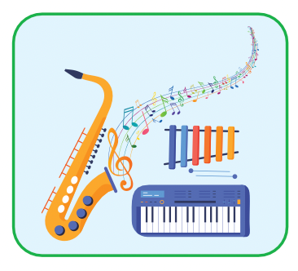


Do you like music?
GREAT
music
Yes, I do.
No, I don’t.

Slide 28
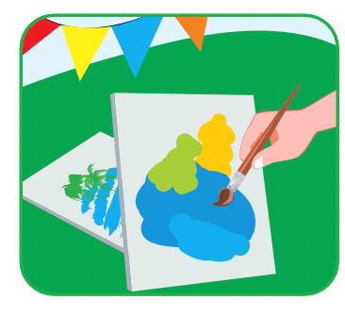
Do you like music ?
GREAT
math
Yes, I do.
No, I don’t.

Slide 29
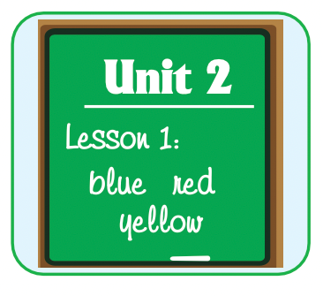


Yes, I do.
Do you like music?
GREAT
Do you like English?
Do you like art?

Slide 30
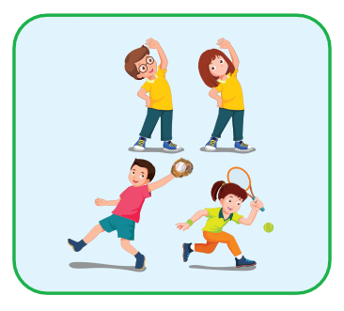

No, I don’t.
Do you like music?
GREAT
Do you like art?
Do you like P.E.?

Slide 31

CONSOLIDATION

Slide 32
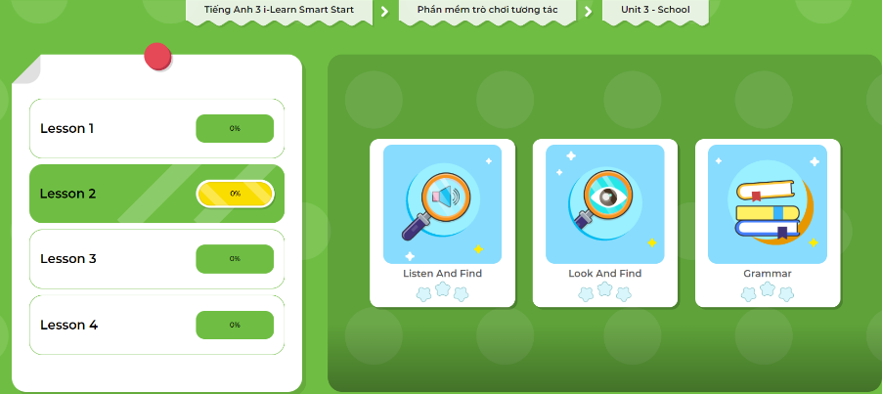
Extra Practice
DHA App
Let’s play!
Click here to play the games.

Slide 33
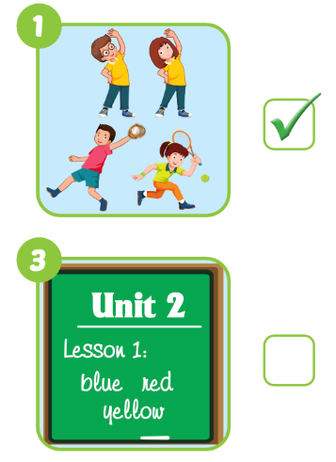
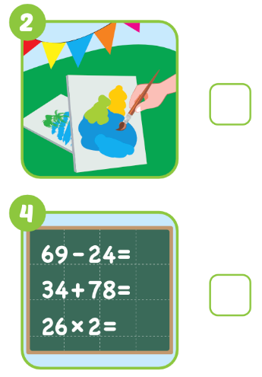

Extra Practice
WB p. 31
Click on the icon to hear the sound

Slide 34
Interview game
Draw this table
Choose 3 school subjects to write
Names | Math | English | Art
Tam
✓
✓
✘
Move around to ask: Do you like…? And write in the table
Work in pairs and tell about your friends
Notes:
134722862

Slide 35

WRAP-UP

Slide 36
Lesson 3
Today’s lesson
Phonics
/eɪ/ and /ɪə/
Structures/ Sentence patterns
Is this your (eraser)?
- Yes, it is./No, it isn't.
Are these your (notebooks)?
- Yes, they are./No, they aren't.

Slide 37
Lesson 3
Homework
Review the vocabularies, structure and make sentences using them.
Do the exercises on page 31 WB.
Do the exercises in Tiếng Anh 3 i-Learn Smart Start Notebook on page 23.
Prepare the next lesson (page 43 SB).
Play the consolidation games in Tiếng Anh 3 i-Learn Smart Start DHA App on www.eduhome.com.vn

Slide 38

Lesson 3
Stay positive and have a nice day!

