Slide 1
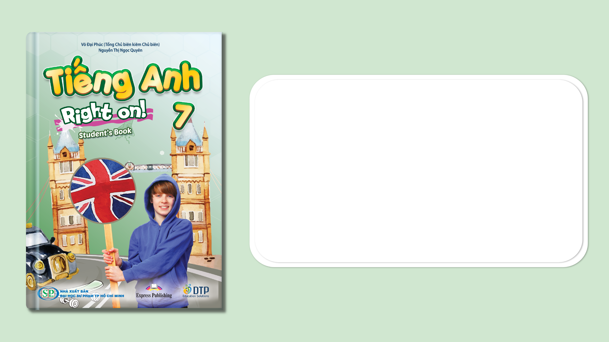
Unit 5: Travel & Transportation
Lesson 5b: Grammar
Page 82

Slide 2
Lesson Outline
Warm-up
Grammar
Wrap-up

Slide 3
Objectives
By the end of this lesson, students will be able to…
use the comparative form to compare two people/things or two groups of people/things.

Slide 4

WARM-UP

Slide 5
Teacher writes 10-20 words on the board from the previous lessons (e.g. hoverboard, self-driving bus, hyperloop train, ﬂying taxi, hoverbike, electric car, etc.). Then invite two students to come to the front of the class and give each student a board eraser. Ask the two students to stand with their backs to the board and tell them that when you call out one of the words, they should turn around and try to erase the word quickly.
The first student to erase the word is the winner. Then, ask the rest of the class ‘Who is faster?’, and all students should answer using a comparative sentence (e.g. ‘Sarah is faster than James.’).

Slide 6

It’s time to learn …

Slide 7

PRESENTATION
Comparative

Slide 8
Look at the sentences and choose suitable phrases to complete the rule for comparative:
more/less * Long * -er * than * than* Short
Jack is taller than Mary.
This white shirt is smaller than the blue one.
My hair is longer than your hair.
Peter is more helpful than Mark.
Apples are more delicious than carrots.
Maths is more difficult than English.
_____ adjectives:
adjective + ____+ ____ (+ noun)
____ adjectives:
_______ + adjective + ____ (+ noun)
Short
Long
-er
than
more/less
than

Slide 9
Complete the table with the rules for irregular forms of comparative:
Adjectives | Comparative forms
good | better
 | worse
much / many
little
bad
more
less

Slide 10
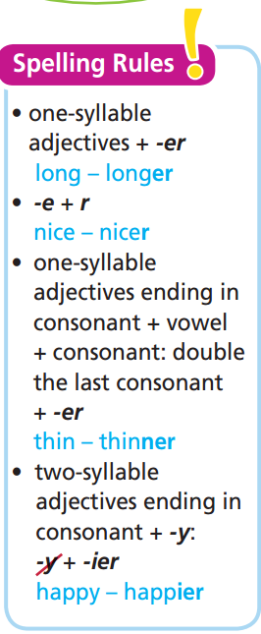
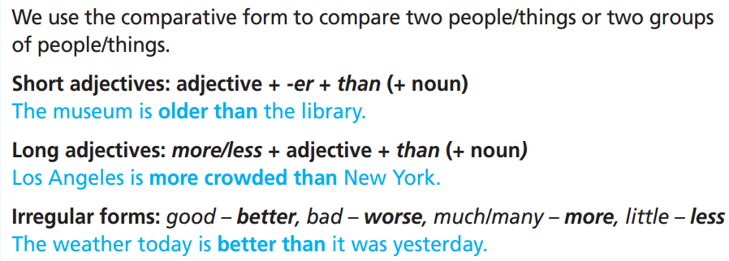
Remember:

Slide 11
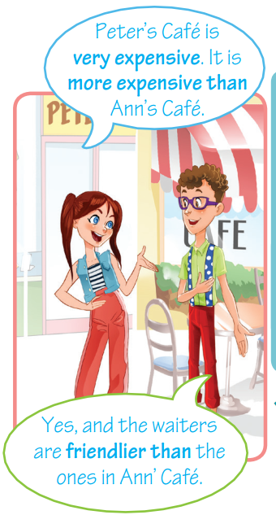
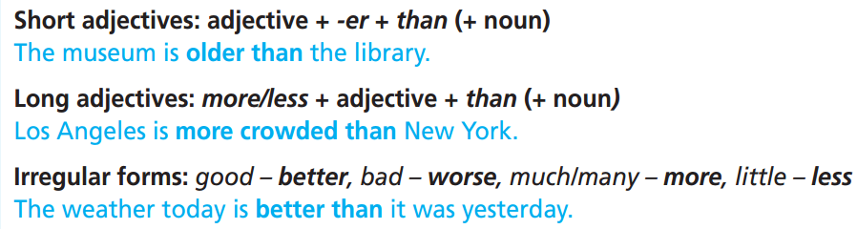

Slide 12

PRACTICE

Slide 13
Extra Practice
Grammar Bank, WB p. 73
56 ★ Write the comparative form of the adjectives below.
1 loud ____________________
2 interesting ____________________
3 busy ____________________
4 beautiful ____________________
5 bad ____________________
6 hot ____________________
louder
more interesting
busier
more beautiful
worse
hotter

Slide 14
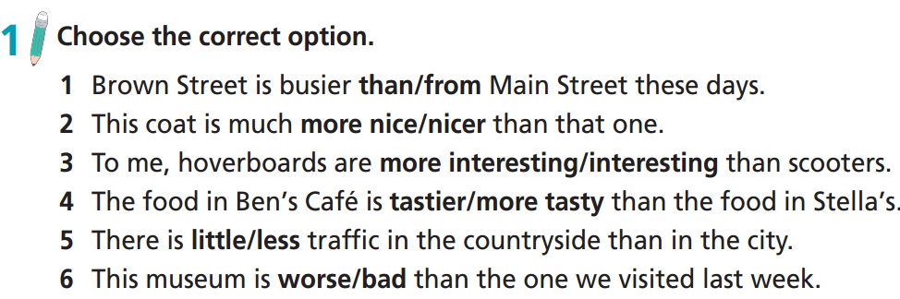

Slide 15
Extra Practice
Complete the sentences with the adjectives in brackets in the comparative form.
younger
Ben is ________________ (young) than Bill.
A supermarket is ________________ (large) than a florist’s.
Flying taxis are ________________ (fast) than cars.
Toy shops are ________________ (popular) to kids than banks.
It may be ________________ (expensive) at the department store.
New Zealand is ________________ (quiet) than Australia.
larger
faster
more popular
more expensive
quieter

Slide 16
Extra Practice
Grammar Bank p. 74
Complete the sentences with the adjectives in brackets in the comparative form.
1. The Tokyo Skytree in Japan is _________ (tall) than the CN Tower in Canada.
2. The city is________________ (crowded) than the countryside.
3. The weather in the UK is ________________ (wet) than the weather in Egypt.
4. The Old Town is ________________ (popular) with tourists than the modern city centre.
5. It’s ________________ (quick) to walk than to catch a bus in rush hour.
6. The restaurants in this part of town are ________________ (expensive) than the ones in my area.
7. Your coffee is ________________ (strong) than mine. I can’t drink it!
8. The university library is ________________ (modern) than the school library.
9. It’s ________________ (difficult) to climb the mountain in the winter than in the summer.
10. I think Hanoi is ________________ (sunny) than Doha.
taller
more crowded
wetter
more popular
quicker
more expensive
stronger
more modern
more difficult
sunnier

Slide 17
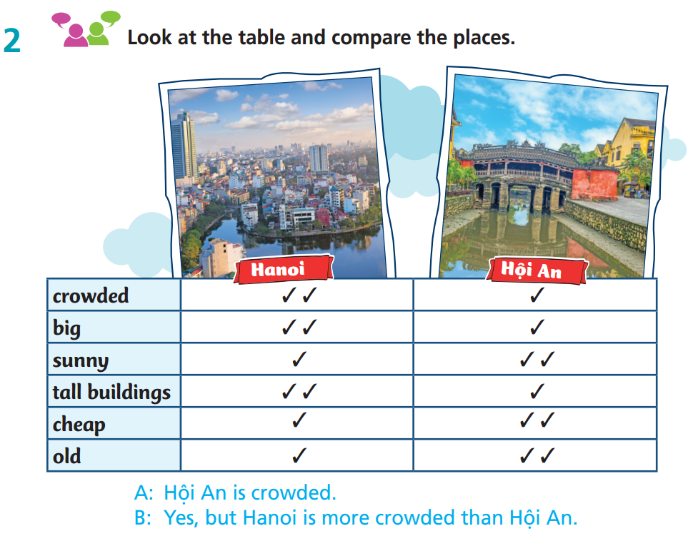
A: Hội An is big.
B: Yes, but Hanoi is bigger than Hội An.
A: Hanoi is sunny.
B: Yes, but Hội An is sunnier than Hanoi.
A: Hội An has tall buildings.
B: Yes, but Hanoi has taller buildings than Hội An.
A: Things are cheap in Hanoi.
B: Yes, things in Hội An are cheaper than things in Hanoi.
A: Hanoi is old.
B: Yes, but Hội An is older than Hanoi.

Slide 18
PRODUCTION

Slide 19
Extra Practice
Make sentences using the comparative form of the adjectives below.
1 loud ____________________
2 interesting ____________________
3 busy ____________________
4 beautiful ____________________
5 bad ____________________
6 hot ____________________
louder
more interesting
busier
more beautiful
worse
hotter

Slide 20
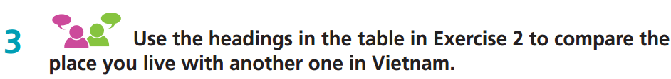
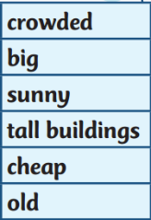
Work in pairs
E.g.
Ho Chi Minh City is more crowded than Hanoi. It is also bigger and sunnier than Hanoi. It has taller buildings than Hanoi. It’s more expensive than Hanoi. Hanoi is older than Ho Chi Minh City.

Slide 21
Report about your comparison of two places in Vietnam.
Hi, my name is ……. I live in ……... It is ………….. than ……….. It is also ……………. than ………….. It has ……………. buildings than …...... ……………………………

Slide 22

Work in pairs.
Please compare the following things:
Staying home and going on holiday
Walking to school and riding a bike to school
Eating fruits and eating snacks
Life in the city and in the countryside
e.g.
Going on holiday is more interesting than staying home.
Riding a bike to school is faster than walking to school.
Eating fruits is healthier than eating snacks.
Life in the city is busier than in the countryside.

Slide 23

CONSOLIDATION

Slide 24
Write at least 5 sentences to compare two places.
e.g.
It is hotter in Đà Nẵng than in Long An.
Đà Nẵng is older than Long An.
Đà Nẵng is more crowded than Long An.
Đà Nẵng is more expensive than Long An.
The beach in Đà Nẵng is more beautiful than in Long An.

Slide 25

WRAP-UP

Slide 26
Today’s lesson
Grammar
Use the comparative form to compare two people/things or two groups of people/things.

Slide 27
Homework
Practise the grammar point and make sentences using them.
Do the exercises in TA 7 Right on WB (page 43)
Prepare the next lesson (page 83 SB)
Complete the grammar notes in TA 7 Right on Notebook (page 37)

Slide 28

Enjoy your day!

