Slide 1

Unit 10: Energy Sources
Lesson 2.3: Pronunciation & Speaking
Page 81

Slide 2




LESSON OUTLINE
Consolidation

Slide 3

By the end of this lesson, students will be able to…
- practice pronouncing “and” like /n/.
- talk about the advantages and disadvantages of the energy sources.

Slide 4

WARM-UP

Slide 5

Work in pairs.
Choose the word whose main stress is placed
differently from the others.
1. A. describe B. express C. compare D. study
2. A. obligation B. invitation C. opinion D. declaration
3. A. weekend B. Chinese C. birthday D. parents
/dɪˈskraɪb/
/ɪkˈspres/
/kəmˈper/
/ˈstʌdi/
/ˌɑːbləˈɡeɪʃn/
/ˌɪnvəˈteɪʃn/
/əˈpɪnjən/
/ˌdekləˈreɪʃn/
/ˈwi:kend/
/tʃaɪˈniːz/
/ˈbɜ:rθdeɪ/
/ˈperənts/

Slide 6
Work in pairs.
Choose the word whose underlined part is
pronounced differently from that of the other words.
1. A. exchange B. enjoy C. collect D. design
2. A. difficult B. important C. historic D. delighted
3. A. river B. island C. midnight D. boarding
/ɪksˈtʃeɪndʒ/
/ɪnˈdʒɔɪ/
/kəˈlekt/
/dɪˈzaɪn/
/ˈdɪfəkəlt/
/ɪmˈpɔ:rtnt/
/hɪˈstɔ:rɪk/
/dɪˈlaɪtɪd/
/ˈrɪvər/
/ˈaɪlənd/
/ˈmɪdnaɪt/
/ˈbɔ:rdɪŋ/

Slide 7

Work in pairs
Discuss about the advantages of each energy source.
Coal is cheap and easy to use.
→ How to pronounce “and”
Hydropower is clean and cheap.
Wind power is clean and renewable.

Slide 8



Slide 9
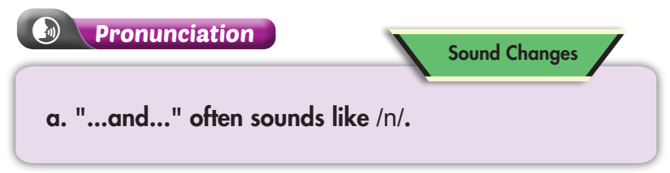
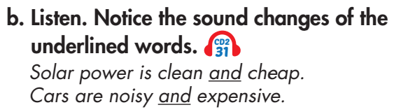

Click on the icon to hear the sound
Listen again and repeat.

Slide 10
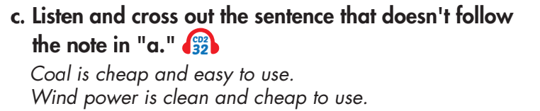

Click on the icon to hear the sound

Slide 11
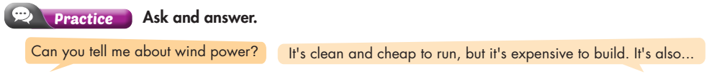
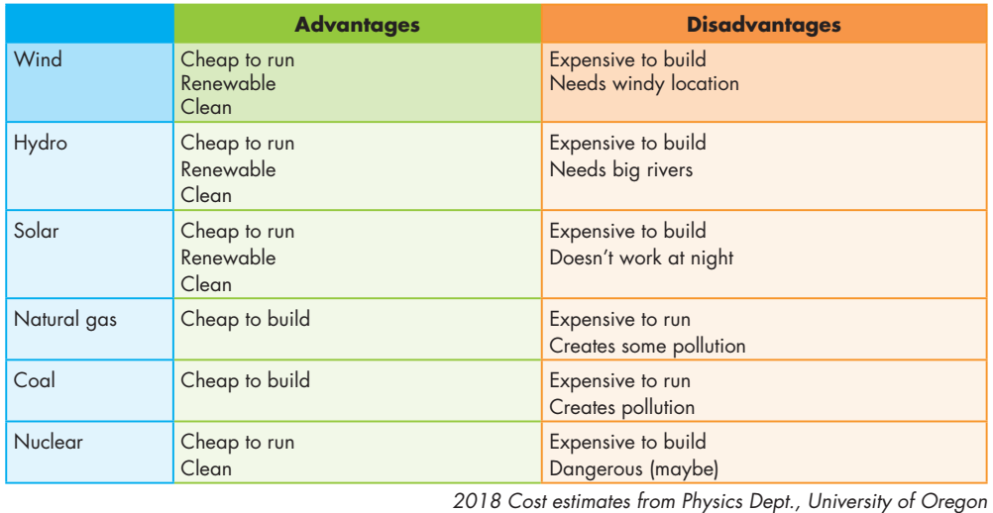

Slide 12
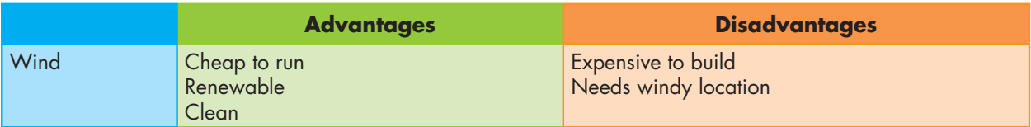
Can you tell me about wind power?
It’s clean and cheap to run. It’s also renewable.
Are there any disadvantages?
Yeah, it’s expensive to build and needs windy location.

Slide 13
Can you tell me about hydro power?
It’s clean and cheap to run. It’s also renewable.
Are there any disadvantages?
Yeah, it’s expensive to build and needs big rivers.

Slide 14
Can you tell me about solar power?
It’s clean and cheap to run. It’s also renewable.
Are there any disadvantages?
Yeah, it’s expensive to build and doesn’t work at night.

Slide 15
Can you tell me about natural gas?
It’s cheap to build.
Are there any disadvantages?
Yeah, it’s expensive to run and creates some pollution.

Slide 16
Can you tell me about coal?
It’s cheap to build.
Are there any disadvantages?
Yeah, it’s expensive to run and creates pollution.

Slide 17
Can you tell me about nuclear power?
It’s clean and cheap to run.
Are there any disadvantages?
Yeah, it’s expensive to build and maybe dangerous.

Slide 18

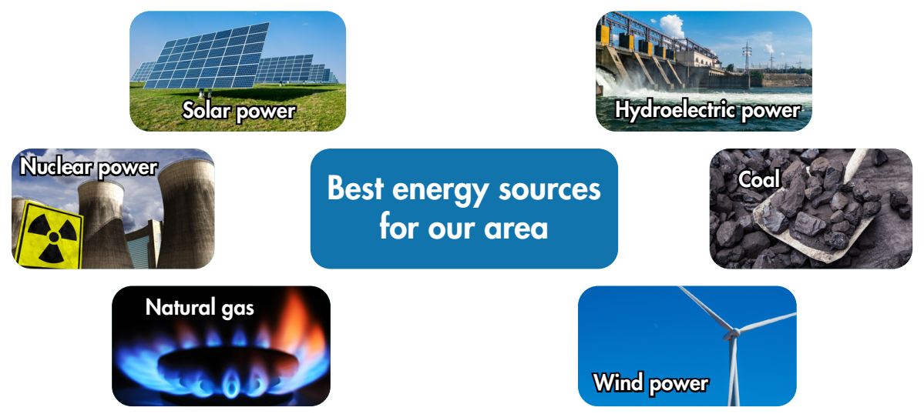
Discuss the advantages and disadvantages of the energy sources, and say why each would be good or bad for your city/town

Slide 19

Advantages
Cheap to run
Renewable
Clean
Disadvantages
Expensive to build
Doesn’t work at night

Slide 20

Advantages
Cheap to run
Renewable
Clean
Disadvantages
Expensive to build
Dangerous

Slide 21

Advantages
Cheap to run
Clean
Disadvantages
Expensive to build
Needs big rivers

Slide 22
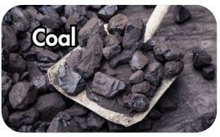
Advantages
Cheap to build
Disadvantages
Expensive to run
Creates pollution

Slide 23

Advantages
Cheap to build
Disadvantages
Expensive to run
Creates some pollution

Slide 24

Advantages
Cheap to run
Renewable
Clean
Disadvantages
Expensive to build
Needs windy location

Slide 25
I think solar power would be good for Ho Chi Minh City because the average number of sunshine hours in the South ranges from 1,500-1,700 hours per year. (According to Wikipedia)

Slide 26

I think the three best energy sources are hydropower, wind power, and solar power.

Slide 27

CONSOLIDATION

Slide 28
Write about the advantages and disadvantages of your favorite type of energy sources, using the words and information you learned today. (about 60-80 words)

Slide 29

WRAP-UP

Slide 30
Today’s lesson
Pronunciation:
- Practice pronouncing “and” like /n/.
Speaking & Writing:
- Talk about the advantages and disadvantages of the energy sources.

Slide 31
Homework
Practice the weak sound of “and”.
Practice talking about energy sources.
Review the vocabulary and grammar notes in Tiếng Anh 7 i-Learn Smart World Notebook (pages 62 & 63).
Prepare the next lesson (page 82 SB).
Play the consolidation games in Tiếng Anh 7 i-Learn Smart World App on www.eduhome.com.vn

Slide 32

Lesson 3
Stay positive and have a nice day!

