Slide 2
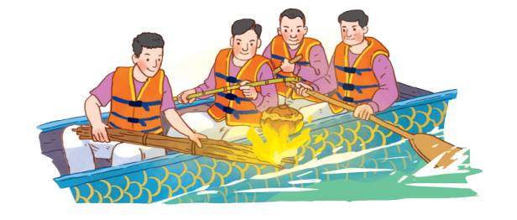
Unit
5
OUR CUSTOMS AND TRADITIONS
Unit
ETHNIC GROUPS OF VIET NAM
LESSON 5: SKILLS 1
LESSON 3: A CLOSER LOOK 2
Unit
HOBBIES
READING
SPEAKING

Slide 3
LESSON 5: SKILLS 1
WARM-UP
Option 1: Asking questions
Option 2: Asking questions: Bamboozle
Vocabulary
Task 1: Work in pairs. Look at the picture and answer questions.
Task 2: Read the text. Choose the correct answer A, B, or C.
Task 3: Read the text again. Complete the mind map about a family party.
READING
Task 4: Work in pairs. Put the questions in the correct blanks to make a complete dialogue. Then role-play it.
Task 5: Make notes about a normal family event that you take part in. Then make a dialogue asking and answering about the event.
SPEAKING
CONSOLIDATION
Wrap-up
Homework

Slide 4
WARM-UP
Option 1
1. Have you ever been to a festival?
2. Do you like it?
3. Can you describe it?

Slide 5
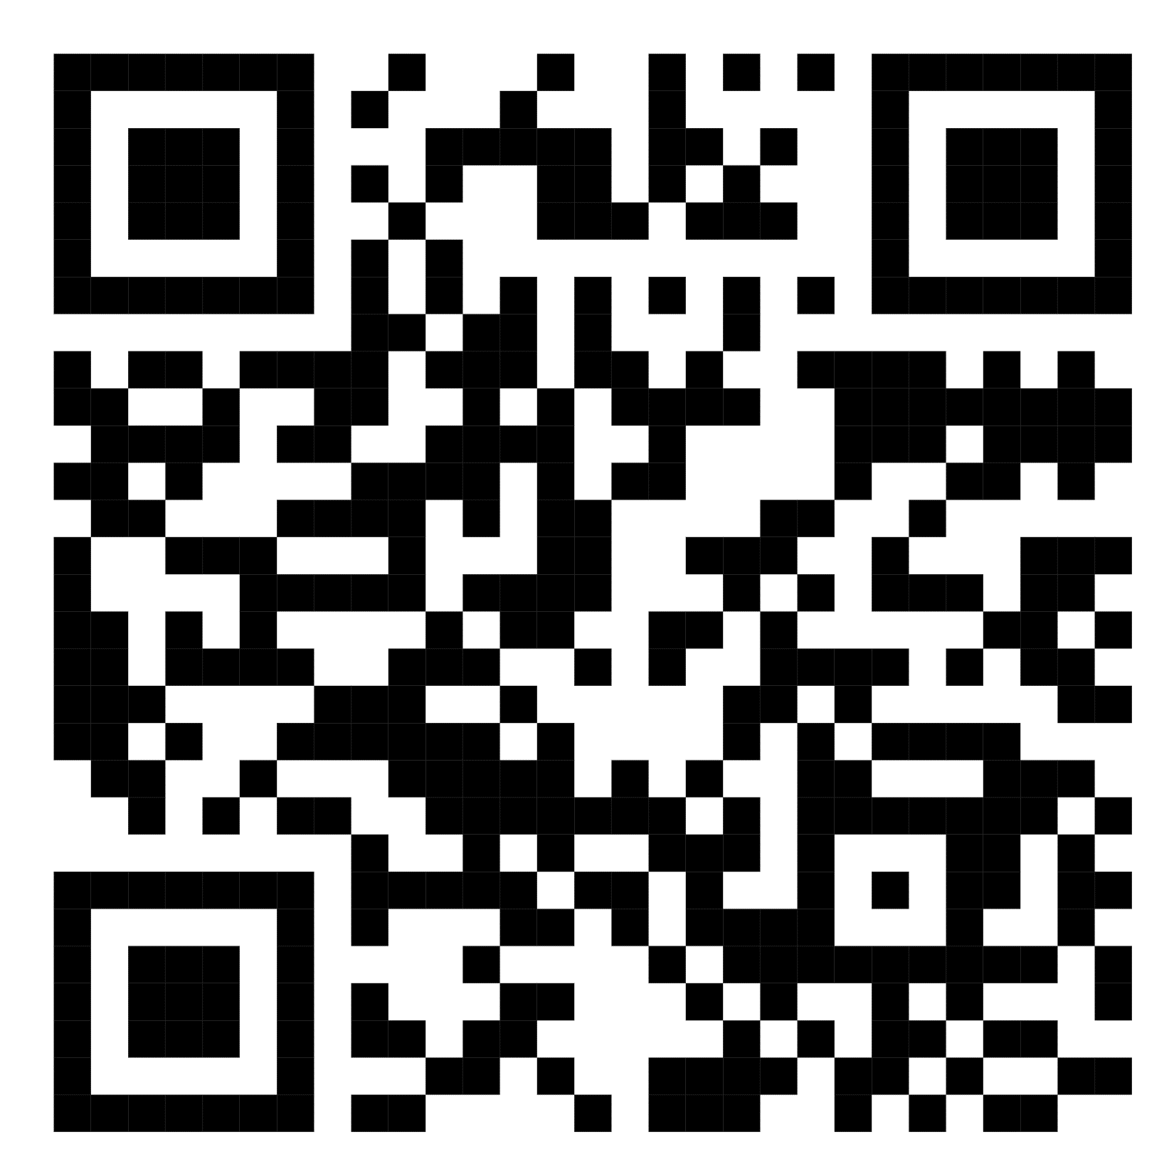
WARM-UP
Option 2
Scan the QR code to play the game.
Notes:
Game link: https://www.baamboozle.com/game/283002
Teacher can devide the class into 4 or 8 groups and let students choose numbers to answer the questions.

Slide 6
READING
release (v)
/rɪˈliːs/
thả

Slide 7
READING
contestant (n)
/kənˈtestənt/
thí sinh,
người thi đấu

Slide 8
READING
family bonding
/ˈfæməli ˈbɒndɪŋ/
sự gắn kết tình cảm gia đình

Slide 9
READING
New words | Pronunciation | Meaning
release (v) | /rɪˈliːs/ | thả
contestant (n) | /kənˈtestənt/ | thí sinh, người thi đấu
family bonding | /ˈfæməli ˈbɒndɪŋ/ | sự gắn kết tình cảm gia đình

Slide 10
READING
1
Work in pairs. Look at the picture and answer the following questions.
1. What are the men doing?
- They are rowing a boat. They are cooking rice on an open fire.
2. When do you think this event occurs?
- This event may occur in a festival in the North of Viet Nam.

Slide 11
READING
2
Read the text. Choose the correct answer A, B, or C.
1. What is the text mainly about?
A. A local tradition.
B. A family tradition.
C. A family tradition.
2. To win the boat race, a team must ______.
A. row the boat more quickly than the other teams B. row the boat the fastest and properly cook the rice
C. cook rice properly and catch the duck

Slide 12
READING
2
Read the text. Choose the correct answer A, B, or C.
3. The phrase “releases a duck” in the text means ______.
A. gives it freedom
B. catches it
C. takes it home
4. Why is the festival important?
A. Because it is exciting.
B. Because people win valuable prizes.
C. Because it keeps some village traditions alive.

Slide 13
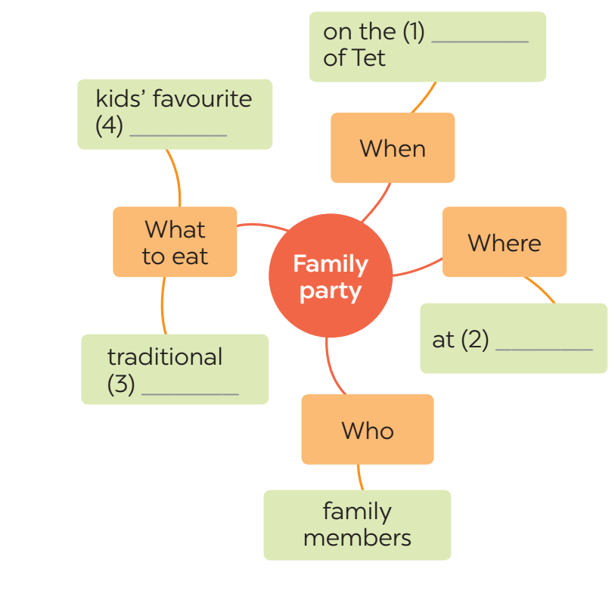
READING
3
Read the text again. Complete the mind map about a family party.
third day
food
home
dishes

Slide 14
SPEAKING
4
Work in pairs. Put the questions (A - E) in the correct blanks (1 - 5) to make a complete dialogue. Then role-play it.
Nick: (1) ______ Lan: Well, I join birthday parties of all my family members. Nick: (2) ______ Lan: In a Vietnamese restaurant. But sometimes we break with tradition by going to a Western one. Nick: (3) ______ Lan: Everyone in my family.
Nick: (4) ______ Lan: Well, the birthday person opens the gifts. and everyone has some good food. Nick: (5) ______ Lan: Yes, I always look forward to them. They are a great time for family bonding.

Slide 15
SPEAKING
5
Make notes about a normal family event that you take part in. Use the questions below as cues.
1. What is the event?
2. Where and when does it happen?
3. Who joins with you?
4. What do you often do at that event?
5. Do you like it or not? Why or why not?
Full Moon Festival
Now work in pairs. Make a dialogue asking and answering about the event. You can use your notes.
On the 15th day of the 8th Lunar Month in Asia
My family, my friends,…
Eat moon cake, hang lantern....
Yes, I do. Because I can celebrate it with my family.

Slide 16
CONSOLIDATION
1
Wrap-up
+ Reading:
Read for specific information about a village festival day.
+ Speaking:
Talk about a family event.

Slide 17
CONSOLIDATION
2
Homework
Do exercises in the workbook.

Slide 18
Website: hoclieu.vn
Fanpage: facebook.com/www.tienganhglobalsuccess.vn/

