Slide 1

Unit 5: Travel & Transportation
Progress Check
Page 92

Slide 2
Lesson Outline
Warm-up
Vocabulary
Grammar
Listening
Consolidation
Wrap-up

Slide 3
Objectives
By the end of this lesson, students will be able to…
consolidate vocabulary and grammar learnt throughout the unit.
practise everyday English.

Slide 4

WARM-UP

Slide 5

Work in pairs.
Choose the word whose main stress is placed
differently from the others.
1. A. support B. collect C. include D. finish
2. A. cathedral B. countryside C. ambulance D. balcony
3. A. popular B. impatient C. generous D. talkative
/səˈpɔːt/
/kəˈlekt/
/ɪnˈkluːd/
/ˈfɪnɪʃ/
/kəˈθiːdrəl/
/ˈkʌntrisaɪd/
/ˈæmbjələns/
/ˈbælkəni/
/ˈpɑːpjələr/
/ɪmˈpeɪʃnt/
/ˈdʒenərəs/
/ˈtɔːkətɪv/
Notes:
Celebration
gates bank
floor soon
great

Slide 6
Teacher invites some students to the front of the class. Each student invited will take turns acting out a new word in Unit 5 provided by the teacher (e.g. statue, guard, truck, etc.). Their classmates try to guess what it is. Teacher rewards 1 point for the student with correct answer, and 1 point for the person who acts out the word.
In the end, who gets more points is the winner.

Slide 7

It’s time to learn …

Slide 8
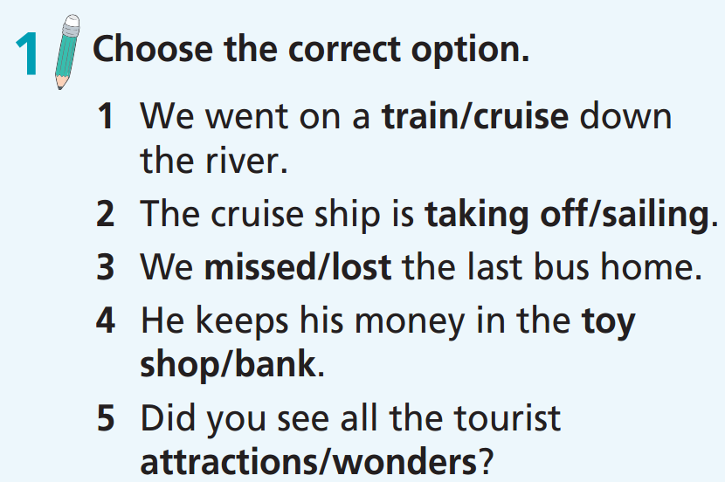

Slide 9
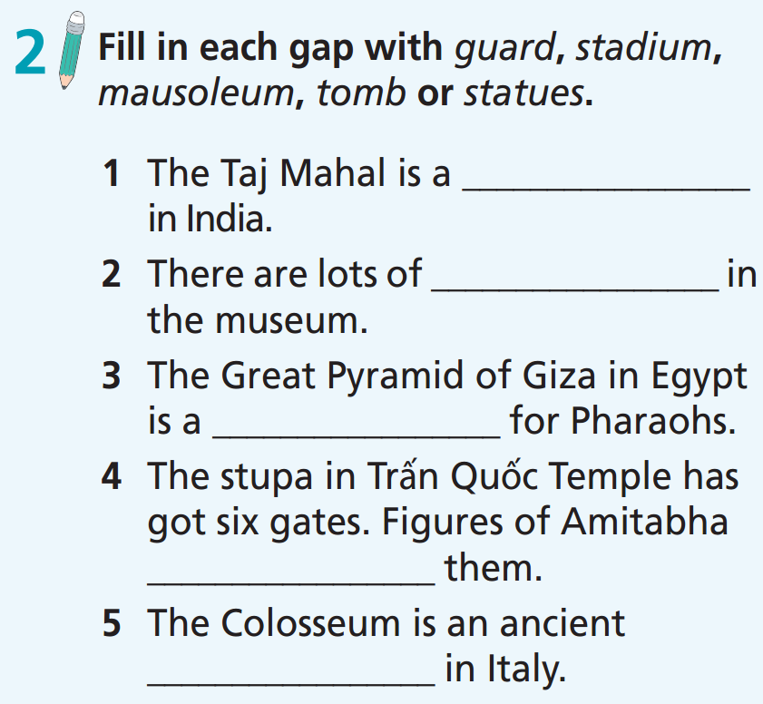
mausoleum
statues
tomb
guard
stadium

Slide 10
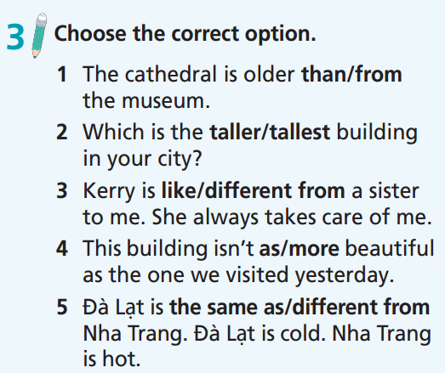

Slide 11
4 Complete the gaps with the correct comparative or superlative forms of the adjectives in brackets.
1. Spain is _________________ (sunny) country in Europe.
2. This year, 21st December will be ________________ (short) day of the year.
3. Their new house is _________________ (large) than their old house.
4. Ho Chi Minh City is _________________ (crowded) than Đà Nẵng.
5. I thought Barcelona was as __________________ (beautiful) as Rome.
6. I think summer is _________________ (good) time of year to visit Croatia.
7. A holiday in the countryside is_________________ (relaxing) than one in the city.
8. It’s _________________ (easy) to book ﬂights online than going to a travel agent.
9. Which is _________________ (popular) restaurant in the town?
10. Dubai is much _________________ (hot) than Hanoi.
the sunniest
the shortest
larger
more crowded
beautiful
the best
more relaxing
easier
the most popular
hotter

Slide 12

Listening

Slide 13

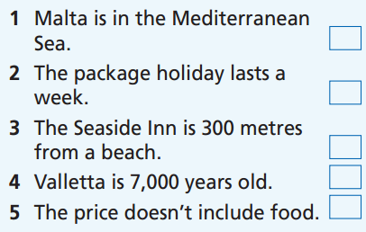
Pre-Listening
Read the instruction quickly. Underline the key words.

Slide 14


While-Listening
Now listen and choose the correct answer.  FIRST TIME
☞ YOUR ANSWER?
R
W
W
R
W
☞ WHY?

Slide 15


Now listen again and check.  SECOND TIME
Malta is a beautiful island in the Mediterranean Sea, and we’re offering a two-week package holiday there!
R
W

Slide 16

Now listen again and check.  SECOND TIME
Your hotel is the Seaside Inn. It’s only 100 metres from a beach where you can go swimming, snorkelling and diving!
W

Slide 17
Now listen again and check.  SECOND TIME
And the hotel is just 15 kilometres from the capital city
Valletta. There you can visit museums and see old stone buildings from its 7,000-year history!
R

Slide 18
Now listen again and check.  SECOND TIME
This holiday includes ﬂights, your hotel room and one
meal a day – all this for just £1,250 per person!
W

Slide 19
Now listen again and choose one word to fill
in each gap.
Extra Practice
beach * flights * museums * island * country * city * temples
island
Malta is a beautiful ………………… in the Mediterranean Sea.
The weather is often nice in Malta. Your hotel is only 100 metres from a …………………, and 15 kilometres from the capital ………………… Valletta. There you can visit ………………… and see old stone buildings. This holiday includes …………………, your hotel room and one meal a day – all this for just £1,250 per person!
beach
city
museums
flights

Slide 20
Now listen again and check.
Malta is a beautiful island in the Mediterranean Sea, and we’re offering a two-week package holiday there! Malta gets over 300 sunny days a year, so you’re sure to get nice weather! Your hotel is the Seaside Inn. It’s only 100 metres from a beach where you can go swimming, snorkelling and diving! And the hotel is just 15 kilometres from the capital city Valletta. There you can visit museums and see old stone buildings from its 7,000-year history! This holiday includes ﬂights, your hotel room and one meal a day.
island
Malta is a beautiful ………………… in the Mediterranean Sea. The weather is often nice in Malta. Your hotel is only 100 metres from a …………………, and 15 kilometres from the capital …………………Valletta. There you can visit ………………… and see old stone buildings. This holiday includes …………………, your hotel room and one meal a day – all this for just £1,250 per person!
beach
city
museums
flights

Slide 21
Audio Scripts
Practise presenting this.
Hello, everyone. I’m Perry Baker from the Sunset Travel Agency – the best travel agency in town! We’ve got a great deal for you this summer! Malta
is a beautiful island in the Mediterranean Sea, and we’re offering a two-week package holiday there! Malta gets over 300 sunny days a year, so you’re
sure to get nice weather! Your hotel is the Seaside Inn. It’s only 100 metres from a beach where you can go swimming, snorkelling and diving! And the hotel is just 15 kilometres from the capital city Valletta. There you can visit museums and see old stone buildings from its 7,000-year history! This holiday includes ﬂights, your hotel room and one meal a day – all this for just £1,250 per person! This is a chance you don’t want to miss!

Slide 22

Post-Listening
Work in pairs
Do you prefer a package tour or making your trip?
I prefer making my trip because it gives you more freedom. You can travel anywhere and any time you want.

Slide 23

WRAP-UP

Slide 24
Today’s lesson
Consolidate vocabulary and grammar learnt throughout the unit.
Practise everyday English.
Practise test taking skills.

Slide 25
Homework
Prepare the next lesson (page 93 SB)
Do Test 1 in Bài Tập Bổ Trợ TA 7 Right on (pages 42 - 45)

Slide 26

Enjoy your day!

