Slide 1

Unit 5: London Was Great!
Lesson 5b: Grammar
Page 90

Slide 2
Lesson Outline
Warm-up
Grammar
Consolidation
Wrap-up

Slide 3
Objectives
By the end of this lesson, students will be able to…
- learn and practise the Past Simple of the verb to be.
- learn and practise the Past Simple (affirmative &
negative) of regular verbs.
- learn and practise the spelling rules of the Past
Simple for regular verbs.

Slide 4

WARM-UP

Slide 5

Work in pairs.
Choose the word whose underlined part is
pronounced differently from that of the other words.
a. sofa b. cozy c. long d. old
a. mum b. husband c. funny d. museum
a. thin b. kind c. chimney d. crisp
a. onion b. row c. cold d. snow

Slide 6
Work in pairs.
Choose the word whose underlined part is
pronounced differently from that of the other words.
a. sofa b. cozy c. long d. old
/ˈsəʊfə/ /ˈkəʊzi/ /lɒŋ/ /əʊld/
2. a. mum b. husband c. funny d. museum
/mʌm/ /ˈhʌzbənd/ /ˈfʌni/ /mjuˈziːəm/
3. a. thin b. kind c. chimney d. crisp
/θɪn/ /kaɪnd/ /ˈtʃɪmni/ /krɪsp/
4. a. onion b. row c. cold d. snow
/ˈʌnjən/ /rəʊ/ /kəʊld/ /snəʊ/

Slide 7
Put the correct sentence into the correct column:
I get up at 6 a.m. I got up at 9 a.m.
I arrived at school at 7.am. I have rice and drink milk for breakfast.
She watched cartoon with her sister. He goes to school with his dad.
Usually | Yesterday
I get up at 6 a.m.
I got up at 9 a.m.
Past Simple
I have rice and drink milk for breakfast.
I arrived at school at 7.am.
He goes to school with his dad.
She watched cartoon with her sister.

Slide 8

It’s time to learn …

Slide 9

Presentation

Slide 10
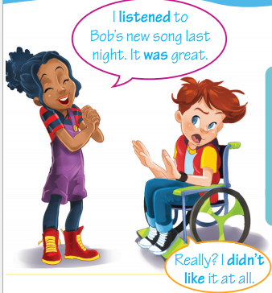
Last week, before class, last year, last night, last weekend, in 1998, …
past
Today
What day was it yesterday?
What day will it be tomorrow?
What day is it today?

Slide 11
He was at home yesterday.
Questions:
was/were + S
He wasn’t at home yesterday.
Was he at home yesterday?
They were at home yesterday.
Negative form:
S + was not (wasn’t)/ S + were not (weren’t)
They weren’t at home yesterday.
Were they at home yesterday?

Slide 12
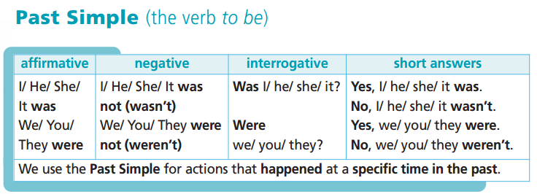

Slide 13
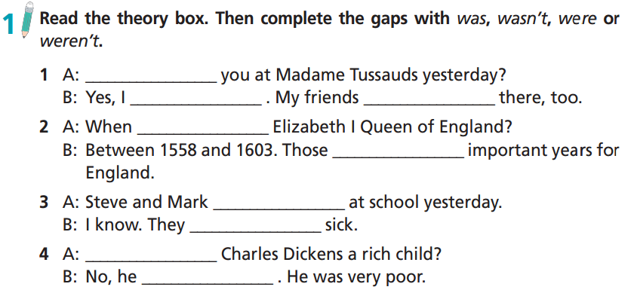
Were
was
were
was
were
weren’t
were
Was
wasn’t

Slide 14
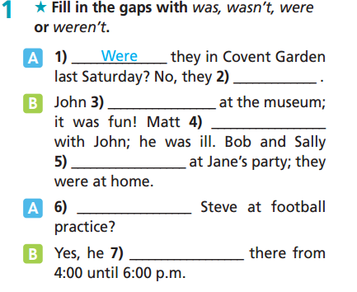
Extra-practice
WB-p. 45
weren’t
was
wasn’t
weren’t
Was
was

Slide 15
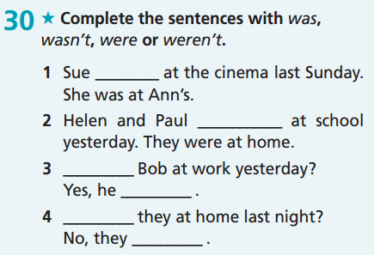
Extra-practice
GB-p. 70
wasn’t
weren’t
Was
was
Were
weren’t

Slide 16
Complete the answer with your own idea:
Where were you yesterday?
→ I was …………………………………..
2. Who was with you?
→ I was with ………………………….
3. Were you happy yesterday?
→ ………………………………………..
4. Where was your mum yesterday?
→ She was ……………………………….
5. Were you at school yesterday?
→ ……………………………………………..

Slide 17
I arrived at school at 7.am yesterday.
I didn’t arrive at school at 7.a.m yesterday.
She watched a cartoon with her sister last night.
She didn’t watch a cartoon with her sister last night
Complete the rules.
-ed
- regular verbs: verbs take ______ to form their Past Simple form.
- to form the negative of the Past Simple: S + _________________
did not/didn’t + V-inf

Slide 18
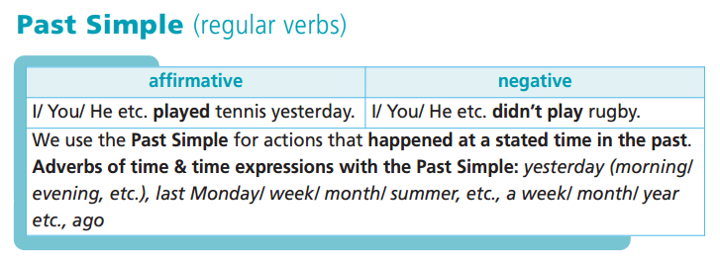

Slide 19
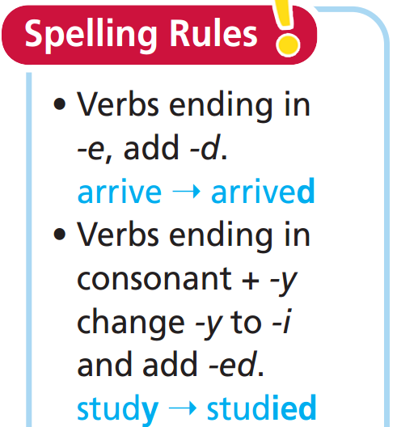
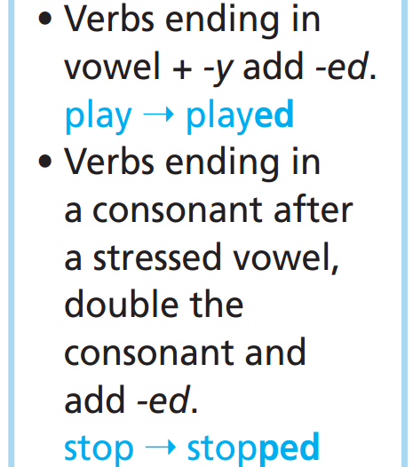
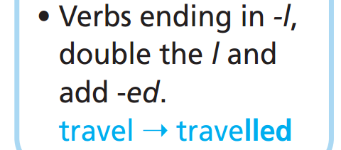

Slide 20
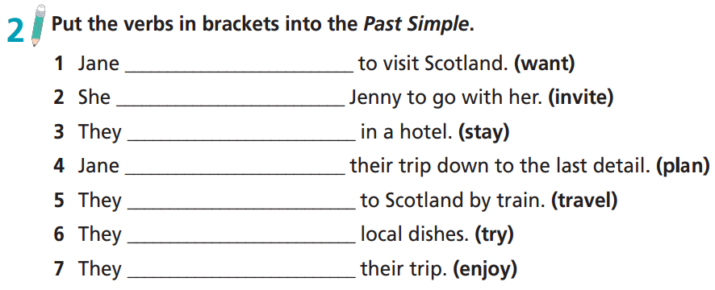
wanted
invited
stayed
planned
travelled
tried
enjoyed

Slide 21
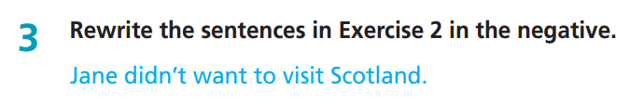

Slide 22
2. She invited Jenny to go with her. (invite)
She didn’t invite Jenny to go with her.
3. They stayed in a hotel. (stay)
They didn’t stay in a hotel.
4. Jane planned their trip down to the last detail. (plan)
Jane didn’t plan their trip down to the last detail.
5. They travelled to Scotland by train. (travel)
They didn’t travel to Scotland by train.
6. They tried local dishes. (try)
They didn’t try local dishes.
7. They enjoyed their trip. (enjoy)
They didn’t enjoy their trip.

Slide 23
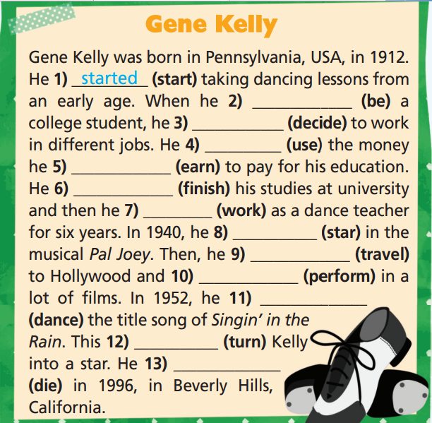

Extra-practice
GB-p.70
was
decided
used
earned
finished
worked
starred
travelled
performed
danced
turned
died

Slide 24
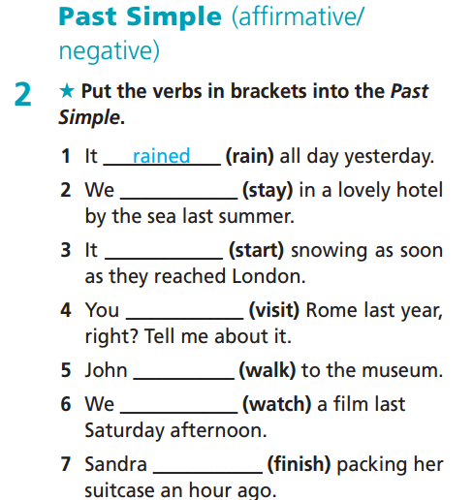
Extra-practice
WB-p.45
stayed
started
visited
walked
watched
finished

Slide 25
Correct the mistakes in the following sentences:
invite
She didn’t invited her friend to the party.
He decideed to work different jobs to earn money.
My mother stoped to buy some flowers.
They wasn’t at the museum yesterday.
Do you play in the park last week?
Last night, my mother arrives home very late.
decided
stopped
weren’t
Did
arrived

Slide 26
Work in pairs. Complete the following sentences with your own idea.
Yesterday, I watched …………………………………………….
We didn’t study …………………………………….. yesterday.
We didn’t play ……………………………………. yesterday.
I walked to ……………………………………….. last Sunday.
My family visited ……………………………….. last summer.

Slide 27

CONSOLIDATION

Slide 28
Write some sentences about your activities for yesterday. Try to use Past Simple of “be” and regular verbs both in affirmative and negative form.
Yesterday, I was ………………… (where) with ………… I ………. (activities: play/watch/ study/etc.). I was ……………… (feeling).

Slide 29

WRAP-UP

Slide 30
Today’s lesson
Grammar
- Learn and practise the Past Simple of the verb to be.
- Learn and practise the Past Simple (affirmative &
negative) of regular verbs.
- Learn and practise the spelling rules of the Past
Simple for regular verbs.

Slide 31
Homework
Practise the grammar point and make sentences using them.
Do the exercises in TA 6 Right on WB (p. 45).
Complete the grammar notes in TA 6 Right on Notebook (p. 48).
Prepare for the next lesson (p. 91 SB).

Slide 32

Enjoy your day!

