Slide 1

Unit 5: Sports and hobbies
P.E. Lesson 4.3
Page 79

Slide 2
Lesson Outline
Warm-up
Reading
Writing
Consolidation
Wrap-up

Slide 3
Objectives
By the end of this lesson, students will be able to talk about what they can use and what they can do / can’t do in some sports, using
Vocabulary: hand, arm, foot/feet, leg, head, body
Structure:
I use my legs and feet in soccer.
I can kick the ball in soccer.
I can't kick the ball in basketball.

Slide 4

WARM UP

Slide 5

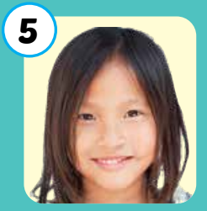
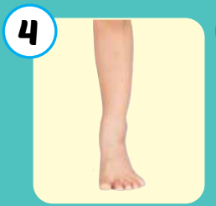

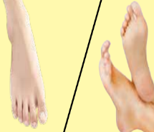
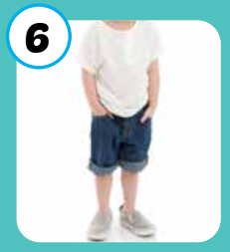
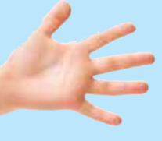
1
2
3
4
Click on the square to see the picture
5
6
7
8
Click on the button to close the picture
9
10
11
12
Notes:
Memory game. GV nhấn vào ô để mở, nếu HS chọn 2 hình không giống nhau, GV nhấn vào hình tròn để đóng hình lại, HS phải nhớ những hình đã mở.

Slide 6

It’s time to learn …

Slide 7

Reading

Slide 8
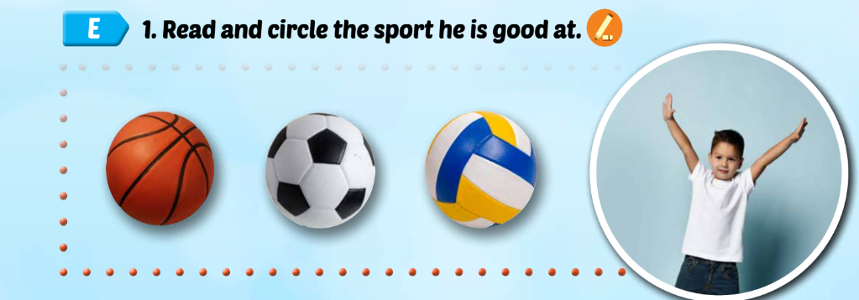


My favorite sport is basketball. I am good at playing basketball. I use my hands and arms. I can catch and throw the ball in basketball. I can’t kick the ball.

Slide 9

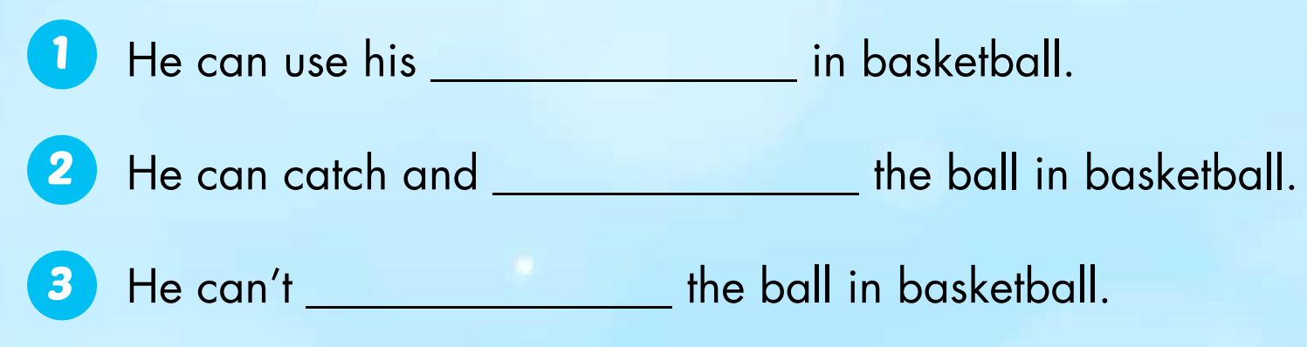
hands and arms
throw
kick

Slide 10

Writing

Slide 11

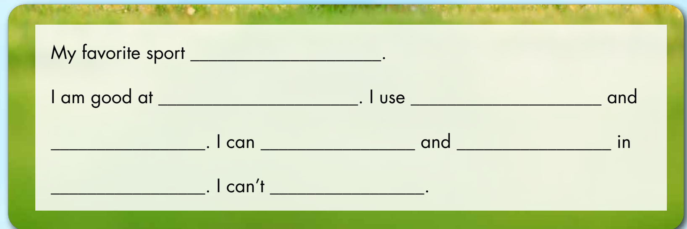

Slide 12

Production

Slide 13
1. Divide the class into fours.
2. Have students read their sentences to their group.
3. Afterwards, have some students read their sentences in front of the class.

Slide 14
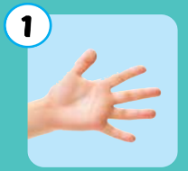
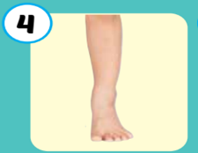

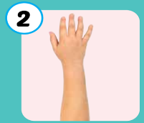

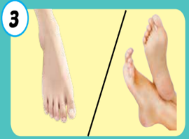
Practice writing sentences.
I use my ____in ____.
6
1
SPIN
5
2
4
3
Notes:
GV dùng vòng quay để HS chọn số ngẫu nhiên. Khi chọn vào ô số nào thì sẽ làm câu cho số đó

Slide 15

CONSOLIDATION

Slide 16
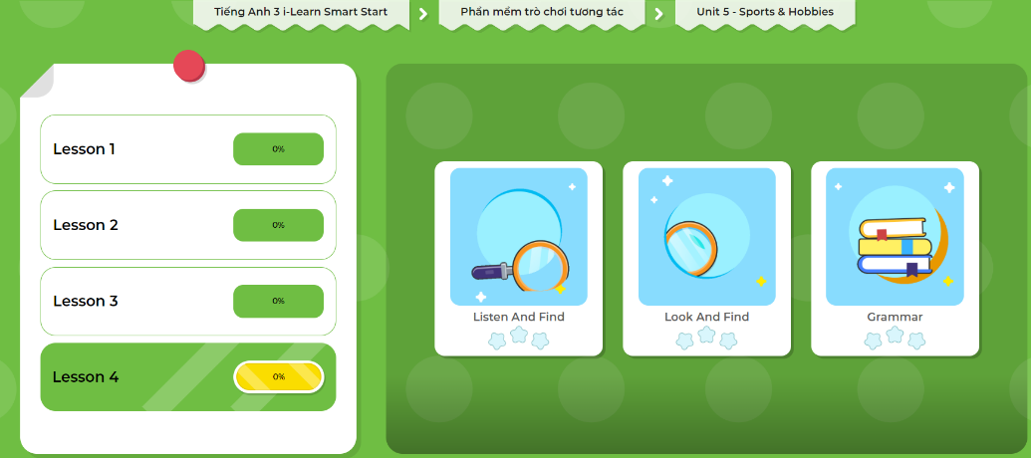
LET’S PLAY!
Click here to play the games.

Slide 17
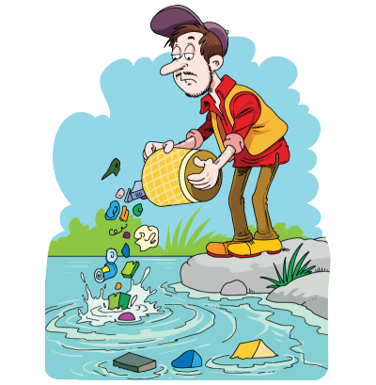
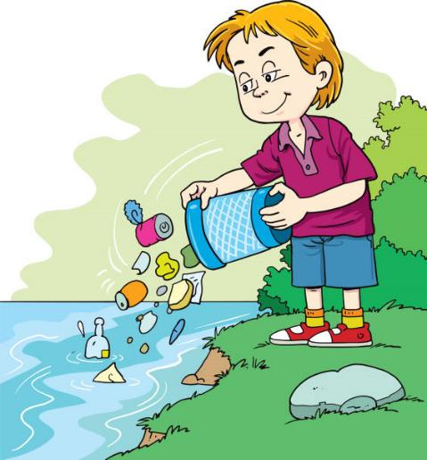
Clean up trash by answering questions correctly ☺

Slide 18





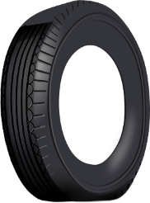




Clean up
the ocean

Slide 19



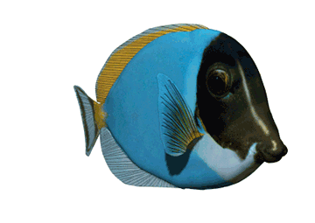










1
end
3
4
2
Rewrite the sentences
6
8
5
7

Slide 20



favorite/My/is/soccer/sport
My favorite sport is soccer.
Back

Slide 21
good/am/at/ basketball./ I/playing
I am good at playing basketball.
Back

Slide 22
my/use/ and/ I / hands/arms.
I use my hands
and arms.
Back

Slide 23
throw/ can/ I / basketball./ catch/ the ball/ and/ in
I can catch and throw the ball in basketball.
Back

Slide 24
can’t/ I/ the ball / kick
I can’t kick the ball.
Back

Slide 25
you/ Can/ your/ use /head /volleyball?/ in
Can you use your head in volleyball?
Back

Slide 26
can/ You/the ball/ soccer/ kick/ in
You can kick the ball in soccer.
Back

Slide 27
legs/ You/ use/ and/ your feet in/soccer
You use your legs and feet in soccer.
Back

Slide 28

WRAP-UP

Slide 29
Today’s lesson
Vocabularies
hand
arm
foot/feet
leg, head
body
Structures/ Sentence patterns
I use my legs and feet in soccer.
I can kick the ball in soccer.
I can't kick the ball in basketball.

Slide 30
Homework
Practice vocabularies and structure. Make sentences using them.
Do the exercises in Tiếng Anh 3 i-Learn Smart Start Workbook (page 55)
Do the exercises in Tiếng Anh 3 i-Learn Smart Start Notebook (page 37)
Play the consolidation games in Tiếng Anh 3 i-Learn Smart Start DHA App on www.eduhome.com.vn
Prepare the next lesson (page 80)

Slide 31

Have a nice day!

