Slide 1


Slide 2
Unit
10
The ecosystem
Unit
FAMILY LIFE
LESSON 2
LANGUAGE

Slide 3
LESSON 2
LANGUAGE
WARM-UP
Categorising game
PRONUNCIATION
Task 1: Listen and practise.
Task 2: Listen and mark the intonation.
Task 1: Match the words/phrase with their meanings.
Task 2: Complete the sentences.
VOCABULARY
Task 1: Make five compound nouns.
Task 2. Use the words to make compound nouns. Then make sentences with them.
GRAMMAR
CONSOLIDATION
Wrap-up
Homework

Slide 4
WARM-UP
CATEGORISING GAME
- Work in groups.
- Put plants and animals into correct categories.
- The first team to complete the task correctly is the winner.
- The winners go to the board and show the correct answers.

Slide 5
WARM-UP
Put plants and animals into correct categories.
salmon parrot ant wasp dolphin
human butterfly mushroom cactus palm
squirrel daisy bamboo oak deer
lobster peacock eagle hedgehog marigold
orchid owl daffodil squid oyster
bat seagull crow snail beetle
worm poopy lily seaweed trout octopus
Mammals | Birds | Insects and invertebrates | Flowers | Trees and other plants | Sea and river creatures

Slide 6
WARM-UP
Put plants and animals into correct categories.
Mammals | Birds | Insects and invertebrates | Flowers | Trees and other plants | Sea and river creatures
human squirrel hedgehog deer bat dolphin | seagull crow owl eagle peacock parrot | wasp butterfly snail beetle worm ant | marigold orchid daffodil poppy lily daisy | cactus palm bamboo oak seaweed mushroom | lobster squid trout octopus oyster salmon

Slide 7


PRONUNCIATION
1
Listen to these conversations. Pay attention to the intonation of the question tags. Then practise saying them in pairs
1. A: So we need to protect local ecosystems, don’t we?
B: Yes, we do.
2. A: You'll take the books back to the library, won’t you?
B: OK, I’ll do that tomorrow.
3. A: We don’t want our planet to lose biodiversity, do we?
B: No, we don’t.
4. A: An ecosystem is a community of living things, isn’t it?
B: No, it isn’t. It’s a community of both living and non-living things.
5. A: You went to Cuc Phuong National Park last weekend, didn’t you?
B: Yes, I did.

Slide 8
PRONUNCIATION
2
Mark the intonation in the question tags.
1. A: Sorry, I didn’t hear my alarm this morning.
B: So you were late again, weren’t you?
2. A: I couldn’t watch the match last night. We won, didn’t we?
B: Yes, we did.
3. A: There are several ecosystems that can be found in Viet Nam.
B: Yes. Viet Nam is biologically diverse, isn’t it?
4. A: We are running out of fossil fuels, aren’t we?
B: Yes, we are. We should find more alternative sources of energy.
5. A: People should stop damaging the environment, shouldn’t they?
B: Yes, I agree with you.

Slide 9
VOCABULARY
1
Match the words with their meanings.
native (adj)
tropical forest (np)
species (n)
conservation (n)
mammal (n)
a group of animals or plants that have similar characteristics
the protection of the natural environment
any animal that gives birth to live young, not eggs, and feeds its young on milk
thick forest that grows in the hot parts of the world
existing naturally in a place

Slide 10
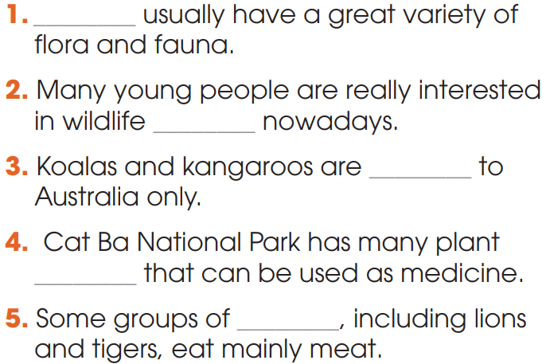
VOCABULARY
2
Complete the sentences using the words in Task 1.
1. Tropical forests
2. conservation
3. native
4. species
5. mammals

Slide 11
GRAMMAR
A compound noun is a noun that is made with two or more words. It is usually formed by:
1. noun + noun | E.g: bus stop
2. adj + noun | E.g: wildlife
3. V-ing + noun | E.g: washing machine
4. noun + V-ing | E.g: film-making
5. verb + preposition | E.g: break-out

Slide 12
GRAMMAR
1
Use the words in the box to make five compound nouns.
endangered nature life rain
vocational species reserve
expectancy forest school
endangered species
nature reserve
life expectancy
vocational school
rainforest

Slide 13
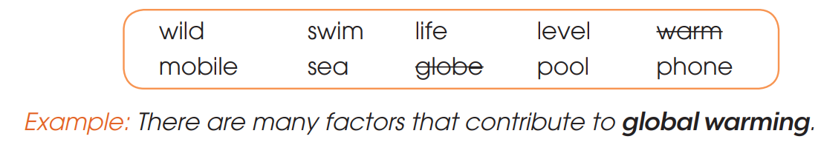
GRAMMAR
2
Work in pairs. Use the words in the box to make compound nouns. Then make sentences with them.
2. wildlife (Wildlife helps maintain ecological balance and biodiversity.)
3. sea level (Sea level rise is caused primarily by two factors related to global warming.)
4. swimming pool (The resort is famous for its amazing swimming pools.)
5. mobile phone (Mobile phones are used for a variety of purposes.)

Slide 14
CONSOLIDATION
1
Wrap-up
What have you learnt today?
Some lexical items about the ecosystem;
Intonation in question tags;
Compound nouns.

Slide 15
CONSOLIDATION
2
Homework
Do exercises in the workbook.
Prepare for Lesson 3 - Unit 10.

Slide 16

Website: hoclieu.vn
Fanpage: facebook.com/sachmem.vn/
Website: hoclieu.vn
Fanpage: facebook.com/www.tienganhglobalsuccess.vn

