Slide 2


Unit
11
ELECTRONIC DEVICES
LESSON 7: LOOKING BACK & PROJECT
1

Slide 3
LESSON 6: SKILLS 2
LESSON 1: GETTING STARTED
WARM-UP
Warm up: Brainstorming
- Task 1: Write the name of an electronic device under each picture.
- Task 2: Complete the sentences with the words from the box.
VOCABULARY
- Task 3: Choose the correct answer A, B, C, or D.
- Task 4: Fill in each blank with the correct form of the verb in brackets.
GRAMMAR
Projects
Wrap-up
Homework
PROJECT &
CONCOLIDATION

Slide 4
WARM-UP
Write as many electronic devices as possible
BRAIN
STORMING

Slide 5
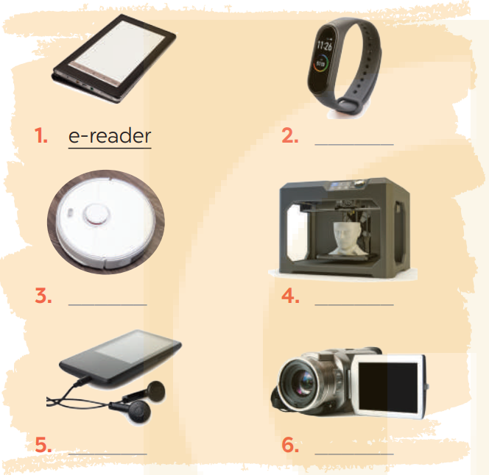
VOCABULARY
1
Write the name of an electronic device under each picture.
smartwatch

Slide 6
VOCABULARY
1
Write the name of an electronic device under each picture.
robotic vacuum cleaner
3D printer

Slide 7
VOCABULARY
1
Write the name of an electronic device under each picture.
portable music player
camcorder

Slide 8
VOCABULARY
2
Complete the sentences with the words from the box.
copper
1. We often use ________________ to make power lines and electrical wires because it is a good conductor of electricity.
2. I can adjust the text size and font to suit my reading preferences on my ________________.
3. My ________________ can track my physical activity, heart rate, and sleep patterns, so it can help me monitor my overall health and fitness.
4. We often use ________________ to make toys for children because it’s durable, lightweight, and easy to mold into different shapes.
5. If I need a replacement part for a machine or device, I can use my ________________ to create a new one that is a perfect fit.
e-reader
smartwatch
plastic
3D printer

Slide 9
GRAMMAR
3
Choose the correct answer A, B, C, or D.
1. My teacher advised I ______ harder to pass the exam.
A. studies B. study C. studying D. to study
2. The professor suggested he ______ the research before March.
A. submit B. submitting C. submits D. would submit
3. Her leader suggested ______ on time.
A. be B. being C. is D. to be
4. Linh recommended that Nam ______ a new e-reader.
A. should buy B. bought C. buying D. will buy
5. The coaches advised that we ______ a Facebook group.
A. creating B. created C. to create D. create

Slide 10
GRAMMAR
4
Fill in each blank with the correct form of the verb in brackets
1. I recommend that you (reduce) _____________ your screentime.
2. It’s so cold outside. We suggest (close) _____________ the window.
3. My teacher advised that I (look) __________ for a part-time job to earn more money.
4. Henry has recommended (choose) _____________ a better smartwatch for your dad.
5. The government advised (travel) _______________ by bus to reduce environmental pollution.
(should) reduce
closing
(should) look
choosing
travelling

Slide 11

PROJECT

Slide 12

CONSOLIDATION
1
Wrap-up
What have we learnt in this lesson?
Review the vocabulary and grammar of Unit 11
Apply what they have learnt (vocabulary and grammar) into practice through a project.

Slide 13

CONSOLIDATION
2
Homework
- Do exercises in the Workbook.
- Prepare for the next lesson

Slide 14
Website: hoclieu.vn
Fanpage: facebook.com/www.tienganhglobalsuccess.vn/

