Slide 1


Welcome to our class

Slide 2
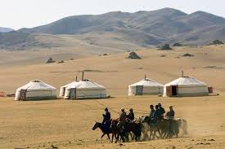
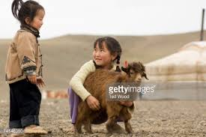
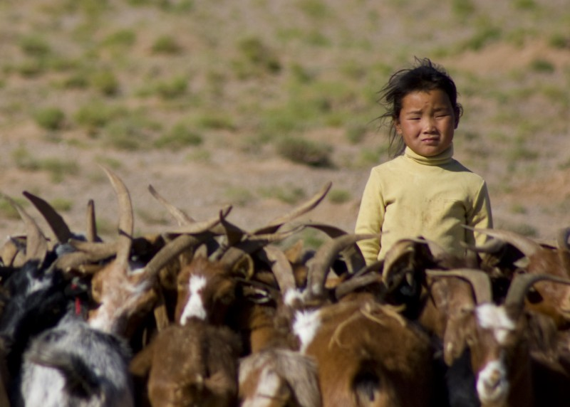
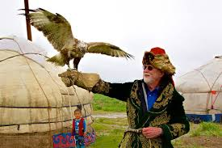
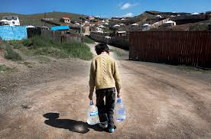
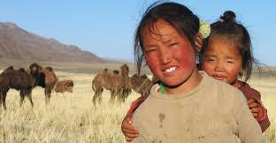
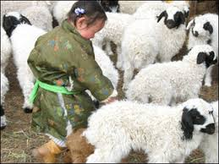

Slide 3
What have you seen in the pictures?
What place is this?
Where is it?
What is the life? Who are the people?

Slide 4
English 8
UNIT 2 . LIFE IN THE COUNTRYSISE
PERIOD 13: SKILLS 1

Slide 5

A. Reading : 1. Quickly read the passage and choose the most suitable heading A, B, or C for each paragraph.
A. Nomadic children’s lives B. The importance of cattle to the nomads C. The nomads’ home
NOMADIC LIFE ON THE
GOBI HIGHLANDS
B. The importance of cattle to the nomads
1. ________________________________________ We don’t live a normal life like many other people. We live a nomadic life. This means we move two or three times a year to look for new pastures - grasslands - for our cattle. The cattle provide most of our needs: dairy products, meat, and clothing.
2. ______________________________________ We live in a ger, our traditional circular tent. It keeps us cool in summer and warm in winter, even when the temperature drops to -50°C. It can be put up then taken down and transported.
3. ______________________________________
For most of the year, we are surrounded by vast pastures, rivers and mountains. We see few people from the outside world. When we are small, we play on our land and with the animals. The horse is our best friend. Any nomadic child can ride a horse. We learn from an early age to help in the family, from household chores to heavier work like herding the cattle. We also learn to be brave.
C. The nomads’ home
A. Nomadic children’s lives

Slide 6
2. Match the descriptions with the words/ phrases from the passage.
Words/ Phrases | Descriptions
a ger dairy products cattle nomadic life pastures | a life on the move a circular tent in which Mongolian nomads live grasslands milk, butter, cheese cows, goats, buffaloes ...

Slide 7
3. Read the passage again and choose the best answer A, B, C, or D.
1. We live __________ other people.
A. a different life to
B. similarly to
C. the same life as
in exactly the same way as
2. We have to move in order to __________.
A. change our lifestyle
B. look for better weather
C. look for food for our cattle
be closer to the city
3. Our cattle can provide us with __________.
A. most of our needs
B. food only
C. means of transport only
anything we want
We don’t live a normal life like many other people.
This means we move two or three times a year to look for new pastures - grasslands - for our cattle.
The cattle provide most of our needs: dairy products, meat, and clothing.

Slide 8
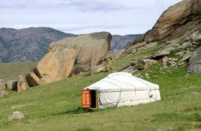
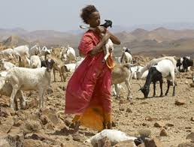
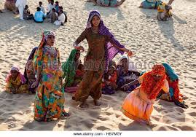
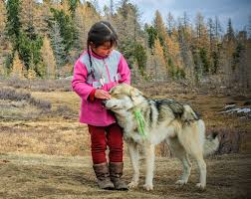
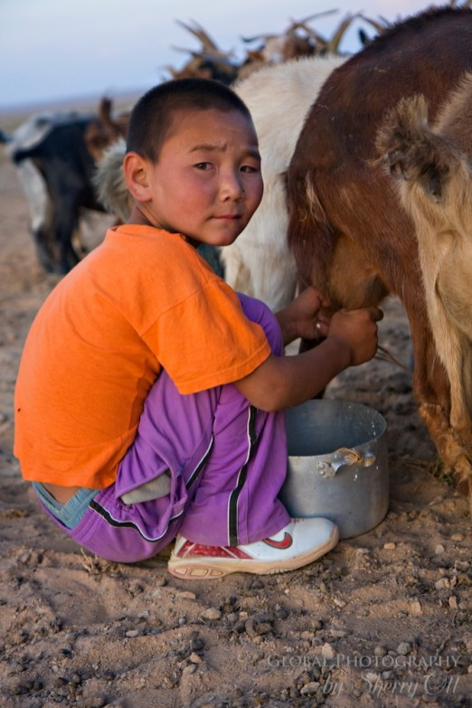
It can be put up then taken down and transported.
4. When we move to a new place, we __________.
A. have to make a new ger
B. put up the ger
C. buy a new ger
share a ger with our neighbours
5. Nomadic children __________.
A. play the same games as other children in the world
B. use nature and their animals as playthings
C. do not like toys
spend all their time helping with housework
6. Mongolian children in the Gobi learn __________.
A. to ride a goat
B. to live in the mountains
C. to be generous
D. to help with household chores
It keeps us cool in summer and warm in summer.

Slide 9
speaking
4. Work in pairs: Interview your partner to find out what he/ she likes/ doesn’t like about the life of the nomads.
I like ….. | I don’t like ……
Example:
A: What do you like about their nomadic life?
B: Well, the children learn to ride a horse.
A: And what don’t you like about it?
B: They can’t live permanently in one place.
Children learn to ride a horse
It’s very hot in summer and very cold in winter
Children play on vast pastures
* Imagine you are a nomadic child. Shortly tell us about your life in Gobi highlands.
Start like this:
I am a nomad in Gobi Highlands ………..

Slide 10
a horse
a camel
a tent
a pole
ride
put up
the buffaloes
the cattle
hay
water
herd
collect
wild flowers
apples
pick

Slide 11
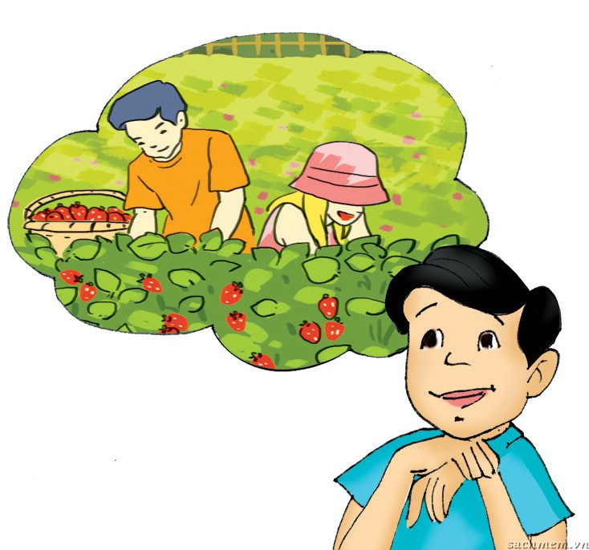
5a. Work in pairs. Discuss and find.
- two things you like about life in the countryside
- two things you don’t like about life in the countryside
I like ….. | I don’t like …… | Because …….
Picking fruit in the summer
Hard work but satisfying
Swimming in the river
Dangerous
5b. Report your findings to the class.
Example:
Both of us love picking fruit in the summer.
It can be hard work but very satisfying.

Slide 12
HOMEWORK
Copy down & Learn by heart the new words.
Be ready for SKILLS 2.
Prepare for Project: I love the countryside
* Draw a picture of a place you would like to live in the countryside
- the things you have in your picture
→ TALK ABOUT the activities you can do there
Example:
▪ a wooden house ▪ a beautiful river ▪ a boat ▪ a field of wild flowers
▪ biking along the river ▪ picking wild flowers
▪ swimming in the river ▪ boating on the river

Slide 13


