Slide 2
LOOKING BACK and PROJECT
Unit
5
GLOBAL WARMING
Unit
FAMILY LIFE
LESSON 8
Student Book – page 60 + 61

Slide 3
LESSON 8
LOOKING BACK AND PROJECT
WARM-UP
Quiz
Pronunciation: Underline the stressed words.
Vocabulary: Choose the correct word or phrase
Grammar: Rewrite the sentences.
LOOKING BACK
PROJECT
What we can do every day to help limit global warming.
CONSOLIDATION
Wrap up
Homework

Slide 4
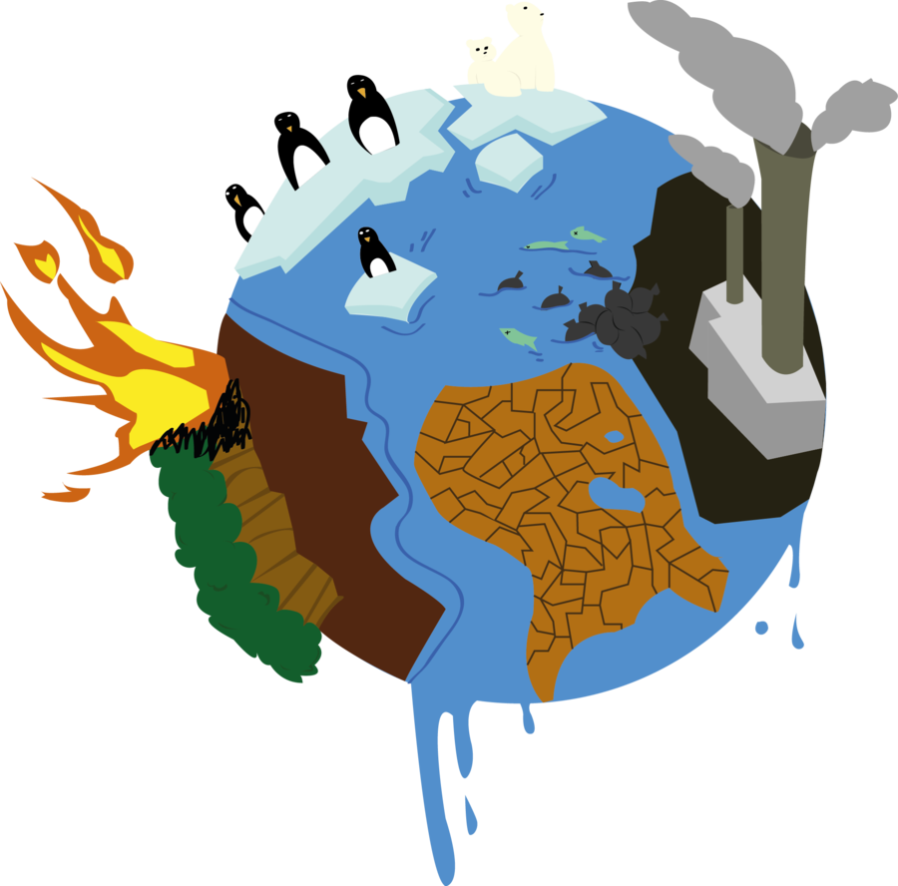
WARM-UP
Climate Change Quiz

Slide 5
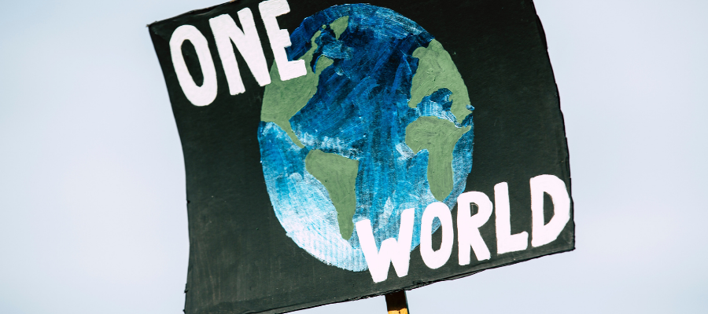
1/ True or False: The overwhelming majority of scientists agree that climate change is real and caused by humans.
True
False

Slide 6
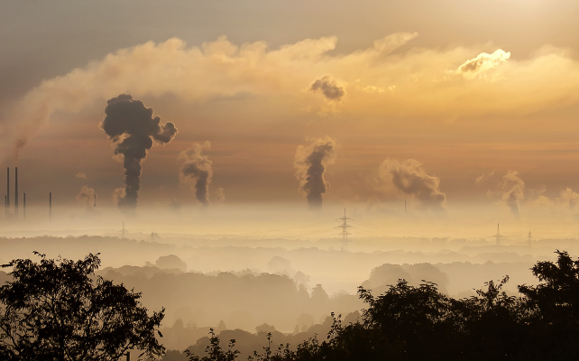
2/ Which of these countries emits the most carbon dioxide?
USA
UK
China
Russia

Slide 7
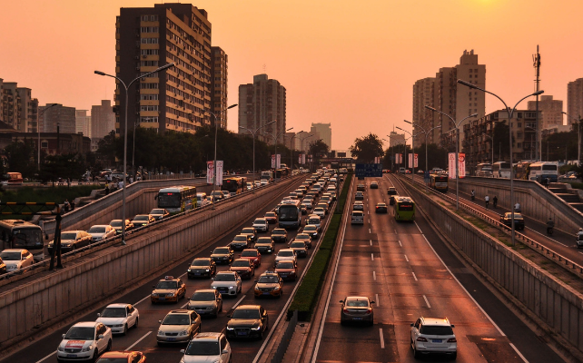
3/ What percentage of the global greenhouse gas emissions does the transportation sector emit?
1%
14%
33%
70%

Slide 8
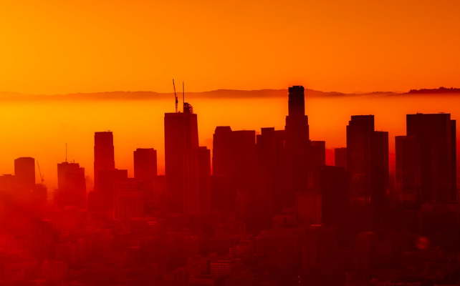
4/ Globally, which of the following economic sectors emits the largest percentage of greenhouse gas emissions?
Transportation
Buildings
Industry
Electricity & heat production

Slide 9
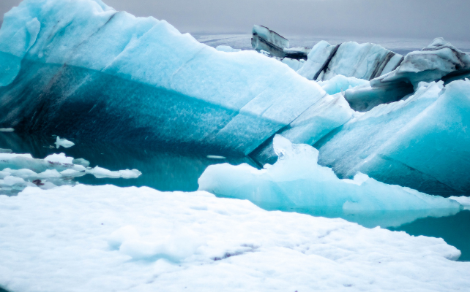
5/ Which has been the hottest year on record?
2016
2020
2023
All of the above

Slide 10
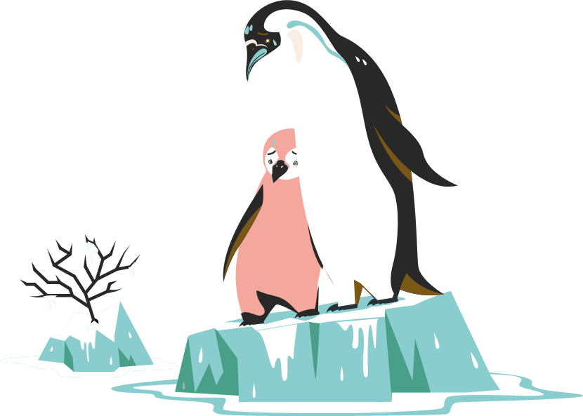
PRONUNCIATION
Listen and underline the stressed words. Then practise saying the sentences with a natural rhythm.
1. Forests are helpful in cooling down our planet.
2. Plants can store a lot of carbon in their roots, branches, and leaves.
3. Oceans can also remove carbon from the atmosphere and store it.
4. Oceans may start releasing the carbon they store as global temperatures rise.

Slide 11
VOCABULARY
Choose the correct word or phrase to complete each sentence.
1. Ending the use of carbon / coal is one of the COP’s key goals. 2. Human activities cause most of the global warming by releasing / melting greenhouse gases. 3. Crop waste / Renewable energy comes from sources like wind, rain, waves, and sunlight, and is replaced naturally. 4. The burning of fossil fuels / soot increases the amount of greenhouse gas emissions in the atmosphere.

Slide 12
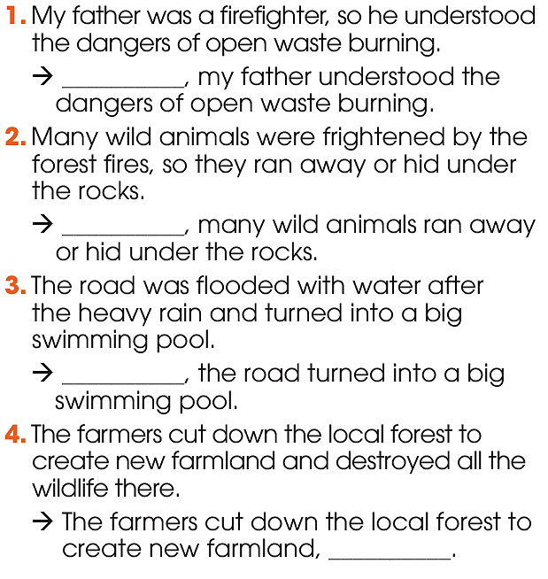
GRAMMAR
3
Rewrite the sentences using present or past participle clauses.

Slide 13
GRAMMAR
ANSWER KEY:
1. Being a firefighter, my father understood the dangers of open waste burning.
2. Frightened by the forest fires, many wild animals ran away or hid under the rocks.
3. Flooded with water after the heavy rain, the road turned into a big swimming pool.
4. The farmers cut down the local forest to create new farmland, destroying all the wildlife there.

Slide 14
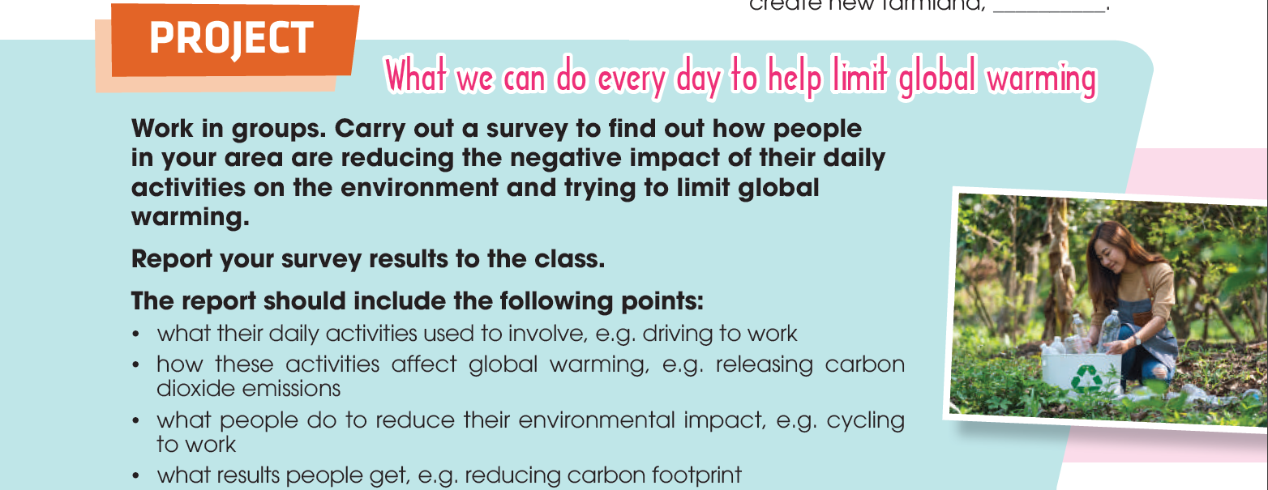
PROJECT

Slide 15
What have you learnt today?
CONSOLIDATION
1
Wrap-up
Review the vocabulary and grammar of Unit 5.
Apply what you have learnt (vocabulary and grammar) into practice through a project.
Carry out a survey to find out how local people reduce their environmental impact and present the survey results to the class.

Slide 16
CONSOLIDATION
2
Do exercises in the workbook.
Prepare for Unit 6.
Homework

Slide 17
Website: hoclieu.vn
Fanpage: facebook.com/tienganhglobalsuccess.vn/

