Slide 1

Unit 6: Be green
Lesson 6b: Grammar (Cont.)
Page 99

Slide 2
Lesson Outline
Warm-up
Grammar
Consolidation
Wrap-up

Slide 3

Objectives
By the end of this lesson, students will be able to:
To revise/practise
the Present Simple
the Present Continuous
the Past Simple
the Future Simple and be going to.

Slide 4

WARM-UP

Slide 5
Work in pairs.
1. When did you last see a film?
2. What type of books do you like reading?
3. What will the weather be like tomorrow?
4. What are your parents doing now?
5. What are you going to do this weekend?
The last time I saw a film was yesterday.
I like reading comic books.
It will be very hot tomorrow.
My parents are working now.
I am going to read a book this weekend.

Slide 6

PRESENTATION

Slide 7
Identify the tense and form of each example.
Tenses | Examples
 | I like reading comic books.
 | My parents are working now.
 | The last time I saw a film was yesterday.
 | It will be very hot tomorrow.
 | I am going to read a book this weekend.
Present Simple
Present Continuous
Past Simple
Future Simple
be going to

Slide 8

PRACTICE

Slide 9
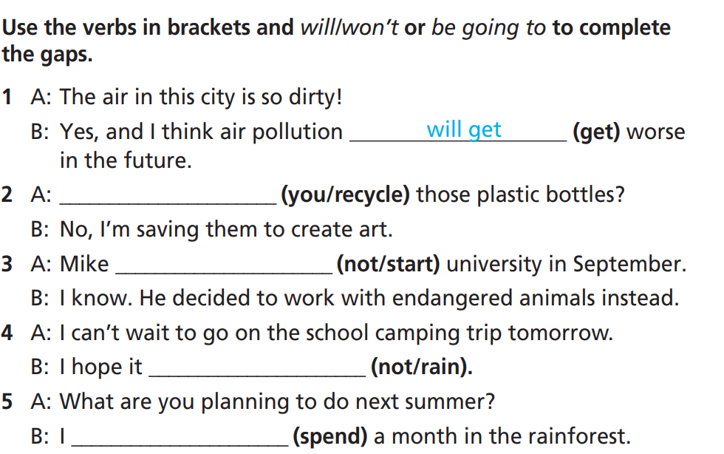
Are you going to recycle
isn’t going to start
won’t rain
am not going to spend

Slide 10
Extra Practice
WB p. 49
Put the verbs in brackets into the Past Simple.
1. _________________ (you/see) the news last night?
2. They _________________ (visit) the Amazon rainforest last year.
3. I _________________ (not/catch) the bus to school yesterday.
4. Last week, we _________________ (do) a project about air pollution in our city.
5. _________________ (Tom/organise) a clean-up day last month?
Did you see
visited
didn’t catch
did
Did Tom organise

Slide 11
Extra Practice
WB p. 49
Put the verbs in brackets into the Future Simple, be going to, the Present Continuous or the Present Simple.
1. A: ________________ (Andy/take) the train to the cinema this evening?
B: I’m sure his mum ________________ (give) him a lift in her car.
2. A: I hear you quit your job and you ________________ (not/look) for a new one.
B: That’s right. I ________________ (study) zoology at university. The course ________________ (start) in September.
3. A: My parents ________________ (see) a play at the theatre tonight and I don’t want to stay at home on my own.
B: Don’t worry – I ________________ (come) to your house and we can watch a film together.
Is Andy taking
will give
are not looking
am going to study
starts
are seeing
will come

Slide 12
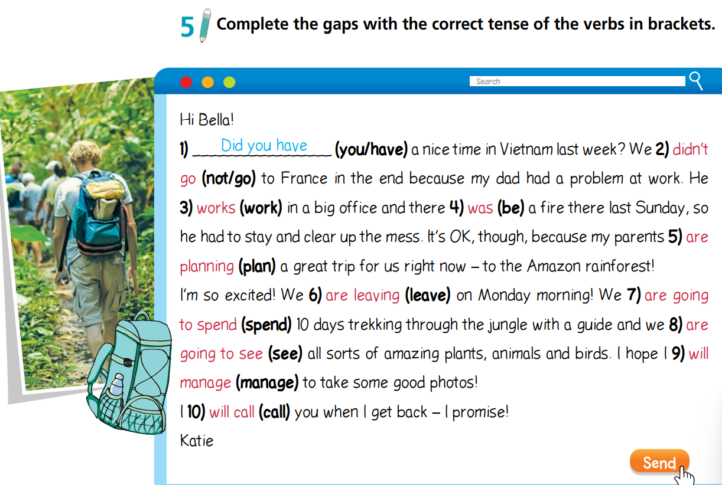

Slide 13
PRODUCTION

Slide 14

Take turns to tell your partner about your plan for the next holiday. Try to use a variety of tenses.
Where are you going to go for your next holiday?
What is special about this place?
Who are you going to go with?
Where are you going to stay?
What are you going to do?
(Your ideas)

Slide 15
Challenge your class by giving report on your partner’s plan for his/her next holiday. The whole class guess the correct place.
Hi, my name is ……. My friend’s name is ……. This summer holiday, he/she is going to a place which is famous for … He/She is going to go with ….. They are going to stay in …. They are going to go swimming in the sea and play in a theme park. I think they will have a lot of fun there.

Slide 16

CONSOLIDATION

Slide 17
Write about your plan for the next holiday. Remember to include “Where? When? What? Who? How?” and use a variety of tenses. (Please write at least 40 words).
Sample
I am going to Nha Trang this summer holiday with my family. This city is famous for the beautiful beaches and coral reef. We are going to stay in a hotel near the beach. We are going to go swimming in the sea and play in Wonderworld …. I think I will have a lot of fun in Nha Trang.

Slide 18

WRAP-UP

Slide 19
Today’s lesson
Grammar
To revise/practise the Present Simple, the Present Continuous, the Past Simple, the Future Simple and be going to.

Slide 20
Homework
Review the grammar points and make sentences using them.
Do the exercises on page 49 WB.
Prepare the next lesson (page 100 SB).
Complete the grammar notes in TA 7 Right On Notebook (page 46).

Slide 21
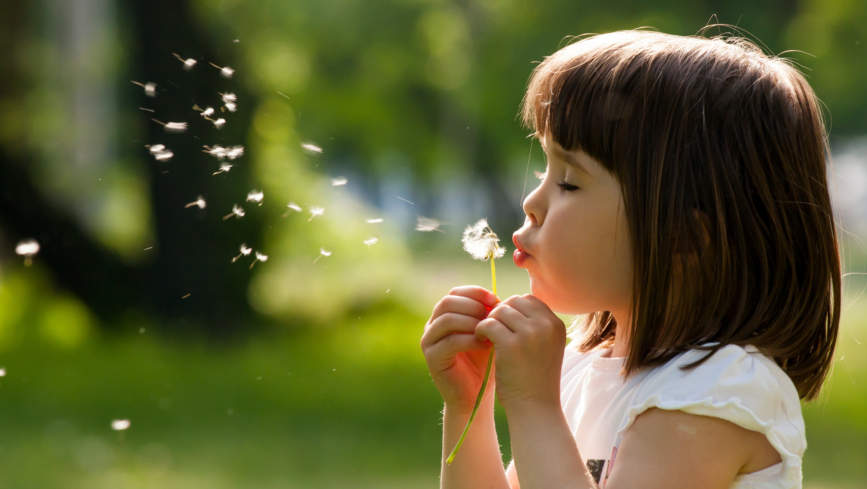
Enjoy your day!

