Slide 1

Unit 4: All things high-tech
Lesson 4e: Grammar (Cont.)
Page 71

Slide 2
Lesson Outline
Warm-up
Grammar
Consolidation
Wrap-up

Slide 3
Objectives
By the end of this lesson, students will be able to…
- use -ing form correctly.

Slide 4

WARM-UP

Slide 5

Work in pairs
Omit one extra letter in each line to make a correct word.
assiegnment
browsaer
clicek
filae
porteal
uploard

Slide 6
ANSWER
assiugnment
browsaer
clicek
filve
portbal
uploard
assignment
browser
click
file
portal
upload

Slide 7
Find eight grammar mistakes in the email and correct them.
Hi Jenny,
Guess what! I’m going to a science camp this summer. Do you fancy to coming with me?
It’s going to be great! We do lots of experiments every day and we learn about science. I know you hate camp, but you don’t need worry about that because we are staying in a hostel. There’s a river nearby, so we can go to canoeing, too. I will asking some other friends if they want come as well. Can you to write back and tell me what you think? I hope hearing from you soon.
All the best,
Thanh

Slide 8
ANSWERS
Hi Jenny,
Guess what! I’m going to a science camp this summer. Do you fancy to coming with me?
It’s going to be great! We do lots of experiments every day and we learn about science. I know you hate camp, but you don’t need worry about that because we are staying in a hostel. There’s a river nearby, so we can go to canoeing, too. I will asking some other friends if they want come as well. Can you to write back and tell me what you think? I hope hearing from you soon.
All the best,
Thanh.
2. camping
3. to worry
1. coming
5. ask
6. to come
4. canoeing
7. write
8. to hear

Slide 9

It’s time to learn …

Slide 10

Presentation

Slide 11
Examples
I enjoy posting videos on social media.
Mary goes swimming every Saturday.

Slide 12
Lead in
1. What kind of verb is after “enjoy/go” in sentence 1,2?
-ing form (V-ing).
2. When do we use -ing form ?
- the verbs like, love, dislike, hate, enjoy, prefer, fancy, etc.
- the verb go when we talk about activities.

Slide 13
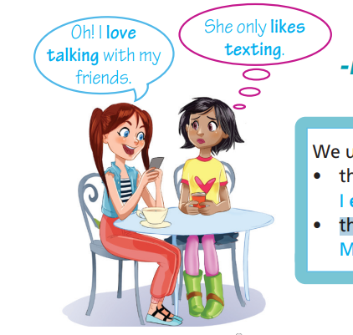
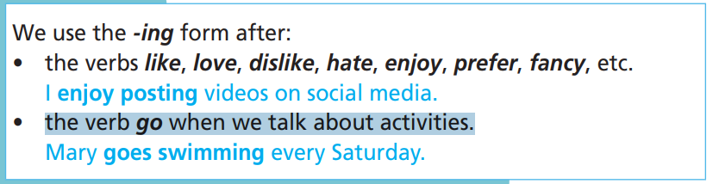

Slide 14

Practice

Slide 15
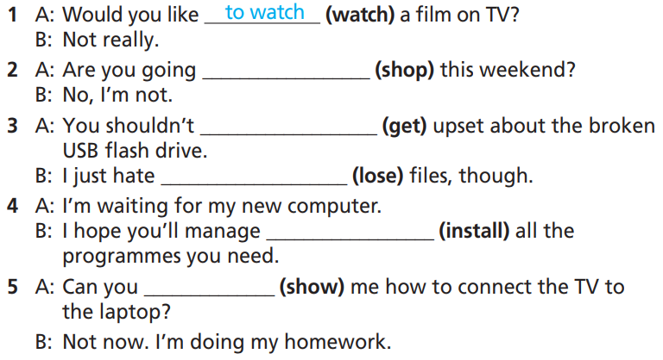
Practice
3 Put the verbs in brackets into to-infinitive, infinitive without to or -ing form.
How many sentences are there?
→ There are 5.
What are you going to do?
Put the verbs in brackets into to-infnitive or infnitive without to or -ing form.

Slide 16
Practice
3 Put the verbs in brackets into to-infinitive, infinitive without to or -ing form.
1. A: Would you like _____________ (watch) a film on TV?
B: Not really.
2. A: Are you going __________ (shop) this weekend?
B: No, I’m not.
3. A: You shouldn’t ___________ (get) upset about the broken USB flash drive.
B: I just hate __________ (lose) files, though.
to watch
shopping
get
losing

Slide 17
Practice
3 Put the verbs in brackets into to-infinitive, infinitive without to or -ing form.
4. A: I’m waiting for my new computer.
B: I hope you’ll manage ____________ (install) all the programmes you need.
5. A: Can you __________ (show) me how to connect the TV to the laptop?
B: Not now. I’m doing my homework.
to install
show

Slide 18
Practice
4 Put the verbs in brackets into to-infinitive, infinitive without to or
-ing form.
1. She loves ___________ (chat) with her friends online.
2. She managed ___________ (download) the files.
3. He decided ___________ (study) computer engineering.
4. Do you fancy ___________ (come) with us to the museum?
chatting
to download
to study
coming

Slide 19
Practice
4 Put the verbs in brackets into to-infinitive, infinitive without to or
-ing form.
5. How can I _________ (help) you?
6. I hate ___________ (listen) to classical music.
7. I can’t __________ (fix) this laptop.
8. I promised ___________ (give) Ann a new mouse on her birthday.
help
listening
fix
to give

Slide 20
Extra Practice
WB, page 36
Choose the correct option.
1. I’d like see/to see the new Star Wars film tonight.
2. Sally enjoys to chat/chatting online with her friends.
3. I want thank/to thank you for repairing my tablet.
4. You must install/to install a good anti-virus program.
5. I expect get/to get a drone for my birthday.

Slide 21
Extra Practice
WB, page 36
Choose the correct option.
6. Tom can’t remember/to remember Sue’s email address.
7. I have to do/doing homework online.
8. Tracey should get/to get up earlier.
9. I managed to upload/uploading my assignment to the school portal yesterday.
10. Dan promised play/to play games with me.

Slide 22
Extra Practice
Grammar Bank, page 72
Choose the correct option.
1. I’d love to go/go out tonight.
2. He can’t reach/reaching the top shelf.
3. Do you fancy go/going to the theatre tomorrow?
4. My dad goes to jog/jogging every Saturday morning.
5. He decided to stay/staying at home.

Slide 23
Extra Practice
Grammar Bank, page 72
Choose the correct option.
6. We mustn’t enter/to enter this room.
7. Can you help/helping me?
8. He promises be/to be back soon.
9. I love wearing/to wear jeans.
10. He dislikes to talk/talking to her.

Slide 24
Extra Practice
Grammar Bank, page 72
Put the verbs in brackets into to-infinitive, infinitive without to or
-ing form.
1. Simon hates _________ (listen) to rock music.
2. I would like _____________ (learn) how to ﬂy an aeroplane.
3. You shouldn’t _____________ (worry). We’ll get there on time.
4. Mary goes _____________ (swim) every day when she is on holiday.
listening
to learn
worry
swimming

Slide 25
Extra Practice
Grammar Bank, page 72
Put the verbs in brackets into to-infinitive, infinitive without to or
-ing form.
5. He promised _____________ (meet) us here.
6. Jane and Kevin want _____________ (watch) the new comedy.
7. I love _____________ (go) to the cinema.
8. You can _____________ (visit) us at the weekend.
9. She doesn’t fancy _____________ (travel) by boat.
10. He likes _____________ (read) science-fiction novels.
to meet
to watch
going
visit
travelling
reading

Slide 26

Production

Slide 27

Use these words to continue the story.
• love
• couldn’t
• would like
• go
• want
• ask
• can
• hate
• manage

Slide 28
Suggested Answer Key
S1: My best friend Tony loves playing computer games.
S2: Last Friday, he couldn’t go out, so he stayed in to play his new video game.
S3: He said to his mum, “Can I play my computer game?”.
S4: She said, “Clean your room first, then you can play it.”
S5: So Tony managed to clean his room.
S6: When the room was clean, he said, “I want to play my game now!”

Slide 29
Suggested Answer Key
S7: His mum asked to see his room.
S8: When she saw it, she said, “OK, you can play it now.”
S9: So Tony started his game.
S10: But he didn’t manage to finish it because the phone rang.
S11: It was his best friend Bert. He wanted to come round to watch a film.

Slide 30

CONSOLIDATION

Slide 31

Work in pairs.
Practise the conversations.
1. A: Would you like watch a film on TV?
B: Not really.
2. A: Are you going shopping this weekend?
B: No, I’m not.
3. A: You shouldn’t get upset about the broken USB flash drive.
B: I just hate lose files, though.

Slide 32
Work in pairs.
Practise the conversations.
4. A: I’m waiting for my new computer.
B: I hope you’ll manage install all the programmes you need.
5. A: Can you show me how to connect the TV to the laptop?
B: Not now. I’m doing my homework.

Slide 33

WRAP-UP

Slide 34
Today’s lesson
Grammar: Practice and use -ing form correctly.

Slide 35
Homework
Practise the grammar point and make sentences using them.
Do the exercises in TA 7 Right on WB (page 36).
Prepare the next lesson (page 72 SB).
Complete the grammar notes in TA 7 Right on Notebook (pages 32).

Slide 36

Enjoy your day!

