Slide 2
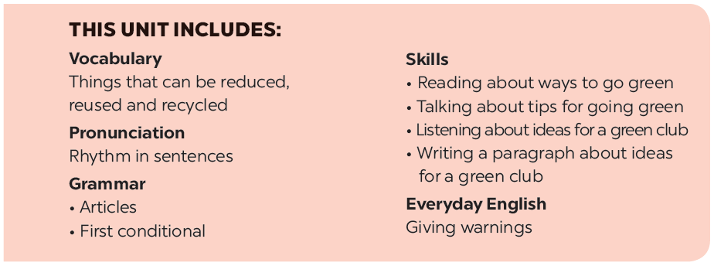

Slide 3
Grammar
Articles
Write a or an.
Combine each pair of sentences below to make a first conditional sentence.
Write a / an or the.
First conditional
Fun matching
Write the correct form of each verb in brackets.
Work in groups, A and B.

Slide 4
Grammar
Articles
There are two kinds of articles in English: the inde finite article (a / an) and the de finite article (the).
We use a / an
- with singular countable nouns when we are talking about them in general.
Example:
An ant is a tiny animal.
- after the verbs to be and to have.
Example:
I’m a student. / I have an eraser.

Slide 5
Grammar
Articles
We use the
- with singular or plural nouns when we already know them or when they are mentioned for the second time.
Example:
The bike in front of her house is nice.
- with nouns which are unique.
Example:
The air is dirty.

Slide 6
Write a or an.
____ mouth
___ egg
a mouth
1.
an egg
5.
___ friend
a friend
____ onion
2.
6.
an onion
___ sink
____ umbrella
3.
a sink
7.
an umbrella
___ arm
4.
an arm
____ classmate
8.
a classmate

Slide 7
Write a / an or the.
My father is
a doctor.
1.
_______ doctor.
2.
The Sun keeps
_______ Earth warm.
_______ Sun keeps _______ Earth warm.
the Earth warm.
A dolphin is
_______ dolphin is _______ intelligent animal.
an intelligent animal.
3.
_______ intelligent animal.
4.
I have
_______ orange shirt too.
an orange shirt too.
5.
My brother likes
_______ blue pen, not _______ red one.
_______ red one.
the blue pen, not
the red one.

Slide 8
Grammar
Might for future possibility
First conditional sentences describe things which are possible and likely to happen in the present or the future.
If + subject + V (present simple),
If-clause
subject + will / won’t + V (base form)
main clause
Example:
If you use less paper, you will save a lot of trees.

Slide 9
Write the correct form of each verb in brackets.
1.
If it (be)
_______ sunny next week, we (go) _______ on a picnic.
will go on a picnic.
is sunny next week, we (go)
_______ on a picnic.
2.
If we (recycle)
will help the Earth.
_______ more, we (help) _______ the Earth.
recycle more, we (help)
_______ the Earth.
3.
We (save)
much paper.
_______ so
_______ a lot of trees if we (not waste) _______ so
will save a lot of trees if we (not waste)
don’t waste so
More people (have)
less water.
_______
_______ fresh water if we (use) _______
4.
will have fresh water if we (use)
use
5.
If the river (not be)
isn’t / is not dirty, there (be)
will be more fish.
_______ dirty, there (be) _______ more fish.
_______ more fish.

Slide 10
Combine each pair of sentences below to make a first conditional sentence.
1.
The air isn’t fresh. People cough.
If the air isn't fresh, people will cough.
2.
The water is dirty. A lot of fish die.
If the water is dirty, a lot of fish will die.
3.
We cut down trees in the forest. There are more floods.
If we cut down trees in the forest, there will be more floods.
4.
There is too much noise. People don’t sleep.
If there is too much noise, people will not / won't sleep.
5.
There is no water. Plants die.
If there is no water, plants will die.

Slide 11
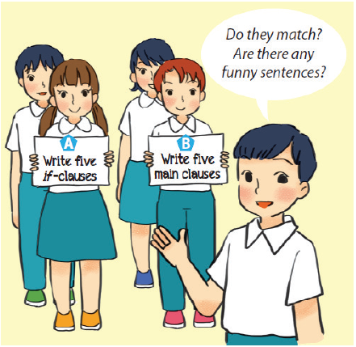
Fun matching
Work in groups, A and B.
Group A secretly writes five if-clauses on a sheet of paper.
Group B secretly writes five main clauses on another sheet of paper.
Match the if-clauses with the main clauses.
Do they match? Are there any funny sentences?

Slide 12
Website: hoclieu.vn
Fanpage: facebook.com/www.tienganhglobalsuccess.vn/

