Slide 1
WELCOME TO OUR CLASS

Slide 2
UNIT 9: NATURAL DISASTERS
Period 70: A Closer Look 1

Slide 3
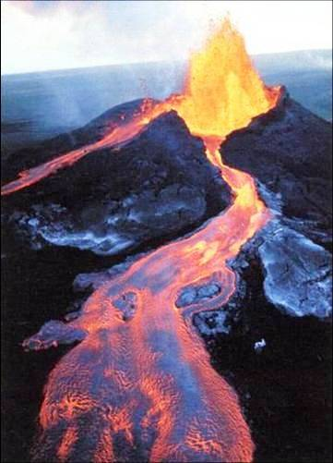
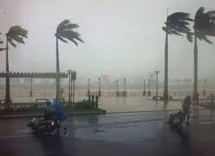
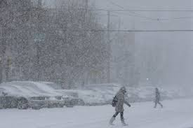
Stick the words with the suitable pictures.
Earthquake
Typhoon
Snowstorm
Volcano
Volcano
Typhoon
Earthquake
Snowstorm

Slide 4
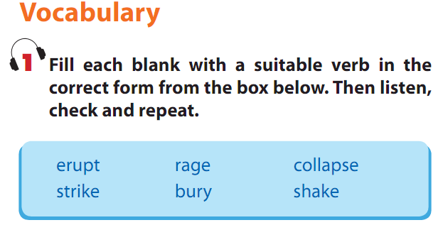
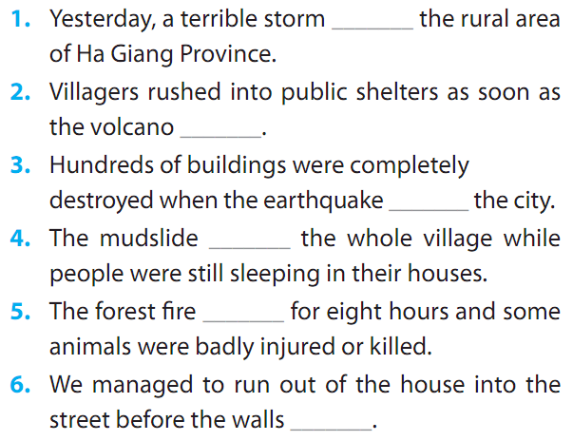
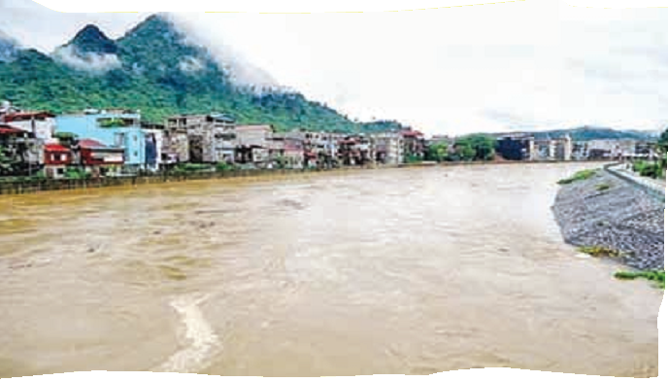

Slide 5
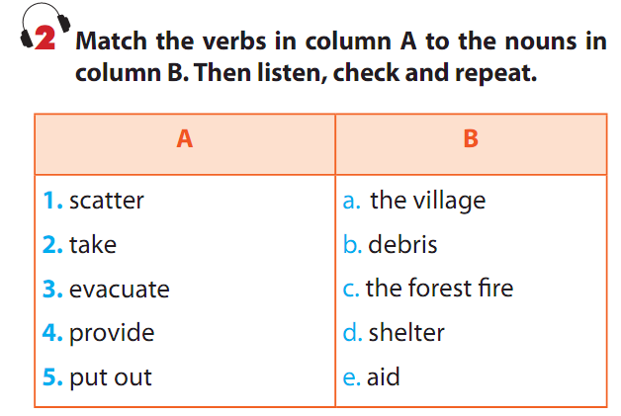

Slide 6
3. Now use the phrase in 2 in the correct form to complete the sentences.
provide aid
The rescue workers set up a camp to ____________ for the flood victims.
On the second day, there was a rainstorm which helped to ____________________ .
When the storm started, they _____________ in a cave.
As the tornado moved through the town, high winds _________________ across the streets.
The police had to _________________ to public shelters before the volcano started to erupt.
put out the forest fire
took shelter
scattered debris
evacuate the village

Slide 7
PRONUNCIATION
Stress in words ending in – logy and - graphy
4. Listen and repeat these words. Pay attention to the stressed syllables.
technology biology geography
photography aplogy
ecology biography psychology

Slide 8
REMEMBER!
For words ending in – logy and – graphy, place the stress on the third syllable from the end.
Ex: biology photography

Slide 9
5. Listen and mark the stress on the correct syllable in the words below. Pay attention to –logy and –graphy.
1. sociology | 4. climatology
2. zoology | 5. astrology
3. biliography | 6. demography

Slide 10
6. Read the following sentences and mark the stressed syllables in the underlined words.
Then listen and repeat the sentences.
1.geography
2.biology
3.photography
4.biography
5.zoology

Slide 11
HOMEWORK
Learn by heart new words.
Do all these tasks on workbook.
Prepare “ A closer look 2”.

Slide 12
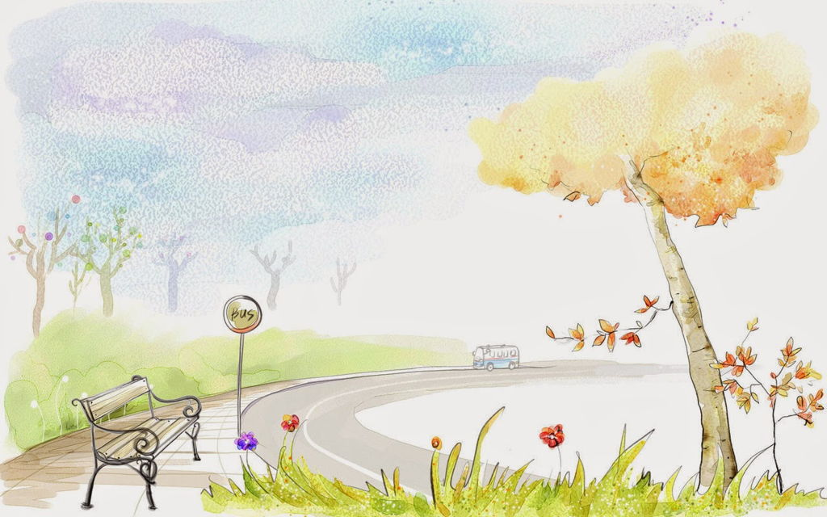
THANKS FOR YOUR ATTENTION!
GOODBYE AND SEE YOU AGAIN!

