Slide 1
HAVE FUN + Watch Video = 玩得开心 + 看视频 = Wán dé kāixīn + Kàn shìpín=
Be quiet 安靜 Ānjìng Sit down 坐下 Zuò xià Look at me 看着我 Kànzhe wǒ Listen to me 听我说 Tīng wǒ shuō
Answer me 回答我 Huídá wǒ
.

Slide 3
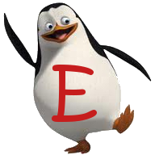
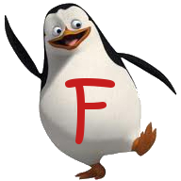
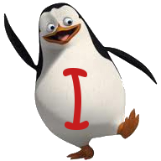
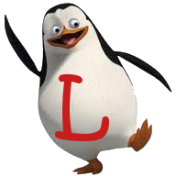

Slide 4
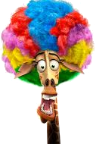
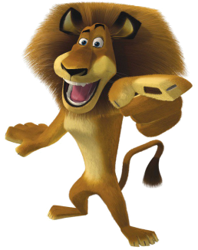
What season is it?
It’s spring.

Slide 5
1 point

Slide 6
What season is it?
It’s summer.

Slide 7
6 points

Slide 8
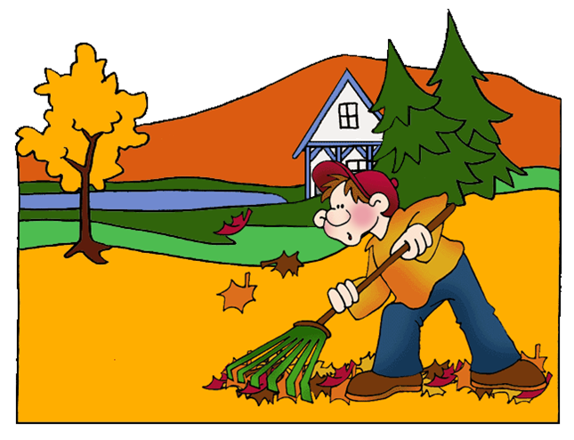
What season is it?
It’s autumn.

Slide 9
2 points

Slide 10
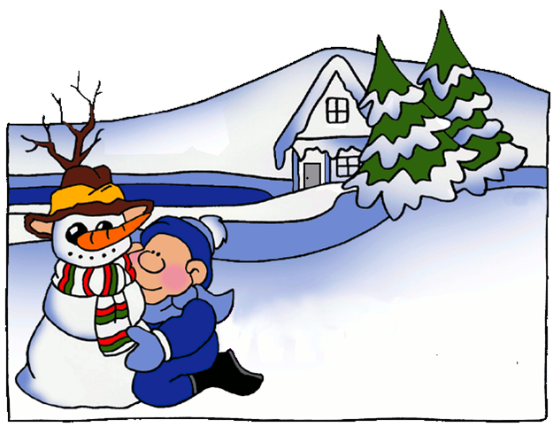
What season is it?
It’s winter.

Slide 11
Pick a crate!

Slide 12
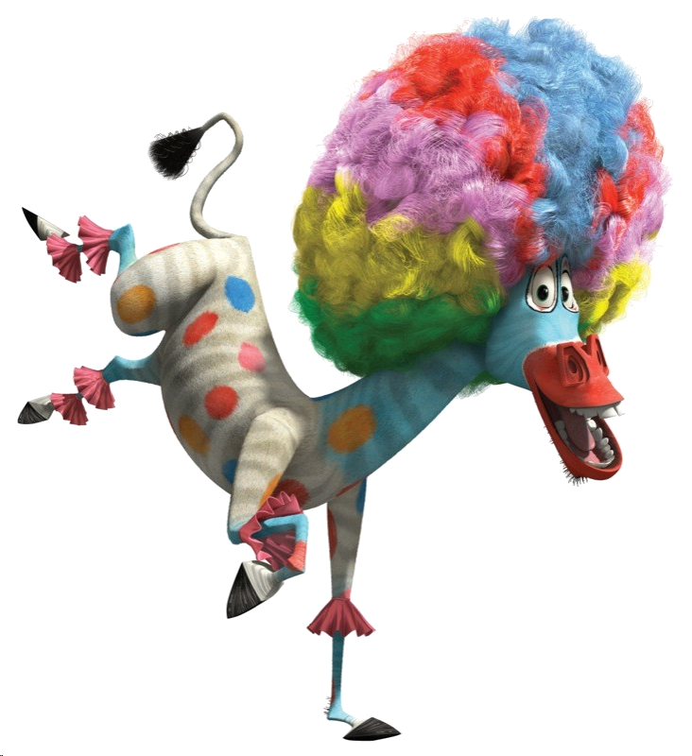
add 10 points

Slide 13
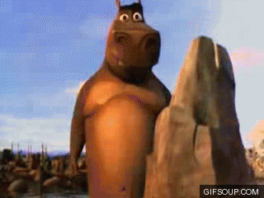
Steal 3 points.

Slide 14
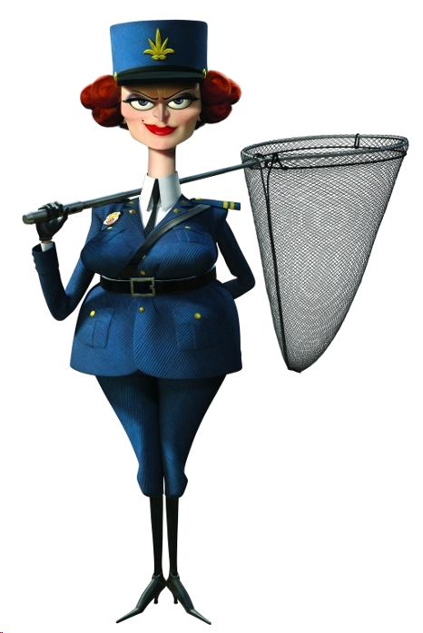
Everyone lose 5 points

Slide 15
It’s autumn. I…
fly a kite.

Slide 16
5 points

Slide 17
It’s spring. I…
ride a bicycle.

Slide 18
Pick a crate!

Slide 19
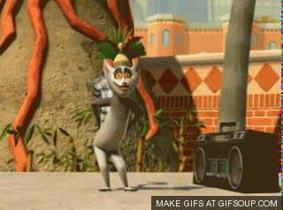
9 points
You like to move it!

Slide 20
Lose 2 points.

Slide 21
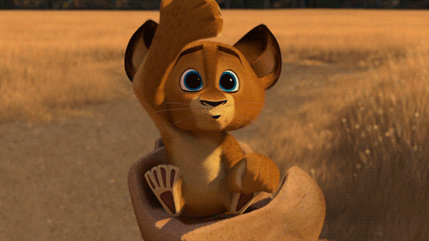
Steal 3 points.

Slide 22
It’s winter. I…
make a snowman.

Slide 23
4 points

Slide 24
It’s summer. I…
swim..

Slide 25
6 points

Slide 26
Let’s…
Stop.

Slide 27
4 points

Slide 28
Let’s…
wait..

Slide 29
Pick a crate!

Slide 30
Lose 3 points.

Slide 31
Steal 3 points.

Slide 32
8 points
You like to move it!

Slide 33
Let’s…
go.

Slide 34
5 points

Slide 35
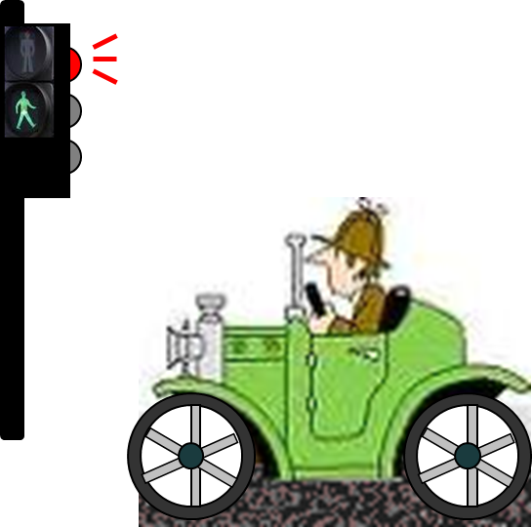
Look at the light.
It’s red. Let’s stop.

Slide 36
Pick a crate!

Slide 37
Lose 2 points.

Slide 38
10 points
You like to move it!

Slide 39
Steal 3 points.

Slide 40
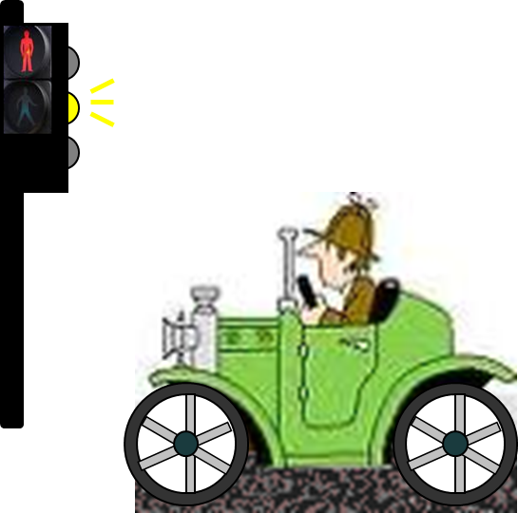
Look at the light.
It’s yellow. Let’s wait.

Slide 41
3 points

Slide 42
Look at the light.
It’s green. Let’s go.

Slide 43
6 points

Slide 44
I have a…
t-shirt.

Slide 45
1 point

Slide 46
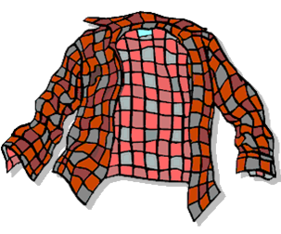
I have a…
shirt.

Slide 47
3 points

Slide 48
I have a…
coat.

Slide 49
Pick a crate!

Slide 50
Steal 3 points.

Slide 51
Everyone lose 5 point

Slide 52
add 10 points

Slide 53
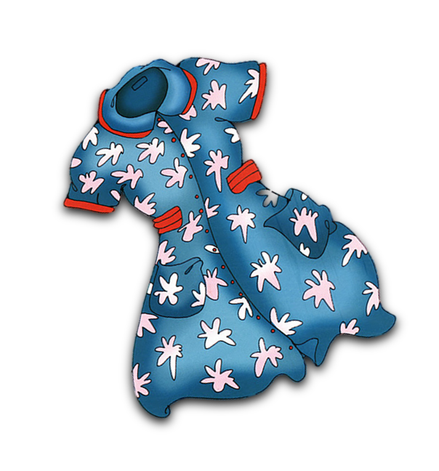
I have a…
dress.

Slide 54
5 points

Slide 55
I have a…
sweater

Slide 56
2 points

Slide 57
I have …
trousers

Slide 58
4 points

