Slide 1

UNIT 6: COMMUNITY LIFE
Lesson 3.2 – Writing & Speaking
Page 55

Slide 2




LESSON OUTLINE
Consolidation

Slide 3

By the end of this lesson,
students will be able to …
- write a letter about ways to improve community, using pronouns to avoid repetition.

Slide 4
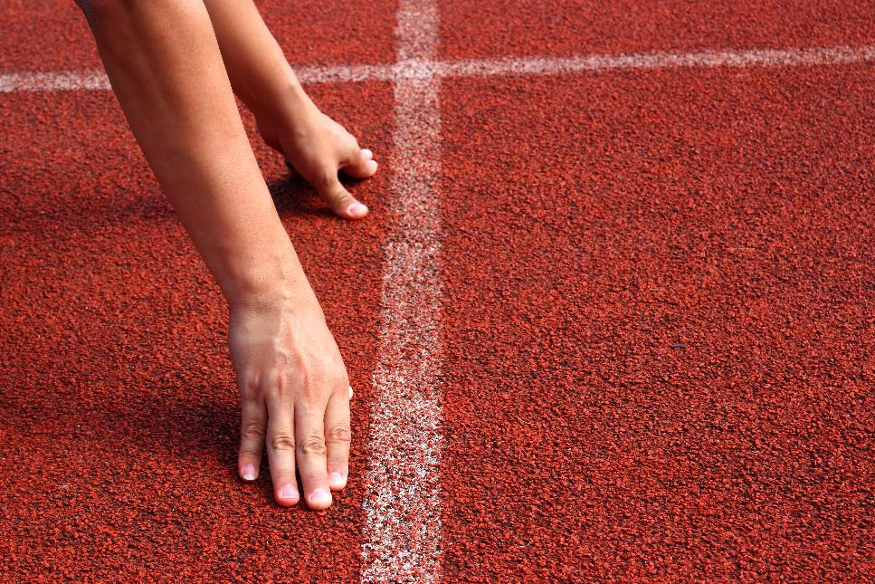


Slide 5
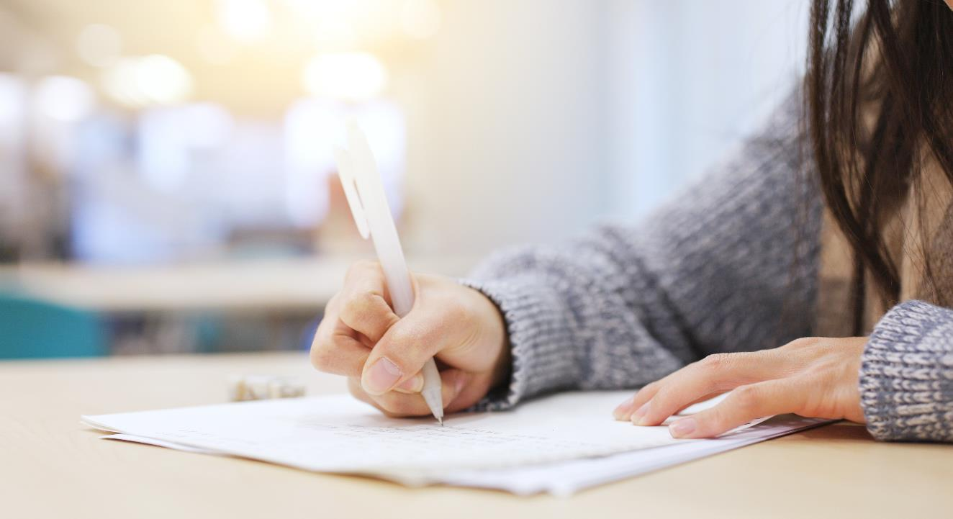


Work in pairs.
Talk about the best place for children to play

Slide 6

Pre-Writing
Using pronouns to avoid repetition To stop your writing from being repetitive and uninteresting, you can use pronouns (I, me, mine, she, her, hers, etc.) to replace nouns and noun phrases.

Slide 7
For example:
• Sophie wrote a letter about a city project. She sent the letter to the city government. → She sent it to the city government. • Children have nowhere to play because the children live in apartments and houses with no yards. → Children have nowhere to play because they live in apartments and houses with no yards.

Slide 8
a. Read about using pronouns to avoid repetition, then read Lisa's letter again and match the words in bold with the pronouns that reference them.
Dear Sir/Madam, My name is Lisa Bolton and I think the project Green Spaces for All will help improve Hartmouth. Many people live in apartments or small houses without any yards. There are not enough green spaces for them to use. I think we should use the money from the city budget to build more parks around the city. They can be a safe place for all people to enjoy, and they will make our city's air cleaner.

Slide 9
We can buy exercise equipment and put it in the parks, then people will not have to pay to use a gym. We can also build basketball courts and skateboard parks. Teenagers can hang out there, so they can have something fun to do. The parks can have play equipment and sandboxes for young children, so they can play safely while their parents watch. Finally, the parks will make our city a healthier place to live. Studies show that trees and plants improve air quality. It is very bad right now because of the traffic. I hope you will consider my suggestion. Yours faithfully, Lisa Bolton

Slide 10
1. Many people → they
2. more parks → them
3. exercise equipment → it
4. teenagers → they
5. young children → they
6. air quality → it

Slide 11
b. Replace the underlined words with the correct pronouns.
1. The teenagers have nowhere to use their skateboards. The teenagers want to have more skate parks. 2. We can buy equipment for people to exercise on. They can use the equipment for free. 3. The city doesn't have enough green spaces. The city needs more parks. 4. Young children need safe places to play in. They can play in the safe places while their parents watch. 5. My friends and I think trees will improve the air quality. My friends and I think it is very bad in our city.
They
it
it
them
we

Slide 12
Extra Practice
WB, page 37
Replace the underlined words with the correct pronouns.
1. Owen Masters wrote an article about ways to make his city better. Owen Masters suggested three ideas. 2. Arlington should have more places of entertainment for children. Arlington needs a free playground. 3. People don't want to play on the old basketball court anymore. People want to build a new playground to replace it. 4. We can give Christmas gifts to sick children in the hospital. The children will be happy to get Christmas gifts. 5. Young people like us should find ways to improve our community. Young people like us can organize charity events.
He
It
They
Them
we

Slide 13

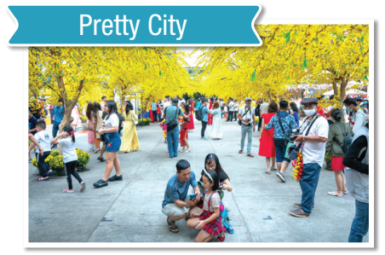
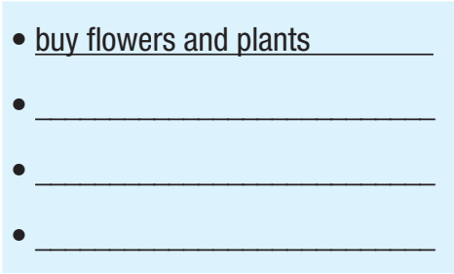
Think about ways you could improve your city. Write at least three more ideas under each picture.
put garbage cans around the city
fix up local parks
smile, even at strangers

Slide 14
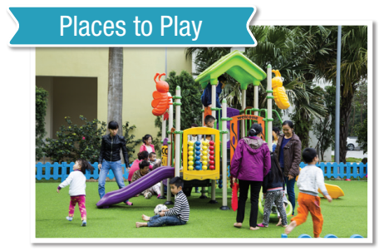
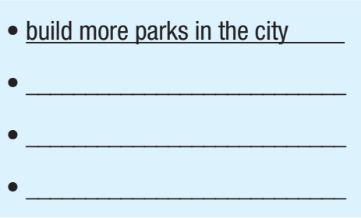
make some gardens and plant trees
put exercise equipment in the parks
put sandboxes in the parks

Slide 15

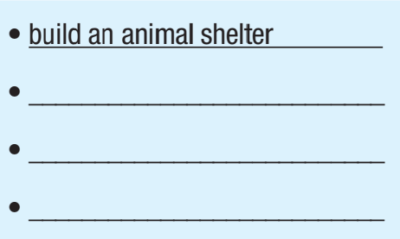
volunteer looking after animals
donate (supplies or monetary)
adopt an abandoned animal if any

Slide 16

a. You are working on a class project on ways to improve your city. In pairs: Discuss and add two or three more ideas in each column.

Slide 17
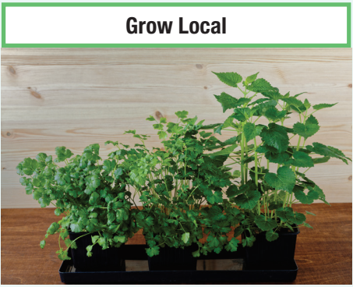
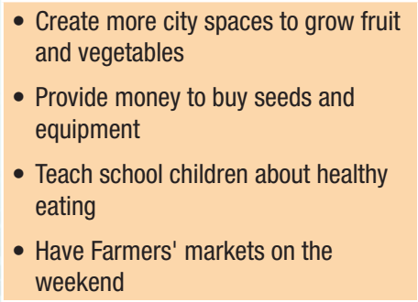

Slide 18

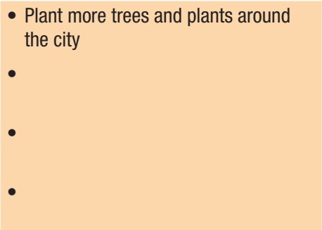
Build more parks around the city
Put exercise equipment in the parks
Put garbage cans around the city

Slide 19

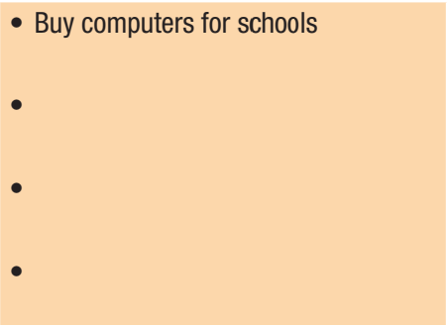
buy tablets or laptops for students to practice
increase practicing hours
build a free neighborhood Wi-Fi

Slide 20
b. Join another pair. Choose one of the projects and say why you think it is best.
I think the project Technology in Schools will help to improve our city.
So do I. With available computers or laptops, students can find out information for their lessons easily …

Slide 21

While -Writing
Choose one of the projects and write an article about how to improve the city. Write at least three ideas for your project. Remember to use pronouns to avoid repetition. Write 120 to 150 words.

Slide 22
Sample
Places to Play Tony Phan, June 10 I think Places to Play will improve our city the most. Many people don't have gardens or parks near them. I think we should build more parks in the city for everyone to use. Families can go there on the weekends and play with their children. We can put exercise equipment in the parks for the parents to use. They won't need to pay for a gym. The children can play safely and have fun with their friends.

Slide 23
Another thing we can do is make some gardens and plant trees, so people can look at flowers and hear birds. Students can go there to have fun with their classmates. They can do exercise with their teachers. They can also learn about nature and paint pictures. It will help them relax as well. Finally, the park can be a great place to have picnics and fun days. People can take photos for their weddings and birthdays.

Slide 24

While-Writing
Now, write a letter to the Youth Lead the Change project talking about why you think your project is the best one. Use the Feedback form to help you. Write 120 to 150 words.

Slide 25
Sample
Technology in Schools Dear Sir/Madam, My name is Phương Huỳnh and I think the project Technology in Schools will help students. Many students do not have computers or laptops. They cannot study very easily at school. I think we should use the money from the city budget to buy more computers and laptops for schools.

Slide 26
Students can use the computers to help them plan projects. They can go on the internet to find information for their lessons. We can also buy tablets for students, so they can study at home and do their homework. Finally, the students can use the computers and laptops to talk to other students around the world. I hope you will consider my suggestion. Yours faithfully, Phương Huỳnh

Slide 27
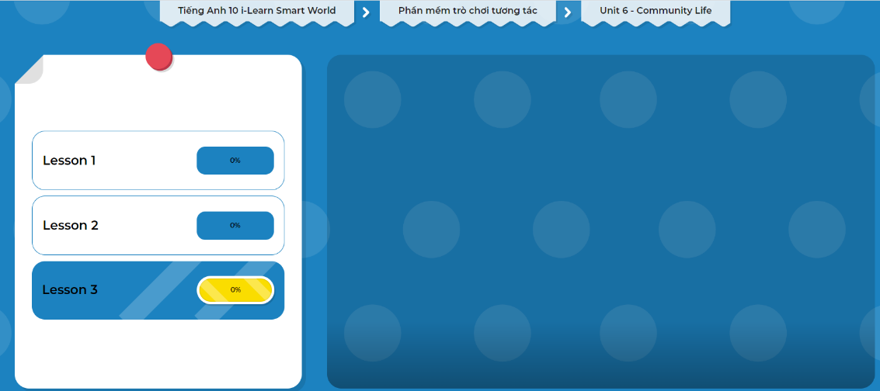
Extra Practice
DHA on Eduhome
Let’s Play!
Click here to play the games.

Slide 28

WRAP-UP

Slide 29
Today’s lesson
Writing: write a letter about ways to improve community, using pronouns to avoid repetition
Speaking: talk about some ways to improve our city

Slide 30

Complete the writing notes in Tiếng Anh 10 i-Learn Smart World Notebook on page 37.
Prepare the next lesson – Unit 7 on page 56 in SB.
Play the consolidation games in Tiếng Anh 10 i-Learn Smart World DHA App on www.eduhome.com.vn

