Slide 1

Welcome back
(cont.)
Pages 10 & 11

Slide 2
Lesson Outline
Warm-up
Vocabulary
Grammar
Speaking
Consolidation
Wrap-up

Slide 3
Objectives
By the end of this lesson, students will be able to:
- revise and practise Prepositions of place, there is/there are, question words.
- revise vocabulary for and talk about School subjects, Days of the week, Months, Seasons.
- ask for personal information.

Slide 4

WARM-UP

Slide 5
Match the prepositions with the correct places of the balls
in
between
under
on
above
behind
next to

Slide 6

It’s time to learn …

Slide 7
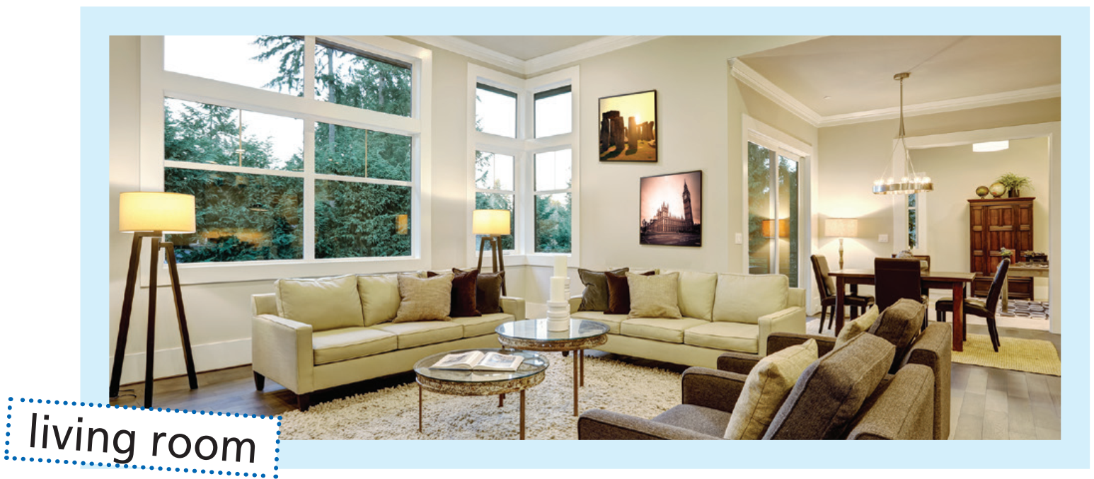
Grammar
window
1 There’s a big window next to/ between the two lamps behind/beyond the sofa.
2 There are two pictures on/in the wall.
3 There’s a carpet above/under the coffee tables.
pictures
lamp
coffee tables
lamp
sofa
carpet

Slide 8

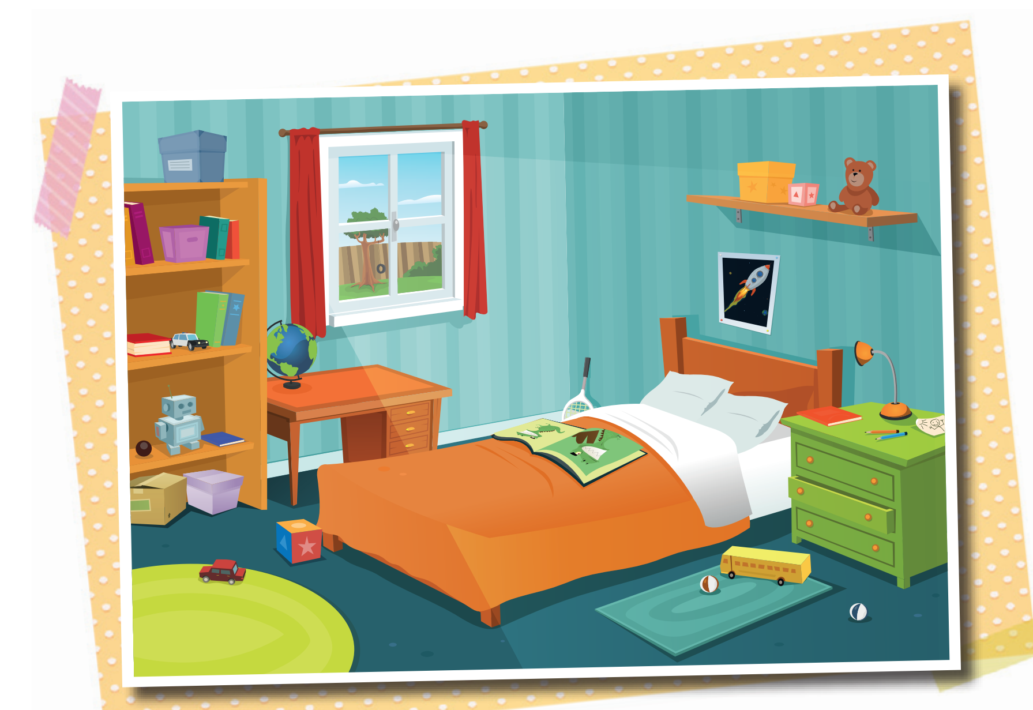
Note! Is there + singular nouns / Are there + plural nouns
bookcase
teddy bear
Is there
1 _________ a bedside cabinet next to the bed? Yes, _____________ .
2 __________ pillows on the bed? _______________ .
3 ________ a desk next to the bookcase?_________________ .
4 ________ a teddy bear on the bedside cabinet?_______________ .
5 _____________ books on the desk? ______________________ .
there is
Are there
pillows
Yes, there are
bed
Is there
Yes, there is
Is there
No, there isn’t
Are there
desk
No, there aren’t
beside cabinet

Slide 9
Speaking
What are there in the room?
Where are they in the room?

Slide 10

Vocabulary
Monday
Tuesday
Days: Sunday, 1) ______________ , 2) ______________ , Wednesday, 3) ______________ , Friday, Saturday
Months: January, 4) ______________ , March, April, 5) ______________ , 6) ______________ , July, 7) ______________ , September, 8) ______________ , November, 9) ______________
Thursday
February
May
June
August
October
December

Slide 11
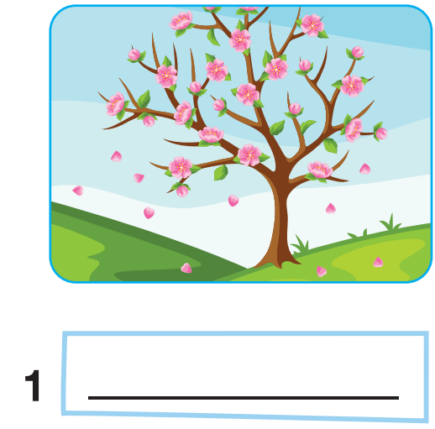
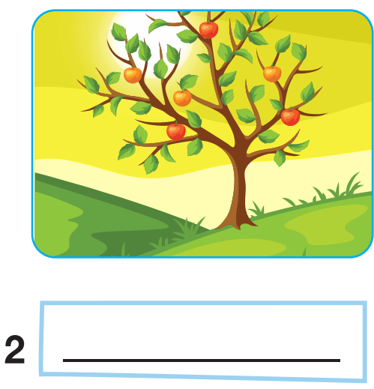
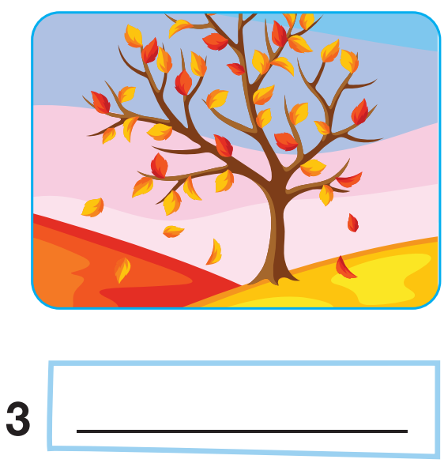
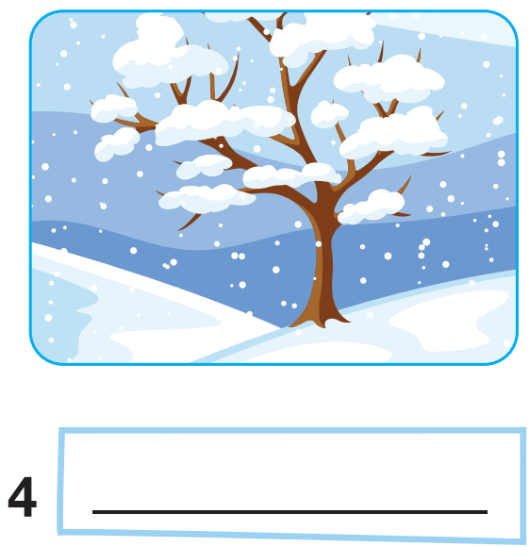
spring
summer
autumn
winter

Slide 12


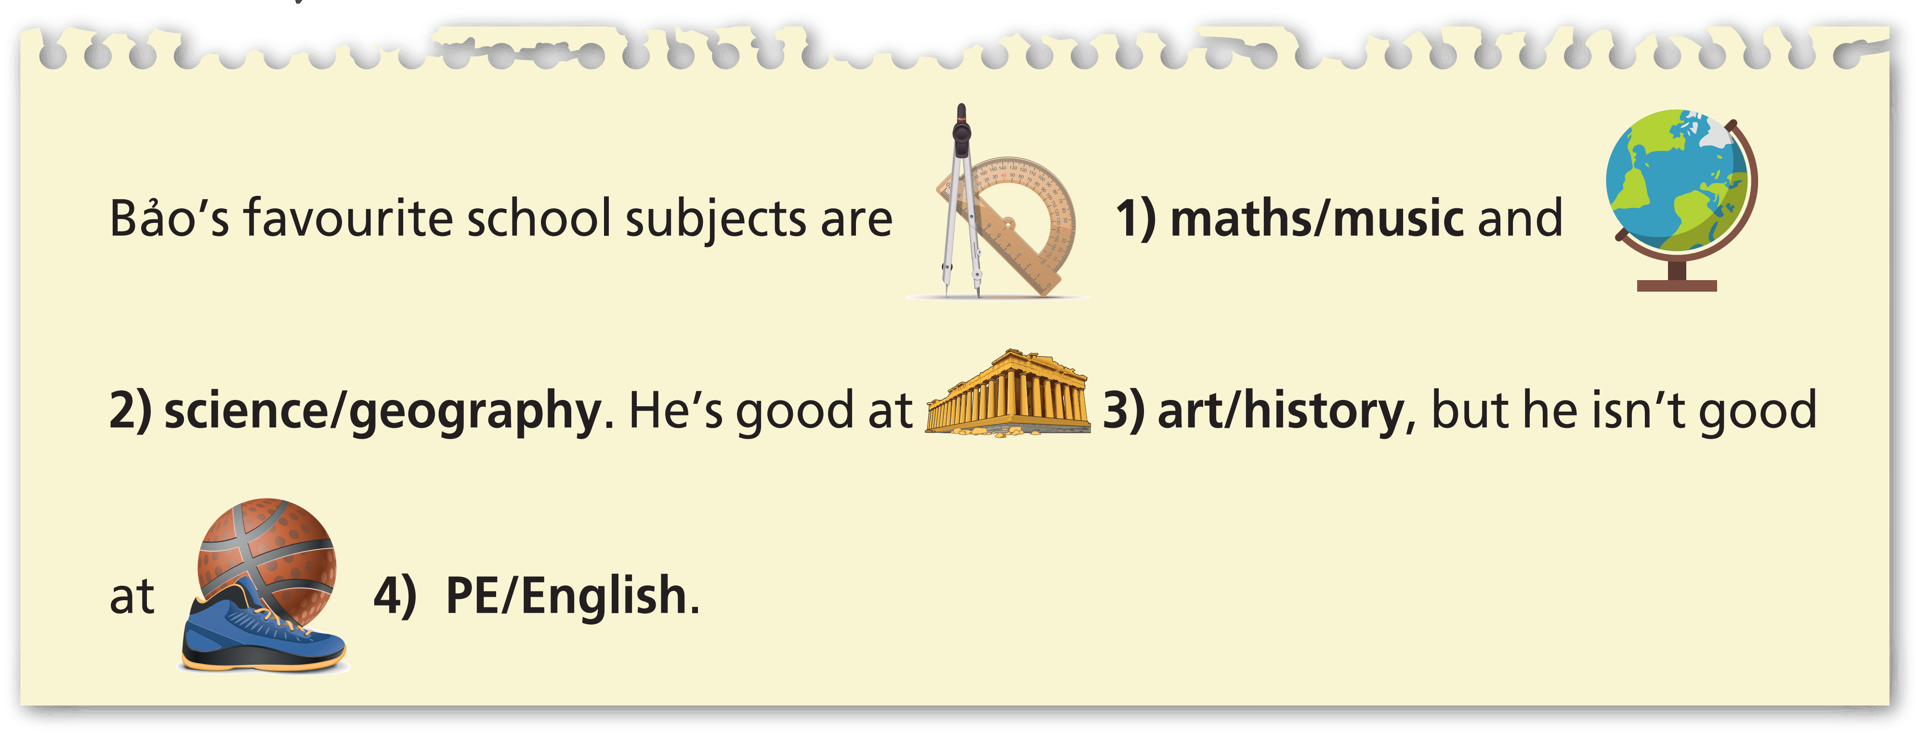
Vocabulary

Slide 13

Example

Slide 14
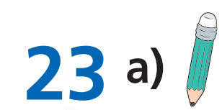
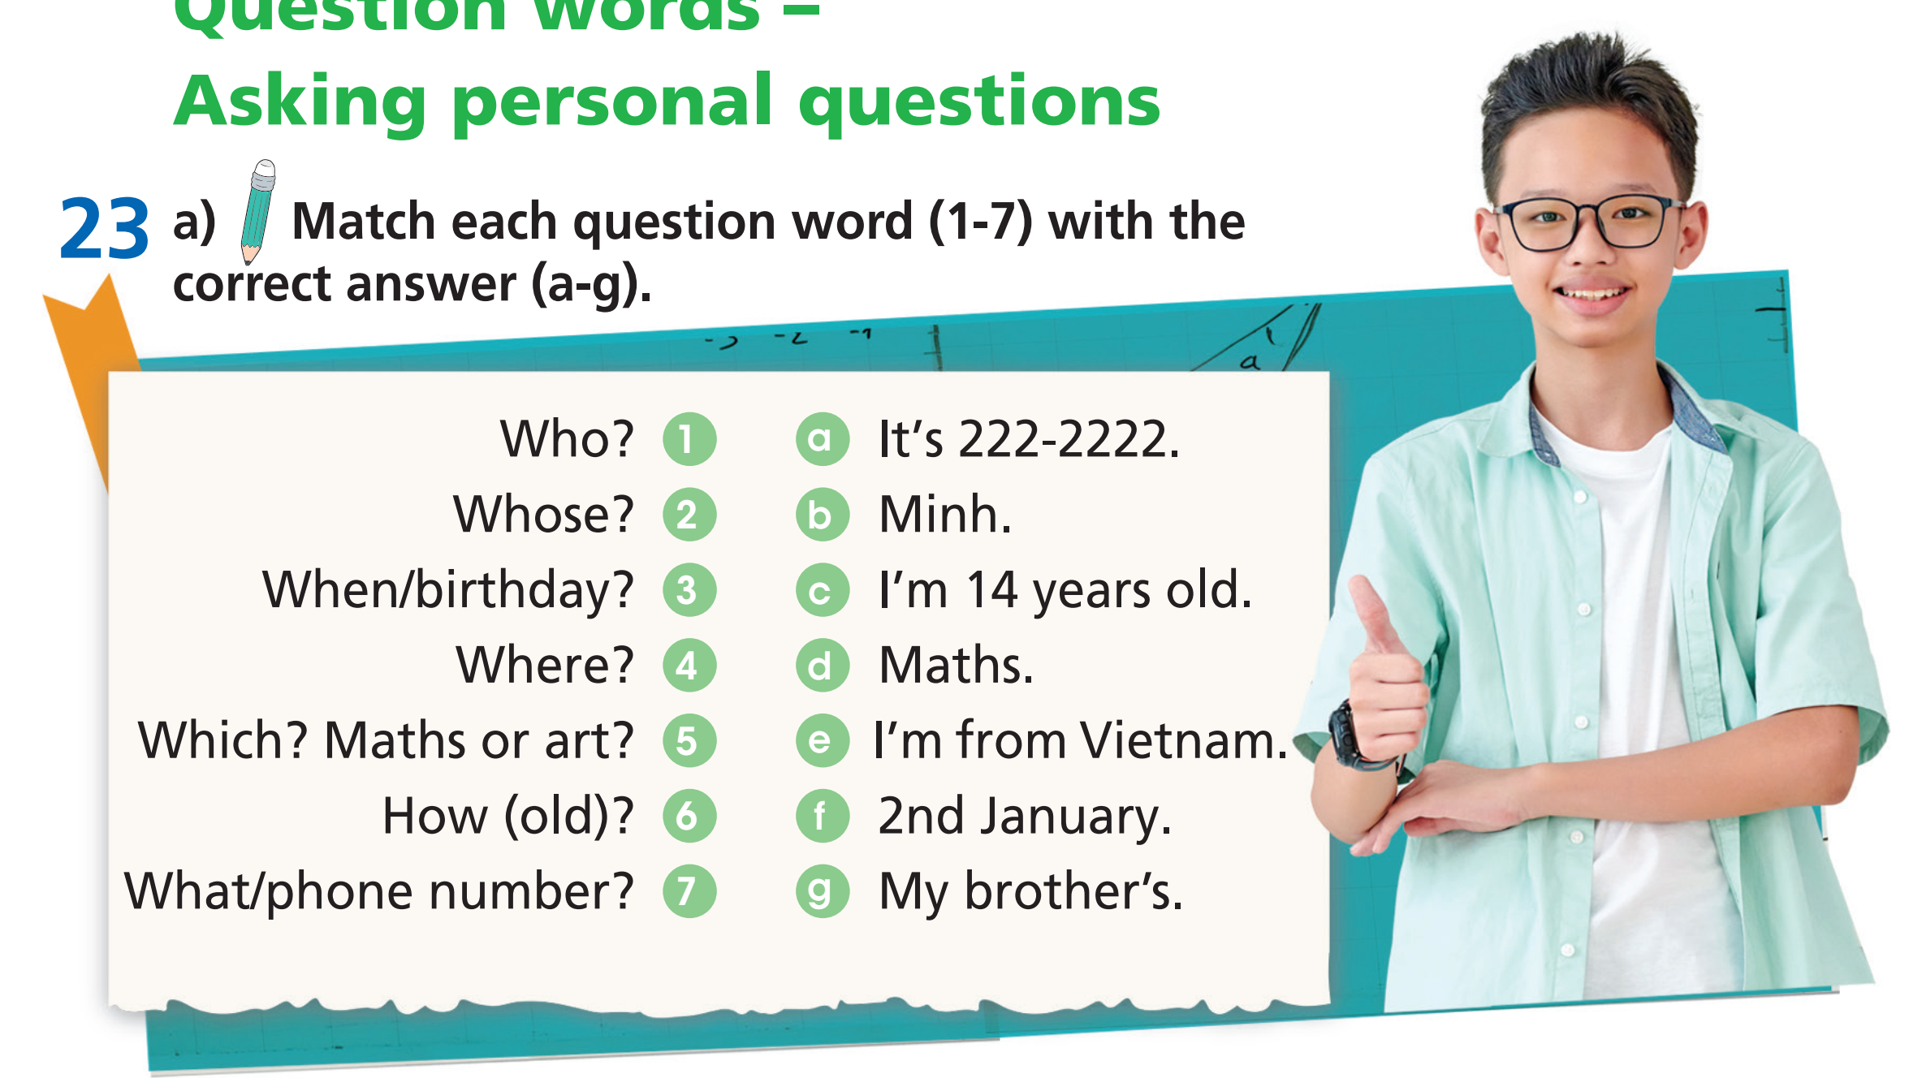
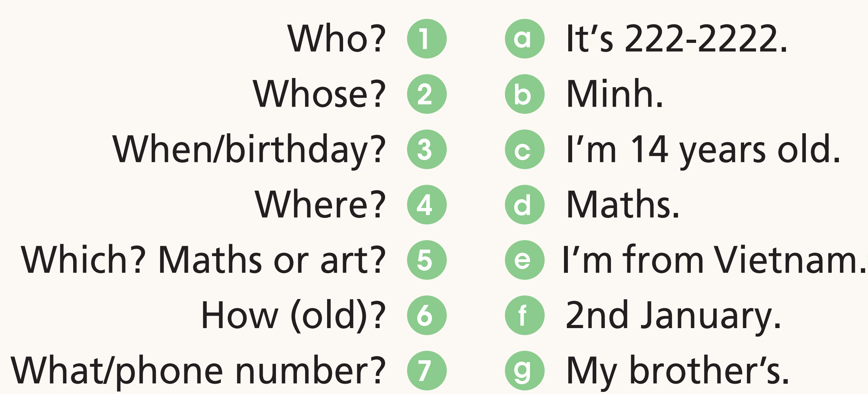








Speaking
Question words – Asking personal questions
Match each question word (1-7) with the correct answer (a-g).

Slide 15

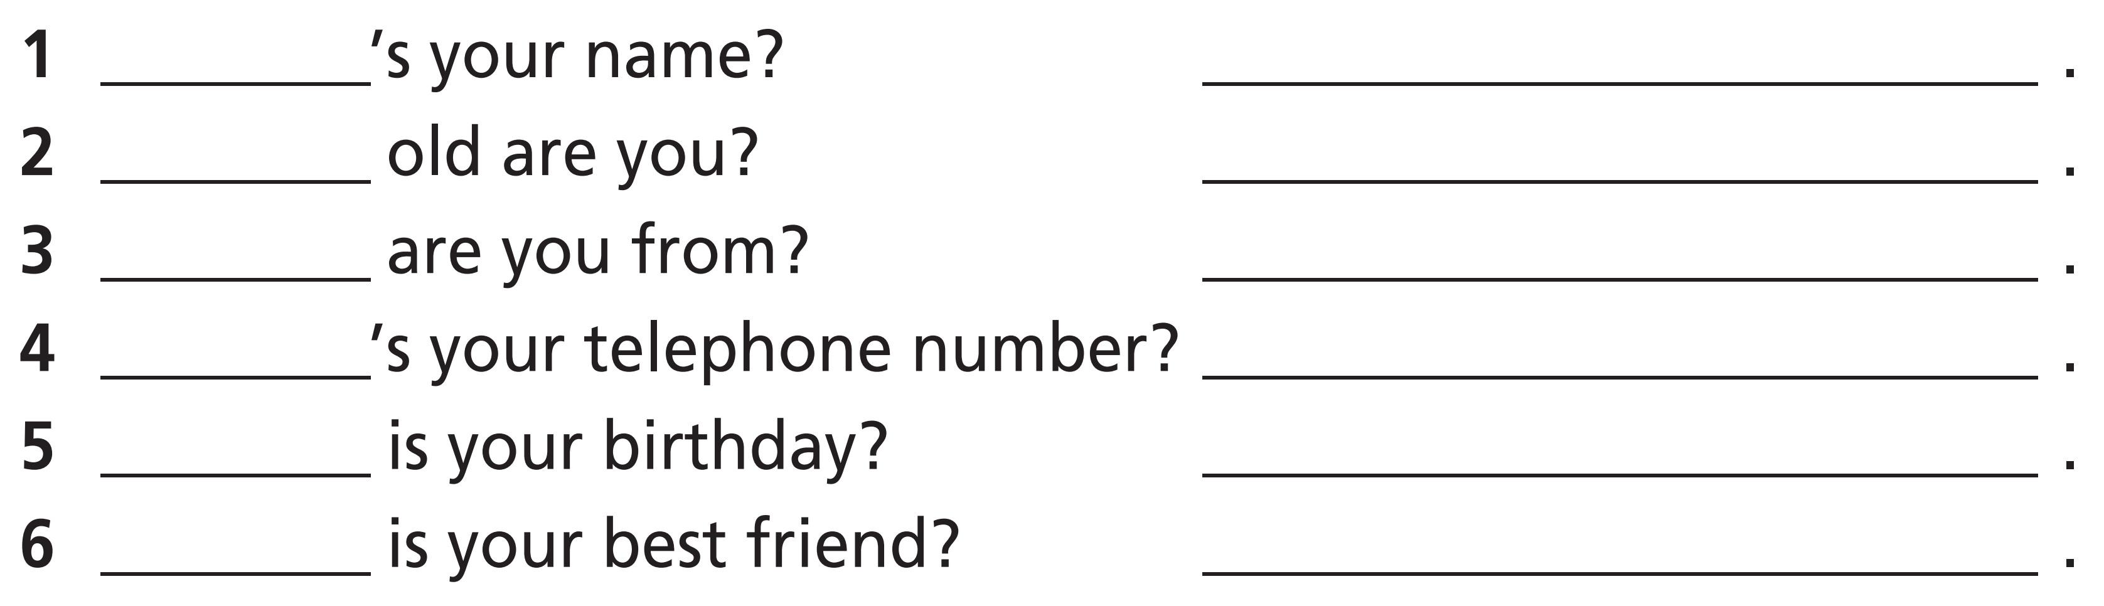
What
My name’s …….
How
I’m …… years old.
Where
I’m from …….
What
My telephone number’s ……
When
My birthday is on …….
Who
My best friend is …….

Slide 16


Slide 17
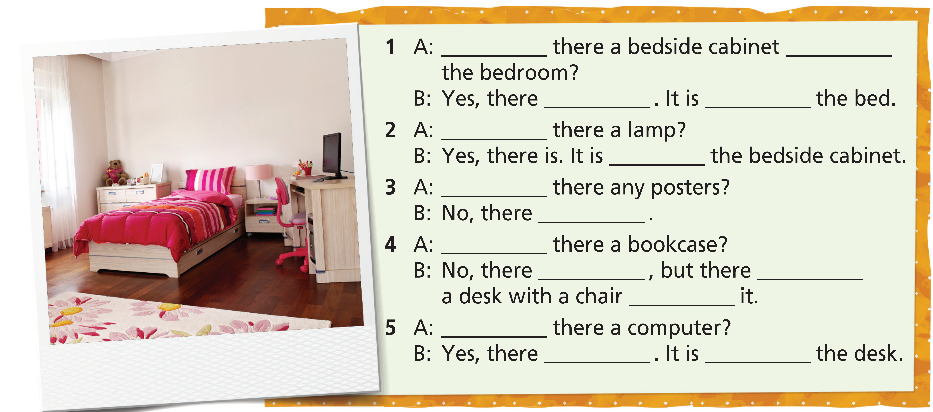
Extra Practice
WB, page 9
Is
next to
is
next to
Is
on
Are
aren’t
Is
isn’t
is
in
Is
is
on

Slide 18
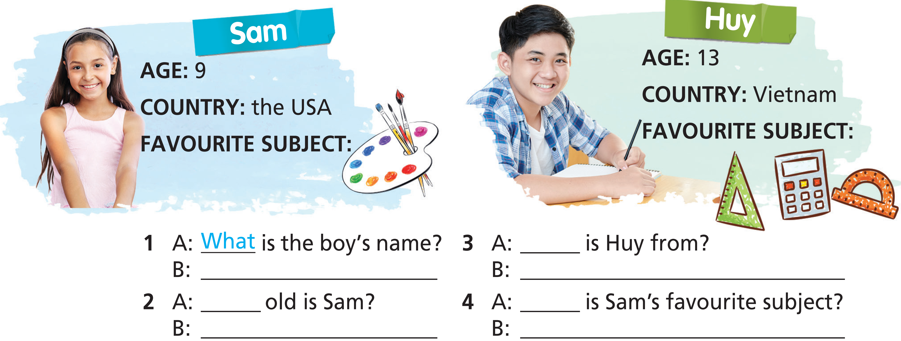
Extra Practice
WB, page 9
Where
His name’s Huy.
He’s from Vietnam.
How
What
She’s 9 years old.
Her favourite subject is art.

Slide 19

CONSOLIDATION

Slide 20
Write a paragraph (60-80 words) to introduce yourself. Your paragraph should include:
your name
your age
your address
your birthday
your favorite school subjects
…

Slide 21

WRAP-UP

Slide 22
Today’s lesson
Vocabularies
Days of the week
Months
Seasons
School subjects
Structures/ Sentence patterns
Prepositions of place
there is/ there are
Question words

Slide 23
Homework
Practise the vocabularies and grammar and make sentences using them.
Do the exercises in TA 7 Right on WB (pages 9, 60, 61).
Prepare the next lesson (pages 12 & 13 SB).
Do the Test 1 & Test 2 in Bài Tập Bổ Trợ TA 7 Right on (pages 2 – 9)

Slide 24

Enjoy your day!

