Slide 1
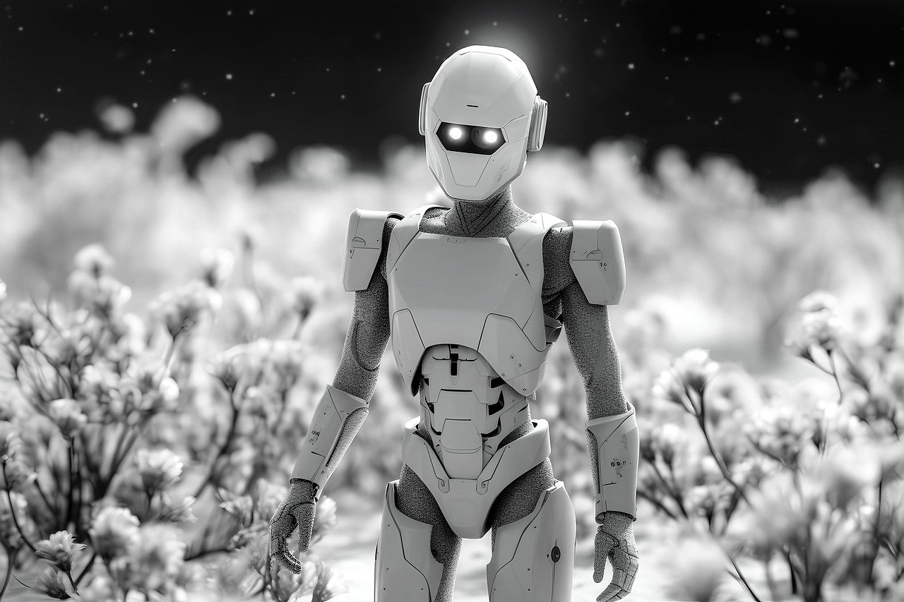


Slide 2


Unit
12
ROBOTS
LESSON 3: A CLOSER LOOK 2

Slide 3

LESSON 3: A CLOSER LOOK 2
LESSON 1: GETTING STARTED
Sentence racing
WARM-UP
Superlative adjectives: short adjectives
Task 1: Write the superlative form of the adjectives in the table. (p. 61)
GRAMMAR FOCUS
Task 2 + 3: Complete the sentences with comparative or superlative form of the adjectives. (p. 61 + 62)
Task 4: Work in pairs. Look at the information of three robots: M10, H9 and A3 and talk about each of them, using superlative adjectives. (p. 62)
PRACTICE
PRODUCTION
Game: Find someone who…
CONSOLIDATION
Wrap-up
Homework

Slide 4

WARM-UP
SENTENCE RACING

Slide 5
WARM-UP
- Work in groups
- There is a set of word cards which contains superlative adjectives of short adjectives to each group.
- You have to work in groups to create as many correct sentences from the word cards as possible.
- The group with the most correct sentences will be the winner.

Slide 6
WARM-UP
Example:
.................... is the tallest in my class

Slide 7

WARM-UP

Slide 8

LESSON 3: A CLOSER LOOK 2
LESSON 1: GETTING STARTED
Sentence racing
WARM-UP
Superlative adjectives: short adjectives
Task 1: Write the superlative form of the adjectives in the table. (p. 61)
GRAMMAR FOCUS

Slide 9
Superlative adjectives: short adjectives
I‘m the TALLEST

Slide 10


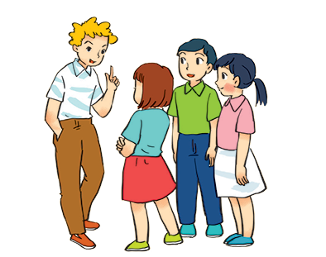
Superlative adjectives: short adjectives
We use superlative adjectives to compare three or more people or things.
Example:
- Tom is the tallest in his class.
- This is the biggest of the three bags.

Slide 11

GRAMMAR FOCUS
Write the superlative form of the adjectives in the table below.
Adjectives | Superlative form
fast
tall
noisy
nice
hot
light
quiet
heavy
large
fastest
tallest
noisiest
nicest
hottest
lightest
quietest
heaviest
largest

Slide 12

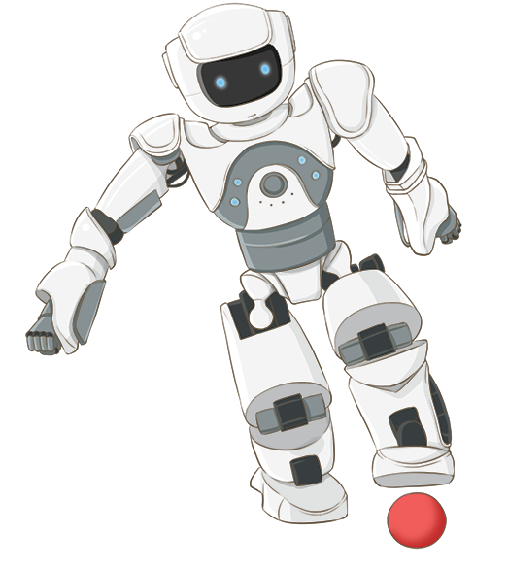
GRAMMAR FOCUS
Complete the following sentences with superlative form of the adjectives in brackets. 1 is an example.
1.
Bonbon can move 10 tons; it’s the strongest of all. (strong)
2.
This robot can understand all of what we say. It’s the
_______ in the robot show. (smart)
smartest in the robot show. (smart)
He is the
he is about 1.8 m tall. (tall)
_______ in our class;
3.
tallest in our class;
4.
This is the
we can put it in our bag. (small)
_______ of all home robots;
smallest of all home robots;
5.
This robot is only 200 dollars.
It’s the
cheapest in our shop. (cheap)
_______ in our shop. (cheap)

Slide 13



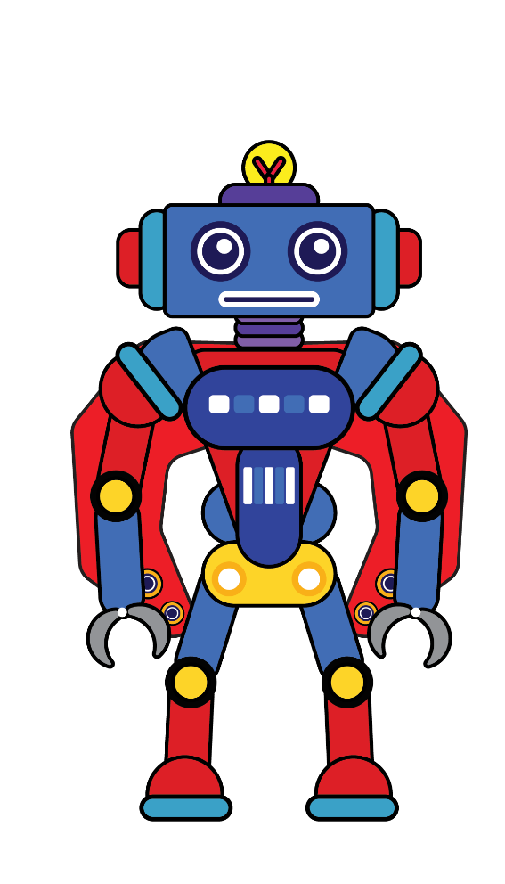
GRAMMAR FOCUS
A3
H9
Complete the following sentences with comparative or superlative form of the adjectives in brackets.
My brother’s room is
_______ than mine. (tidy)
1.
tidier than mine. (tidy)
2.
_______ desert of all is the Sahara and it’s in Africa. (hot)
The
hottest desert of all is the Sahara and it’s in Africa. (hot)
Travelling by plane is
faster than going by car. (fast)
3.
_______ than going by car. (fast)
Who is the
_______ in your family? (tall)
4.
tallest in your family? (tall)
_______ than cats. (smart)
5.
I think dogs are
smarter than cats. (smart)
M10
M10

Slide 14

GRAMMAR FOCUS
Work in pairs. Look at the information of the three robots: M10, H9, and A3 and talk about each of them, using superlative adjectives.
A3
H9
M10

Slide 15
GRAMMAR FOCUS
 | M10 | H9 | A3
Age | 5 | 7 | 10
Weight | 20 kg | 45 kg | 50 kg
Height | 80 cm | 120 cm | 150 cm
Price | $1.800 | $1.000 | $1.500
M10
H9
A3
Example:
A: A3 is the tallest of the three robots.
B: M10 is the youngest of the three robots.
…

Slide 16
LESSON 3: A CLOSER LOOK 2
LESSON 1: GETTING STARTED
Sentence racing
WARM-UP
Superlative adjectives: short adjectives
Task 1: Write the superlative form of the adjectives in the table. (p. 61)
GRAMMAR FOCUS
Task 2 + 3: Complete the sentences with comparative or superlative form of the adjectives. (p. 61 + 62)
Task 4: Work in pairs. Look at the information of three robots: M10, H9 and A3 and talk about each of them, using superlative adjectives. (p. 62)
PRACTICE
PRODUCTION
Game: Find someone who…

Slide 17


PRODUCTION
Find someone who…
Work in pairs. Ask your partner to find in your class someone who is
the tallest
the oldest
the smartest
the shortest
the biggest
the smallest

Slide 18
LESSON 3: A CLOSER LOOK 2
LESSON 1: GETTING STARTED
Sentence racing
WARM-UP
Superlative adjectives: short adjectives
Task 1: Write the superlative form of the adjectives in the table. (p. 61)
GRAMMAR FOCUS
Task 2 + 3: Complete the sentences with comparative or superlative form of the adjectives. (p. 61 + 62)
Task 4: Work in pairs. Look at the information of three robots: M10, H9 and A3 and talk about each of them, using superlative adjectives. (p. 62)
PRACTICE
PRODUCTION
Game: Find someone who…
CONSOLIDATION
Wrap-up
Homework

Slide 19

CONSOLIDATION
1
Wrap-up
What have we learnt in this lesson?
Use superlative adjectives: short adjectives correctly..

Slide 20

CONSOLIDATION
2
Homework
Write the answers of exercise 2 and 3 on your notebooks.

Slide 21






Website: hoclieu.vn
Fanpage: facebook.com/www.tienganhglobalsuccess.vn/

