Slide 1

Unit 5: London Was Great!
Lesson 5e: Grammar
Page 94

Slide 2
Lesson Outline
Warm-up
Grammar
Consolidation
Wrap-up

Slide 3
Objectives
By the end of this lesson, students will be able to…
learn and practise the Past Simple (interrogative/
short answers) and question words.

Slide 4

WARM-UP

Slide 5
Which word has the underlined part pronounced differently from the others?
a. exciting b. relaxing c. vitamin d. arrive
a. scarf b. fat c. fast d. cart
a. expensive b. waterfall c. celebrate d. attend
a. loved b. rained c. washed d. planned
a. needed b. stopped c. finished d. checked
a. waited b. posted c. ended d. used

Slide 6
a. exciting b. relaxing c. vitamin d. arrive
/ɪkˈsaɪtɪŋ/ /rɪˈlæksɪŋ/ /ˈvɪtəmɪn/ /əˈraɪv/
2. a. scarf b. fat c. fast d. cart
/skɑːf/ /fæt/ /fɑːst/ /kɑːt/
3. a. expensive b. waterfall c. celebrate d. attend
/ɪkˈspensɪv/ /ˈwɔːtəfɔːl/ /ˈseləbreɪt/ /əˈtend/

Slide 7
4. a. loved b. rained c. washed d. planned
5. a. needed b. stopped c. finished d. checked
6. a. waited b. posted c. ended d. used
/d/
/d/
/t/
/d/
/id/
/t/
/t/
/t/
/id/
/id/
/id/
/d/

Slide 8
Each student chooses one phrase and makes a sentence using Past Simple.
get a good/ bad mark | sing a song | play football | read a book
visit somewhere | take lots of phots | eat at a restaurant | eat fried chicken
stay at home | play games | help mother with housework | watch TV
do my homework | draw a picture | go to the park | clean my house

Slide 9
Teacher asks some students to read aloud their sentences.
Teacher elicits that if we want to know more information about friends’ activities in the past, we should ask questions:
Did you watch TV alone?
Why did you stay at home?
What book did you read?

Slide 10
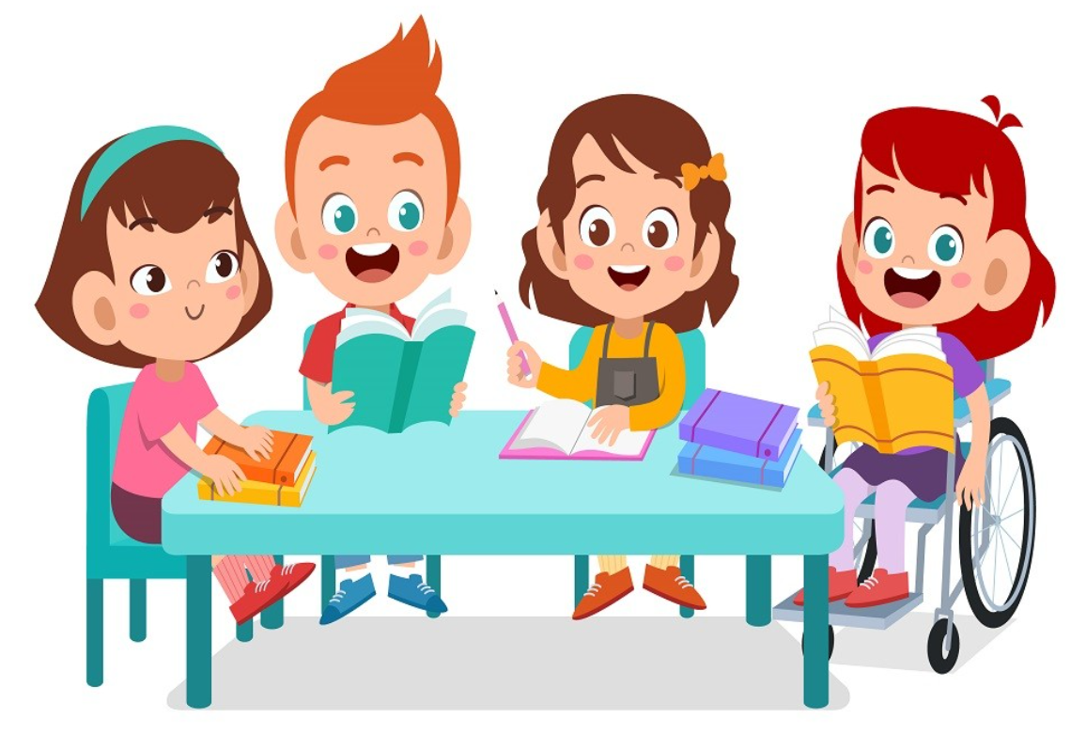
It’s time to learn …

Slide 11
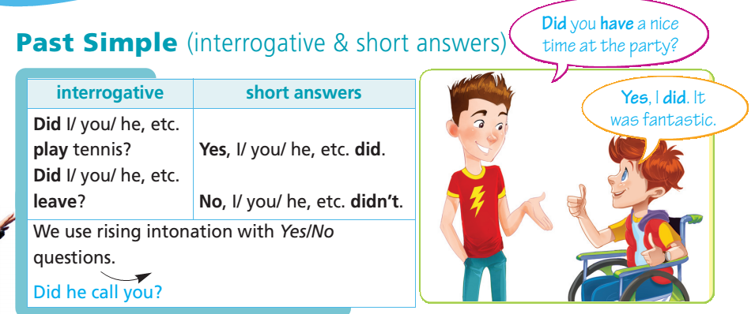

Slide 12
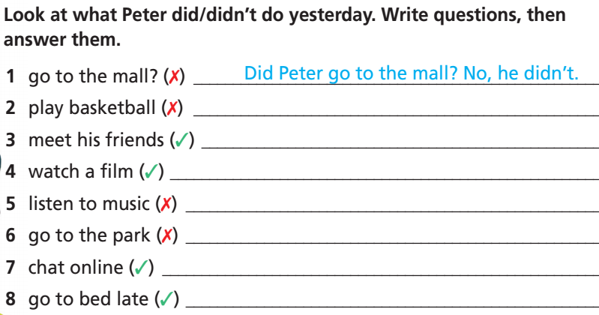
Did Peter play basketball? No, he didn’t.
Did Peter meet his friends? Yes, he did.
Did Peter watch a film? Yes, he did.
Did Peter listen to music? No, he didn’t.
Did Peter go to the park? No, he didn’t.
Did Peter chat online? Yes, he did.
Did Peter go to bed late? Yes, he did.

Slide 13
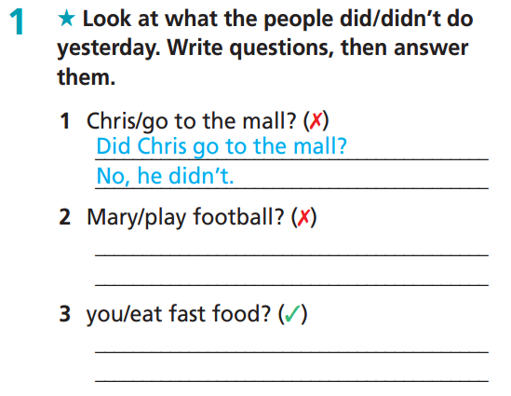
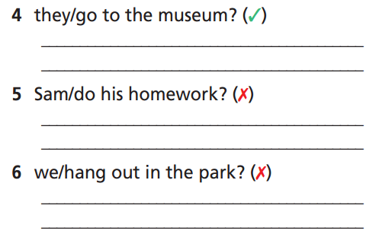
Extra-practice
WB-P. 48
Did they go to the museum?
Yes, they did.
Did Mary play football?
No, she didn’t.
Did Sam do his homework?
No, he didn’t.
Did you eat fast food?
Yes, I did.
Did we hang out in the park?
No, we didn’t.

Slide 14
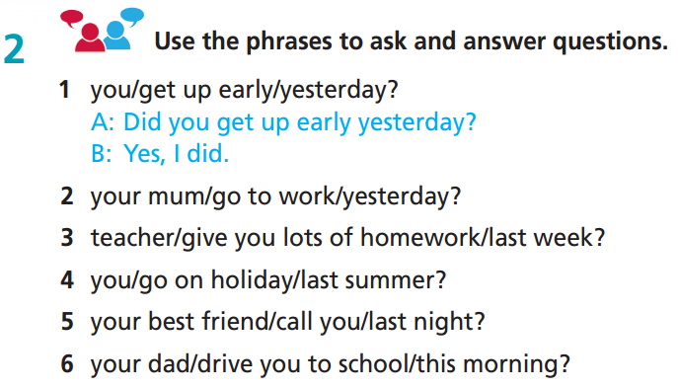

Slide 15
2 . your mum/go to work/yesterday?
Did your mum go to work yesterday? Yes, she did./No, she didn’t.
3. teacher/give you lots of homework/last week?
Did your teacher give you lots of homework last week? Yes, he/she did./No, he/she didn’t.
4. you/go on holiday/last summer?
Did you go on holiday last summer? Yes, I did./ No, I didn’t.
5. your best friend/call you/last night?
Did your best friend call you last night? Yes, he/she did./No, he/she didn’t.
6. your dad/drive you to school/this morning?
Did your dad drive you to school this morning? Yes, he did./No, he didn’t.

Slide 16
Past Simple (question words)
Why did you go to the party?
Question word + did + S + V-inf
Who did you talk to?
What time did you get up yesterday?
Where did you go last night?
What did you watch on TV last night?
When did you see the film?

Slide 17
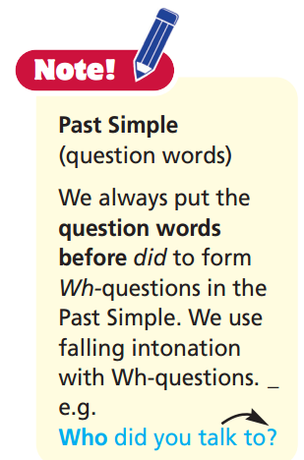

Slide 18
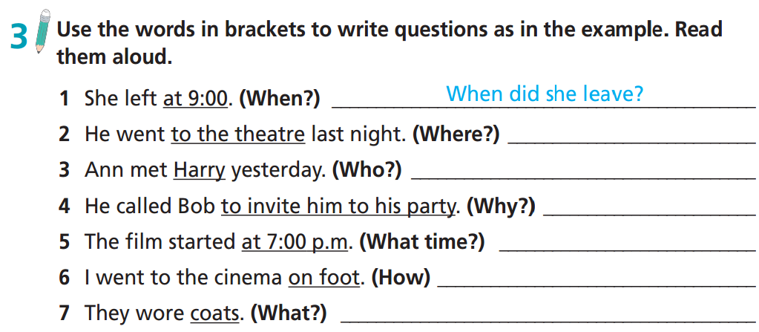
Where did he go last night?
Who did Ann meet yesterday?
Why did he call Bob?
What time did the film start?
How did you go to the cinema?
What did they wear?

Slide 19
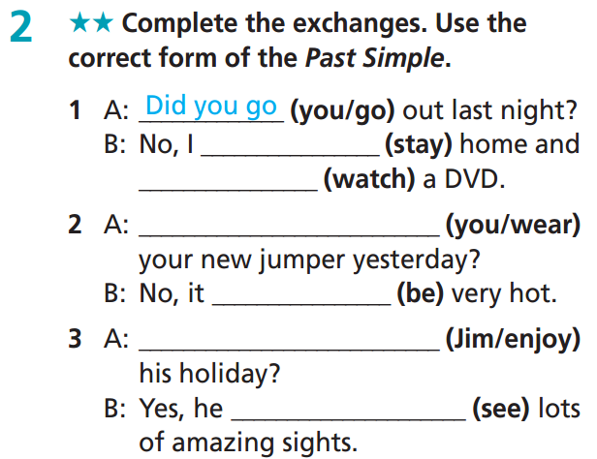
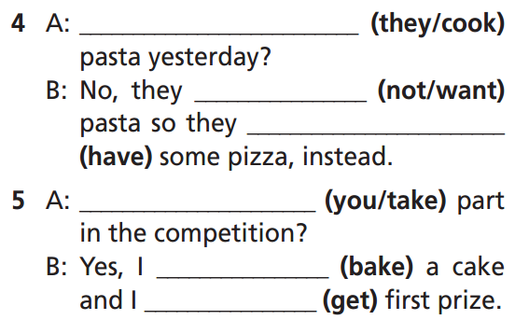
Extra-practice
WB-P.48
Did they cook
didn’t want
stayed
watched
had
Did you wear
Did you take
was
Did Jim enjoy
baked
got
saw

Slide 20
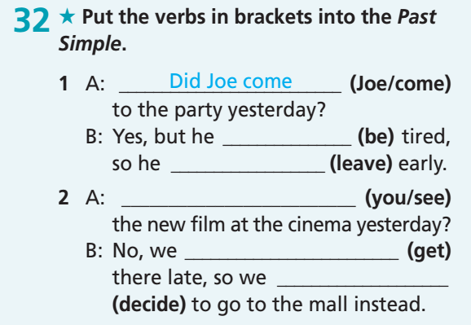
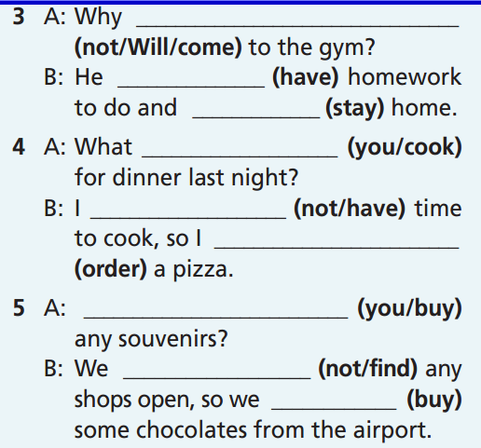
Extra-practice
GB-P. 71
didn’t Will come
had
stayed
did you cook
was
left
didn’t have
ordered
Did you see
got
Did you buy
decided
didn’t find
bought

Slide 21
Answer the questions:
Where did you on your last holiday?
What did you play yesterday evening?
Did you watch a film last night?
How did your mother go to work yesterday?
5. What did you do for your last birthday?
6. Did you eat ice cream when you were a child?
7. Did you have a lot of friends when you were a child?
8. Who taught you to ride a bike?

Slide 22
Find someone who ………. by asking questions using Past Simple.
Find someone who ….. | Name | More information
watched TV yesterday | Nam | Cartoon
had lunch at home yesterday
got up before 6.am. this morning
went shopping last week
ate pizza
took photos last week
- Did you watch TV yesterday?
- What did you watch?

Slide 23

CONSOLIDATION

Slide 24
Write about 40-50 words about activities that you did when you were a child.
There are some verbs you may want to use: ride, play, eat, read, listen, have…..
My name is Tuan. I was born in 2011. When I was a child, I went to a school near my house. After school, I went home and had dinner with my family. Then, I played games with friends near my house. We also ate ice cream. In the evening, I watched TV for 15 minutes. I didn’t have homework. At the weekend, my dad took me to the zoo. I saw lots of animals there.

Slide 25
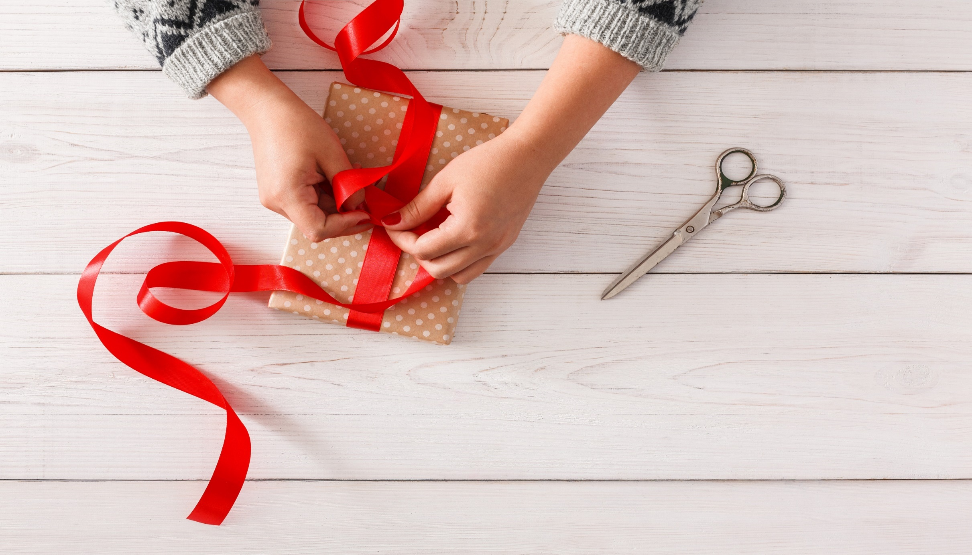
WRAP-UP

Slide 26
Today’s lesson
Grammar
Learn and practise the Past Simple (interrogative/short answers) and question words.

Slide 27
Homework
Practise grammar and make sentences using them.
Do the exercises in TA 6 Right on WB (p. 48).
Complete the grammar notes in TA 6 Right on Notebook (p. 50).
Prepare the next lesson (p. 95 SB).

Slide 28
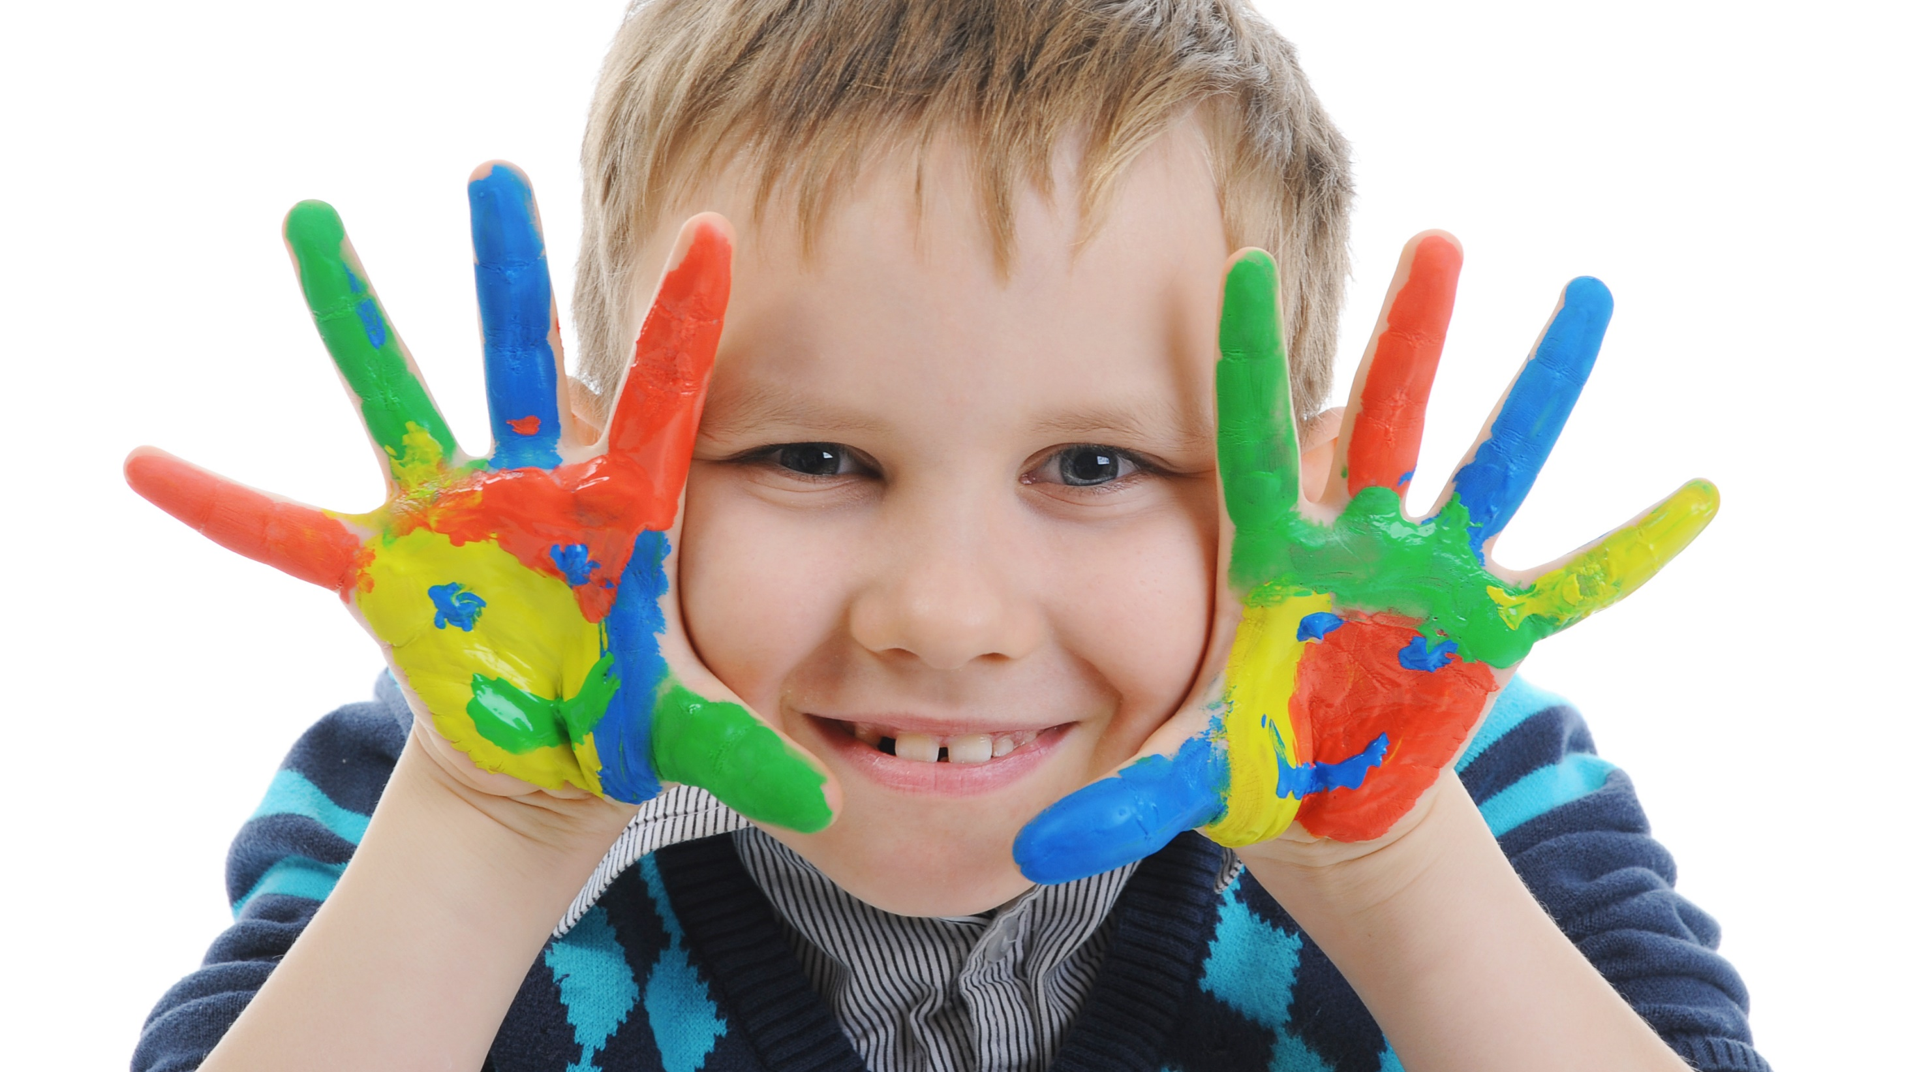
Enjoy your day!

