Slide 1

UNIT 9: TRAVEL AND TOURISM
Lesson 2.3 – Pronunciation & Speaking
Page 79

Slide 2



Lesson 2.3
LESSSON OUTLINE
Consolidation

Slide 3
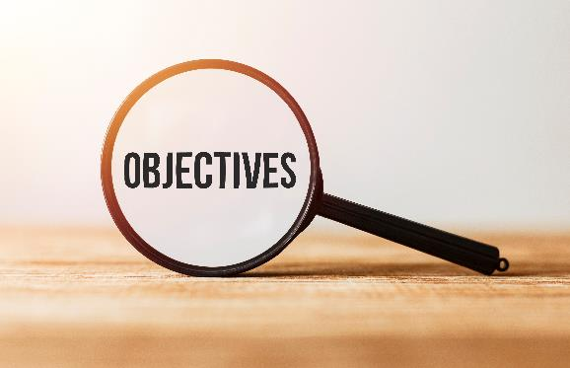
By the end of this lesson,
students will be able to:
- practice falling intonation.
- talk about experiences on vacations.
- improve speaking skill.

Slide 4
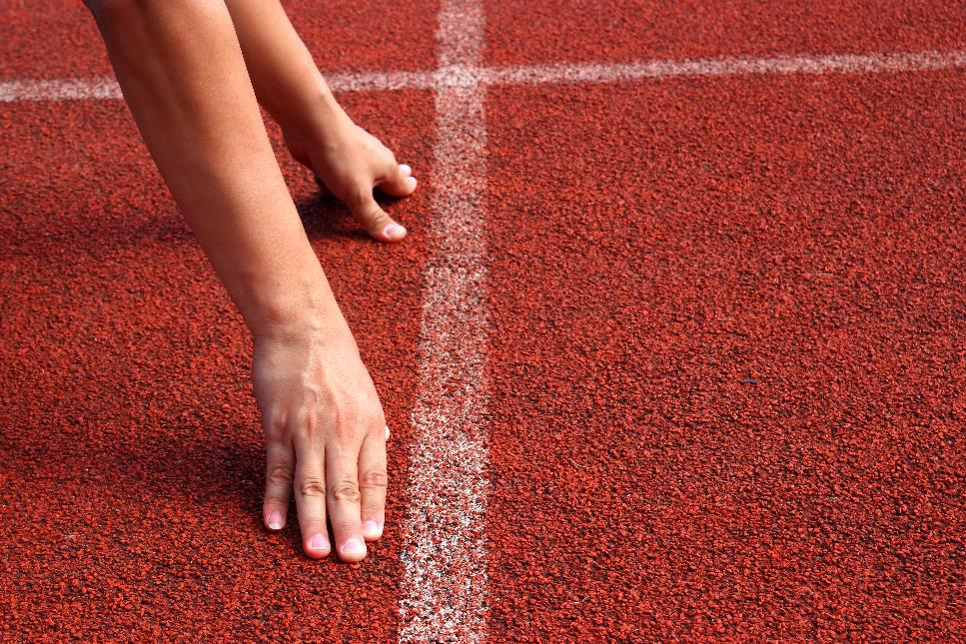


Slide 5

Choose the word whose main stress is placed
differently from the others.
Work in pairs.
A. dolphin B. alarm C. fashion D. shelter
2. A. measurement B. family C. fluency D. safari
3. A. bungalow B. poisoning C. prediction D. e-learning
/ˈdɑ:lfɪn/
/əˈlɑ:rm/
/ˈfæʃən/
/ˈʃeltə/
/ˈmeʒəmənt/
/ˈfæməli/
/ˈflu:ənsi/
/səˈfɑ:ri/
/ˈbʌŋɡəloʊ/
/ˈpɔɪzənɪŋ/
/prɪˈdɪkʃn/
/ˈi: lɜ:rnɪŋ/

Slide 6
Work in pairs.
Choose the word whose underlined part is
pronounced differently from that of the other words.
A. broken B. stolen C. chosen D. gotten
2. A. busy B. funny C. muddy D. sunny
3. A. introduce B. interrupt C. interfere D. isolate
/ˈbroʊkən/
/ˈstoʊlən/
/ˈtʃoʊzən/
/ˈɡɑːtən/
/ˈbɪzi/
/ˈfʌni/
/ˈmʌdi/
/ˈsʌni/
/ˌɪntrəˈdu:s/
/ˌɪntəˈrʌpt/
/ˌɪntəˈfɪr/
/ˈaɪsəleɪt/

Slide 7
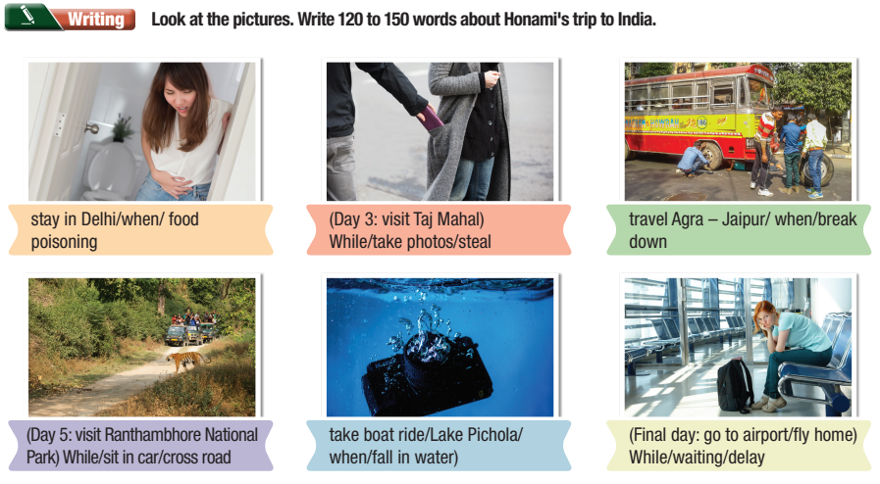
Checking homework
Notes:
Choose some student’s products to stick on the board, ask the others to move around to read and give comments (check the grammar mistakes related to the using of when and while)

Slide 8
Checking homework
Suggested answers/ product
Honami's trip to India was full of events. First, she was staying in Delhi when she had food poisoning. Then, on Day 3, she visited the Taj Mahal. While she was taking photos, her wallet was stolen. Next, she was travelling from Agra to Jaipur when the bus broke down. Then, on Day 5, she visited Ranthambhore National Park. While Honami was sitting in a car, a tiger crossed the road in front of her. After that, she was taking a boat ride on Lake Pichola when her camera fell into the water. On the final day, Honami went to the airport to fly home. While she was waiting at the airport, her flight was delayed.

Slide 9


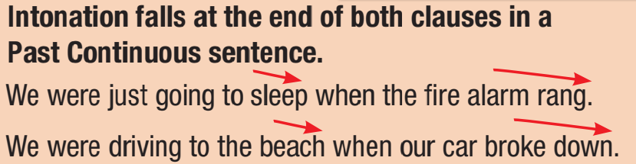
Listen to the sentences and notice how the intonation falls.
I was watching TV when the phone rang.
While we were driving to the beach, our car broke down.

Slide 10
c. Listen and cross out the sentence with the wrong intonation.
While we were walking, it started to snow.
While he was waiting for his taxi, someone stole his phone
Read the sentences with the correct intonation to a partner.

Slide 11

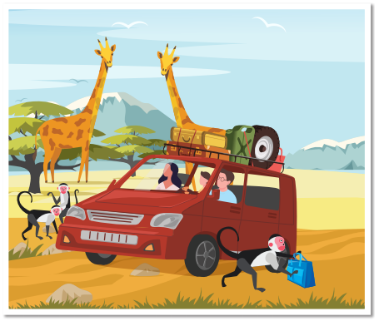
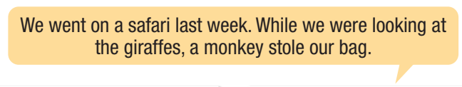
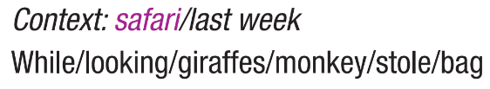
Take turns making sentences using the pictures and prompts.
Example:

Slide 12

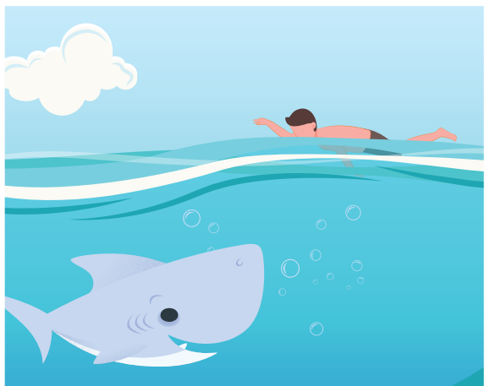
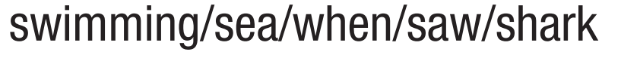
Take turns making sentences using the pictures and prompts.

Slide 13
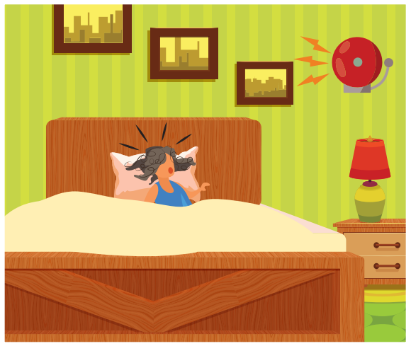
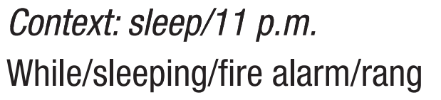
Take turns making sentences using the pictures and prompts.

Slide 14
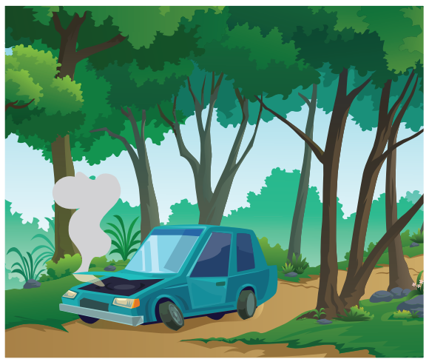

Take turns making sentences using the pictures and prompts

Slide 15

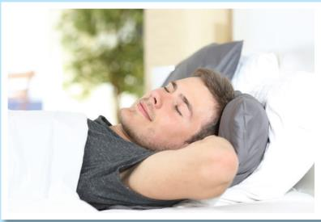
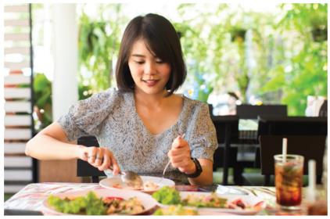
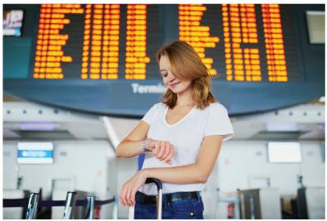
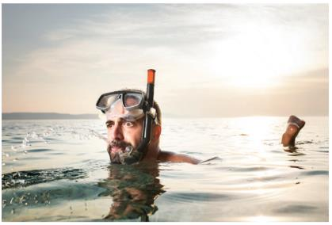
YOU WOULDN'T BELIEVE WHAT HAPPENED ON MY VACATION.
a. You had a nightmare vacation. In pairs:
Look at the pictures and make a story. Tell your story to your partner. (Page 93)
ACTIONS

Slide 16
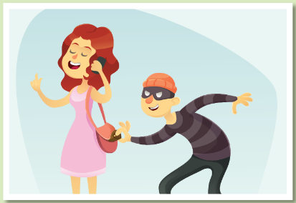
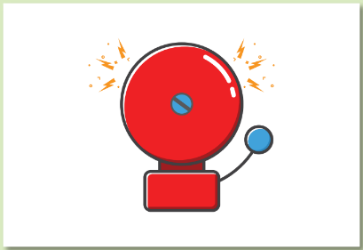
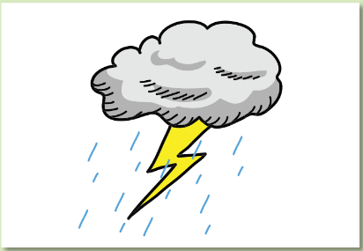
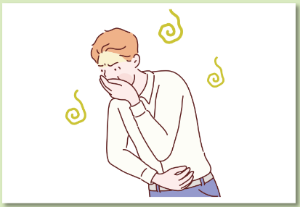
YOU WOULDN'T BELIEVE WHAT HAPPENED ON MY VACATION
a. You had a nightmare vacation. In pairs:
Look at the pictures and make a story. Tell your story to your partner. (Page 93)
INTERRUPTIONS

Slide 17
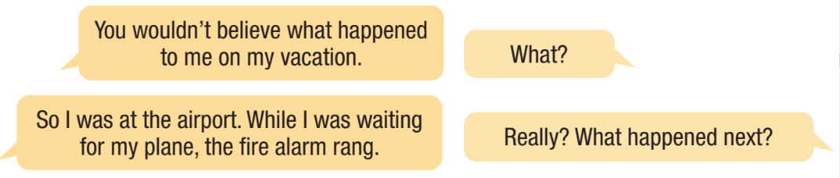
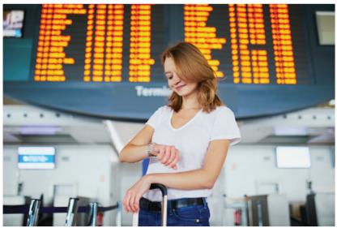
Example
ACTIONS
INTERRUPTIONS

Slide 18

Post Speaking
In pairs: Have you ever had any problems while traveling? Tell your partner.

Slide 19

Consolidation

Slide 20
Wrap-up
Today’s lesson
Pronunciation: practice falling intonation.
Speaking: talk about experiences on vacations.

Slide 21
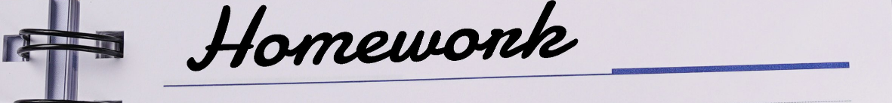
Make a list of five things that help you have good vacations.
Prepare the next lesson: Lesson 3.1 – Listening & Reading, (page 80).
Play the consolidation games in Tiếng Anh 10 i-Learn Smart World DHA App on www.eduhome.com.vn

