Slide 2
Unit
10
The ecosystem
Unit
FAMILY LIFE
LESSON 8
LOOKING BACK AND PROJECT

Slide 3
LESSON 8
LOOKING BACK AND PROJECT
WARM-UP
Who is faster?
- Pronunciation: Intonation in tag questions
- Vocabulary: Ecosystem
- Grammar: Compound nouns
LOOKING BACK
PROJECT
Presentation: Restore and protect a local ecosystem
CONSOLIDATION
- Wrap up
- Homework

Slide 4
WARM-UP
MMING GAME
A student comes to the front
Teacher whispers one word into his/her ears.
Ss have to draw or mime the word. The rest of the class makes guesses.
The first student who correctly calls out the word gets a point.

Slide 5
WARM-UP
Suggested words:
Flora and fauna
Bacteria
Ecosystem
Insect
Climate change
Biodiversity

Slide 6
LOOKING BACK
1
Mark the intonation in the question tags. Then listen and check. Practise saying them in pairs.

Slide 7
LOOKING BACK
2
Choose the correct word to complete each sentence

Slide 8
LOOKING BACK
3
Find and correct the mistakes in the following sentences
➔ bus stop
➔ sunset
➔ sightseeing
➔ wildlife

Slide 9
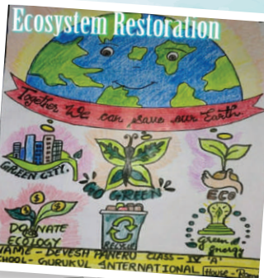
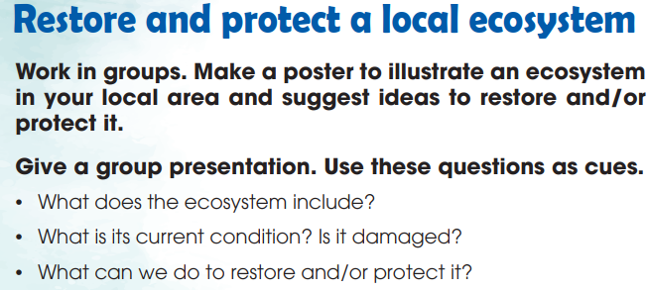
PROJECT
HOW CAN WE PRESERVE OUR HERITAGE?

Slide 10
CONSOLIDATION
1
Wrap-up
What have you learnt today?
- Review the vocabulary and grammar of Unit 10;
- Apply what you have learnt (vocabulary and grammar) into practice through a project.

Slide 11
CONSOLIDATION
2
Homework
Do exercises in the workbook.
Prepare for the End-of-term test.

Slide 12
Website: hoclieu.vn
Fanpage: facebook.com/sachmem.vn/

