Slide 1


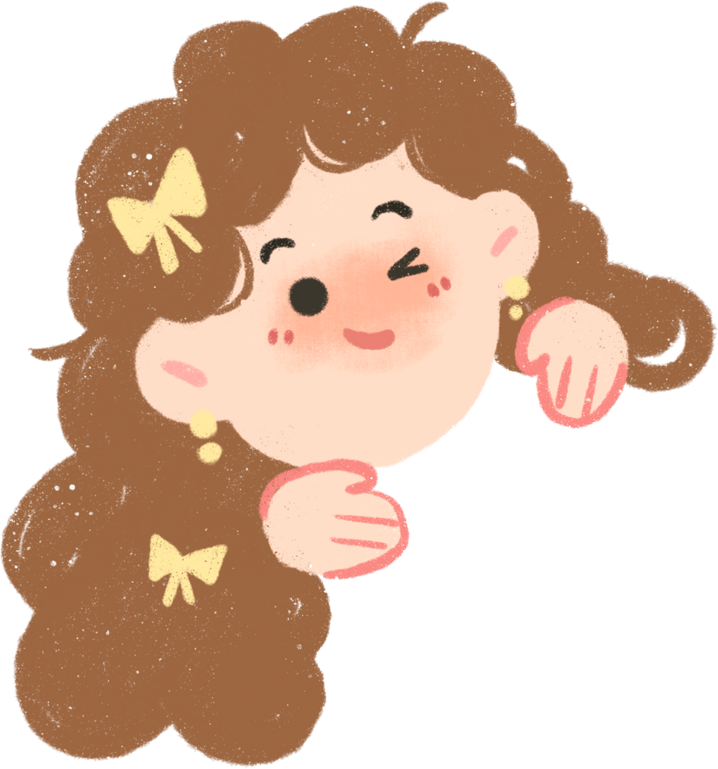
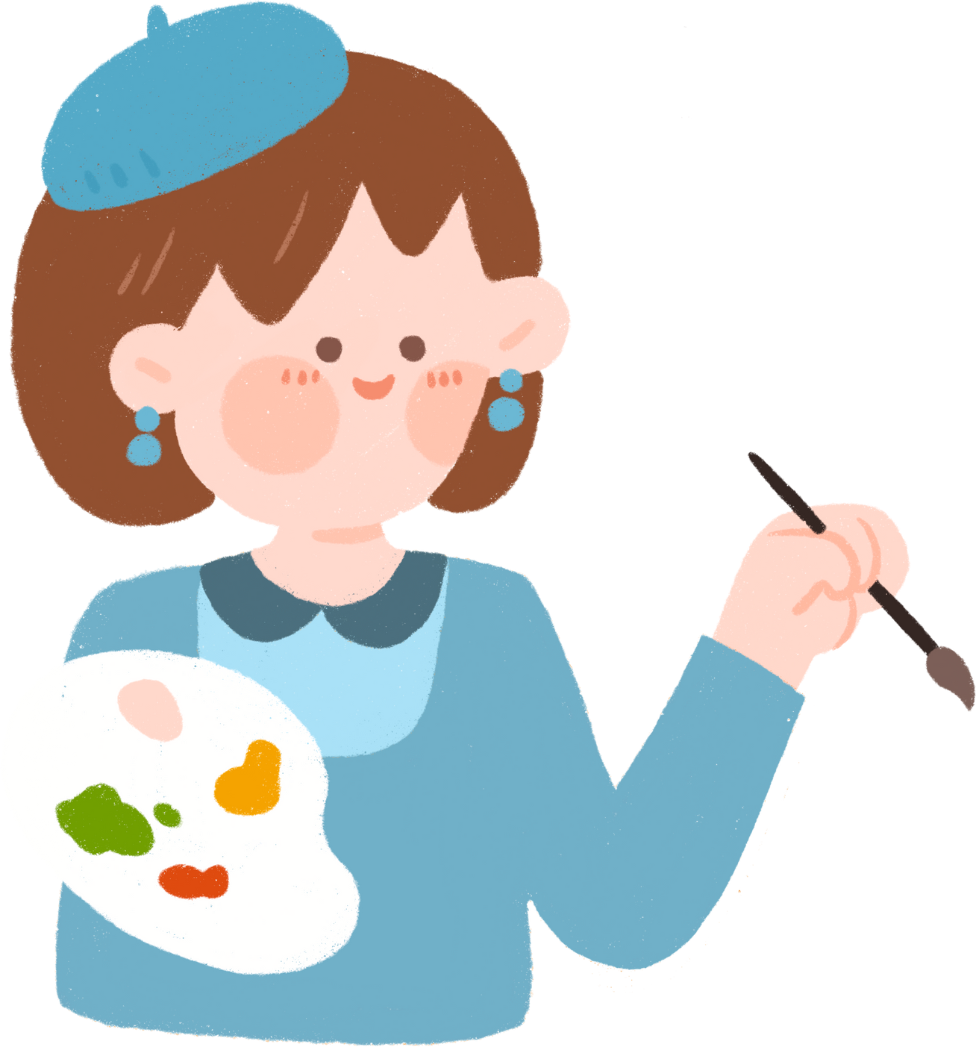




UNIT 3.
MY FRIENDS

Slide 2
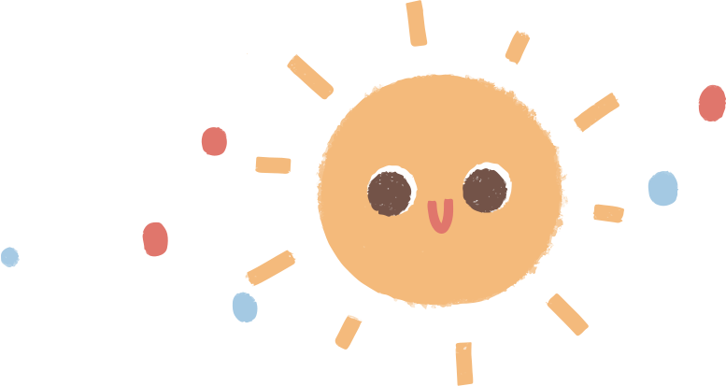




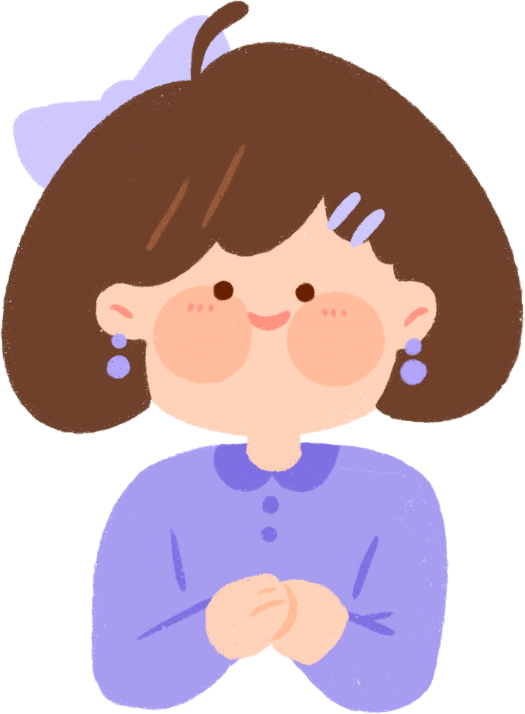

PART 1. THEORY
  I. VOCABULARY

Slide 3

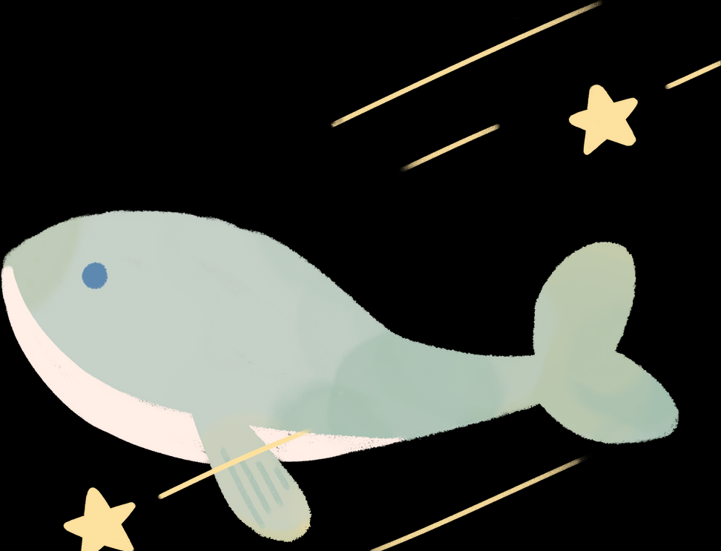

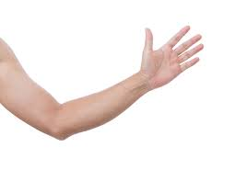
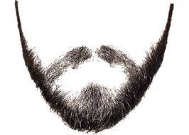

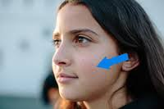
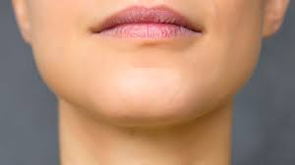
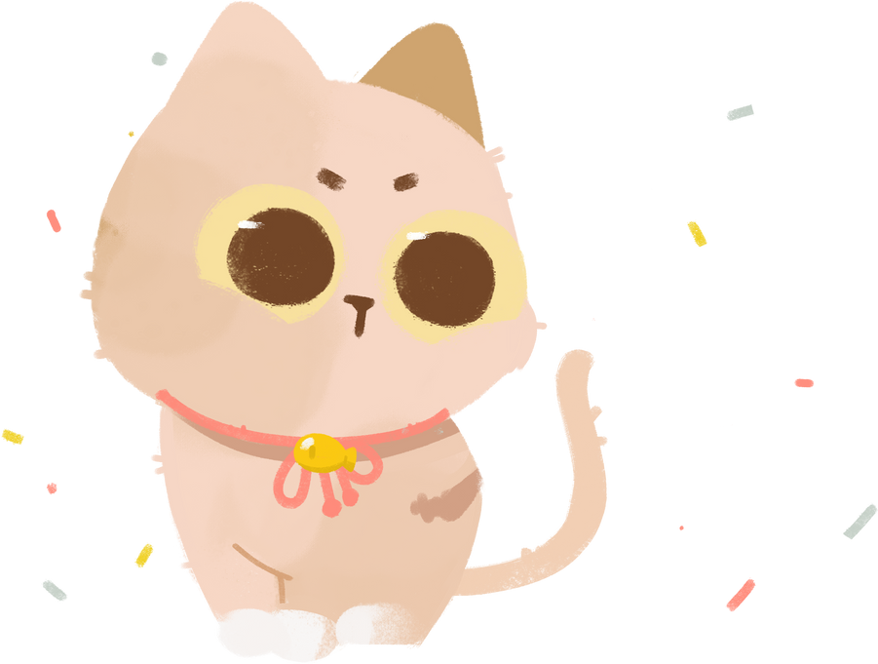

1. arm :
/ɑːm/
cánh tay
2. beard :
/bɪəd/
râu
3. cheek :
4. chin :
/tʃɪn/
cằm
/tʃi:k/
má

Slide 4
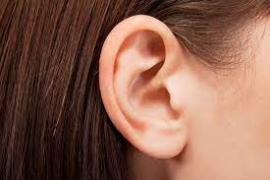
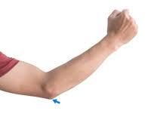
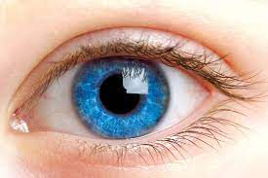
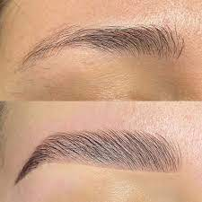
5. ear :
6. elbow :
/’elbəʊ/
khuỷu tay
/ɑːm/
cánh tay
8. eyebrow :
/'aɪbraʊ/
lông mày
7. eye :
/aɪ/
mắt

Slide 5
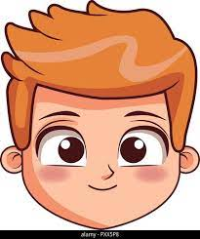

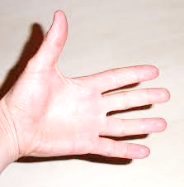
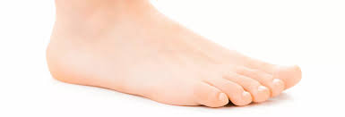
9. face :
/feɪs/
khuôn mặt
10. finger :
/'fɪηgə(r)/
ngón tay
11. foot :
12. hand :
/hænd/
bàn tay
/fʊt/
bàn chân

Slide 6

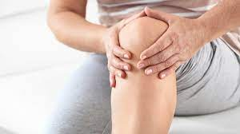

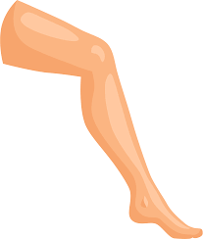
13. head :
/hed/
đầu
14. knee:
/ni:/
đầu gối
15. leg :
16. lip :
/leg/
chân
/lɪp/
môi

Slide 7

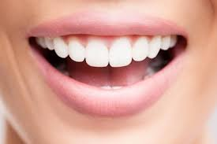


17. moustache :
18. mouth :
/mə'stɑːʃ/
ria
/maʊθ/
miệng
19. neck :
20. nose :
/nek/
cổ
/nəʊz/
mũi

Slide 8
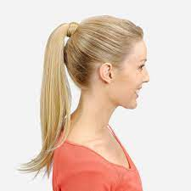
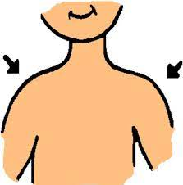
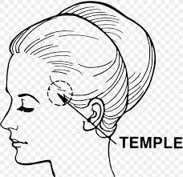

21. ponytail :
22. shoulder :
/'ʃəʊldə(r)/
vai
/'pəʊnɪteɪl/
tóc đuôi ngựa
23. temple :
24. tooth :
/'templ/
thái dương
/tu:θ/
răng

Slide 9
arm
beard
cheek
chin
ear
elbow
eye
eyebrow
face
finger
foot
Hand
head
knee
leg
lip
moustache
mouth
neck
nose
ponytail
shoulder
Temple
tooth

Slide 10



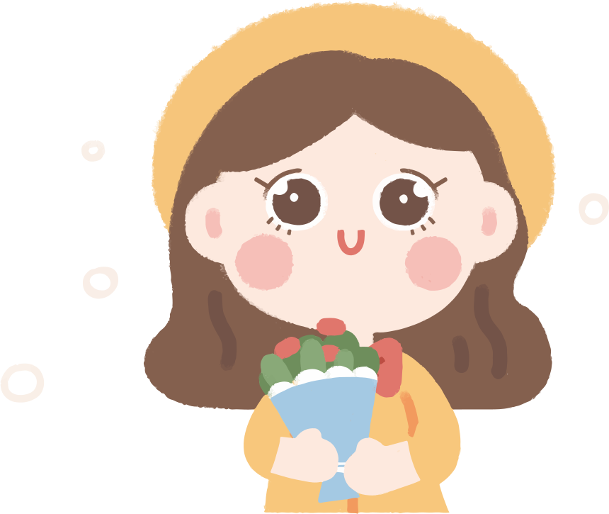

Vocabulary checking
https://wordwall.net/resource/26535276
https://wordwall.net/resource/27459064
Notes:
Link 1: face part
Link 2: body parts

Slide 11
Một số tính từ chỉ ngoại hình.

Slide 12
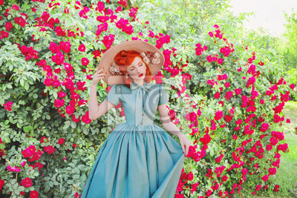
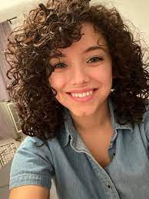
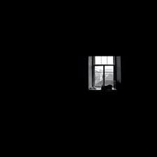
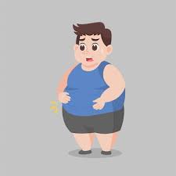
1. bonny :
2. curly :
/'kɜ:lɪ/
(tóc) xoăn
/'bɒnɪ/
xinh, có duyên
3. dark :
4. fat :
/dɑːk/
đen (màu da, tóc)
/fæt/
béo

Slide 13

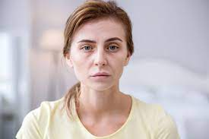
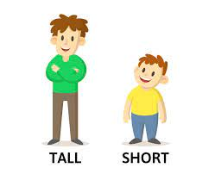
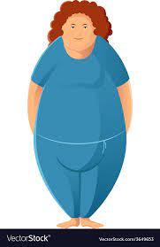
5. light-brown :
6. pale :
/laɪt braʊn/
nâu nhạt
/peɪl/
nhợt nhạt (màu da)
7. plump :
/plʌmp/
mập
8. short :
/ʃɔ:t/
thấp, lùn, ngắn

Slide 14
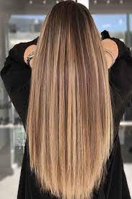
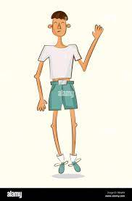
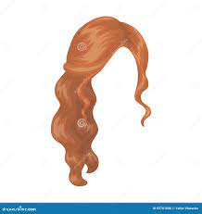
9. slim/ slender :
10. straight :
/streɪt/
(tóc) thẳng
/slɪm/, /'slendə(r)/
gầy, mảnh mai
(nghĩa tích cực)
11. tall :
/tɔ:l/
cao
12. thin/ skinny:
/θin/, /'skɪnɪ/
gầy, ốm
(nghĩa tiêu cực)
13. wavy:
/'weɪvɪ/
(tóc) lượn sóng

Slide 15
bonny
curly
dark
fat
light-brown
pale
plump
short
slim/ slender
straight
tall
thin/ skinny
wavy

Slide 16
Vocabulary checking
https://wordwall.net/resource/33220922
https://wordwall.net/resource/26980014

Slide 17
Một số tính từ chỉ phẩm chất, tính cách.

Slide 18
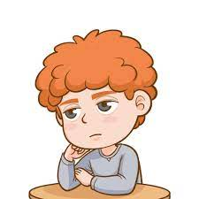
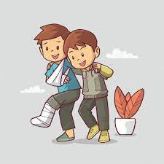
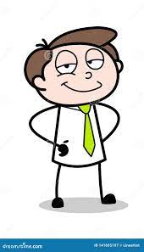

1. boring :
2. caring:
/'bɔ:rɪη/
nhàm chán
/'keərɪη/
chăm sóc, quan tâm
3. clever :
4. confident :
/'klevə(r)/
thông minh, khéo léo
/'kɒnfɪdənt/
tự tin

Slide 19

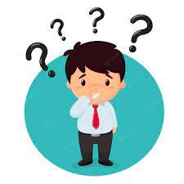
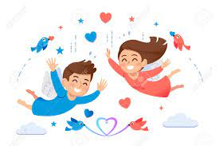

5. creative :
6. curious:
/krɪ’eɪtiv/
sáng tạo
/‘kjuərɪəs/
tò mò
7. freedom-loving :
8. hard-working :
/hard 'wɜ:kɪη/
chăm chỉ
/'frɪrdəm 'Iʌvɪη/
yêu tự do

Slide 20
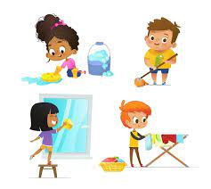

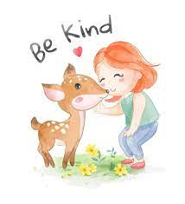

9. helpful :
10. independent:
/'helpfl/
hữu ích, giúp đỡ
/.ɪndɪ’pendənt/
tự lập
12. kind :
/kaɪnd/
tốt bụng
11. intelligent :
/ɪn'telɪdʒənt/
thông minh

Slide 21
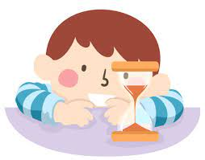

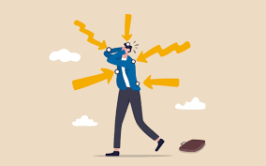

13. patient :
14. reliable :
/rɪ'laɪəbl/
đáng tin cậy
/'peɪʃnt/
kiên nhẫn
16. sensitive :
/'sensətɪv/
nhạy cảm
15. responsible :
/rɪspɒnsəbl/
có trách nhiệm

Slide 22
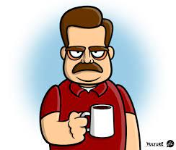
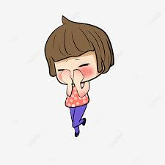
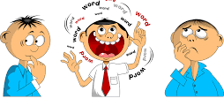
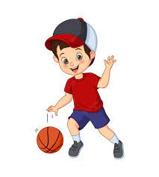
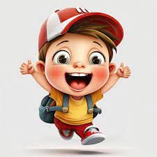
17. serious :
18. shy :
/ʃaɪ/
xấu hổ, ngại ngùng
/'sɪərɪəs/
nghiêm túc
20. talkative :
/'tɔ:kətɪv/
nói nhiều
19. sporty :
/'spɔ:tɪ/
yêu thể thao,
khỏe mạnh
21. funny :
/fʌnɪ/
vui nhộn

Slide 23
boring
caring
clever
confident
creative
curious
freedom-loving
hard-working
Helpful
Independent
intelligent
kind
patient
reliable
responsible
sensitive
serious
shy
sporty
talkative
funny

Slide 24
Vocabulary checking
https://wordwall.net/resource/58064966
https://wordwall.net/resource/24749457

Slide 25
PART 1. THEORY
  II. GRAMMAR

Slide 26

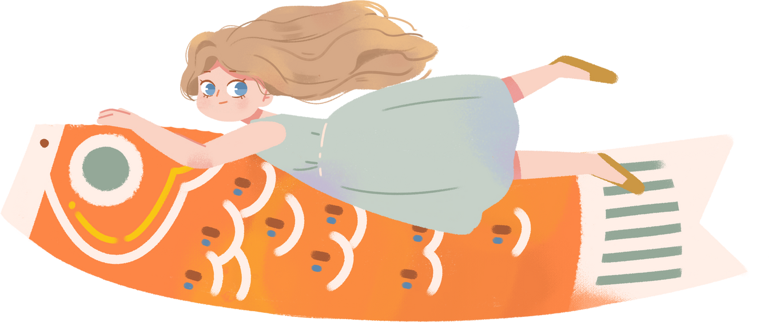
1. Present continuous
a. Form (Câu trúc)
Examples:
• I am studying English now.
He is playing badminton.
She is not cooking dinner.
• Are you learning Maths now?
- Yes, I am.
• Is she cleaning the floor?
- No, she isn’t.

Slide 27
b. Usage (Cách sử dụng)
- Thì hiện tại tiếp diễn diễn tả một hành động đang xảy ra tại thời điểm nói.
Ex. My brother is watching TV now.
(Anh trai tôi đang xem tivi.)
My sister is listening to music at the moment.
(Vào lúc này, chị tôi đang nghe nhạc.)
- Thì hiện tại tiếp diễn cũng diễn tả một hành động đang xảy ra nhưng không nhất thiết tại thời điểm nói mà có thể xung quanh thời điểm nói đó.
Ex. My father is quite busy these days. He is writing a novel.
(Dạo này bố tôi tôi khá bận. ông ấy đang viết một cuổn tiểu thuyết.)
Chú ý: Việc "writing a novel" đang không thực sự diễn ra nhưng vẫn xảy xung quanh thời điểm nói. Ý những câu này là hành động đang trong quá trình thực hiện và vẫn chưa làm xong.

Slide 28
- Thì hiện tại tiếp diễn diễn tả hành động thường xuyên lặp đi lặp lại gây bực mình hay khó chịu cho người nói. Ta thường dùng kèm với trạng từ tần suất "always, continually”.
Ex. He is always losing his key.
(Anh ta lúc nào cũng đánh mất chìa khóa.)
Why are you continually putting your toys on the bed?
(Tại sao con cứ luôn để đồ chơi trên giường thế?)

Slide 29
c. Signals (Các dấu hiệu nhận biết)
Trong câu thường có các trạng từ chỉ thời gian như:
- now: bây giờ
- right now: ngay bây giờ
- at the moment: ngay lúc này
- at present: hiện tại
- It’s + giờ cụ thể + now. (It's 10 o'lock now.)

Slide 30
Hoặc thường có các động từ như:
- Look!/ Watch! (Nhìn kìa!)
Ex: Look! A man is jumping from the bridge!
(Nhìn kìa! Một người đàn ông đang nhảy từ trên cầu xuống!)
- Listen! (Nghe này!)
Ex: Listen! Someone is knocking at the door!
(Nghe này! Ai đó đang gõ cửa.)
- Keep silent! (Hãy im lặng!)
Ex: Keep silent! The teacher is explaining the lesson!
(Trật tự! Thầy giáo đang giảng bài!)
- Watch out! = Look out! (Coi chừng)
Ex: Watch out! The car is moving very fast!
(Coi chừng! Chiếc ô tô đang di chuyển rất nhanh!)

Slide 31
d. Cách thêm đuôi -ing
- Thông thường nhất, ta thêm đuôi -ing vào sau hàu hết các động từ.
Ex: learn – learning go - going
- Với những động từ có tận cùng là "e”, khi thêm đuôi -ing thì ta sẽ bỏ đuôi "e" và thêm "ing”.
Ex: make - making use – using
- Nếu động từ có 1 âm tiết kết thúc bằng một phụ âm (trừ h, w, X, y), đi trước là một nguyên âm, ta gấp đôi phụ âm trước khi thêm "ing.
Ex: stop - stopping run - running
- Động từ kết thúc là "ie” thì khi thêm "ing", thay "ie” bằng "y” rồi thêm "ing”.
Ex: lie - lying die - dying

Slide 32
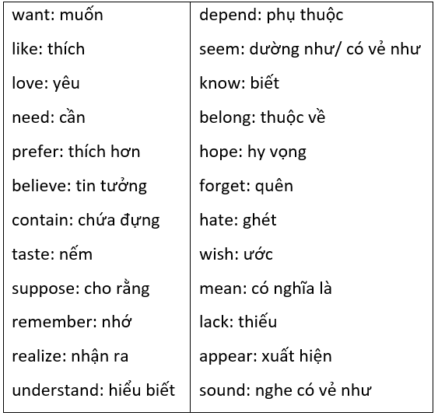
e. Chú ý: Những động từ trong bảng sau không chia ở thì hiện tại tiếp diễn:

Slide 33
Grammar checking
https://wordwall.net/resource/23454157
https://wordwall.net/resource/19215075
https://wordwall.net/resource/38257289
Notes:
Link 1: chọn đáp án
Link 2: quy tắc thêm ing
link3L chọn đáp án tổng hợp

Slide 34
PART 1. THEORY
  III. PHONETICS

Slide 35


 Cách phát âm âm /p/ và /b/.
a. Âm /p/

Slide 36


b. Âm /b/

Slide 37
PART 2. LANGUAGE
  I. VOCABULARY

Slide 38






Exercise 1. Write the opposite adjective.
mean
unfriendly
lazy
cruel
shy
careless
stupid
dishonest
funny
impatient
rude/impolite
interesting

Slide 39

Exercise 2. Guess these following words from their definitions.
eyes
mouth
neck
hand
hair
nose
arm
beard
fingers
teeth

Slide 40
Exercise 3. Complete each sentence with suitable word. There are 2 extra words.
patient
hard-working
lazy
reliable
curious
funny
sporty
talkative
sensitive
boring
lovely
independent
1. This place is so ___________. There is nothing to play with.
2. She is so ___________. She always makes everybody laugh.
3. Maria is a ______________ student. Every day she studies until 11 p.m.
4. Nam is a ___________ boy. He even talks more than a girl.
5. They do sports every day. They are so ___________.
6. Tomorrow is my birthday. I am so ___________ that I open my gift before my birthday.
7. Sarah is very ___________. Yesterday she spent three hours just to explain one task for me.
8. Nana is quite ___________. You don't need to be worried to let her do that work.
9. She left her hometown to live on her own without taking any money from her parents. She was so _______________.
10. Danny's teeth are really ___________. They seem frostbitten when he drinks or eats something cold.

Slide 41
Exercise 4. Complete the sentences with the correct adjectives from the box.
cheerful
shy
confident
outgoing
generous
talkative
sporty
reliable
sensitive
curious
1. Don't say unkind things to Linda - she's very __________________.
2. Bill is very ___________. He gives money to charity every month.
3. Tom never stops talking in class. He's very ___________.
4. The new girl in my class is so ___________. She's afraid to talk in front of us
5. You can trust David with a secret. He’s a ___________ man.
6. James loves partying, meeting people and talking to them. He’s so ___________.
7. Jenny is such a ___________ girl. She is always laughing and smiling.
8. John is always sure of his own abilities. He's so ___________.
9. My best friend Jack is really ___________. He plays badminton, basketball and football very well.
10. My sister is very ___________. She wants to know everything!

Slide 42
PART 2. LANGUAGE
  II. GRAMMAR

Slide 43
Exercise 1. Complete the sentence with positive form of to be or to have.
1. I ___________ a taxi driver.
2. She ___________ a new house.
3. Anna ___________ a little girl.
4. We ___________ a small farm.
5. Tom ___________ short hair.
6. He ___________ an old car.
7. You ___________ a red pencil box.
8. The children ___________ many toys.
9. You ___________ two cats.
10. Kate ___________ long hair.
11. The giraffe ___________ a long neck.
12. We ___________ short and black hair.
13. Diana ___________ not a tall girl.
14. They ___________ not young but they__________ strong.
15. She ___________ a pink bag.
have
am
have
has
has
is
has
have
have
is
has
are
has
are
have
has

Slide 44
Exercise 2. Put the verbs in brackets in the correct form.
1. Look! She (smoke] ___________ in the non-smoking area.
2. My brother (tour) ___________ Italy at the moment.
3. We (save) ___________ money for the trip.
4. I (wear) ___________ a beautiful dress today because it's a special day.
5. This valuable watch (belong) ___________ to my mother now.
6. The telephone (ring) ___________. Can you please answer now?
7. Listen! Someone (knock) ___________ at the door.
8. It’s a beautiful day. The Sun (shine) ___________.
is smoking
is touring
are saving
am wearing
belongs
is ringing
is knocking
is shining

Slide 45
Exercise 2. Put the verbs in brackets in the correct form.
9. She usually (wear) ______________ a uniform to school but today she (wear) _____________casual clothes.
10. Peter (have) _______ a bad cold now. He (lie) ________on the sofa in the living room.
11. It (snow) _______________ at the moment?
12. Listen! John and Sue (play) _____________ the piano in our class.
13. We (wait) ___________ for a bus now.
14. It's 8 o'clock and my parents (work) ___________ in the office.
15. They (not/ jog) _______________ in the park right now.
wears
is wearing
has
is lying
Is it snowing
are playing
are waiting
are working
are not jogging

Slide 46
Exercise 3. Write in complete sentences using the present continuous.
1. She/ wash / her hair.
→ She's washing her hair.
2. It/ rain.
→ It's raining.
3. Jack and Rose/ sit/ on the couch.
→ Jack and Rose are sitting on the couch.
4. It/ snow/ heavily.
→ It's snowing heavily.
5. Linda/ learn/ French.
→ Linda's learning French.
6. My dad/ listen/ to the stereo.
→ My dad's listening to the stereo.
7. My friends/ smoke/ in their rooms.
→ My friends are smoking in their rooms.
8. I/ play/ video games.
→ I'm playing video games.
9. You/ watch/ movies?
→ Are you watching movies?
10. What/ you/ think?
→ What are you thinking?

Slide 47
Exercise 4. Choose the best option to complete the sentence.
1. Where (be) ________ his wife?
A. am B. is C. are D. be
2. Jack (wear) _______ a suit today.
A. is wearing B. are wearing C. am wearing D. wears
3. The weather (get) _______ warm this season.
A. gets B. are getting C. is getting D. are gets
4. My kids (be) _________ downstairs now. They (play) ________ chess.
A. am/am playing B. is/is playing C. are/are playing D. be/being
5. Look! The train (come) __________.
A. are coming B. is coming C. are coming D. is coming
6. Alex always (borrow) _______ me cash and never (give) ________ back.
A. is borrowing/ giving B. are borrowing/ giving
C. borrows/ giving D. borrow/ giving

Slide 48
Exercise 4. Choose the best option to complete the sentence.
7. While I (do) _______ my homework, my sister (read) _____ newspapers.
A. am doing/ is reading B. are doing/ is reading
C. is doing/ are reading D. am doing/ are reading
8. Why __________ at me like that? What happened?
A. do you look B. have you looked C. did you look D. are you looking
9. I _____________ in the bathroom right now.
A. am being B. was being C. have been being D. am
10. It _____________ late. Shall we go home?
A. is getting B. get C. got D. has got
11. - 'Are you ready, Belle?” - "Yes, I _____________.”
A. am coming B. come C. came D. have come
12. Look! That guy _____________ to break the door of your house.
A. try B. tried C. is trying D. has tried

Slide 49
Exercise 5. Write the sentences using the given words.
1. My/ father/ water/ some plants/ garden/ now.
→ My father is watering some plants in the garden now.
2. My/mother/clean/floor/.
→ My mother is cleaning the floor.
3. Mary/ have/ lunch/ her/ friends/ a/ restaurant/ present.
→ Mary is having lunch with her friends in a restaurant at present.
4. They/ ask/ a/ man/ about/ the/ way/ the/ railway/ station.
→ They are asking a man about the way to the railway station
5. My/ student/ draw/ a/ beautiful/ picture/ moment.
→ My student is drawing a beautiful picture at the moment.

Slide 50
Exercise 5. Write the sentences using the given words.
6. The students/ not try/ hard enough/ competition.
→ The students are not trying hard enough in the competition.
7. All of Jack's friends/ have fun/ the concert/ moment.
→ All of Jack's friends are having fun at the concert at the moment.
8. My children/ travel/ around Asia/ now.
→ My children are travelling around Asia now.
9. My little brother/ drink milk.
→ My little brother is drinking milk.
10. Listen! Our teacher/ speak English/ Mr. Louis.
→ Listen! Our teacher is speaking English to Mr. Louis.

Slide 51
PART 2. LANGUAGE
  III. PHONETICS

Slide 52
Exercise 1. Complete each word with /p/ or /b/.
_oy | _oster | _oxing | _lay | _aint
_uild | school_ag | _est | _lan | _ank
_ye | _asketball | _icnic | _rown | _retty
_oint | _aby | _atient | _rint | _arty
b
p
b
p
p
b
b
b
p
b
b
b
p
b
p
p
b
p
p
p

Slide 53

Exercise 2. Complete each word with /p/ or /b/.
b
p
p
b
b
b
p
b
p
b
b
b

Slide 54
PART 3.
COMMUNICATION SKILLS
  I. LISTENING

Slide 55

Exercise 1. Listen and decide if each statement is True (T) or False (F).  Track 05
T
F
T
T
T

Slide 56
Exercise 2. Listen again and answer the question.  Track 06
1. Who creates the nickname for Sophie?
→ Her brother does.
2. Why is Sophie on a diet?
→ Because she is a bit plump.
3. What does Sophie talk to friends about?
→ She talks to friends about everything such as shopping, movie, music.
4. What's Sophie like?
→ She is reliable, honest and careful.
5. Why is Sophie usually late for school?
→ Because she usually goes to bed late.

Slide 57
PART 3.
COMMUNICATION SKILLS
  II. SPEAKING

Slide 58
Exercise 1. Complete the conversation using the sentences in the box.
Then practise speaking it.
Tom: (1) ____________________________________
Ann: Of course!
Tom: (2) ____________________________________
Ann: Kate, Kate Johnson.
Tom: (3) ____________________________________
Ann: She’s tall and slim. She has long blond hair and blue eyes.
Tom: (4) ____________________________________
Ann: Yes, she is.
Tom: (5) ____________________________________
Ann: I met her on my first day at primary school. We were in the same class.
Tom: (6) ____________________________________
Ann: Because she’s nice and very friendly and she has a great sense of humour. She always makes me laugh.
Tom: (7) _____________________________________
Ann: Of course!
Why do you like her?
What’s her name?
Do you have a best friend?
When and where did you meet her?
What does she look like?
Can you introduce me to her?
Is she beautiful?

Slide 59
Exercise 2. Choose the best option to complete the sentences.
1. "_______________ hold my books for me?” - "No problem.”
A. Do you B. Should you C. Can you D. May you
2. "___________ to come to the cinema tonight?" - "Oh, rd love to."
A. Can you B. Could you please C. Do you like D. Would you like
3. "_______________ help me with my homework, please?" - "Certainly."
A. Do you B. Could you C. Are you D. May you
4. "Lorry, _________ please pass me the newspaper?" - "Sure. Here you are.”
A. can you B. are you C. do you D. should you
5. "_______________ to go out for dinner?" - "I’d like to, but I can't."
A. Would you B. Can you C. Would you like D. Do you like
6. "Marco, ______ erase the blackboard for me?" - "Yes, of course, teacher."
A. would you please B. would please you
C. would you mind D. would you like

Slide 60
Exercise 2. Choose the best option to complete the sentences.
7. "_______________ closing that window?" - "Not at all."
A. Would you like B. Could you please
C. Would you mind D. Do you want
8. "_______________ lend me your book, please?" - "No. I'm sorry I need it."
A. May I B. Can I C. Will you D. May you
9. "Thank you for the nice gift." - "_______________"
A. But do you know how much it costs. B. You're very good,
C. You're welcome. D. My goodness.
10. "Would you like to join our volunteer group this summer?" – “_______________”
A. Do you think I would? B. I wouldn't. Thank you.
C. Yes, you're a good friend. D. Yes, I'd love to. Thanks.

Slide 61
PART 3.
COMMUNICATION SKILLS
  III. READING

Slide 62

Ex 1. Read the passage, and then decide whether the statements are true (T) or false (F).
Lan is a student in grade 6. She is tall and thin. She is slim but she is not weak. She has an oval face and chubby cheeks. Her hair is long and black. Her nose isn't big. It’s small. She has brown eyes and white teeth. She’s very nice.
T
F
T
F
F
T

Slide 63
Exercise 2a. Read and complete the text with the words in the box.
music
good
outgoing
well
subject
together
curly
laugh
My name's Quan. One of my best friends is Phong. He is my classmate and we always go to school (1) ______________.
Phong is twelve. He’s tall and rather thin. He has short (2) ______________ black hair and brown eyes. Phong is funny and (3) ______________ I like being with him because he always makes me (4) ______________. He is also very sporty and plays football and basketball very (5) ______________. We often play basketball and football at the weekend. He loves music and he plays the guitar. I don’t play any instruments but I love (6) ______________, too. Phong doesn’t like computer games. He likes playing with his friends.
Phong is a very good student. His favourite (7) ______________ is Maths. He's not (8) ______________ at Science but he studies hard to pass it.

Slide 64
Exercise 2b. Read the text and choose the best option for each question
1. How old is Phong?
A. 9 B.10 C. 11 D. 12
2. What does Phong look like?
A. He is tall and thin. B. He is tall and fat.
C. He is funny and outgoing. D. He likes to play the guitar.
3. Phong has ___________.
long black hair and brown eyes
B. curly black hair and brown eyes
C. black eyes and short hair
D. brown eyes and straight black hair

Slide 65
Exercise 2b. Read the text and choose the best option for each question
4. What is he like?
A. He is tall and thin. B. He likes sports.
C. He is funny and outgoing. D. His hair is short and curly.
5. What instrument does Phong play?
A. Football and basketball B. The guitar
C. Computer games D. Maths and Science
6. What subject is Phong very good at?
A. Maths B. Science
C. Maths and Science D. Computer

Slide 66
Exercise 3. Read and do the tasks followed.
NAM’S FAMILY
Hello, my name is Nam. I’m 12 years old. I have got red hair and dark eyes. I am hard-working and kind, but I am not so intelligent so I am not so good at study.
This is my family. My father’s name is Minh. He is a doctor. He’s got a round face, dark hair and a large mouth. He is tall and strong. He is friendly but he is not sensitive.
My mother’s name is Nga. She has got long hair and an oval face. Her eyes are blue because she is wearing lens. She is really beautiful. She is really kind, helpful and responsible for everything she does.
I have got a sister. Her name is Lam. She is so pretty, cute, and really talkative. She has got short hair. She is quite chubby so I love to hold her in my arms. She is wearing a pink dress and she has got a bear in her hand.
I love my family very much.

Slide 67

Exercise 3a. Complete the table with adjectives of appearance and
characteristic of each family member.
hard working, kind, not so intelligent
red hair, dark eyes
a round face, dark hair, a large mouth, tall, strong
friendly, not sensitive
long hair, an oval face, blue eyes, beautiful
kind, helpful, responsible
pretty, cute, short hair, chubby
talkative

Slide 68
Exercise 3b. Answer the question.
1. How many people are there in Nam’s family?
→ There are four people.
2. What is Minh’s job?
→ He is a doctor.
3. What is Nam’s mother's name?
→ Her name is Nga.
4. What does Nam like to do with Lam?
→ He loves to hold her in his arms.
5. What is Lam's wearing?
→ She is wearing a pink dress.

Slide 69
PART 3.
COMMUNICATION SKILLS
  IV. WRITING

Slide 70
Exercise 1a. Use the given words to write the complete sentences.
1. My younger brother/ be/ very tall and thin
→ My younger brother is very tall and thin.
2. My mother/ have/ very long/ black/ beautiful hair.
→ My mother has very long, black and beautiful hair.
3. I/ fly/ London/ for/ business/ next month.
→ I am flying to London for business next month.
4. He/ have/very/ beautiful/ blue eyes.
→ He has very beautiful blue eyes.
5. My boss/ attend/ meeting/ company office/ this afternoon.
→ My boss is attending a meeting in the company office this afternoon.

Slide 71
Exercise 1b. Rewrite the sentences without changing their meanings.
1. Mr. Minh rides his bicycle to work every day
→ Mr. Minh gets
2. The bank is behind the cinema.
→ The cinema
3. Huy and Hoa are walking to school now.
→ Huy and Hoa are going
4. The car is white and expensive.
→ It is
5. Does Linh’s school have thirty-five classrooms?
→ Are
to work by bicycle every day.
is front of the bank.
school on foot now.
an expensive white car.
there thirty-five classrooms in Linh's school?

Slide 72

Exercise 2. This is Linda's plan. Write in full sentences about what she is doing.
Number 1 is an example for you.
1. Linda is going to the library with Peter this Monday.
2.
3.
4.
5.
6.
Linda is working on Biology project for school with James this Tuesday.
Linda is drawing a picture this Wednesday.
Linda is visiting her grandparents this Thursday.
Linda is helping her mother make cakes this Friday.
Linda is going to the zoo with Jenny this Saturday.

Slide 73
Exercise 3. Answer the question about you.
1. Who is your best friend?
→ My best friend is Julia.
2. When did you know him/her?
→ I knew her when we were five years old. She and I were at the same class.
3. What was the relationship between you and him/ her at that time?
→ She was my classmate.
4. How does she/he look?
→ She has dark hair, a round face and quite chubby.
5. What’s he/she like?
→ She is funny, hard-working and cute.

Slide 74
Exercise 3. Answer the question about you.
6. What is his/her hobby?
→ She likes cooking and shopping.
7. What do you usually do with him/her?
→ We usually play badminton and go cycling in the park.
8. Why do you like him/ her?
→ Because she is hard-working and she never gives up her dream.
9. What are you and he/ she going to do together?
We are going to go to the same high school.
10. What do you like to do with him/her in the future?
→ I like to spend my summer holiday with her in her grandparents' farm.

Slide 75


Thank you and goodbye

