Slide 2
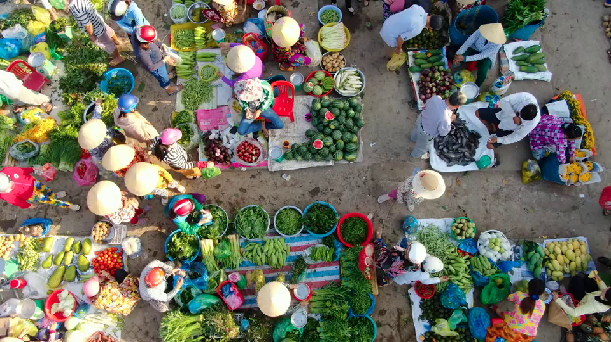


VIETNAMESE LIFESTYLE:
THEN AND NOW
Unit
6
LESSON 3: A CLOSER LOOK 2

Slide 3

OBJECTIVES
By the end of the lesson, students will be able to:
Use correctly to-infinitive and V-ing after a verb.

Slide 4
LESSON 3: A CLOSER LOOK 2
LESSON 1: GETTING STARTED
WARM-UP
Option 1: Review
Option 2: Grammar Challenge
Task 1: Write the correct form of the verbs in brackets.
Grammar Explanation
PRESENTATION
Task 2: Underline the correct verb form for each sentence.
Task 3: Complete each sentence with the correct form of a verb from the box.
Task 4: Choose the incorrect underlined word or phrase in each sentence.
PRACTICE
PRODUCTION
Task 5: Work in pairs. Take turns to complete the sentences.
CONSOLIDATION
Wrap-up
Homework

Slide 5
WARM-UP
OPTION 1
Example:
I enjoy working in the garden with my grandma.
Which certain Verbs can go with V-ing?
enjoy / fancy / hate

Slide 6
WARM-UP
OPTION 1
Example:
My father wants to find a better job in advertising.
Which certain Verbs can go with to-V?
want / learn

Slide 7
WARM-UP
OPTION 2
Grammar Challenge

Slide 8
WARM-UP
OPTION 2
- There is a list a list of verbs.
- You must create sentences using both the to-V and V-ing forms.
Example:
“I like to eat pho.”
“Eating pho is my favorite thing to do.”
HOW TO PLAY

Slide 9
WARM-UP
OPTION 2
LET’S PLAY

Slide 10
WARM-UP
OPTION 2
play Mandarin square capturing
use modern technology
eat fast food
wear ao dai
ride cyclo
List of Verbs:

Slide 11

PRESENTATION
1
Write the correct form of the verbs in bracket.
riding
1. fancy (ride) _______ a buffalo
to use
2. learn (use) _______ traditional farming tools
not touching
3. mind (not touch) _____________ the displays
to make
4. decide (make) _________ a kite
playing
5. avoid (play) ________ on the streets
to learn
6. promise (learn) ________ more about the history of our village

Slide 12
PRESENTATION
– The verb after want, promise, decide, agree, learn, plan has the to-infinitive form.
Example:
We decided to do some research on Thai traditional dancing.
– The verb after enjoy, fancy, finish, mind, avoid, suggest has the -ing form.
Example:
I suggested visiting the Viet Nam Museum of Ethnology.

Slide 13
LESSON 3: A CLOSER LOOK 2
LESSON 1: GETTING STARTED
WARM-UP
Option 1: Review
Option 2: Grammar Challenge
Task 1: Write the correct form of the verbs in brackets.
Grammar Explanation
PRESENTATION
Task 2: Underline the correct verb form for each sentence.
Task 3: Complete each sentence with the correct form of a verb from the box.
Task 4: Choose the incorrect underlined word or phrase in each sentence.
PRACTICE

Slide 14
PRACTICE
2
Underline the correct verb form for each sentence.
1. I really fancy to wear / wearing this traditional cone hat at our Fashion Show
2. My brother has decided to enter / entering the Back to Our Past Competition.
3. Do you mind to replay / replaying that Folk music? It’s lovely.
4. My uncle always avoids to tell / telling stories about his past.
5. They plan to do / doing research about life in Hue in the 19th century.

Slide 15
PRACTICE
3
Complete each sentence with the correct form of a verb from the box.
make learn give
work teach
to learn
1. We want __________ how to make toys from natural materials.
working
2. Yesterday, we finished ___________ on the poster for our Good Old Days project.
to teach
3. I have promised ___________ my grandfather how to find news online.

Slide 16
PRACTICE
3
Complete each sentence with the correct form of a verb from the box.
make learn give
work teach
making
4. My grandmother suggested __________ a traditional long dress for the wedding.
to give
5. Our group agreed _________ a presentation about school uniforms in the 20th century.

Slide 17
PRACTICE
4
Choose the incorrect underlined word or phrase in each sentence.
having
1. Just a few years ago, I would never fancy to have a smart TV in my home.
A
B
C
D
to add
2. Tom promised adding some information about the past to his presentation.
A
B
C
D

Slide 18
PRACTICE
4
Choose the incorrect underlined word or phrase in each sentence.
to learn
3. I’ve decided learning how ethnic minority people use natural materials to dye cloth.
A
B
C
D
to research
4. My children plan researching and make our family tree for the past hundred years.
A
B
C
D

Slide 19
PRACTICE
4
Choose the incorrect underlined word or phrase in each sentence.
talking
5. Do you mind not to talk about the past in such a negative way?
A
B
C
D

Slide 20
LESSON 3: A CLOSER LOOK 2
LESSON 1: GETTING STARTED
WARM-UP
Option 1: Review
Option 2: Grammar Challenge
Task 1: Write the correct form of the verbs in brackets.
Grammar Explanation
PRESENTATION
Task 2: Underline the correct verb form for each sentence.
Task 3: Complete each sentence with the correct form of a verb from the box.
Task 4: Choose the incorrect underlined word or phrase in each sentence.
PRACTICE
PRODUCTION
Task 5: Work in pairs. Take turns to complete the sentences.

Slide 21
PRODUCTION
5
Work in pairs. Take turns to complete the sentences.
- Work in pairs.
- Take turns to complete the sentences in the way they like.
1. For my future career, I want ______________________.
2. Do you mind not _______________________________?
3. We all agreed __________________________________.
4. I have never fancied _____________________________.
5. For our two-day holiday, I suggest __________________.

Slide 22
PRODUCTION
Suggested answers:
1. For my future career, I want to work in fashion design.
2. Do you mind not making noise while studying?
3. We all agreed to visit the nursing home in our neighbourhood.
4. I have never fancied travelling alone abroad.
5. For our two-day holiday, I suggest going camping at Thay pagoda.
5

Slide 23
EXTRA ACTIVITY
- Prepare a short talk about your future, based on the cues provided below. Then share it with your class.
- your future (what you want / hope / plan to do / to become)
- three things that you enjoy doing / you want to learn that you think could help you fulfill your future plan

Slide 24
LESSON 3: A CLOSER LOOK 2
LESSON 1: GETTING STARTED
WARM-UP
Option 1: Review
Option 2: Grammar Challenge
Task 1: Write the correct form of the verbs in brackets.
Grammar Explanation
PRESENTATION
Task 2: Underline the correct verb form for each sentence.
Task 3: Complete each sentence with the correct form of a verb from the box.
Task 4: Choose the incorrect underlined word or phrase in each sentence.
PRACTICE
PRODUCTION
Task 5: Work in pairs. Take turns to complete the sentences.
CONSOLIDATION
Wrap-up
Homework

Slide 25

CONSOLIDATION
1
Wrap-up
What have we learnt in this lesson?
Use correctly to-infinitive and V-ing after a verb.

Slide 26

CONSOLIDATION
2
Homework
- Do exercises in the workbook;
- Make 5 sentences by using to-infinitive and V-ing.

Slide 27
Website: hoclieu.vn
Fanpage: facebook.com/www.tienganhglobalsuccess.vn/

