Slide 2
Unit
3
CITIES OF THE FUTURE
Unit
FAMILY LIFE
LESSON 5
LISTENING
Living in a smart city

Slide 3
LESSON 5
LISTENING
WARM-UP
Kim’s game
PRE-LISTENING
Task 1. Match the words and phrase with their meanings.
Task 2. Listen and choose the correct answer.
Task 3. Listen and complete the table.
WHILE-LISTENING
POST-LISTENING
Task 4. Discuss the questions.
Wrap-up
Homework
CONSOLIDATION

Slide 4
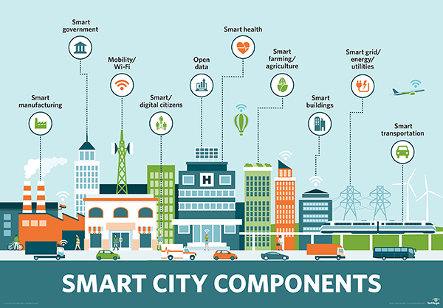
WARM-UP

Slide 5
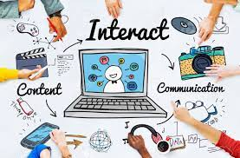
PRE-LISTENING
interact
/ˌɪn.təˈrækt/
to communicate with or react to
E.g. Lucy interacts well with other children in the class.

Slide 6
PRE-LISTENING
privacy (n)
Eg: With seven people squashed in one house, you don't get much privacy.
/ˈprɪvəsi, ˈpraɪ-/
the state of being able to be alone, and not seen or heard by other people

Slide 7
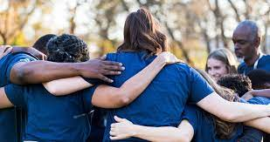
PRE-LISTENING
sense of community (n)
/sens əv kəˈmjuː.nə.ti/
the feeling that you belong to a community

Slide 8
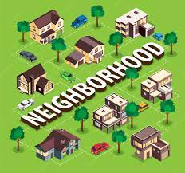
PRE-LISTENING
neighbourhood (n)
/ˈneɪbəhud/
the area of a town that surrounds someone's home, or the people who live in this area

Slide 9
PRE-LISTENING
Form | Pronunciation | Meaning
1. to interact (v) | /ˌɪn.təˈrækt/ | to communicate with or react to
2. privacy (n) | /ˈprɪvəsi, ˈpraɪ-/ | the state of being able to be alone, and not seen or heard by other people
3. sense of community (n) | /sens əv kəˈmjuː.nə.ti/ | the feeling that you belong to a community
4. neighbourhood (n) | /ˈneɪbəhud/ | the area of a town that surrounds someone's home, or the people who live in this area

Slide 10
PRE-LISTENING
1
Match the words and phrase with their meanings.
interact
privacy
sense of community
neighbourhood
an area of a town
the feeling of belonging to a group
to talk or do things with other people
the state of being alone and not watched or interrupted by other people

Slide 11
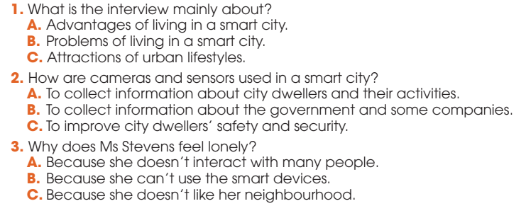
WHILE-LISTENING
2
Listen to an interview and choose the correct answers A, B, or C.

Slide 12
WHILE-LISTENING
3
Listen to the interview again and complete the table.
Situations | Problems
There are cameras and sensors everywhere. | City dwellers may lose their (1) ______________ in public areas.
People use (2) ________________ to help them with household chores. | it is not easy for some people to get familiar with and use the smart devices.
Some city dwellers (3) _________ with each other face to face less. | There is no (4) ___________________ in the neighbourhood.
right to privacy
smart technologies
interact
sense of community

Slide 13
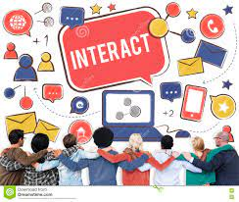
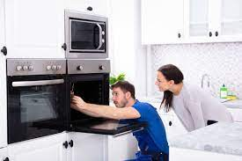
POST-LISTENING
5
Work in groups. Discuss the following questions.
Do you agree with Ms Stevens? Which of the disadvantages she mentions do you think is the most serious? Why?

Slide 14
CONSOLIDATION
1
Wrap-up
What have you learnt today?
Living in a smart city
Listening for main ideas and specific information

Slide 15
CONSOLIDATION
2
Homework
Do exercises in the workbook.
Prepare for Lesson 6 - Unit 3.

Slide 16
Website: hoclieu.vn
Fanpage: facebook.com/www.tienganhglobalsuccess.vn

