Slide 1

Unit 4: Festivals and Free Time
Lesson 2.1: Vocabulary & Reading
Page 33

Slide 2
Lesson Outline
Warm-up
Vocabulary
Reading
Consolidation
Wrap-up

Slide 3
Objectives
By the end of this lesson, students will be able to…
use positive and negative adjectives to describe festival activities.
practice reading for specific information.
talk about some festival activities.

Slide 4
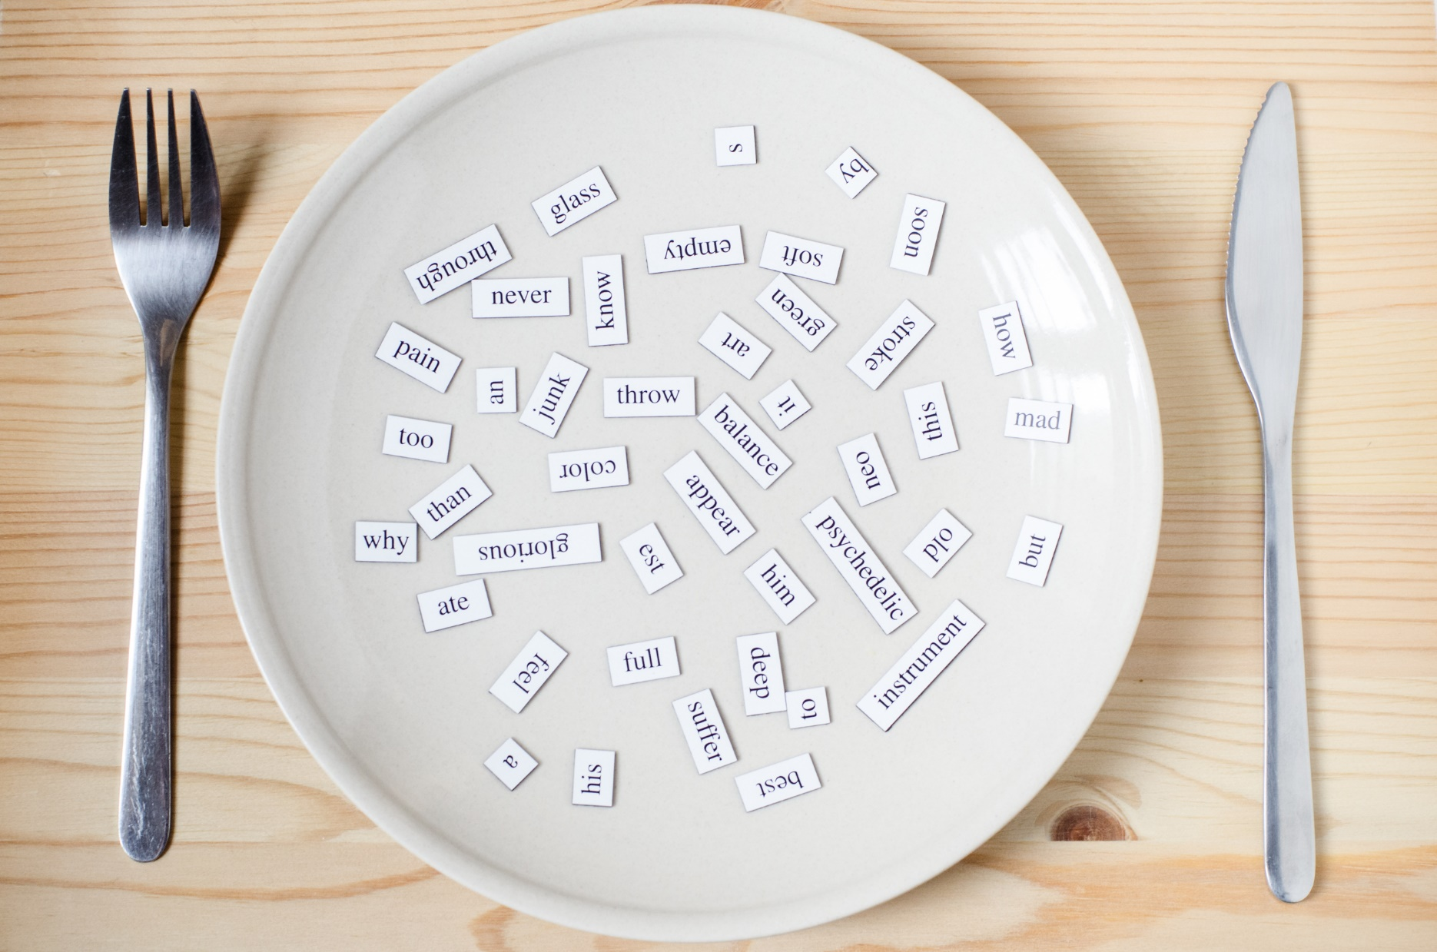
New words
- music performance
- food stand
- fashion show
- puppet show
- tug of war
- talent show

Slide 5

WARM-UP

Slide 6
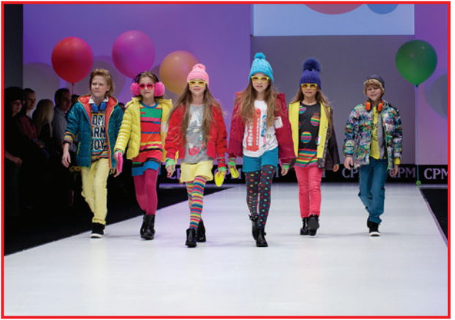

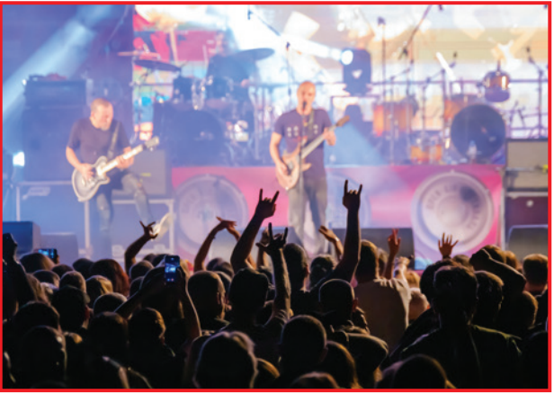
Work in pairs
What are they?
What do you think of them?

Slide 7
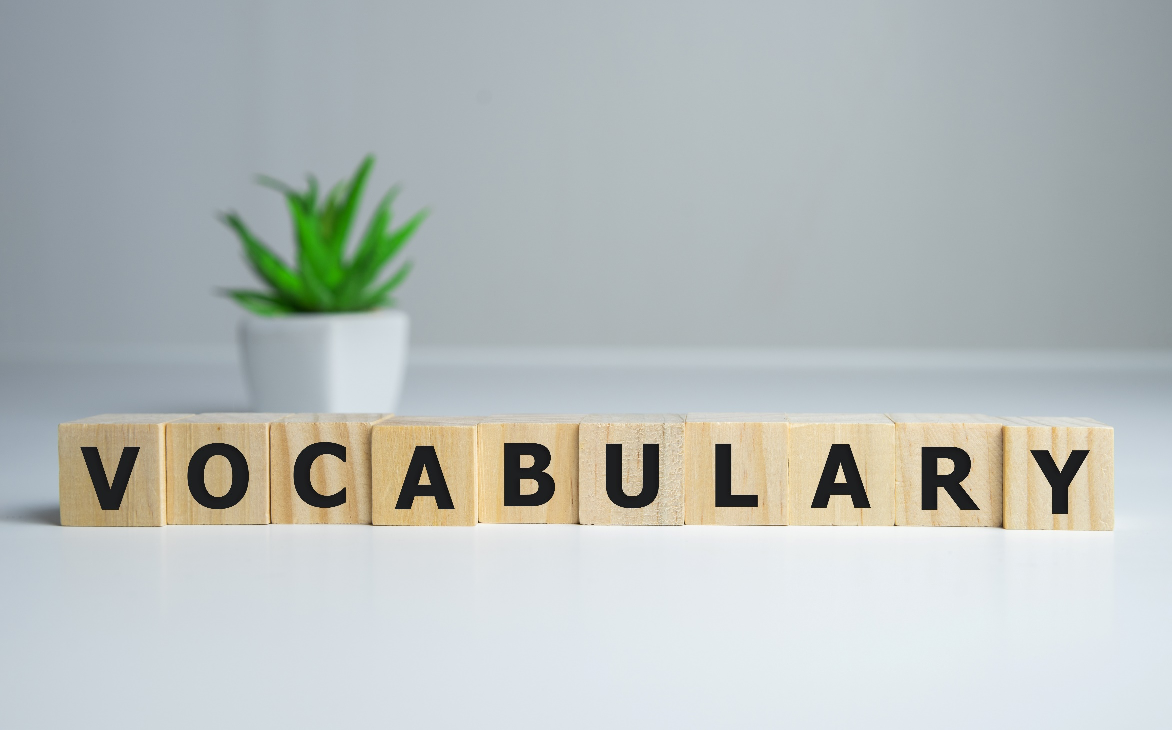


Slide 8
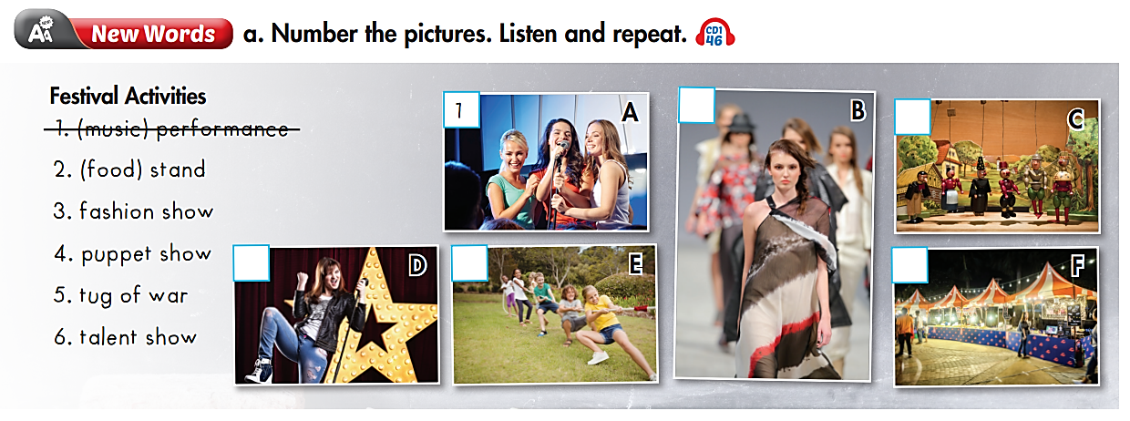

3
4
6
5
2

Slide 9
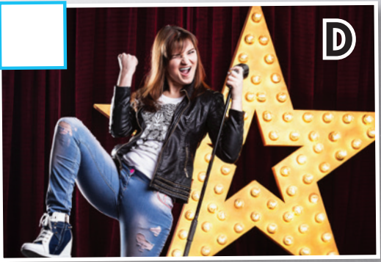
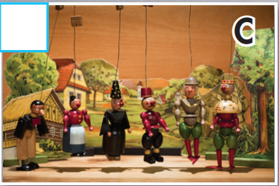
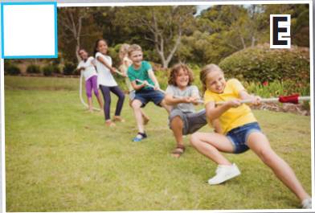
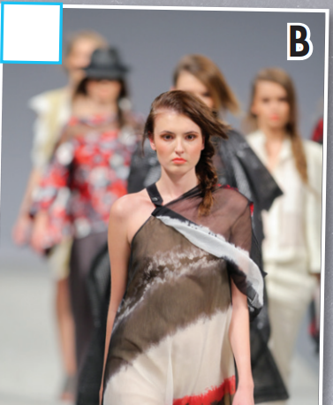
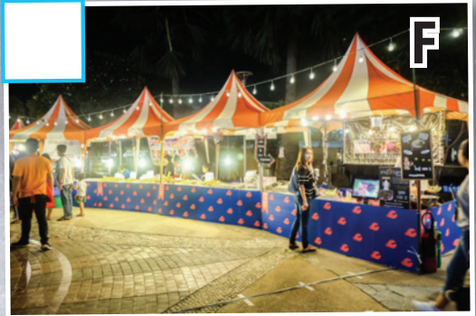
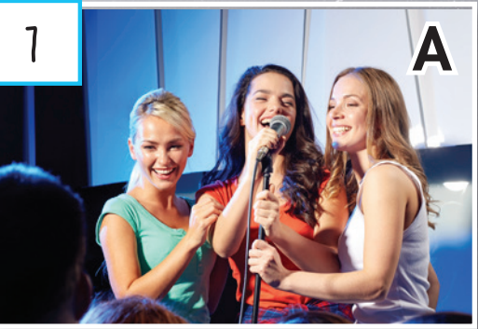
What is it?
music performance /ˈmjuːzɪk/ /pərˈfɔːrməns/ buổi biểu diễn âm nhạc
- food stand /fuːd/ /stænd/ quầy bán thức ăn
fashion show /ˈfæʃn/ /ʃoʊ/ buổi trình diễn thời trang
- puppet show /ˈpʌpɪt/ /ʃoʊ/ buổi biểu diễn múa rối
- tug of war /tʌɡ əv ˈwɔːr/ kéo co
- talent show /ˈtælənt/ /ʃoʊ/ chương trình tìm kiếm tài năng

Slide 10
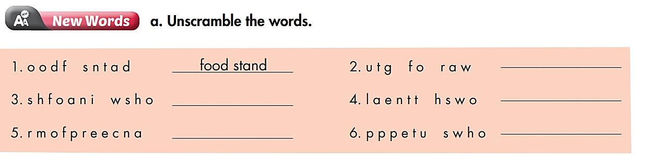
Extra Practice
WB page 22
tug of war
fashion show
talent show
puppet show
performance

Slide 11
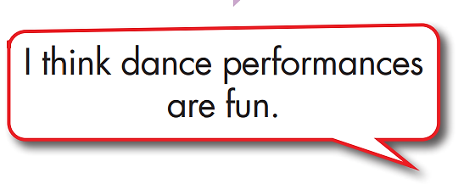
Positive (good) | Negative (bad)
fun | boring
……………………………………….. | ……………………………………………….
………………………………………… | …………………………………………………

Slide 12

Reading

Slide 13
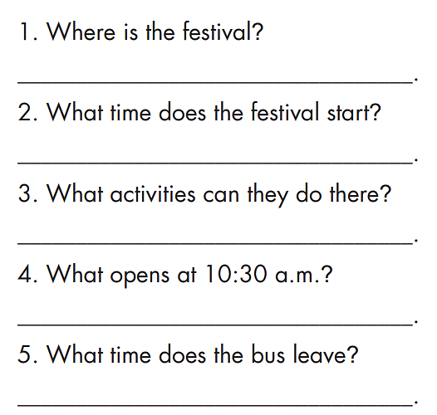
Pre-Reading

Slide 14
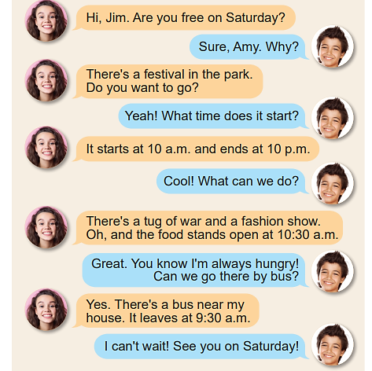
While-Reading
It is in the park.
It starts at 10 a.m.
There's a tug of war and a fashion show.
The food stands open at 10:30 a.m.
The bus leaves at 9:30 a.m.

Slide 15

Post-Reading
Work in pairs
Talk about your favorite show.

Slide 16

CONSOLIDATION

Slide 17
Write 5 sentences about your favorite show.

Slide 18
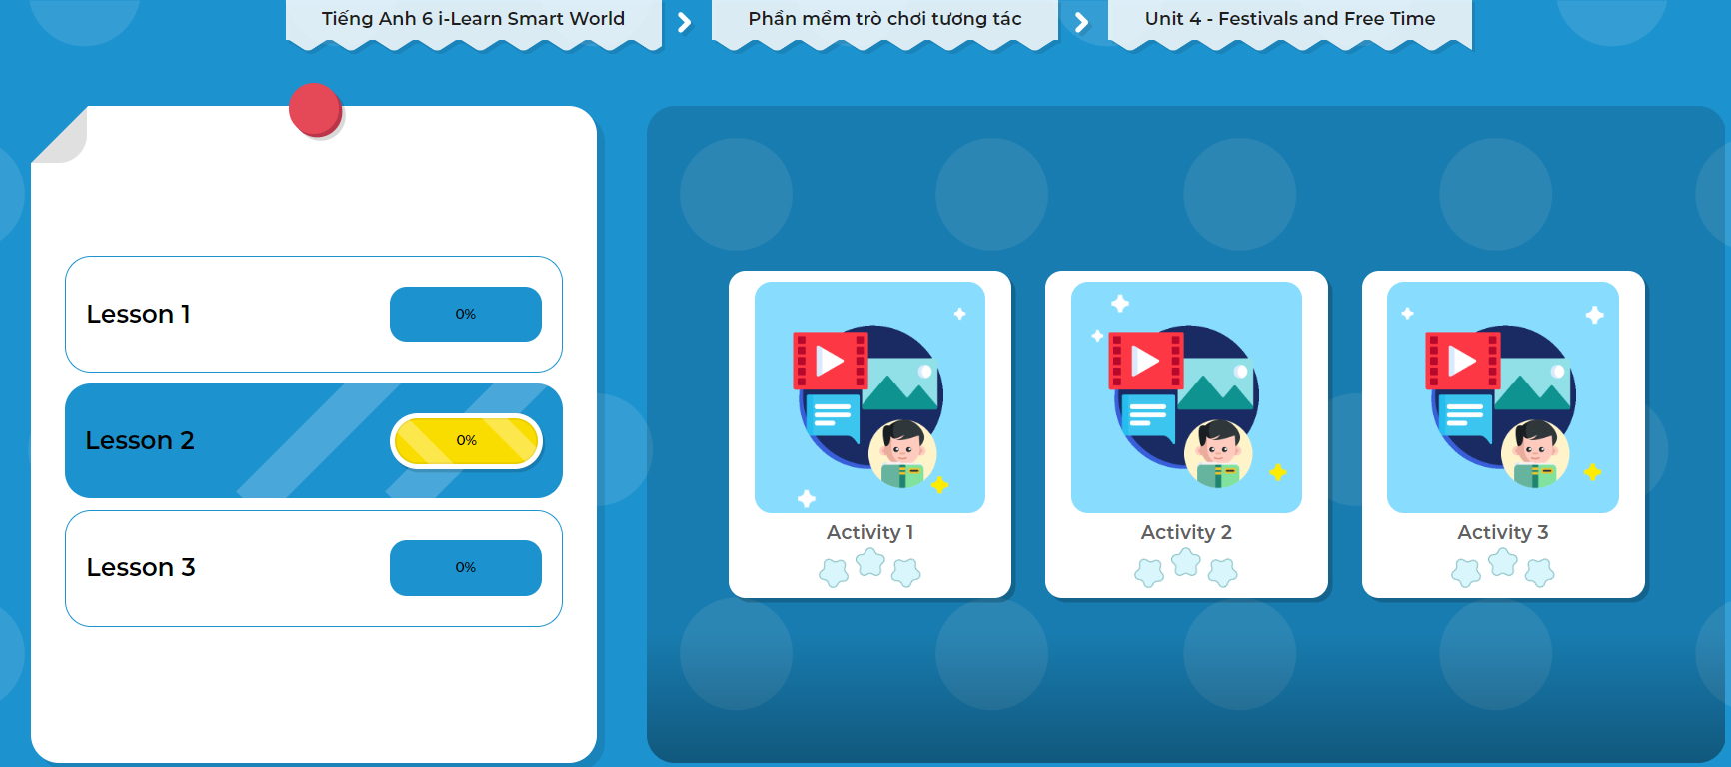
Click on the picture to play the games.

Slide 19
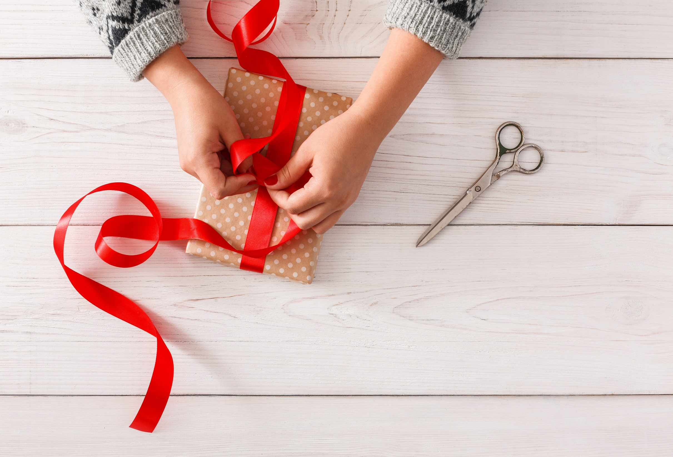
WRAP-UP

Slide 20
Today’s lesson
Vocabularies
- music performance
- food stand
- fashion show
- puppet show
- tug of war
- talent show
Reading:
Scanning for specific information
Speaking:
- Talking about their favorite shows

Slide 21
Homework
Learn by hearts vocabulary and make sentences using them.
Do the exercises in Tiếng Anh 6 i-Learn Smart World Workbook (page 22).
Do the vocabulary exercise in Tiếng Anh 6 i-Learn Smart World Notebook on page 22.
Prepare the next lesson (page 34 - SB).
Play consolidation games in Tiếng Anh 6 i-Learn Smart World DHA App on www.eduhome.com.vn.

Slide 22
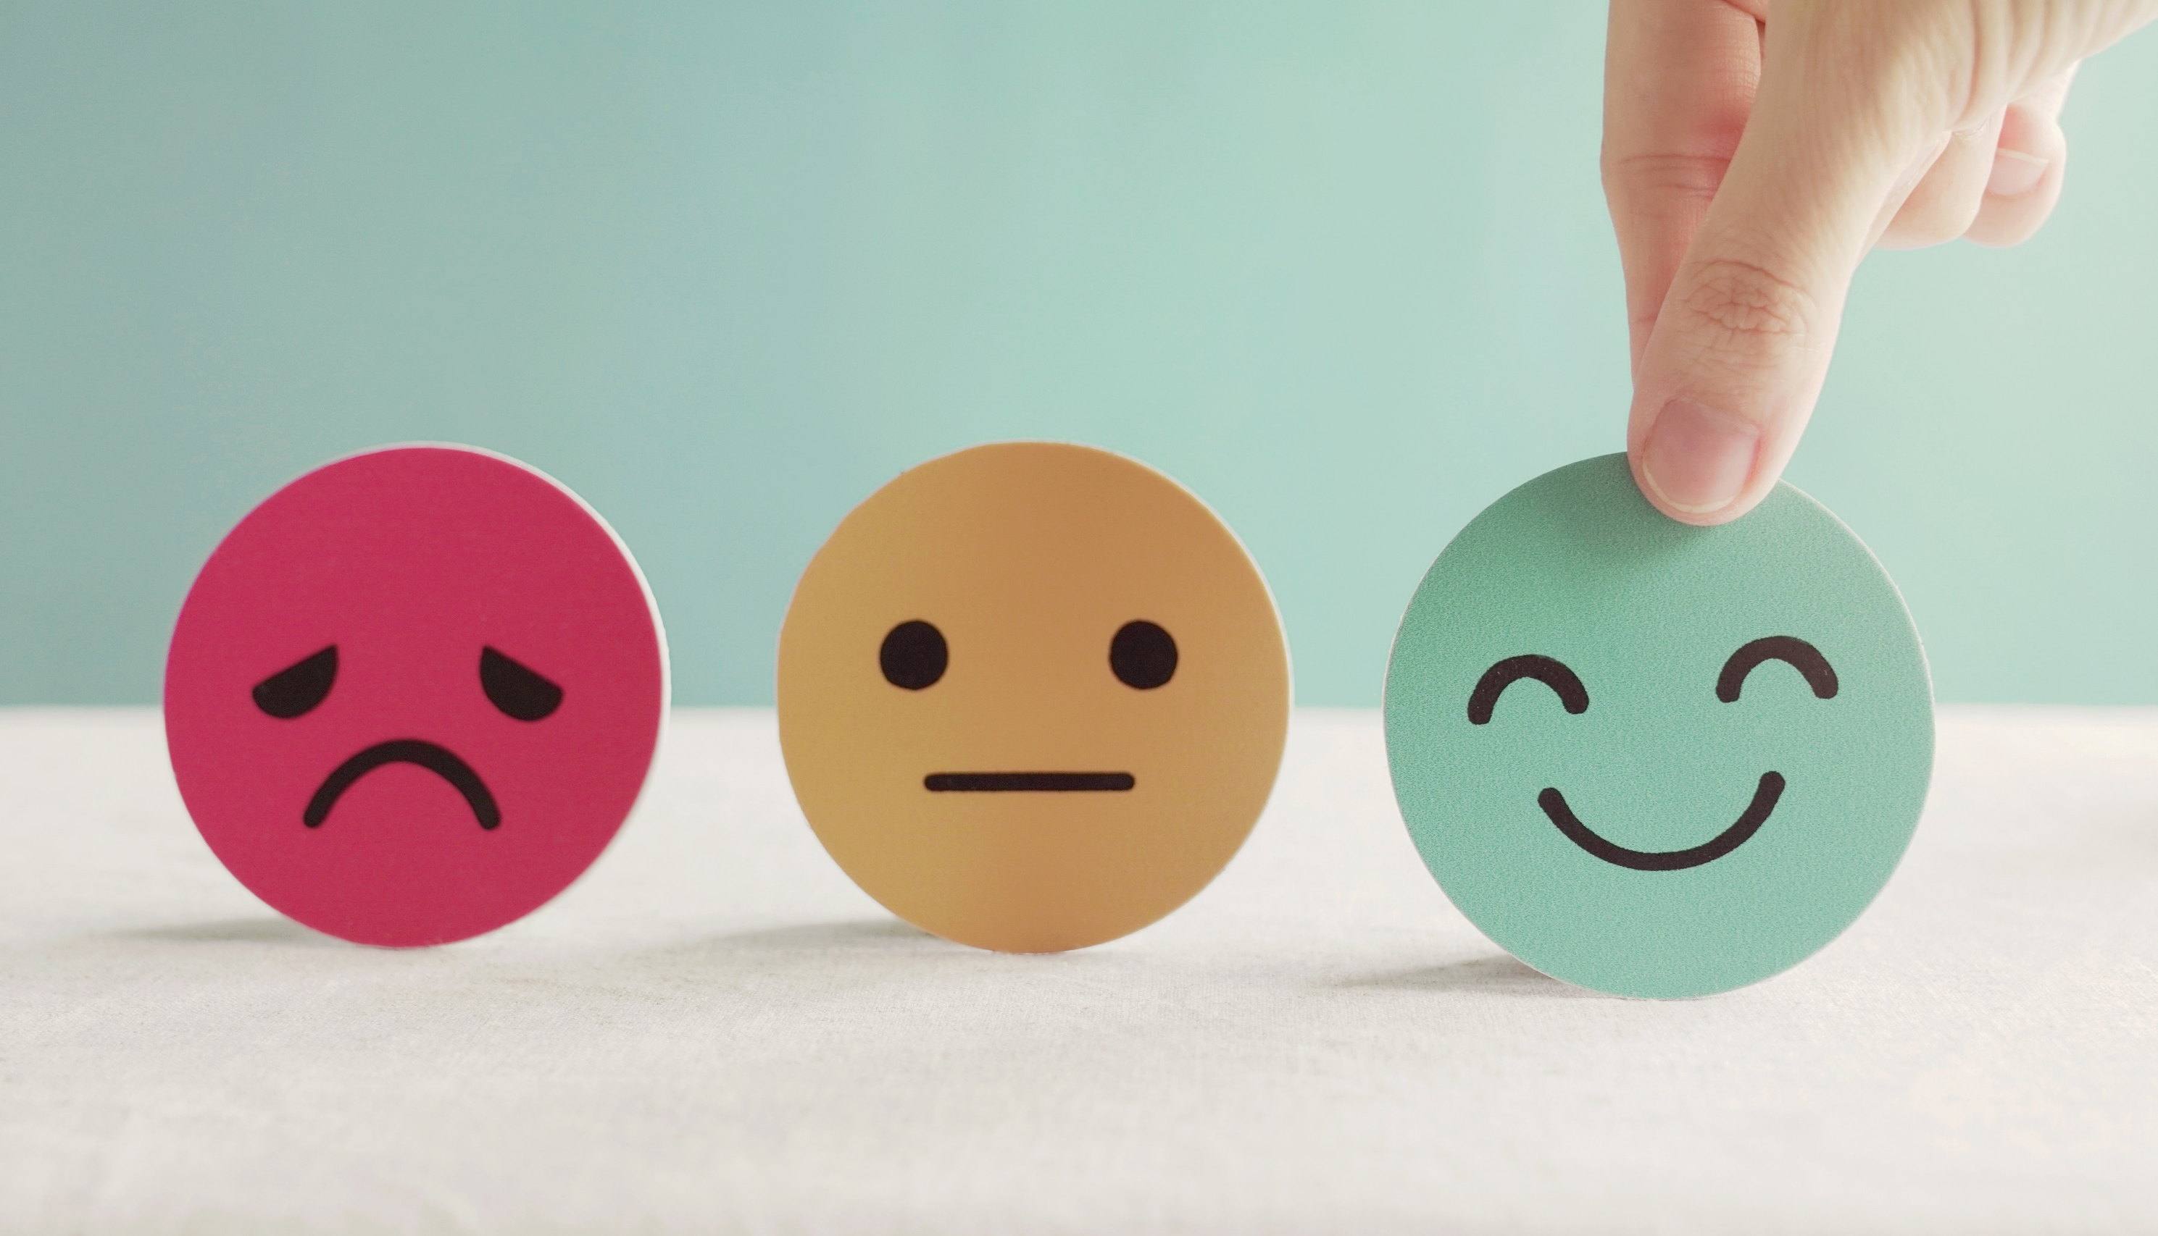
Lesson 3
Stay positive and have a nice day!

