Slide 1


Slide 2
LANGUAGE
Review 4
Unit
FAMILY LIFE
LESSON I

Slide 3
LESSON 1
LANGUAGE
WARM- UP
Mini game: Catch a word
PRONUNCIATION
Mark the intonation.
VOCABULARY
Complete the sentences.
Write one sentence using the linking words and phrases.
Circle the correct answers.
GRAMMAR
CONSOLIDATION
Wrap-up
Homework

Slide 4

Catch a word

Slide 5
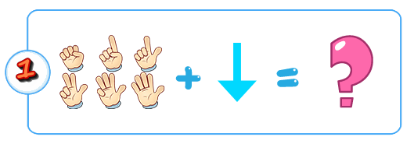

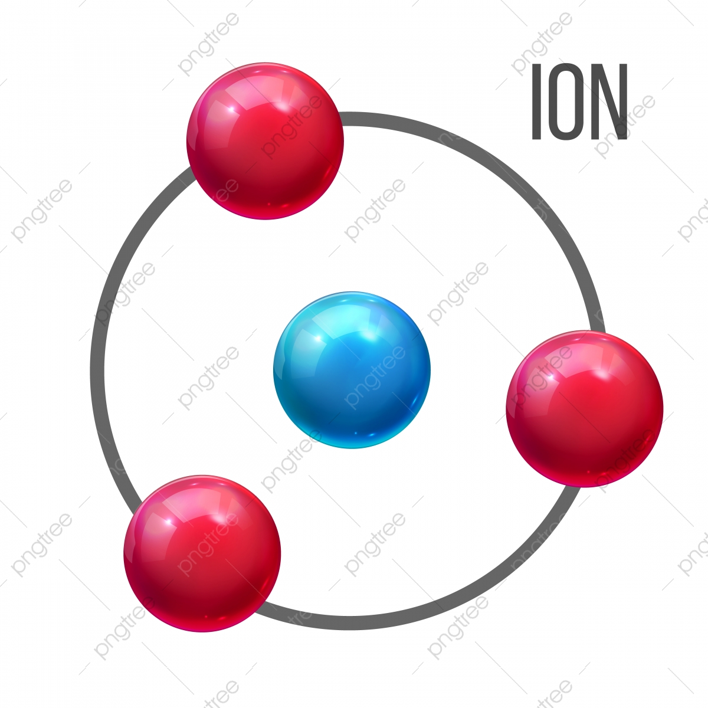
de
+
+
Depression

Slide 6
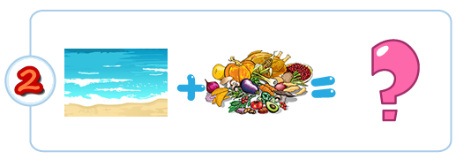

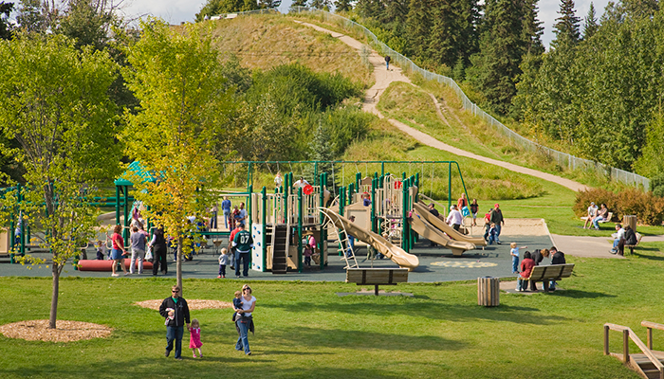
+
National Park

Slide 7
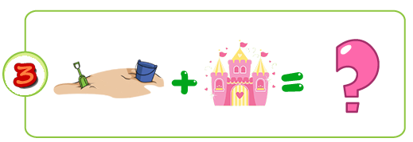
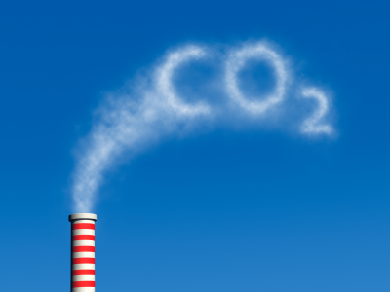
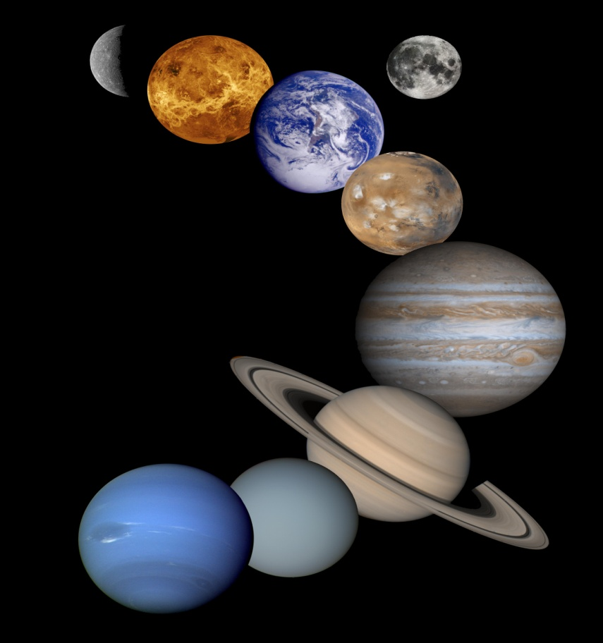
SOLAR
E +
-2
Ecosystem

Slide 8
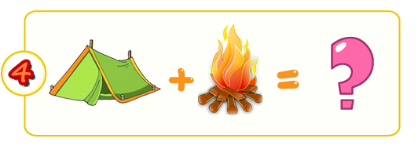
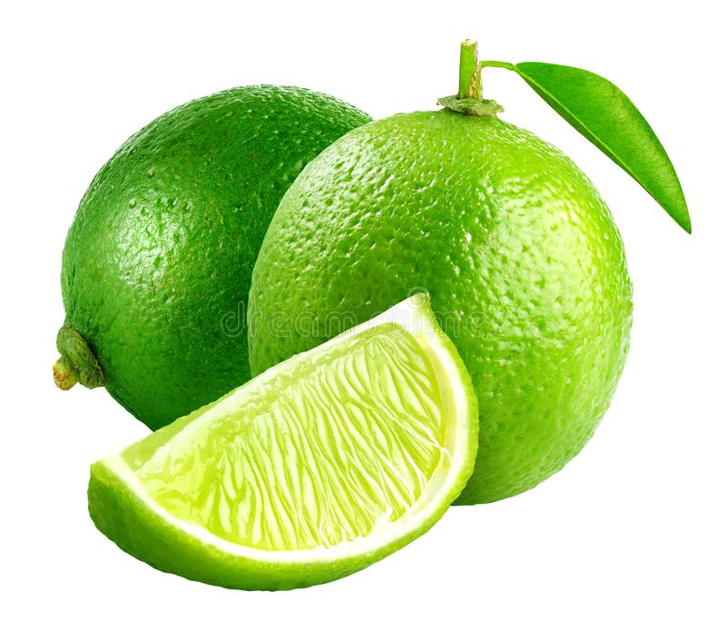
- L
Cr +
Crime

Slide 9
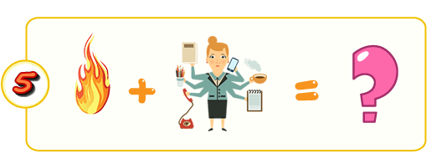

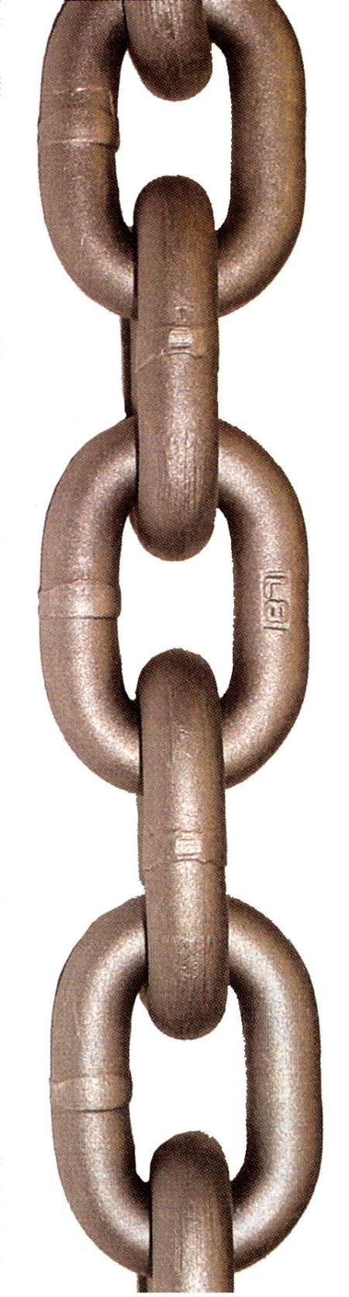
+
Food chain

Slide 10
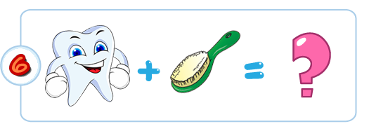
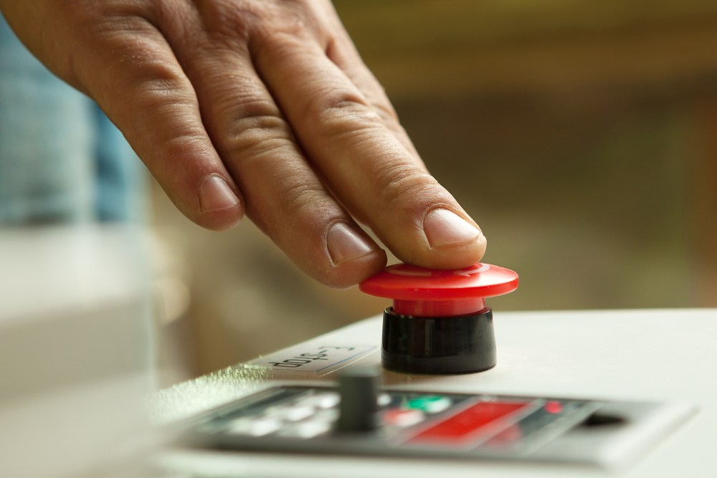
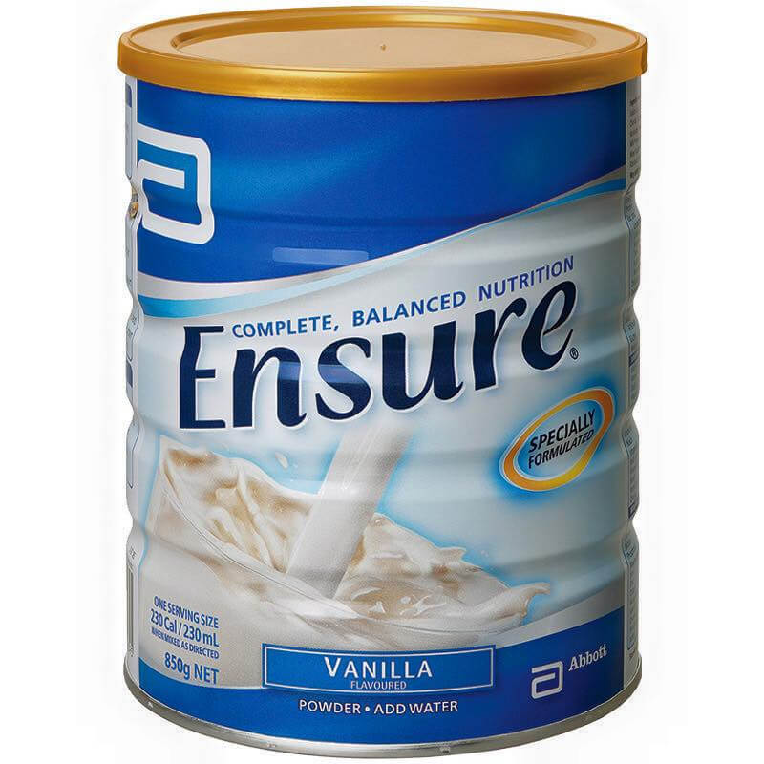
+
x
Pressure

Slide 11

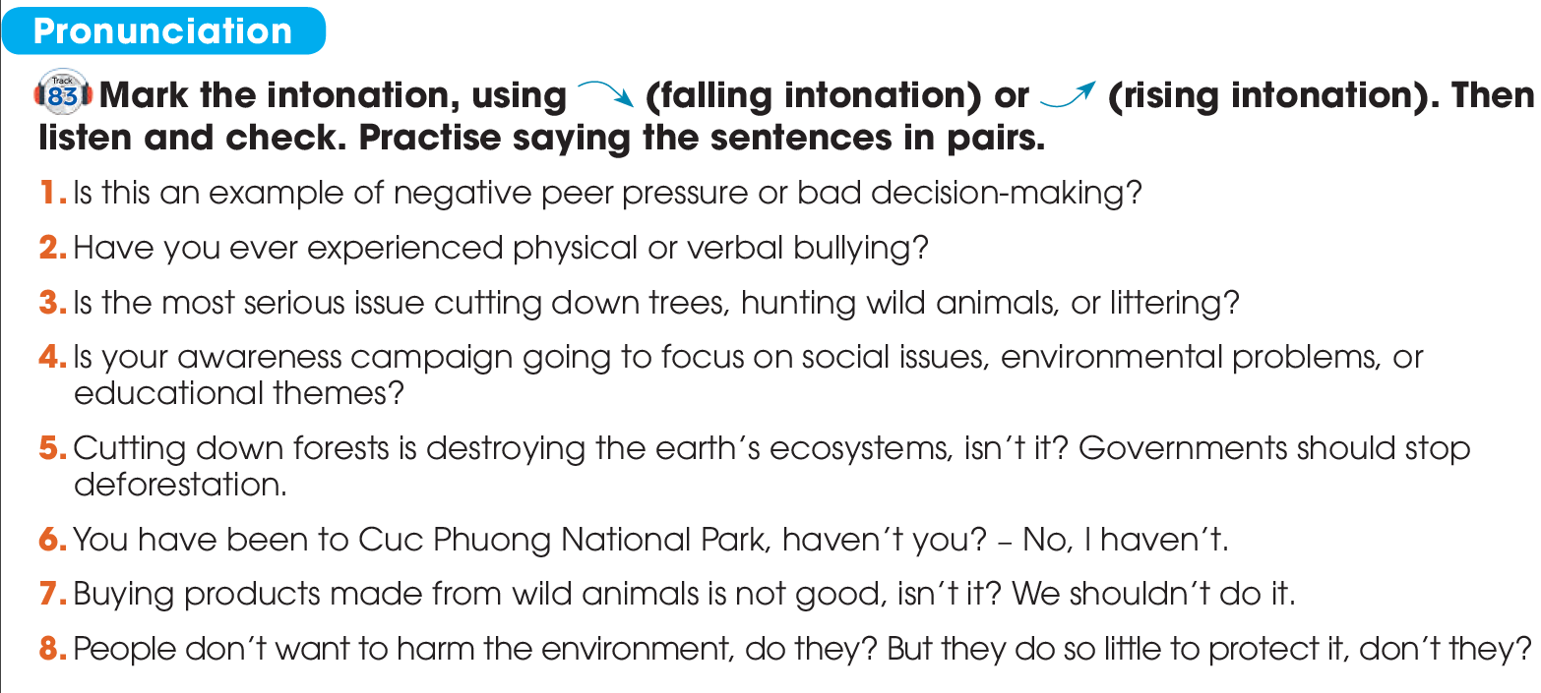


PRONUNCIATION

Slide 12
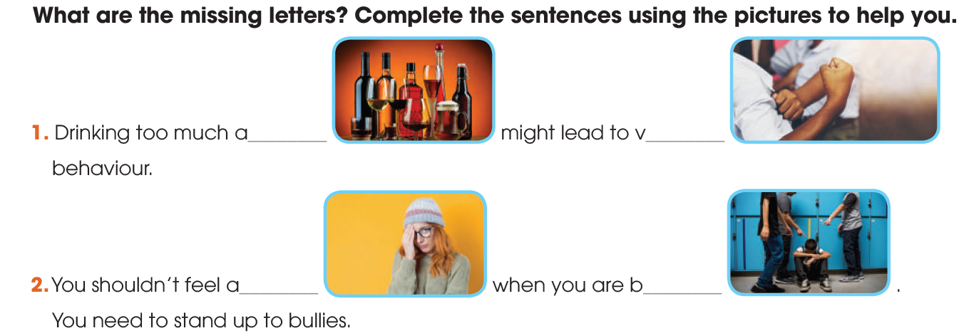
VOCABULARY
alcohol
violent
bullied
ashamed

Slide 13
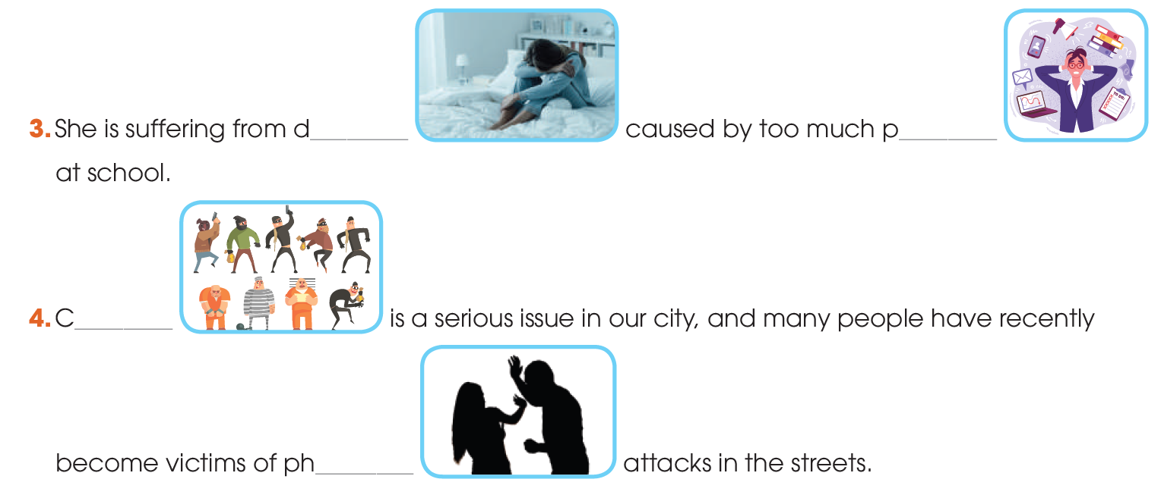
VOCABULARY
depression
pressure
crime
physical

Slide 14
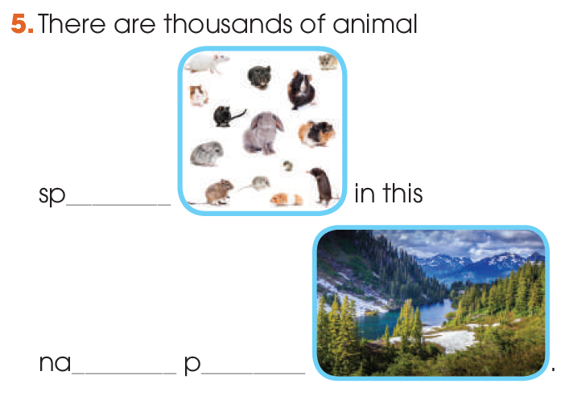
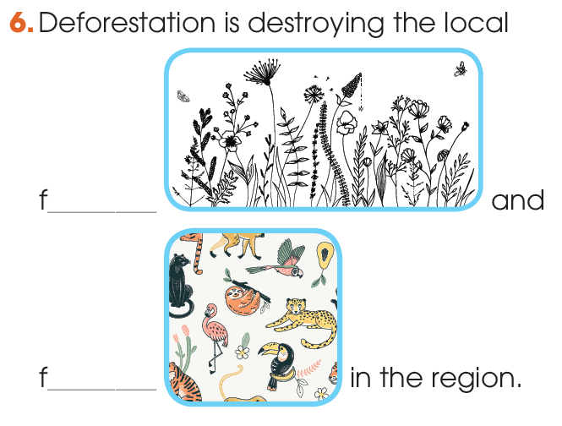
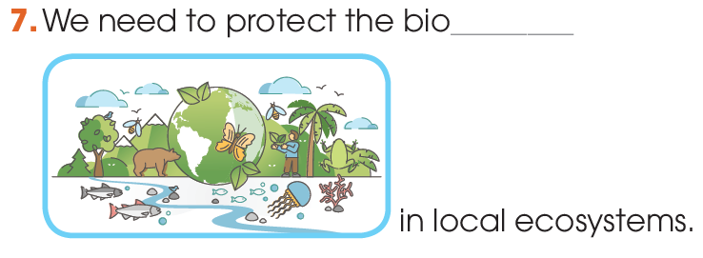
VOCABULARY
species
flora
national
park
fauna
biodiversity

Slide 15
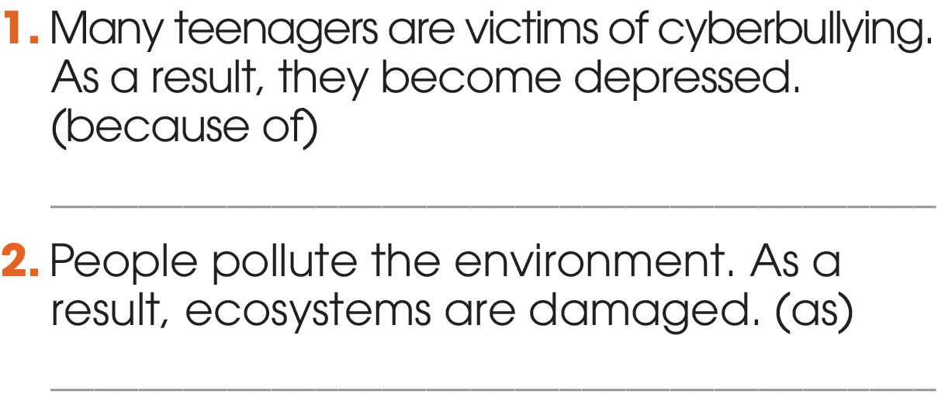
GRAMMAR
1
Write one sentence using the linking words and phrases in brackets. Do not change the meaning of the original sentences.
Because of being victims of cyberbullying, many teenagers become depressed./ Many teenagers become depressed because of being victims of cyberbullying.

Slide 16
GRAMMAR
1
As people pollute the environment, ecosystems are damaged./ Ecosystems are damaged as people pollute the environment.

Slide 17
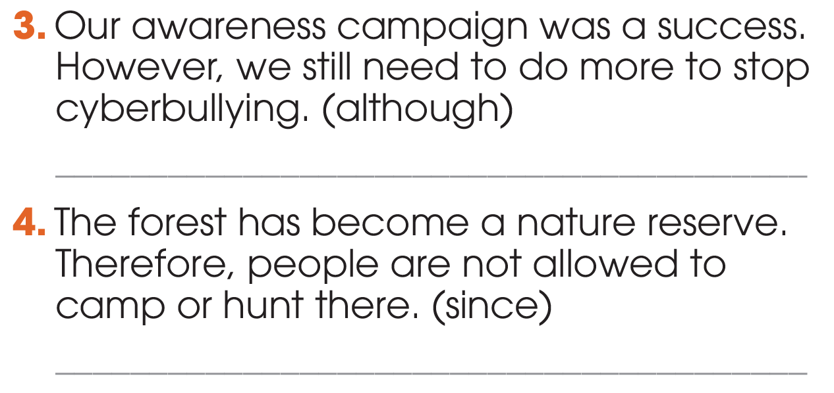
GRAMMAR
Although our awareness campaign was a success, we still need to do more to stop cyberbullying./ We still need to do more to stop cyberbullying although our awareness campaign was a success.

Slide 18
GRAMMAR
Since the forest has become a nature reserve, people are not allowed to camp or hunt there./
People are not allowed to camp or hunt in the forest since it has become a nature reserve.

Slide 19
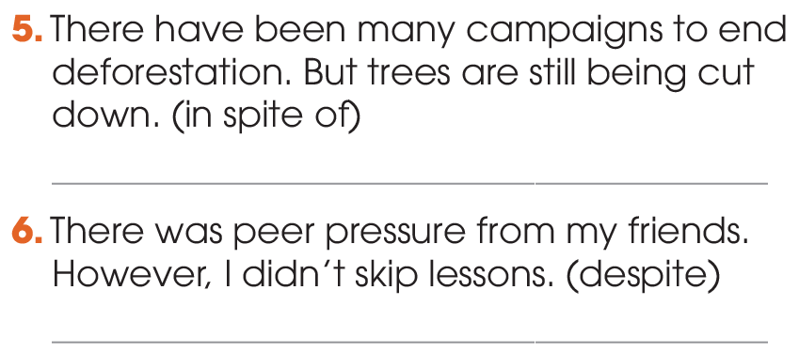
GRAMMAR
In spite of many campaigns to end deforestation, trees are still being cut down./ Trees are still being cut down in spite of many campaigns to end deforestation.

Slide 20
GRAMMAR
Despite peer pressure from my friends, I didn’t skip lessons./ I didn’t skip lessons despite peer
pressure from my friends.

Slide 21
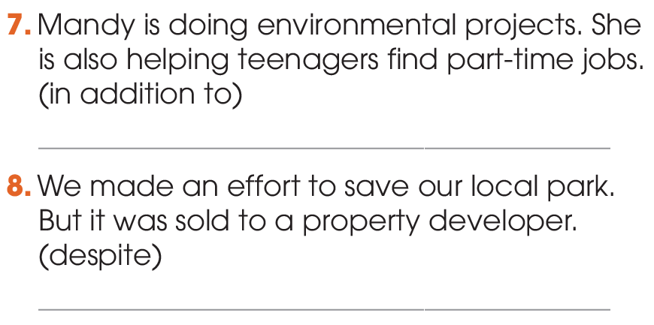
GRAMMAR
1
In addition to doing environmental projects, Mandy is helping teenagers find part-time jobs./ Mandy is helping teenagers find part-time jobs in addition to doing environmental projects.

Slide 22
GRAMMAR
1
Despite the/our effort to save our local park, it was sold to a property developer./ Our local park was sold to a property developer despite the/our effort to save it.

Slide 23
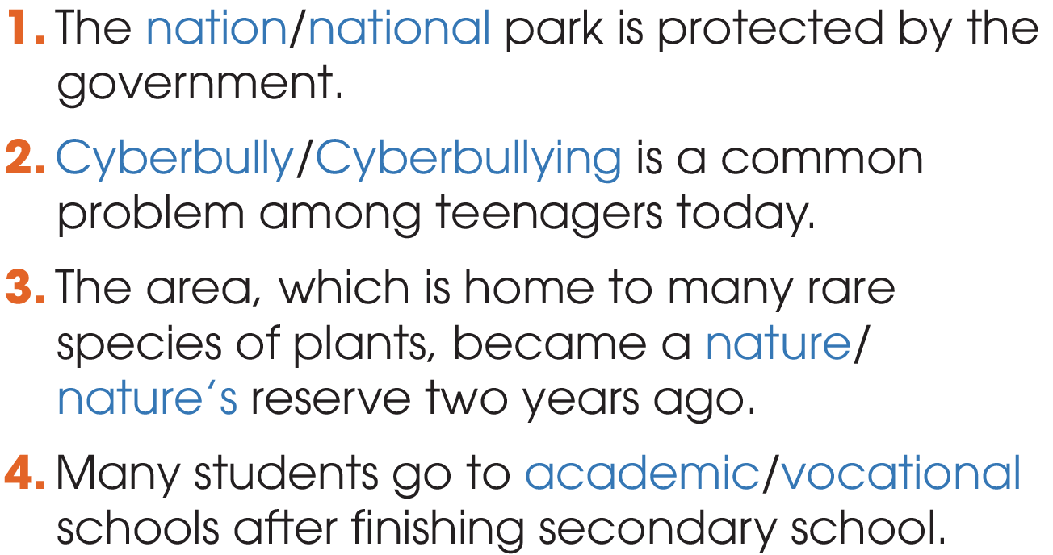
GRAMMAR
2
Circle the correct answers.

Slide 24
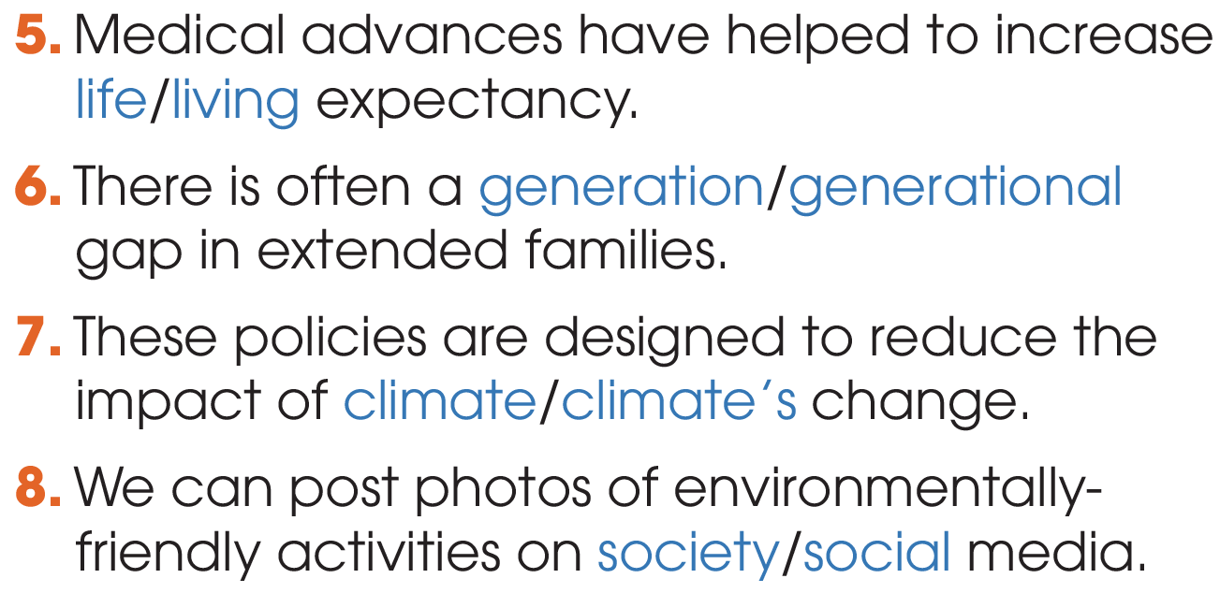
GRAMMAR
2
Circle the correct answers.

Slide 25
CONSOLIDATION
1
Wrap-up
What have you learnt today?
Review the vocabulary and grammar of Unit 9 & 10.
H
0

Slide 26

Website: hoclieu.vn
Fanpage: facebook.com/tienganhglobalsuccess.vn/

