Slide 1




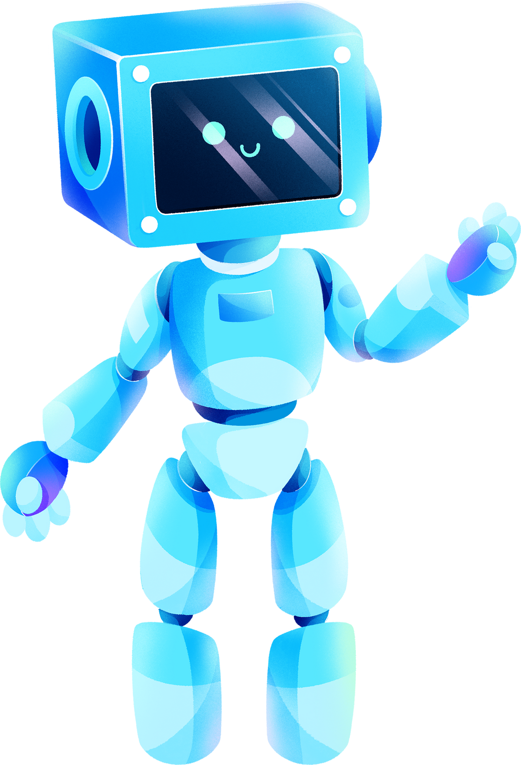

UNIT 12.
ROBOTS

Slide 2


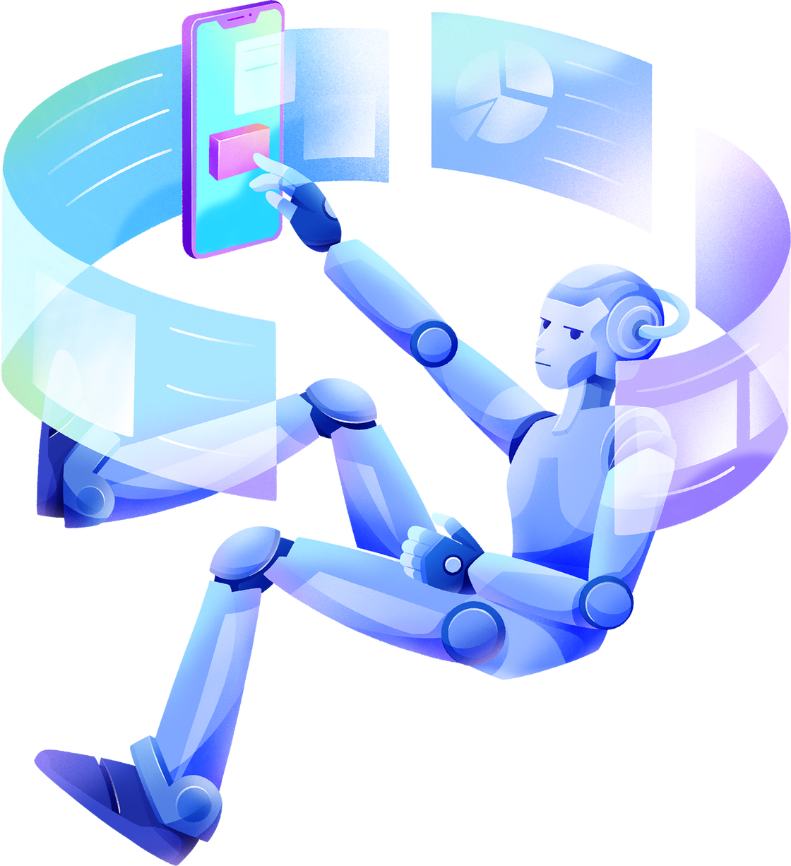

PART 1. THEORY
I.VOCABULARY

Slide 3
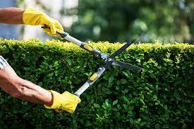


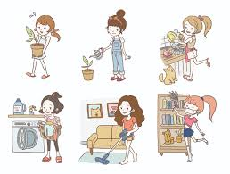
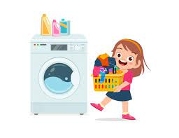
1. cut the hedge (v):
2. dangerous (adj):
/'deɪndʒərəs/
nguy hiểm
/kʌt ðə hedʒ/
cắt tỉa hàng rào
3. do household chores (v):
4. do the laundry (v):
/du: ðə ‘lɔ:ndrɪ/
giặt quần áo
/du: 'haʊshəʊld tʃɔ:rz/
làm việc nhà

Slide 4
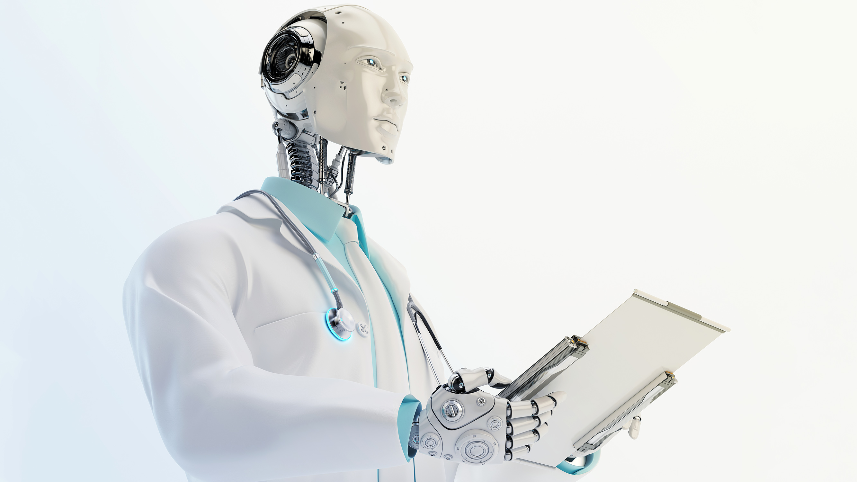
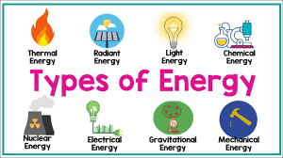
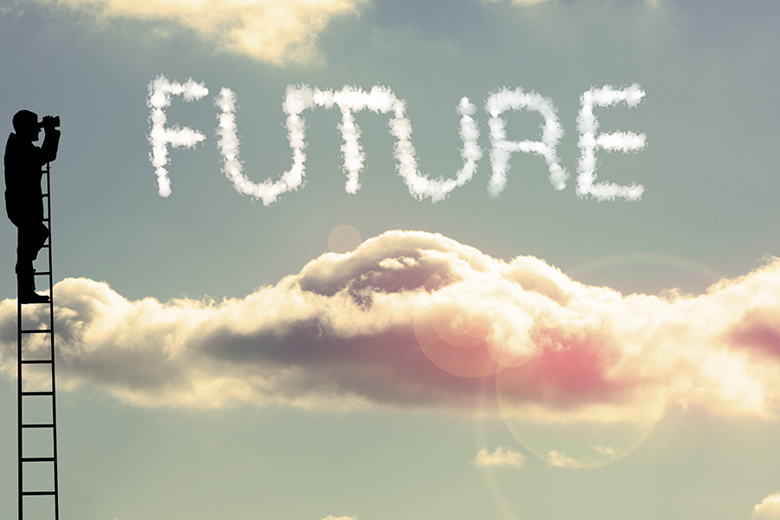
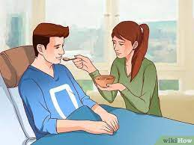
5. doctor robot (n):
6. energy (n):
/'dɒktər 'rəʊbɒt/
người máy bác sĩ
/'enədʒɪ/
năng lượng, điện
7. future (n):
8. help sick people (v):
/help sɪk 'pi:pl/
cứu người (bị ốm)
/'fju:tʃər/
tương lai

Slide 5
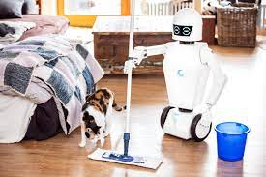
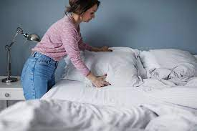
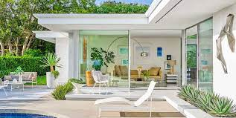
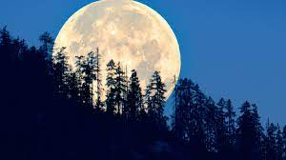
9. home robot (n):
10. make the bed (v):
/həʊm 'rəʊbɒt/
robot gia đình
/meɪk ðə bed/
dọn dẹp giường
11. modern (adj):
12. moon (n):
/mu:n/
mặt trăng
/'mɒdn/
hiện đại

Slide 6
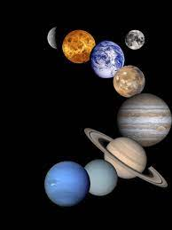

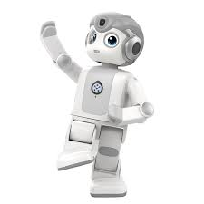
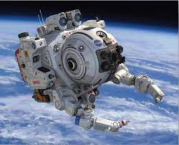
13. planet (n):
14. power (n):
/'paʊər/
năng lượng
/'plænɪt/
hành tinh
15. robot (n):
16. space robot (n):
/speɪs 'rəʊbɒt/
người máy
thám hiểm
không gian
/'rəʊbɒt/
người máy

Slide 7
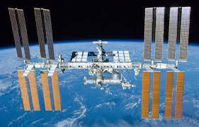
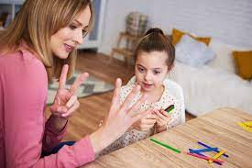
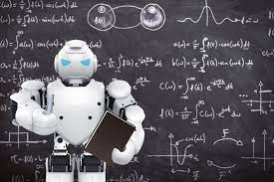
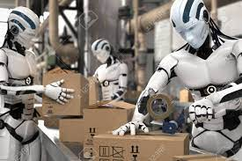
17. space station (n):
18. teach children (v):
/speɪs 'steɪʃn/
trạm vũ trụ
/‘ti:tʃ tʃɪldrən/
dạy trẻ
19. teaching robot (n):
20. worker robot (n):
/’ti:tʃɪη 'rəʊbɒt/
người máy giảng dạy
/’wɜ:kər 'rəʊbɒt/
người máy
công nhân

Slide 8
cut the hedge
dangerous
do household chores
do the laundry
doctor robot
energy
future
help sick people
home robot
make the bed
modern
moon
planet
power
robot
space robot
space station
teach children
teaching robot
worker robot

Slide 9

PART 1. THEORY
II. GRAMMAR

Slide 10
VOCABULARY CHECKING
https://wordwall.net/resource/54400726
https://wordwall.net/resource/54400801

Slide 11
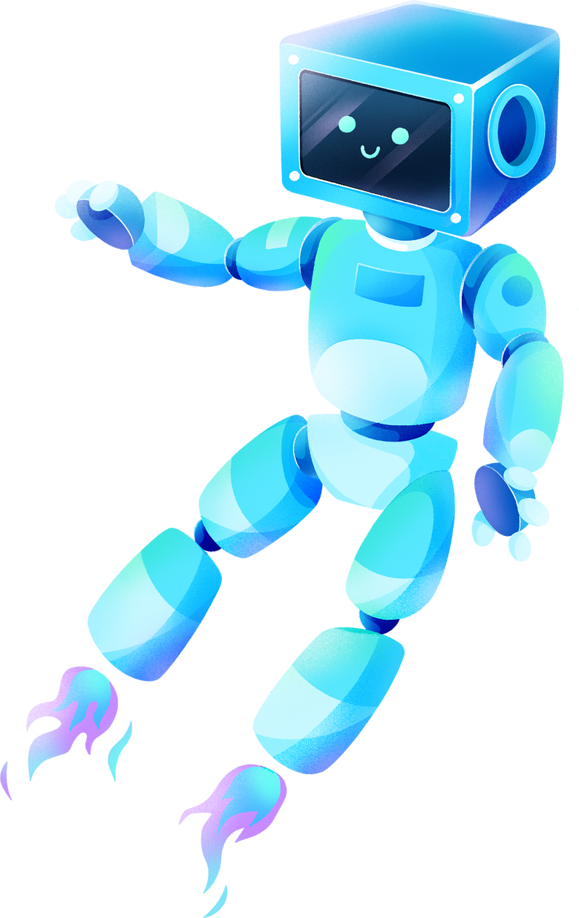

SUPERLATIVE ADJECTIVES WITH SHORT ADJECTIVES
(DẠNG SO SÁNH NHẤT CỦA TÍNH TỪ NGẮN)
a. Khái niệm so sánh nhất
So sánh nhất thường được sử dụng để so sánh một sự vật, hiện tượng với tất cả các sự vật, hiện tượng khác trong tiếng Anh. Trong cấu trúc này, trước mỗi tính từ được sử dụng trong câu sẽ có thêm từ “the”.
b. Cách sử dụng
So sánh nhất thường dùng khi so sánh từ 3 đối tượng trở lên nhằm diễn tả một người hoặc vật nào đó mang một đặc điểm nào đó vượt trội hơn hẳn so với tất cả những đối tượng còn lại được nhắc đến.

Slide 12
SUPERLATIVE ADJECTIVES WITH SHORT ADJECTIVES
(DẠNG SO SÁNH NHẤT CỦA TÍNH TỪ NGẮN)
c. Cấu trúc: S + be + the + adj-est...
Ex:
This dress is the cheapest in the shop. (Chiếc váy này rẻ nhất trong cửa hàng.)
Mai Anh is the tallest girl in the class. (Mai Anh là bạn nữ cao nhất trong lớp)
Chú ý: Ngoài dạng so sánh hơn nhất ta còn có dạng so sánh kém nhất S + be + the least + adj...
Ex: This car is the least safe. (Cái ô tô này kém an toàn nhất.)
Her ideas were the least practical suggestions. (Các ý tưởng của cô ấy là thiếu thực tế nhất.)

Slide 13
SUPERLATIVE ADJECTIVES WITH SHORT ADJECTIVES
(DẠNG SO SÁNH NHẤT CỦA TÍNH TỪ NGẮN)
d. Quy tắc đổi đuôi tính từ
- Thông thường ta thêm đuôi -est vào sau hầu hết các tính từ ngắn.
- Đối với những tính từ ngắn kết thúc bằng một phụ âm mà ngay trước nó là nguyên âm duy nhất thì chúng ta nhân đôi phụ âm rồi thêm đuôi “est”
Ex: hot → the hottest; big → the biggest
- Những tính từ có hai âm tiết và kết thúc bằng “y” thì đổi “y” thành “I” rồi thêm “est”
Ex: happy → happiest; busy → the busiest
- Một số tính từ có hai ầm tiết nhưng kết thúc bằng -le, -et, -ow, -er vẫn được xem là tính từ ngắn.

Slide 14
SUPERLATIVE ADJECTIVES WITH SHORT ADJECTIVES
(DẠNG SO SÁNH NHẤT CỦA TÍNH TỪ NGẮN)
e. Một sô tính từ bất quy tắc.
Adjective | Superlative
good | the best
bad | the worst
much / many | the most
little | the least
far | further
happy | the happiest
simple | the simplest
narrow | the narrowest
clever | the cleverest

Slide 15
GRAMMAR CHECKING
https://wordwall.net/resource/23461810
https://wordwall.net/resource/34916399

Slide 16
PART 1. THEORY
III. PHONETICS

Slide 17

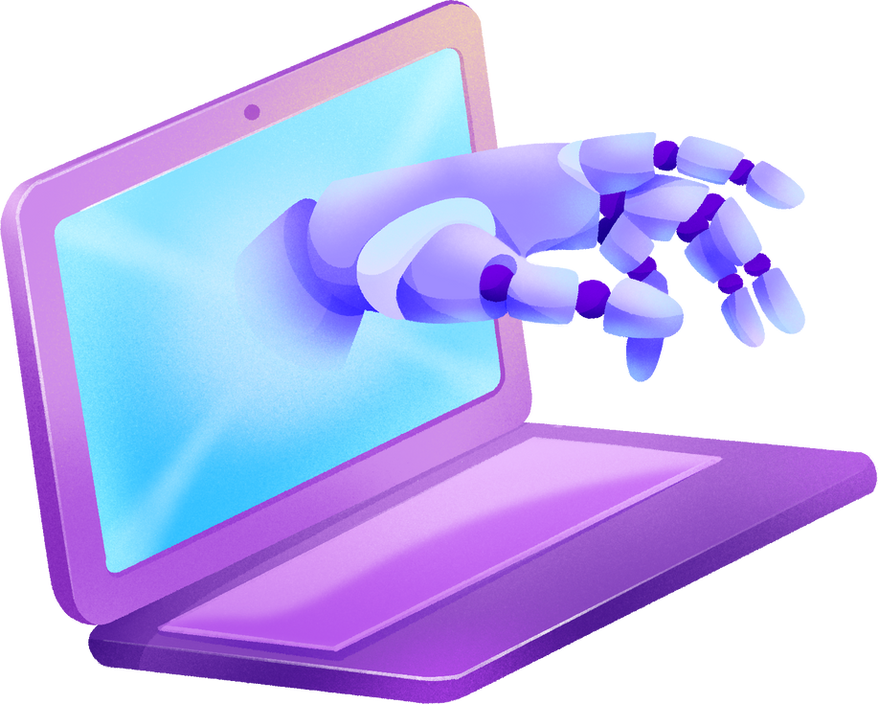
FALLING TONE IN STATEMENTS
( NGỮ ĐIỆU XUỐNG TRONG CÂU KHẲNG ĐỊNH)
Thông thường câu khẳng định có giọng đi xuống ở cuối câu nếu không có một lý do đặc biệt nào khác.
Ex 1: This is my father. His name is Tuan. 
Ex 2: We are very happy to meet you. 

Slide 18
PART 2. LANGUAGE
I. VOCABULARY

Slide 19
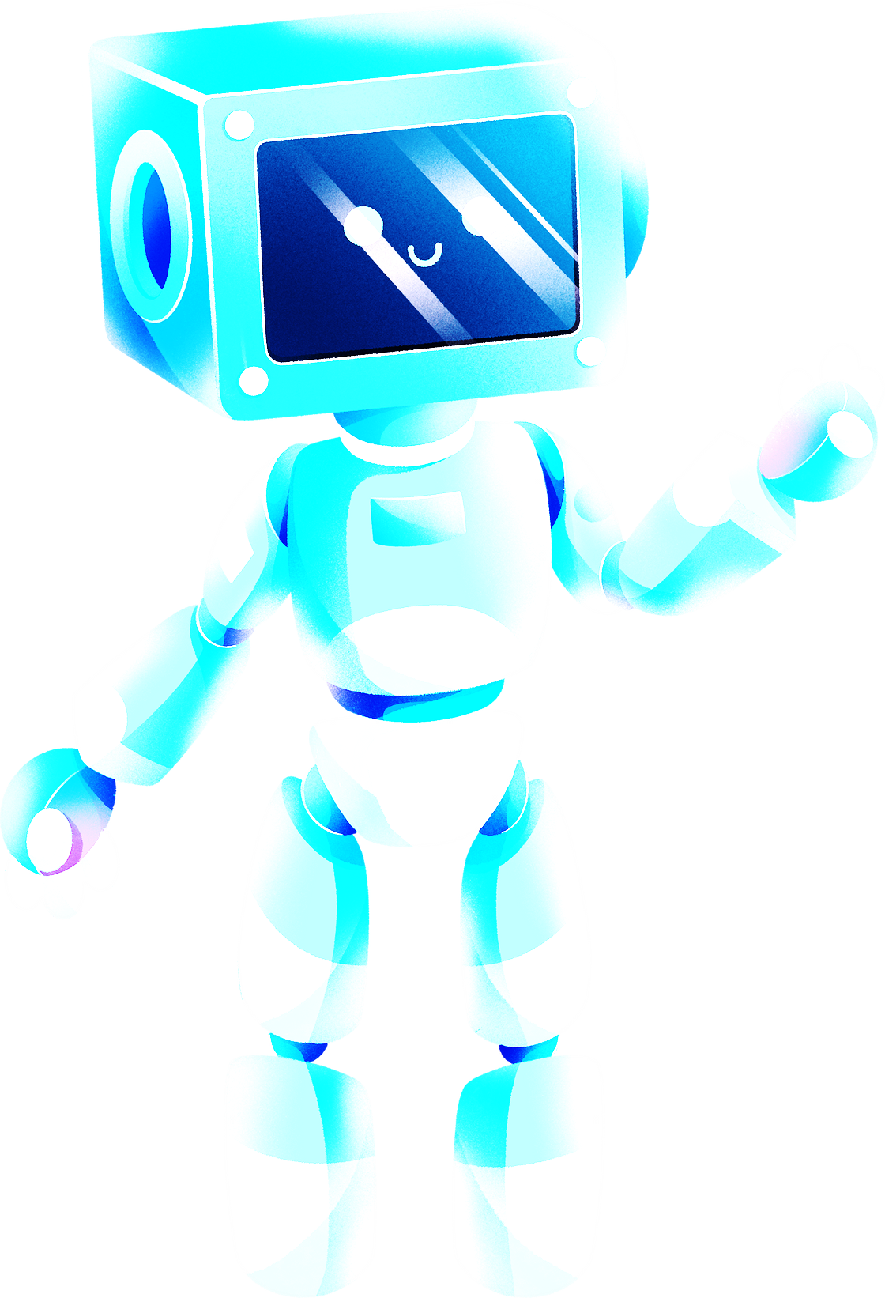
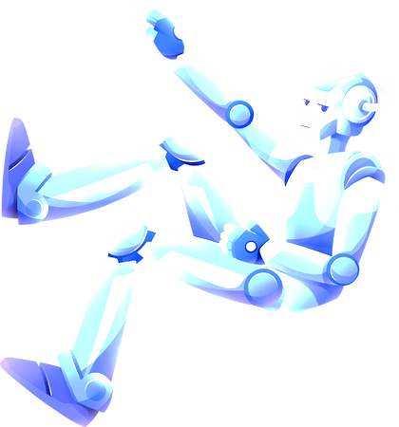
Exercise 1. Match the type of robots with suitable tasks.
No. | A | Opt. | B
1. | space robot | a. | work in mines
2. | home robot | b. | cut the hedge
3. | worker robot | c. | build space stations
4. | teaching robot | d. | explain lessons
5. | doctor robot | e. | help sick people
1. C
2. B
3. A
4. D
5. E

Slide 20
Exercise 2. Complete the sentences with the words in the box.
robots | robot show | dishes | space station
laundry | gardening | hedge | planet
1. He is cutting the _____________ with a pair of garden shears.
2. To go outside the _____________ you must wear a spacesuit!
3. Earth is the _____________ we live on.
4. My grandmother enjoys _____________ and grows her own fruit and vegetables.
5. _____________ have replaced humans in doing many dangerous tasks.
6. They have to do my _____________ today. They have no clean pants to wear.
7. I’ll cook if you do the _____________. Deal? - Deal.
8. We can see many types of robots at the international _____________.
hedge
space station
planet
gardening
Robots
laundry
dishes
robot show

Slide 21
Ex 3. Complete the sentences with the verbs in the box. There are 2 extra words.
listen | go | hear | finish | speak
play | find | love | understand | sleep
1. My dad couldn’t _____________ to work because he was ill.
2. John couldn’t _____________ his pen. It wasn’t in his school bag.
3. Mary wasn’t hungry - she couldn’t _____________ her lunch.
4. I couldn’t _____________ Jane because I don’t speak German.
5. We couldn’t _____________ the teacher because the students were very noisy.
6. Tom couldn’t _____________ to music because his CD player was broken.
7. I was very tired but I couldn’t _____________.
8. We couldn’t _____________ tennis because the weather was bad.
go
find
finish
understand
hear
listen
sleep
play

Slide 22
Exercise 4. What will robots be able to do? Put the words/ phrases into the correct type of robots.
cook meals | make cars | give lessons
write poems | make new medicines | design new machines
find new materials | take our temperatures | help students with their homework
build new space stations | look after the patients | control home appliances
correct homework | feed babies | take care of the garden
work in the mines | guard our house | build cities on Mars
Types of robots | Functions
Home robots | ________________________________________________
Teaching robots | ________________________________________________
Worker robots | ________________________________________________
Doctor robots | ________________________________________________
Space robots | ________________________________________________

Slide 23
Exercise 4. What will robots be able to do? Put the words/ phrases into the correct type of robots.
Types of robots | Functions
Home robots
Teaching robots
Worker robots
Doctor robots
Space robots
cook meals, feed babies, control home appliances, take care of the garden, guard our house
write poems, correct homework, give lessons, help students with their homework
work in the mines, make cars, design new machines
make new medicines, take our temperatures, look after the patients
find new materials, build new space stations, build cities on Mars

Slide 24
Exercise 5. Complete the sentences with the correct form of the verbs in the box. There are 2 extra words.
make | discover | guard | do | lift
speak | recognise | listen | cut | understand
1. Home robots ___________ all our housework, such as cleaning, washing the dishes, etc.
2. Security Robots can patrol streets or ___________ your home.
3. ASIMO can ___________ the faces and voices of multiple people speaking.
4. Nao Robot ___________ Japanese, English, and Chinese and can answer your questions about banking.
5. Worker robots are good at ___________ heavy things.
6. The Bosch robot could ___________ either a latte, a cappuccino or a coffee.
7. Will future robots be able to ___________ human emotions?
8. Bill Shane now ___________ his grass with a robotic lawnmower.
do
guard
recognise
speak
lifting
make
understand
cuts

Slide 25
PART 2. LANGUAGE
II. GRAMMAR

Slide 26
Exercise 1. Put the adjectives in brackets in the superlative form.
1. Who is (tall) ________________ person in your family?
2. My mum is (good) ________________ cook in the world.
3. December is (cold) ________________ month of the year in my country.
4. What’s (dangerous) ____________________ animal in the world?
5. Ethan is (happy) ________________ boy that I know.
6. Where are (beautiful) _____________________ beaches in your country?
7. She bought (big) ________________ cake in the shop.
8. Who is (famous) ____________________ singer in your country?
9. What is (popular) _____________________ makeup look of young girls?
10. This is a really good place. It’s one of (good) ________________ destinations in this city.
the tallest
the best
the coldest
the most dangerous
the happiest
the most beautiful
the biggest
the most famous
the most popular
the best

Slide 27
Exercise 2. Choose the correct answer for each sentence.
1. That was the funniest/ most funny thing to do.
2. Susie is the most prettiest/ prettiest of the four girls.
3. This is a really good school. It’s one of the best/ most schools in the North West.
4. She is by far the most rich/ richest woman in the world.
5. School days are supposed to be the most happy/ happiest days of your life but I don’t agree.
6. What is the most popular/ popularest sport in your country?
7. That was a really good meal, probably one of the deliciousest/ most delicious I have ever eaten.
8. I’m surprised I didn’t fall asleep. I think that he is one of the most boring/ boringest people in the world.

Slide 28
Ex 3. Put the adjectives in brackets in the superlative form and a suitable preposition.
the richest
in
1. She is by far (rich) ___________ woman ___________ Vietnam.
2. That was (funny) _____________ thing to do __________ this weather.
3. Thank you for (delicious) __________________ I have ever eaten ___________ my life.
4. Susie is (pretty) ______________ girl ___________ our team.
5. I think that he is one of (boring) ________________ people ___________ the world.
6. I have had (happy) _______________ days ___________ my life.
7. Where are (nice) ___________ beaches ___________ Da Nang?
8. What’s (small) ______________ animal ___________ the world?
9. July is (hot) ___________ month ___________ the year in Vietnam.
10. Who is (tall) _______________girl ________________ your class?
the funniest
in
the most delicious
in
the prettiest
in
the most boring
in
the happiest
in
the nicest
in
the smallest
in
the hottet
of
the tallest
in

Slide 29
Exercise 4. Put the adjective in brackets in the correct form of comparison: Comparative or Superlative.
nicer
1. The weather this autumn is even ___________ (nice) than last autumn.
2. He is _______________ (clever) student in my group.
3. These products in this grocery are ______________ (natural) than these in the near one.
4. A holiday in the mountains is __________________ (memorable) than a holiday in the sea.
5. The price in the countryside is ___________ (cheap) than that in big cities.
6. Canada is far ___________ (large) than Vietnam.
7. John is a ___________ (good) gardener than Stuart.
8. They are not going to the ___________ (bad) hotel.
9. New York is the ___________ (large) city of the United States.
10. My friend is ___________ (quiet) than me.
the cleverest
more natural
more memorable
cheaper
larger
better
worst
largest
quieter

Slide 30
Exercise 4. Put the adjective in brackets in the correct form of comparison: Comparative or Superlative.
11. The Palace Hotel was ________________ (expensive) than the Rex Hotel.
12. Art-related subjects are _________________ (interesting) than science classes.
13. My current apartment is _________________ (comfortable) than the one, I rented 2 years ago.
14. John is the ___________ (good) student in our class.
15. Many people would argue that robots are ________________ (intelligent) than humans.
16. My garden is a lot _______________ (colorful) than this park.
17. This is the __________________ (interesting) book I have ever read.
18. Who is the ___________ (rich) woman on Earth?
19. These are the __________________ (beautiful) colours.
20. The palace is the __________________ (expensive) hotel.
more expenive
more interesting
more comfortable
best
more intelligent
more colorful
most interesting
richest
most beautiful
most expensive

Slide 31
Exercise 5. Choose the best option to complete the sentence.
1. His illness was ___________ than we had thought at first.
A. much serious B. more serious C. serious D. most serious
2. Nam is ___________ in his class.
A. taller B. the most tall C. the tallest D. more tall
3. Traveling by plane is ___________ than traveling by car.
A. fast B. more fast C. the most fast D. faster
4. Actually, today I feel ___________ than I did yesterday.
A. the worst B. worst C. worse D. bad
5. Could you speak Vietnamese ___________?
A. more clearly B. clearly C. the most clearly D. the clearest

Slide 32
Exercise 5. Choose the best option to complete the sentence.
6. That flight ticket is ___________ of all.
A. expensive B. the most expensive
C. more expensive D. the expensive
7. Phong works ___________ than most of him friends.
A. a lot more hardly B. more hardly C. many harder D. much harder
8. I tried to spend ___________ money.
A. little B. less C. the least D. the less than
9. My friend is much ___________ than me.
A. prettier B. pretty C. the prettiest D. more prettier
10. My mom speaks English ___________ I do.
A. fluently B. more fluently than
C. more fluently D. most fluently

Slide 33
Exercise 6. Use the given words in brackets to rewrite the sentences without changing the meaning of the original sentences.
1. My brother was earning much less in his previous job than he is now. (more)
→ My brother is earning more in his current job than he was (in the past).
  2. Chicken is cheaper than beef. (more)
  → Beef is more expensive than chicken.
    3. To my knowledge, speaking English fluently is easier than listening to conversations in English. (hard)
    → To my knowledge, listening to conversations in English is harder than speaking English fluently.
      4. This is the most delicious lunch she’s ever had. (more)
      → She's never had a more delicious lunch than this one.
        5. There is no better doctor in this hospital than Mr. Long. (best)
        → Long is the best doctor in this hospital.

Slide 34
Exercise 6. Use the given words in brackets to rewrite the sentences without changing the meaning of the original sentences.
6. This is the fastest moving car I’ve ever driven. (fast)
→ I have never driven such a fast car.
  7. There isn’t anywhere as old as this castle in the city. (oldest)
  → This castle is the oldest in the city.
    8. Have you got any bigger shirt than that one? (biggest)
    → Is this the biggest shirt you've/ you have got?
      9. I am not taller than anyone in the class. (shortest)
      → I am the shortest in the class.
        10. The company’s revenue in May is the highest compared to the previous months. (lower)
        → The company's revenue in the previous months is lower than this May.

Slide 35
PART 2. LANGUAGE
III. PHONETICS

Slide 36
Ex 1. Read exactly the sentences and pay attention to your intonation.
1. Many people think spending money on robots is a complete waste of time and money.
2. She can walk when she was two years old.
3. These robots can do many things for the public such as cleaning streets or watering plants.
4. Home robots can do things like repairing things around the house or looking after the garden.
5. This new kinds of robots is fantastic.
6. Our future robot will be able to help us do the gardening.
7. Robots are helping US a lot in industry, education, and in our house.
8. We need a lot of money and time researching and making robots.
9. We must be careful because some people may use robots to do bad things.
10. Robots will be very useful for our lives but they use to much energy.

Slide 37
Exercise 2. Answer the question.
What is the tone of statement?
→ It has falling intonation.

Slide 38
PART 3. COMMUNICATION SKILLS
I. LISTENING

Slide 39
Ex 1. Listen and decide if each statement is True (T) or False (F).  Track 11
1. The speaker only mentions 2 types of robots: home robots and teaching robots.
2. ROVs are used to reach places in the ocean.
3. ROVs have one large camera.
4. ROVs can collect samples.
5. Mars Rover is a robot that was sent to the Moon.
F
T
F
T
F

Slide 40
Exercise 2. Listen and answer the question.  Track 12
1. Who use ROVs to explore the oceans?
→ Ocean explorers do.
2. Why do ROVs help US learn about all the animals that live down the ocean?
→ Because they go where people can't.
3. Why do ROVs have cameras?
→ To send pictures back to a computer.
4. What do most robots have?
→ They have a remote control.
5. What can Roomba do?
→ It can sweep, vacuum or mop the floor.

Slide 41
PART 3. COMMUNICATION SKILLS
II. SPEAKING

Slide 42
Exercise 1. Complete the following conversation with missing sentences then practise it.
Huyen: What are you doing, Linh?
Linh: (1) ____________________________________.
Huyen: Do you clean them every day?
Linh: Yes, I do. How about you? Can your robot clean the house?
Huyen: Yes. (2) ____________________________________.
Linh: What? You are joking!
Huyen: No. (3) ____________________________________. It can clean the floors very well.
Linh: what else can it do?
Huyen: (4) ____________________________________.
Linh: Oh, really?
Huyen: And it wakes me up in the morning, too.
Linh: Wonderful.
Huyen: (5) ___________________________________________!
I’m cleaning the floors.
• It can turn on the lights and TV.
• I hope in the future my robot can do everything for me!
• It helps me clean the house every day.
• I’m cleaning the floors.
• My father has just bought a robot.
It helps me clean the house every day.
My father has just bought a robot.
It can turn on the lights and TV.
I hope in the future my robot can do everything for me

Slide 43
Exercise 2. Reorder the sentences to make a dialogue then practise it.
3
______ What did you watch?
______ Really? what is it about?
______ Hi, Mike. How was your weekend?
_____ Well, the film was very, very touching. David longs to be a 'real boy' so that he can regain the love of his human mother.
______ It sounds great. I’ll watch A.I. - Artificial Intelligence tonight.
______ I just stayed at home and watched a really good science-fiction film.
______ It’s about David, a robotic boy with the ability to feel love.
______ A.I. - Artificial Intelligence. It was brilliant.
______ Who stars in it?
______ A child robot? Sounds exciting.
______ Haley Joel Osment plays the role of David.
5
1
8
11
2
6
4
9
7
10

Slide 44
PART 3. COMMUNICATION SKILLS
III. READING

Slide 45
Exercise 1. Read and complete the text with the words in the box.
safer | sensors | performing | assembly line jobs | automobile industry
Robots are used in the (1) __________________ to assist in building cars. These high- powered machines have mechanical arms with tools, wheels and (2) ______________________ that make them ideal for (3) ________________________. Not only do robots save more money in manufacturing costs, but they also perform tough tasks at a pace no human could possibly do. Robots also make car manufacturing (4) ____________________ because they can take on dangerous and difficult jobs in place of humans. Automotive industry robots are capable of (5) __________________ a wide range of tasks such as installation, painting and welding, and aren’t restricted by fatigue or health risks, therefore making them an incredibly useful and irreplaceable part of car production.
automobile industry
sensors
assembly line jobs
safer
performing

Slide 46
Exercise 2. Read the following passage and answer the questions.
Life in the future will be far better than it is today. People will be able to live in a cleaner environment, breathe fresher air and eating healthier food. Robots will be able to do most of the work in factories and they will be able to do all the dangerous things for us. More people will be able to work from home on computers so there won’t be any traffic jams. Cars will be with us but they will be able to run solar energy instead of petrol. Robots will be able to interact with people. They will be able to do almost everything for us at home.

Slide 47
Exercise 2. Read the following passage and answer the questions.
1. What will life in the future be like?
→ Life in the future will be far better than it is today.
2. Will people be able to live in a cleaner or dirtier environment?
→ They will be able to live in a cleaner environment.
3. Will robots be able to do most of the work in factories for us?
→ Yes, they will.
4. Why won’t there be any traffic jams?
→ Because more people will be able to work from home on computers.
5. Will robots be able to talk to people?
→ Yes, they will.

Slide 48
Exercise 3. Read the text and choose the best option for each question.
ROBOTS
A robot is a machine. But it is not just any machine. It is a special kind of machine. It is a machine that moves. It follows instructions. The instructions come from a computer. Because it is a machine, it does not make mistakes. And it does not get tired. And it never complains. Unless you tell it to!
Robots are all around US. Some robots are used to make things. For example, robots can help make cars. Some robots are used to explore dangerous places. For example, robots can help explore volcanoes. Some robots are used to clean things. These robots can help vacuum your house. Some robots can even recognize words. They can be used to help answer telephone calls. Some robots look like humans. But most robots do not. Most robots just look like machines.
Long ago, people imagined robots. But nobody was able to make a real robot. The gist real robot was made in 1961. It was called Unimate. It was used to help make cars. It looked like a giant arm.
In the future, we will have even more robots. They will do things that we can’t do. Or they will do things that we don’t want to do. Or they will do things that are too dangerous for US. They will help make life better.

Slide 49
Exercise 3. Read the text and choose the best option for each question.
1. As used in paragraph 1, we can understand that something special is NOT ____.
A. normal B. expensive C. perfect D. tired
2. According to the author, robots cannot be used to.
A. explore volcanoes B. make cars C. clean your house D. do the gardening
3. What is the main purpose of paragraph 2?
A. to show how easy it is to make a robot B. to tell what a robot is
C. to describe the things a robot can do
D. to explain the difference between a robot and a machine
4. Which of these gives the best use of a robot?
A. to help make a sandwich B. to help tie shoes
C. to help read a book D. to help explore Mars
5. How does the author feel about robots?
A. Robots are useless. B. Robots are helpful.
C. Robots are confusing. D. Robots are dangerous.

Slide 50
PART 3. COMMUNICATION SKILLS
IV. WRITING

Slide 51
Exercise 1. Rewrite the sentences without changing the meaning of the original sentences.
1. Today is hotter than yesterday.
→ Yesterday was
2. No one in her team is more beautiful than Salim.
→ Salim is
3. No house in the city is higher than his house.
→ His house is
4. Lan is the most intelligent in her class.
→ No one in Lan's class
5. If she reads many science books, she will have much knowledge.
→ The more
6. Minh is very intelligent but his brother is the most intelligent in his family.
Minh’s brother is
7. Thang is more careful than Tuan.
→ Tuan
8. No producers in the world are bigger than Tesla.
→ Tesla
colder than today.
the most beautiful girl in her team.
the highest house in the city.
is more intelligent than her.
science books she reads, the more knowledge she will have.
is more intelligent than him.
not as careful as Thang.
is the biggest producer in the world.

Slide 52
Exercise 2. Write in complete sentences using the words and phrases given.
1. Underwater robots/ dive/ longer/ deeper/ than/ human.
→ Underwater robots can dive longer and deeper than any human.
2. Robots/ become/ increasingly/ important/ investigate/ research/ hazardous/ dangerous/ environments.
→ Robots have become increasingly important for investigate researching hazardous and dangerous environments
3. Military robots/ be/ some/ most/ high-tech/ important/ robots/ used/ today.
→ Military robots are some of the most high-tech and important used today.
4. Robots/ be able to/ think/ like/ humans.
→ Robots won't be able to think like humans.
5. Future/ robots/ be able to/ do/ more/ complicated/ things/ us.
→ In the future, robots will be able to do more complicated thing for us.

Slide 53
Exercise 2. Write in complete sentences using the words and phrases given.
6. Nowadays/ robots/ not/ talk/ people/ but/ future/I/ think/ they/ will.
→ Nowadays robots can't talk to people, but in the future I think they will.
7. More/ people/ lose/ jobs/ because/ robots/ replace/.
→ More people will lose their jobs because robots will replace them.
8. One/ advantages/ robots/ be/ they/ can/ work/ situations/ dangerous/ harmful/ humans.
→ One of the advantages of robots is that they can work in situate are dangerous or harmful for humans.
9. Worker robots/ become/ more/ popular/ industries.
→ Worker robots are becoming more popular in industries.
10. Robodex/ be/ largest/ robot/ exhibition/ world.
→ Robodex is the largest robot exhibition in the world.

Slide 54
Exercise 3. What can robots do? Let's make a writing about 80 – 100 words to talk about functions of robots.
Home robot can help us cook meal, feed babies or clean the house. Teaching robots can give lessons, correct homework or teach students at school. Worker robots can make cars, do heavy things or work in mines. Doctor robots can make new medicines, take our temperature and take care of sick people. And s space robots can build new space stations, build cities on other planets or discover the space. Our life will be better thanks to robots.

Slide 55
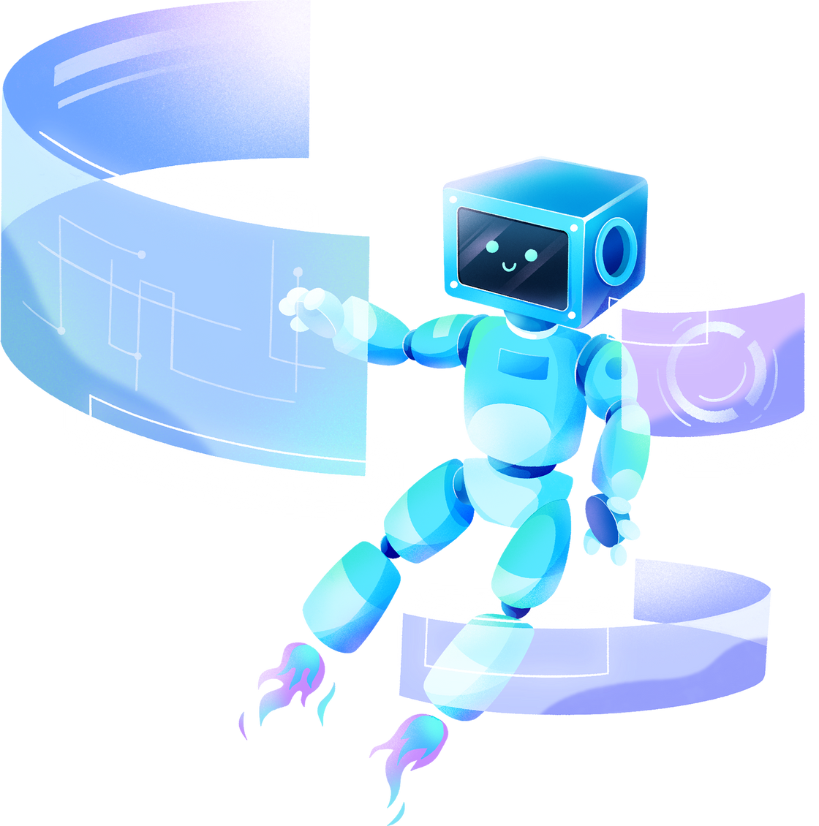
THANK YOU!

