Slide 1
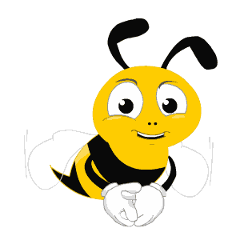
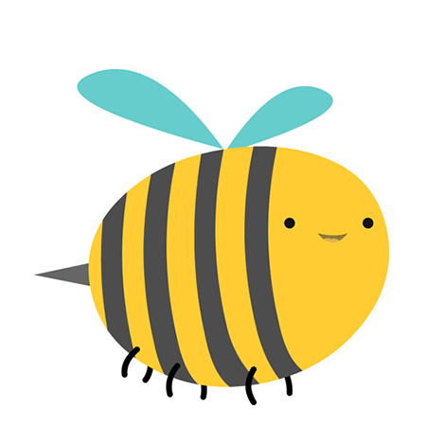
non
Ong
học
việc
The little bee

Slide 2
Question 1?
A. right
B. wrong
C. wrong
D. wrong

Slide 3
Question 2?
A. wrong
B. right
C. wrong
D. wrong

Slide 4
Question 3?
C. right
A. wrong
B. wrong
D. wrong

Slide 5
Question 4?
A. wrong
B. wrong
C. wrong
D. right

Slide 6
my
Subscribe
Channel
please

