Slide 1


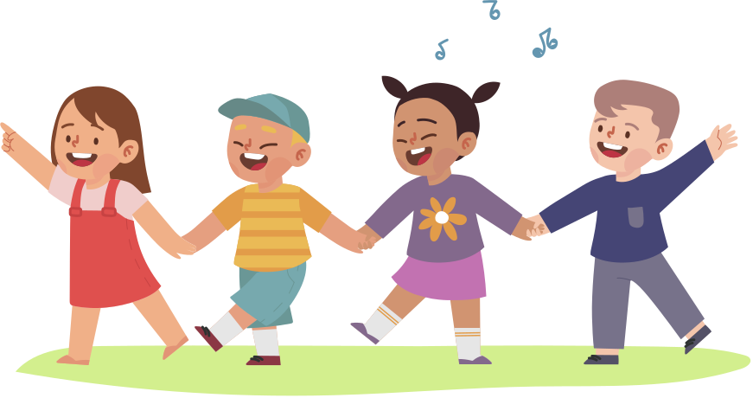

UNIT 1.
MY NEW SCHOOL

Slide 2



PART 1. THEORY

Slide 3
I. VOCABULARY

Slide 4




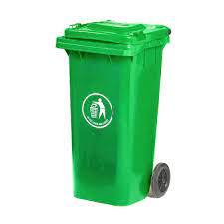
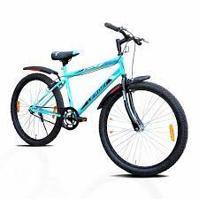
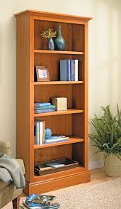
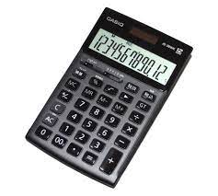


1. bicycle (n):
2. bin (n):
/bɪn/
thùng rác
/'baɪsɪkl/
xe đạp
3. bookcase (n):
4. calculator (n):
/'kælkjuleɪtə(r)/
máy tính
/'bʊkkeɪs/
kệ sách

Slide 5



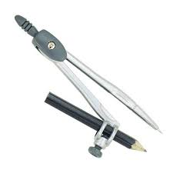
5. clock (n):
6. coloured pencils (n):
/klɒk/
đồng hồ
(treo tường)
/'kʌləd 'penslz/
bút chì màu
8. computer (n):
7. compass (n):
(compasses]
/'kʌmpəs/
/'kʌmpəsɪz/
com pa
/kəm'pju:tə(r)/
máy vi tính

Slide 6
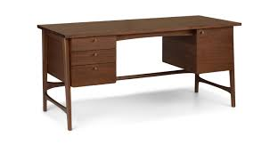
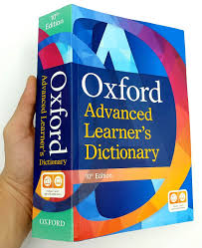

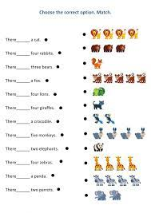
9. desk (n):
10. dictionary (n):
/'dikʃənerɪ/
từ điển
/desk/
bàn học
11. English (n):
12. exercise (n):
/'eksəsaɪz/
bài tập
/'ɪηglɪʃ/
môn Tiếng Anh

Slide 7
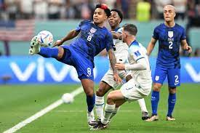
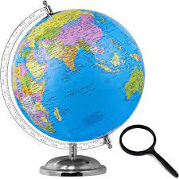
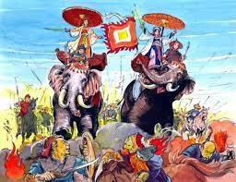

13. football (n):
14. globe (n):
/gləʊb/
quả cầu,
địa cầu
/'fʊtbɔːl/
bóng đá
15. glue (n):
16. History (n):
/'hɪstrɪ/
môn Lịch sử
/glu:/
keo dán

Slide 8

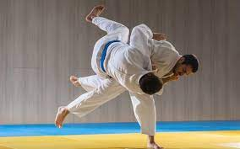
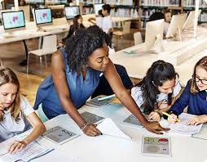
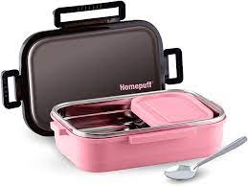
17. homework (n):
18. judo (n):
/'həʊmwɜ:k/
bài tập về nhà
/'dʒu:dəʊ/
võ judo
19. lesson (n):
/’lesn/
tiết học
20. lunch box (n):
/lʌntʃ bɒks/
hộp đựng đồ ăn trưa

Slide 9
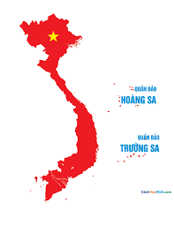

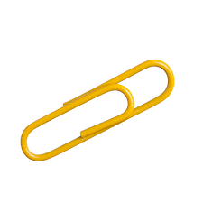

21. map (n):
22. Music (n):
/mæp/
bản đồ
/'mju:zɪk/
môn Âm nhạc
23. notebook (n):
24. paper clip (n):
/'peɪpə(r) klɪp/
ghim giấy, kẹp giấy
/'nəʊtbʊk/
vở viết

Slide 10
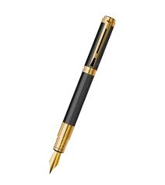
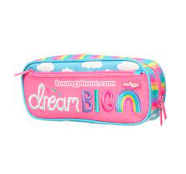
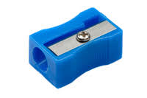
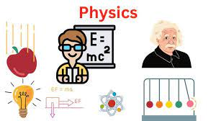
25. pen (n):
/pen /
bút
26. pencil case (n):
/'pensl keɪs/
hộp bút
27. pencil sharpener (n):
28. Physics (n):
/’fɪzɪks/
môn Vật lý
/’pensl ʃɑːpnə(r)/
gọt bút chì

Slide 11
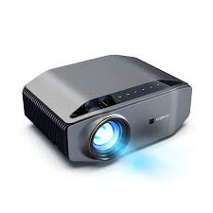
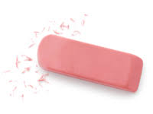
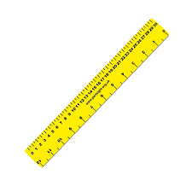
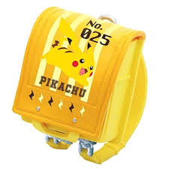
29. projector (n):
30. rubber (n):
/prə'dʒektə(r)/
máy chiếu
/'rʌbə(r)/
cục tẩy
31. ruler (n):
32. school bag (n):
/'ru:lə(r)/
thước kẻ
/sku:l bæg/
cặp sách

Slide 12
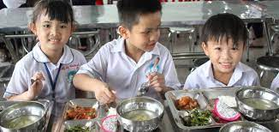

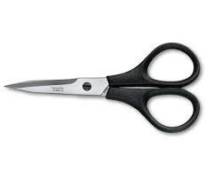
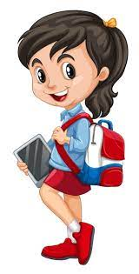
33. school lunch (n):
34. Science (n):
/sku:l lʌntʃ/
bữa ăn trưa ở trường
/saɪəns/
môn Khoa học
35. scissors (n):
36. student (n):
/'stju:dnt/
học sinh
/'sizəz/
kéo

Slide 13

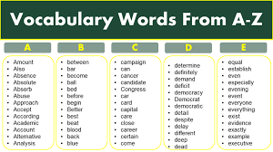
37. textbook (n):
/'tekstbʊk/
sách giáo khoa
38. vocabulary (n):
/və'kæbjələrɪ/
từ vựng

Slide 14
bicycle
bin
bookcase
calculator
clock
coloured pencils
compass (compasses]
computer
desk
dictionary
English
exercise
football
globe
glue
History
homework
judo
lesson
lunch box
map
Music
notebook
paper clip
pen
pencil case
pencil sharpener
Physics
projector
rubber
ruler
school bag
school lunch
Science
scissors
student
textbook
vocabulary

Slide 15
II. GRAMMAR

Slide 16
VOCABULARY CHECKING
https://wordwall.net/resource/32197732
https://wordwall.net/resource/22358510
https://wordwall.net/resource/35996691
Notes:
LINK 1 CHỌN ĐÁP ÁN
LINK 2 : TÌM TỪ
LINK 3 : SẮP XÊÓ CHỮ CÁI

Slide 17



1. PRESENT SIMPLE TENSE (Thì hiện tại đơn)
Form (cấu trúc)
Ex: I go to school every day.
Does she go to school every day?
She doesn't work for that company.

Slide 18
b. Usage
• Dùng để chỉ thói quen hàng ngày, hành động lặp đi lặp lại ở hiện tại
Ex: I usually go to bed at 11 p.m.
(Tôi thường đi ngủ vào lúc 11 giờ.)
• Dùng để chỉ một sự việc, một sự thật hiển nhiên.
Ex: The Sun rises in the East and sets in the West.
(Mặt trời mọc ở phía Đông và lặn ở phía Tây.)
• Dùng để chỉ một sự việc sẽ xảy ra trong tương lai theo thời gian biểu hoặc lịch trình.
Ex: The plane takes off at 3 p.m this afternoon.
(Máy bay hạ cánh lúc 3 giờ chiều nay.)

Slide 19
c. Signals
• Cụm từ với "every": every day (mọi ngày), every year (mọi năm), every month (mọi tháng), every afternoon (mọi buổi chiều), every morning (mọi buổi sáng), every evening (mọi buổi tối)...
• Cụm từ chỉ tần suất: once a week (1 lần 1 tuần), twice a week (2 lần một tuần), three times a week (3 lần một tuần), four times a week (4 lần một tuần), five times a week (5 lần một tuần), once a month (1 lần một tháng), once a year (một lần một năm)...
• Trạng từ chỉ tần suất: always, usually, often, sometimes, never, rarely...

Slide 20
d. How to add "s/es" to verbs
• Thông thường ta thêm "s" vào sau các động từ.
work → works
read → reads
• Những động từ tận cùng bằng -s; -sh; -ch; -z; -x; -o: ta thêm "es".
miss → misses
watch → watches
mix → mixes
wash → washes
buzz → buzzes
go → goes

Slide 21
• Những động từ tận cùng là "y":
+ Nếu trước "y” là một nguyên âm (a,e,i,o,u): ta giữ nguyên "y" + "s"
play → plays
buy → buys
pay → pays
+ Nếu trước "y” là một phụ âm - ta đổi "y" thành "i" + "es”
fly → flies
cry → cries
fry → fries

Slide 22
2. ADVERBS OF FREQUENCY (Trạng từ chỉ tần suất)
Trạng từ chỉ tần suất cho chúng ta biết về mức độ thường xuyên của một hành động nào đó. Loại trạng từ này thường dùng với thì hiện tại đơn để diễn tả các hành động có tính lặp đi lặp lại.

Slide 23
a. Các trạng từ chỉ tần suất thường gặp

Slide 24
b. Vị trí của trạng từ chỉ tần suất
Trạng từ chỉ tần suất thường đứng ở một trong các vị trí sau:
- Trạng từ chỉ tần suất đứng trước động từ thường.
Ex. I usually go to the park with my friends.
(Tôi thường đi công viên với bạn tôi.)
We never go swimming in winter.
(Chúng tôi không bao giờ đi bơi vào mùa đông.)

Slide 25
- Trạng từ chỉ tần suất đứng sau trợ động từ, động từ khuyết thiếu và động từ be.
Các trợ động từ thường gặp nhất là: is, am, are, do, does, have, has, will, can, may, must, etc.
Ex. Tony is often on time.
(Tony thường xuyên đúng giờ.)
Jack is never late for the important meeting.
(Jack không bao giờ đến trễ các cuộc họp quan trọng.)
Tom will never lend her money.
(Tom sẽ không bao giờ cho cô ấy vay tiền.)
She doesn’t often go to the cinema on Tuesday.
(Cô ấy không thường xuyên đi xem phim vào thứ Ba.)

Slide 26
- Trạng từ chỉ tần suất đứng giữa động từ thường và trợ động từ.
Ex. I don't often buy chocolate here.
(Tôi không thường xuyên mua sô-cô-la ở đây.)
He doesn’t usually read this kind of stories.
(Anh ấy không thường đọc loại truyện này.)
What do you usually do in your free time?
(Bạn thường làm gì vào thời gian rảnh?)

Slide 27
GRAMMAR CHECKING
https://wordwall.net/resource/19440455
https://wordwall.net/resource/23443367
Notes:
Link 1: Xác định chủ nào đi vơi V chủ nào đi với V(s/es
LINK 2: TRẮC NGHIỆM

Slide 28
3. Cách dùng của STUDY, HAVE, DO và PLAY
a. STUDY
Động từ study thường dùng với các danh từ chỉ một môn học, một lĩnh vực, hoặc một hoạt động có tính nghiên cứu về một chủ đề hay lĩnh vực gì đó.
Ex: We study Maths. (Chúng tôi học Toán.)
They study Biology. (Họ học Sinh học.)

Slide 29
b. HAVE
Động từ have thường dùng với các danh từ để chỉ việc ai đó sở hữu cái gì đó. Ngoài ra have còn dùng trước tên các bữa ăn.
Ex: I often have lunch at school canteen.
(Tôi thường ăn trưa ở căng tin nhà trường.)
My father has a new cellphone.
(Bố tôi có một chiếc điện thoại di động mới.)

Slide 30
C. DO
Động từ do thường dùng với các danh từ chỉ các hoạt động giải trí, các việc vặt trong gia đình, các hoạt động thể thao không liên quan tới trái bóng hay các hoạt động mang tính rèn luyện sức khỏe.
Ex: Tony does morning exercise every day.
(Tony tập thể dục buổi sáng mỗi ngày.)
I often do the washing in the morning.
(Tôi thường giặt đồ vào buổi sáng.)

Slide 31
d. PLAY
Động từ play thường dùng với các danh từ chỉ các môn thể thao có liên quan tới trái bóng hoặc một vật tương tự. Các môn này thường chơi theo đội và thường có tính thi đấu hay cạnh tranh.
Ex: We play badminton after school.
(Chúng tôi chơi cầu lông sau giờ học.)
They will play football this Sunday.
(Họ sẽ chơi bóng đá vào Chủ nhật này.)

Slide 32
GRAMMAR CHECKING
https://wordwall.net/resource/57826023
https://wordwall.net/resource/57882603
https://wordwall.net/resource/21420669

Slide 33
III. PHONETICS

Slide 34

 Sound /ɑː/ and /ʌ/
1. Long vowel /ɑː/ (Nguyên âm dài /ɑː/)
a. Cách phát âm
☞ Hãy thực hành phát âm các từ sau

Slide 35
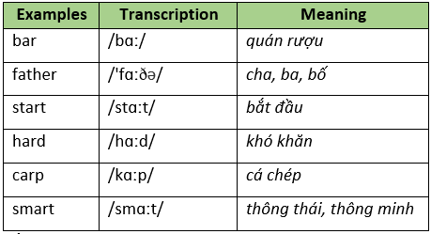
b. Dấu hiệu nhận biết
- Âm /ɑː/ thường xuất hiện trong các từ có a + r.

Slide 36
- Âm /ɑː/ thường xuất hiện trong các từ có au và ua.

Slide 37
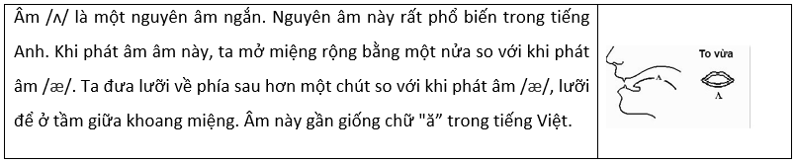
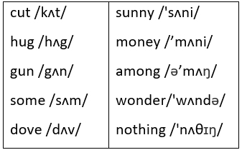
2. Short vowel /ʌ/ (Nguyên âm ngắn /ʌ/)
a. Cách phát âm
☞ Hãy thực hành phát âm các từ sau

Slide 38
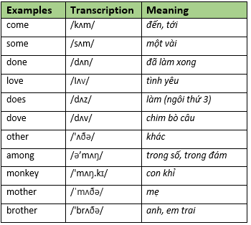
b. Dấu hiệu nhận biết
- Âm /ʌ/ thường xuất hiện trong những từ có chữ "o” có 1 âm tiết. Hoặc nó cũng thường xuất hiện ở những từ có nhiều âm tiết trong đó trọng âm rơi vào âm /ʌ/.

Slide 39
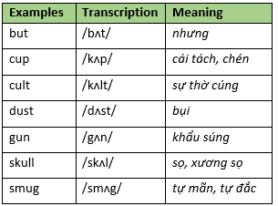
- Âm /ʌ/ thường xuất hiện trong những từ có tận cùng là "u + phụ âm”.

Slide 40
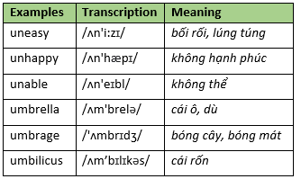
- Âm /ʌ/ thường xuất hiện trong những tiền tố un, um

Slide 41
- Âm /ʌ/ thường xuất hiện trong những từ có chữ "oo"

Slide 42
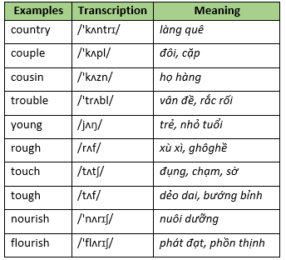
- Âm /ʌ/ xuất hiện trong những từ có chữ "ou" với 1 hay 2 phụ âm.

Slide 43
PART 2. LANGUAGE

Slide 44
I. VOCABULARY

Slide 45


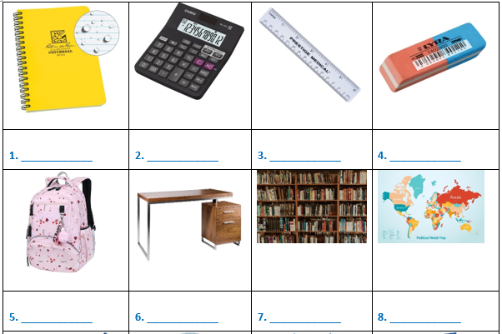
Exercise 1. Look at the picture and write the correct word under each picture.
notebook
calculator
ruler
rubber
school bag
desk
bookcase
map

Slide 46
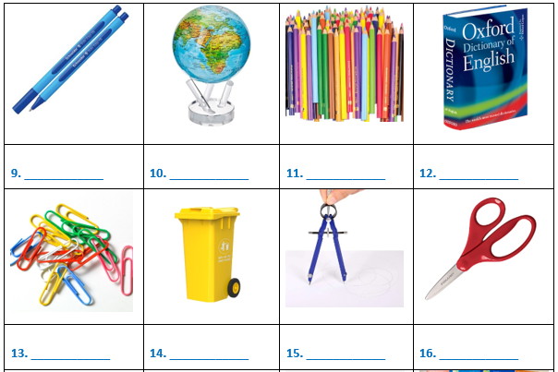
Exercise 1. Look at the picture and write the correct word under each picture.
coloured pencils
pen
globe
dictionary
paper clip
dustbin
compasses
scissors

Slide 47
Exercise 1. Look at the picture and write the correct word under each picture.
pencil sharpener
glue
pencil case
textbooks

Slide 48
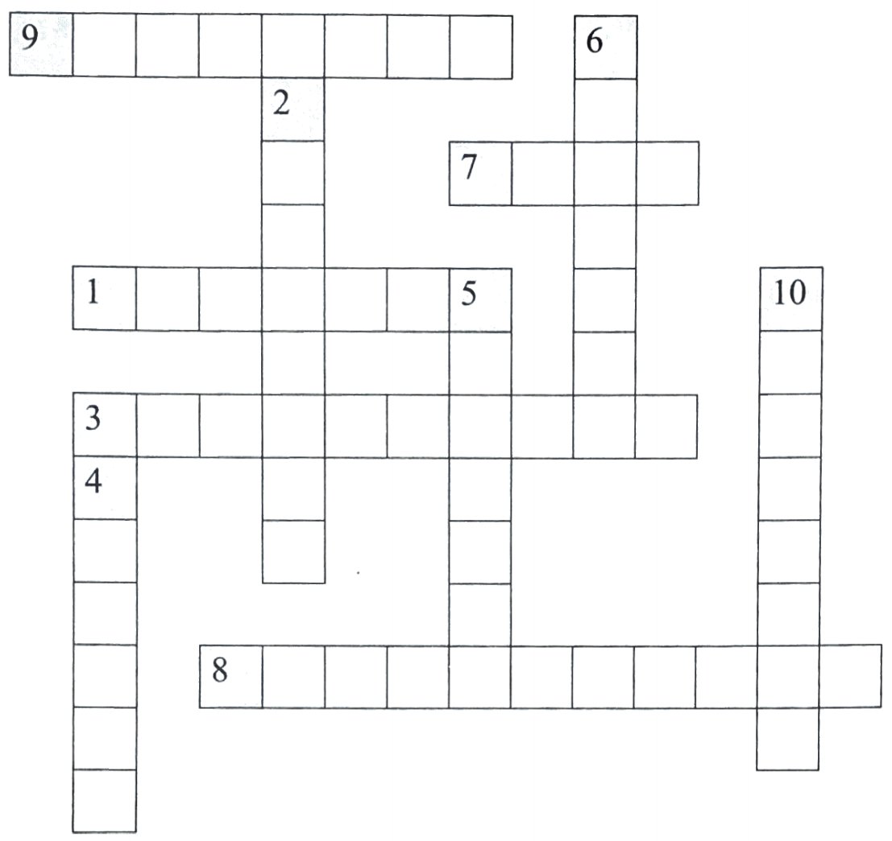
Exercise 2. Read and do the crossword below.
E N G L I S H
FR
ENC
BI
LOGY
A T
S P O R T S
M
TH
S
HI
S
T
O
Y
G E G R A P H Y
MUSIC
L I T E R A T U R E

Slide 49

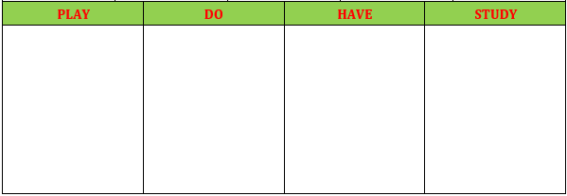
Exercise 3. Put the words into the correct column.
History
Music
sports
lunch
badminton
subjects
paintings
dinner
the violin
basketball
Geography
science
English
lessons
housework
breakfast
drawings
aerobics
pens
judo
Maths
football
rulers
the piano
vocabulary
karate
exercise

Slide 50
Exercise 4. Complete the sentences with available words.
school lunch
projector
football
computer
lessons
bicycle
vocabulary
judo
students
homework
1. My friends do ___________ to protect themselves.
2. We usually have ___________ in the school canteen.
3. Today we have two Art ___________.
4. I stick new words on the wall to learn ___________.
5. We play ___________ at break time.
6. I usually do my ___________ after dinner.
7. We learn about ___________ in IT.
8. Our school has one ___________. This connects to a computer.
9. Every day, I ride my ___________ to school
10. There are 30 ___________ in my class.

Slide 51
Exercise 5. Complete the sentences with the words from the box.
classmates
excited
international
football
creative
boarding
library
equipment
favourite
uniforms
1. AIS is an ___________ school in Viet Nam. It provides American education.
2. Vy and Phong are ___________ about their first day at secondary school.
3. The school gym has lots of new and modern ___________.
4. In the ______________you can read books and newspapers or borrow them to read at home.
5. A ___________ school is a school where students study and live during the school year.
6. Phong and Duy are in the same class at school. They are ___________.
7. Most schools require children to wear school ___________.
8. My sister is very ___________. She is very good at painting pictures.
9. Thang is good at playing ___________. He is the best footballer in my class.
10. What’s your ___________ subject? - I like English.

Slide 52
Exercise 6. Fill in the blank with a correct preposition
1. The children are excited ___________ the holiday.
2. Jenny put ___________ her coast and went out.
3. We have English and Vietnamese ___________ Tuesday
4. What do they usually do ___________ break time.
5. We play football the playground ___________ the morning.
6. She goes home ___________ 4 o'clock every day
7. Phong is doing her homework ___________ the library.
8. They sometimes go home ___________ weekends.
about
on
on
at
in
at
in
at

Slide 53
II. GRAMMAR

Slide 54
Exercise 1. Complete the sentence with don’t/ doesn’t.
1. I ___________ prefer coffee.
2. She ___________ ride a hike to her office.
3. Their friends ___________ live in a small house.
4. They ___________ do the homework on weekends.
5. Mike ___________ play soccer in the afternoons.
6. The bus ___________ arrive at 8.30 a m.
7. We ___________ go to bed at midnight
8. My brother ___________ finish work at 8 p.m.
don't
doesn't
don't
don't
doesn't
doesn't
don't
doesn't

Slide 55
Exercise 1. Complete the sentence with don’t/ doesn’t.
9. I ___________ like tea.
10. He ___________ play football in the afternoon.
11. You ___________ go to bed at midnight.
12. They ___________ do the homework on weekends.
13. The bus ___________ arrive at 8.30 a.m.
14. My brother ___________ finish work at 8 p.m.
15. Our friends ___________ live in a big house.
don't
doesn't
don't
don't
doesn't
doesn't
don't

Slide 56
Exercise 2. Put the verbs in brackets in the present simple form.
1. My mom always _______________ delicious meals. (make)
2. Charlie ____________ eggs. (not eat)
3. Susie _____________shopping every week. (go)
4. ________ Minh and Hoa ________ to work by bus every day? (go)
5. __________ your parents _________ with your decision? (agree)
6. Where ____________ he ____________ from? (come)
7. Where ____________ your father ____________? (work)
8. Jimmy ____________ usually ____________ the trees. (not water)
9. Who ____________ the washing in your house? (do
10. They ____________ out once a month. (eat)
makes
doesn’t eat
goes
Do
go
Do
agree
does
come
does
work
doesn’t
water
does
eat

Slide 57
Exercise 3. Underline the mistake in the following sentences.
1. I often gets up early to catch the bus to go to work.
2. She teach students in a local secondary school.
3. They doesn’t own a house. They still have to rent one to live.
4. Bui Tien Dung am a famous goalkeeper in the National Football Team.
5. What do your sister do?
get
teaches
don’t
is
does

Slide 58
Exercise 3. Underline the mistake in the following sentences.
6. John and Harry doesn’t go swimming in the lake.
7. Liam speak Chinese very well.
8. How often does she goes shopping in the supermarket?
9. Our dogs aren't eat bones.
10. Claire’s parents is very friendly and helpful.
don’t
speaks
go
doesn’t
are

Slide 59
Exercise 4. Put the verbs in brackets in the correct form.
1. It (be) __________ a fact that smart phone (help) __________ us a lot in our life.
2. I often (travel) __________ to some of my favorite destinations every summer.
3. Our Math lesson usually (finish) __________ at 4.00 p.m.
4. The reason why Susan (not eat) ____________ meat is that she (be) __________ a vegetarian.
5. People in Ho Chi Minh City (be) __________ very friendly and they (smile) __________ a lot.
is
hepls
travel
finishes
doesn’t eat
is
are
smile

Slide 60
Exercise 4. Put the verbs in brackets in the correct form.
6. The flight (start) __________ at 6 a.m every Thursday.
7. Peter (not study) _____________ very hard. He never gets high scores.
8. I like oranges and she (like) __________ apples.
9. My mom and my sister (cook) __________ lunch everyday.
10. They (have) __________ breakfast together every morning.
starts
doesn’t study
likes
cook
have

Slide 61
Exercise 5. Complete the sentence with the words in the box.
Remember to put it in the present simple form.
open
wake up
cause
play
do
speak
take
live
close
drink
1. Ann __________ handball very well.
2. I never __________ coffee.
3. The swimming pool __________ at 7:00 in the morning.
4. It __________ at 9:00 in the evening.
5. Bad driving __________ many accidents.
6. My parents __________ in a very small flat.
7. The Olympic Games __________ place every four years.
8. They are good students. They always __________ their homework.
9. My students __________ a little English.
10. I always __________ early in the morning.
plays
drink
opens
closes
causes
live
take
do
speak
wake up

Slide 62
Exercise 6. Write in complete sentences using the present simple.
1. he/drive to work every day.
→ He drives to work every day.
2. I/not/think you/be/right.
→ I don't think you're right.
3. we/have/enough time?
→Do we have enough time?
4. I/ eat cereal/ the morning.
→I eat cereal in the morning.
5. they/write e-mails/every day?
→Do they write e-mails every day?

Slide 63
Exercise 6. Write in complete sentences using the present simple.
6. you/often/watch/TV?
→Do you often watch TV?
7. he/not/read/newspaper.
→He doesn't read the newspaper
8. she/ dance/ often?
→Does she often dance?
9. Where/ she/ go/ Mondays?
→Where does she go on Mondays?
10. What/you/do/the weekend?
→What do you do at the weekend?

Slide 64
Exercise 7. Put the verbs in brackets in the correct form
and put the adverbs in the correct place.
1. My brothers (sleep) on the floor. (often)
→ My brothers often sleep on the floor.
2. He (stay) up late? (sometimes)
→ Does he sometimes stay up late?
3. I (do) the housework with my brother. (always)
→ I always do the housework with my brother.
4. Peter and Mary (come) to class on time. (never)
→ Peter and Mary never come to class on time.

Slide 65
Exercise 7. Put the verbs in brackets in the correct form
and put the adverbs in the correct place.
5. Why Johnson (get) good marks? (always)
→ Why does Johnson always get good marks?
6. You (go) shopping? (usually)
→ Do you usually go shopping?
7. She (cry). (seldom)
→ She seldom cries.
8. My father (have) popcorn. (never)
→ My father never has popcorn.

Slide 66
Exercise 7. Put the verbs in brackets in the correct form
and put the adverbs in the correct place.
5. Why Johnson (get) good marks? (always)
→ Why does Johnson always get good marks?
6. You (go) shopping? (usually)
→ Do you usually go shopping?
7. She (cry). (seldom)
→ She seldom cries.
8. My father (have) popcorn. (never)
→ My father never has popcorn.

Slide 67
III. PHONETICS

Slide 68
Exercise 1. Find the word which has a different sound in the part underlined.
Then say the words aloud.
1. A. study B. lunch C. subject D. computer
2. A. calculator B. classmate C. fast D. father
3. A. school B. teaching C. chess D. chalk
4. A. smart B. sharpener C. grammar D. star
5. A. compass B. homework C. someone D. wonderful

Slide 69
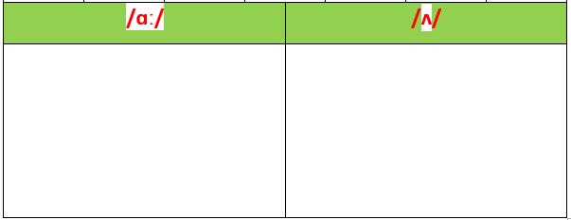
Exercise 2. Divide the words into two columns.
laugh
does
uneasy
heart
done
unhappy
carp
bar
monkey
flood
mother
but
hard
country
love
father
young
brother
start
couple
dove
guard
among
blood
some
cup
draught
smart

Slide 70
PART 3. COMMUNICATION SKILLS

Slide 71
I. LISTENING

Slide 72
Exercise 1. Listen and guess what subject each person is talking about.
Name | Nam | Minh | Hoa | John | Maria
Subjects
History
Geography
Maths
Biology
Chemistry

Slide 73
Exercise 2. Listen again and complete the sentence.
1. Nam thinks the future is a __________ of the past.
2. Minh wants to __________ around the world when he grows up.
3. Hoa realized that maths is based on __________ since she was young.
4. John thinks that people can do everything without endangering the __________.
5. Maria always tries to understand the differences and the ______________ of substances.
reflection
travel
numbers
planet
characteristic

Slide 74
II. SPEAKING

Slide 75
Exercise 1. Complete the following conversations with suitable missing words.
Nam: Hello, Hung.
Hung: Hi. Nice to (1) __________ you again. Nam, this is Ba.
Ba: (2) __________, Nam. (3) __________ to meet you.
Nam: Hi. Where are you (4) __________?
Ba: I am from Nha Trang. I am new here.
Nam: What class are you (5) __________?
Ba: I’m (6) __________ class 6A.
Hung: Yeah. He is our (7) __________ classmate.
Nam: Oh, we are (8) __________ to have you in our class
see
Hello
Nice
from
in
in
new
happy

Slide 76
Exercise 2. Answer the question about your school.
1. What is the name of your school?
→ It is Kim Dong Secondary School.
2. What is your school’s address?
→ It is 63 Hai Ba Trung Street.
3. How many students does your school have?
→ It has about 400 students.
4. What is interesting about your school?
→ It has two playgrounds and a swimming pool.
5. What do you wear at school?
→ We wear uniforms.

Slide 77
Exercise 2. Answer the question about your school.
6. What do students do at break time?
→ We play sports such as badminton, football, and games such as hide-and-seek.
7. What activities do you do after school?
→ We go to the Music Club to practise playing the guitar.
8. What subjects do you have?
→ We have Maths, Literature, History, Biology, Chemistry, English, IT, PE.
9. What is your favourite subject?
→ It is History.
10. Why do you like that subject?
→ Because I can learn about the history of my country and the world.

Slide 78
III. READING

Slide 79
☞ Read and do the tasks followed.
MAI’S SCHOOL
Hello, my name is Mai. I am 11 years old. I go to a public school called Nguyen Du Secondary School. I am in grade 6. In our class there are 27 students, 15 girls and 12 boys.
My classroom is big and nice. Our teacher is Miss Thuy. She likes decorating the walls of the class with posters and maps. In our class there is a computer and a blackboard.
My desk and my chair are brown. My pencil case is on my desk. It’s colorful. I have lots of things in my pencil case: a pencil sharpener, two pencils, a rubber, three paper clips and a purple pen.
I go to school by bicycle with my friends. We like our school because there are playgrounds, a big gym and a fantastic music room with many instruments.

Slide 80

Exercise 1a. Tick ✓ the school things in the passage. (Or you can circle the number)

Slide 81
Exercise 1b. Answer the question.
1. What’s her school’s name?
→ It is Nguyen Du Secondary School.
2. How many boys are there in her class?
→There are 12 boys in her class.
3. What does Miss Thuy decorate the walls with?
→She decorates them with posters and maps.
4. What colour are her desk and chair?
→They are brown.
5. What does Mai have in her pencil case?
→She has a pencil sharpener, two pencils, a rubber, three paper clips and a purple pen in her pencil case.
6. Why does Mai love her school?
→Because there are playgrounds, a big gym and a fantastic music room with many instruments in the school.

Slide 82
Exercise 2. Read the conversation and circle the correct answers.
Kate: Hello! Kate's speaking.
Linda: Hi, Kate. It's Linda here. How are things?
Kate: OK. I'm doing some homework and I'm not enjoying it!
Linda: Oh sorry. Am I disturbing you?
Kate: No, you aren't. It's OK.
Linda: Oh good. Listen, do you have Jack's phone number?
Kate: Yeah. I do. Just a moment. Ready? It's 8693 2210.
Linda: 8693 2210. Thanks.
Kate: Why do you want Jack’s number?
Linda: It’s Steve’s birthday next weekend. I want to buy him something.
Kate: Ah, clever you! You want to ask Jack what Steve likes.
Linda: That's right.
Kate: Ok. But you can’t talk to him now. He's playing football. Phone him after lunch.

Slide 83
Exercise 2. Read the conversation and circle the correct answers.
1. Kate is writing letters/ doing homework.
2. Linda is/isn’t disturbing Kate.
3. Jack’s phone number is 8693 2211/ 8693 2110.
4. It’s Steve’s birthday tomorrow/ next weekend.
5. Linda wants to buy a present for Steve/ Jack.
6. She knows/ doesn’t know what to buy.

Slide 84
IV. WRITING

Slide 85
Exercise 1. Write about your dream school using the words or phrases given.
1. have good teachers/ friendly classmates.
→ We have good teachers and friendly classmates.
2. have outdoor/ indoor activities.
→ We have both outdoor and indoor activities.
3. students/ be/ active/ smart.
→ Students are active and smart
4. students/ learn/ both/ theory/ practice/ all subjects.
Students learn both theory and practice in all subjects.

Slide 86
Exercise 1. Write about your dream school using the words or phrases given.
5. students/ use tablets/ instead of/ books.
→ Students use tablets instead of books.
6. good canteen/ healthy food.
→ We have a good canteen and healthy food.
7. good library/ various kinds of books.
→ We have a good library and various kinds of books.
8. students/ use/ sport facilities/ free time.
→ Students use sport facilities in their free time.

Slide 87
Exercise 2. Write sentences basing on available words.
1. I/ study/ International Secondary School.
→ I study at International Secondary School.
2. I/grade six/and/I/class 6A.
→ I am in grade six and I am in class 6A.
3. There/ three/ building/ and/ a swimming pool/ my school.
→ There are three buildings and a swimming pool in my school.
4. My class/ first floor/ building A.
→ My class is on the first floor of building A.
5. My favourite subject/ Vietnamese/ Maths.
→ My favourite subjects are Vietnamese and Maths.

Slide 88
Exercise 2. Write sentences basing on available words.
6. Mr. Quang/ my favourite teacher./ He/ teach/ History.
→ Mr. Quang is my favourite teacher. He teaches History.
7. I/ not like/ History/1/ think/ it/ a boring subject.
→ I don't like History because I think it is a boring subject.
8. I/ not/ usually/ read/ books/ the library/ break time.
→ I don't usually read books in the library at break time
9. My friends/1/ always/ cycling/ the park/ after school.
→ My friends and I always go cycling in the park after school.
10. Susan and Dan/ often/ play sports/ the playground/ break time/.
→ Susan and Dan often play sports in the playground at break time.

Slide 89


  THANK YOU AND GOODBYE

