Slide 1
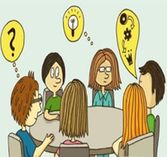
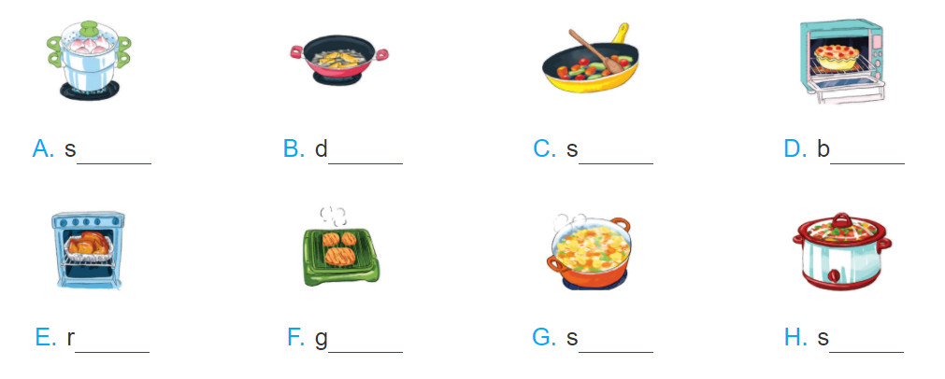
*Write a verb for a cooking method under each picture. The first letter has been provided.
team
eep-fry
tir-fry
ake
oast
rill
immer
tew

Slide 2

Welcome all of teachers and students
UNIT 7: RECIPES & EATING HABITS
Lesson 7: Looking back
Lesson plan for English 9

Slide 3
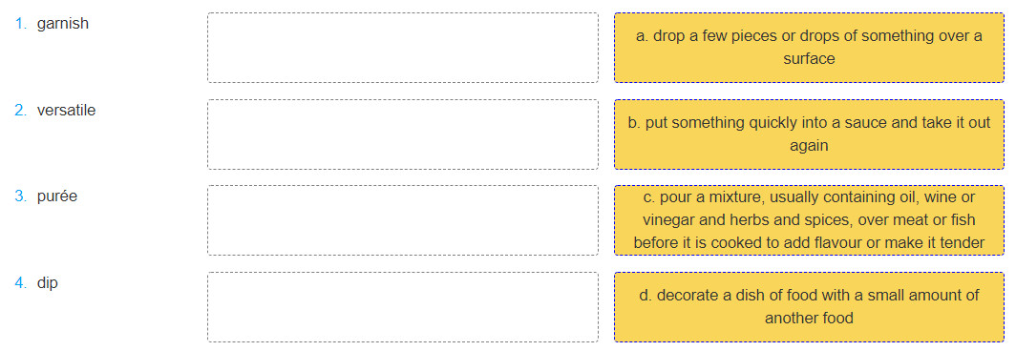
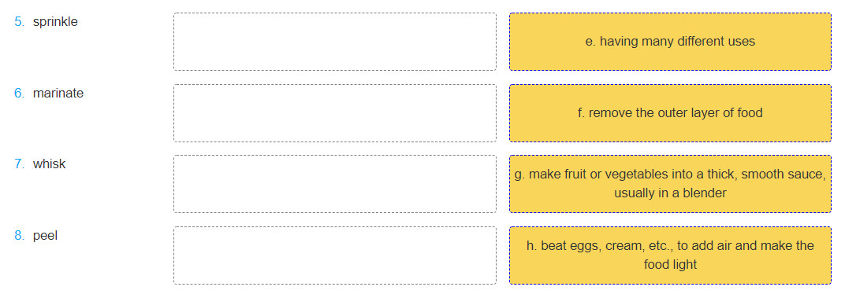
Ex 2: Match the words in A with their description or definition in B.
sprinkle
dip
marinate
garnish
versatile
peel
puree
whisk

Slide 4
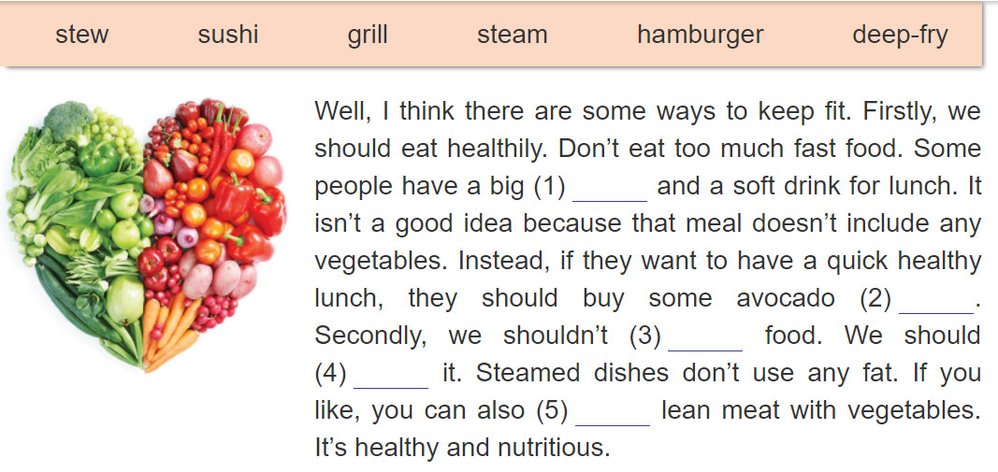
Ex 3: Fill each blank with a word/ phrase in the box. There is one extra word.
hamburger
sushi
deep-fry
steam
stew

Slide 5
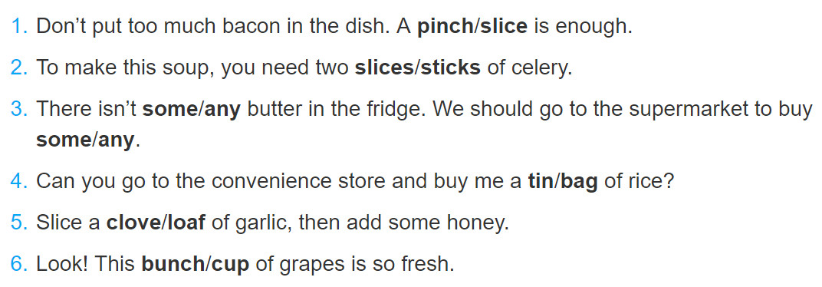
Ex4: Circle the correct answer.

Slide 6
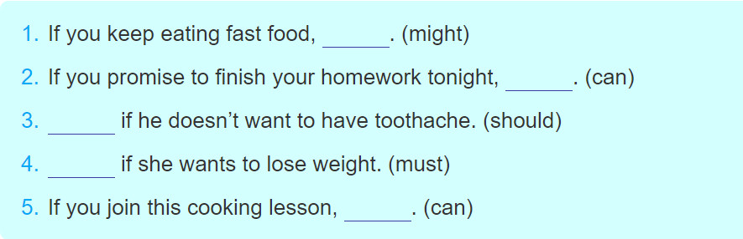
Ex5: Complete the sentences with your own ideas. Use the modal verbs provided.
you might become overweight.
you can go to the cinema with your friend.
He should eat less sweets
She must eat less rice and bread
you can cook many delicious dishes.

Slide 7
Ex6: Rearrange the lines to make a complete conversation.
A. That's right. It's the first time I've made them.
B. What a pleasant Sunday morning it is!
C. Shall I peel the bananas for you?
D. I can't wait to try your first pancakes! They look delicious.
E. Yes. It's cool and sunny. What are you doing?
F. I'm making some pancakes.
G. Sure, you can give me a hand if you want to.
H. Really? Will we have them with honey?
I. Some pancakes?
J. Yes, some honey and some slices of banana.
1- B. What a pleasant Sunday morning it is!
2- E. Yes. It's cool and sunny. What are you doing?
3- F. I'm making some pancakes.
4- I. Some pancakes?
5- A. That's right. It's the first time I've made
them.
6- H. Really? Will we have them with honey?
7- J. Yes, some honey and some slices of banana
8- C. Shall I peel the bananas for you?
9- G. Sure, you can give me a hand if you want to.
10- D. I can't wait to try your first pancakes! They look delicious.

Slide 8
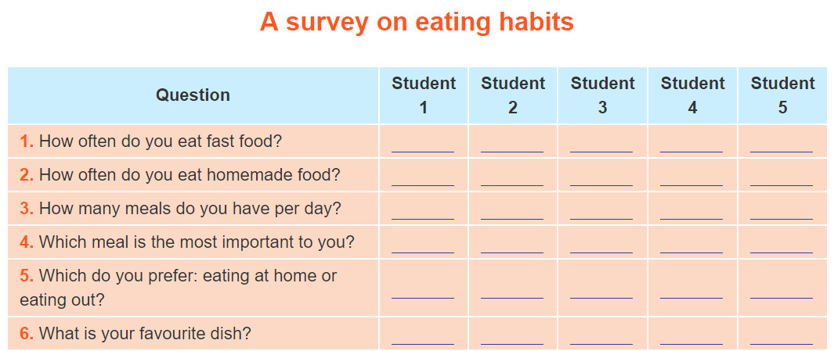
PROJECT
Work in groups. Go to other classes and ask different students about their eating habits. Write the students' answers in the table.

Slide 9
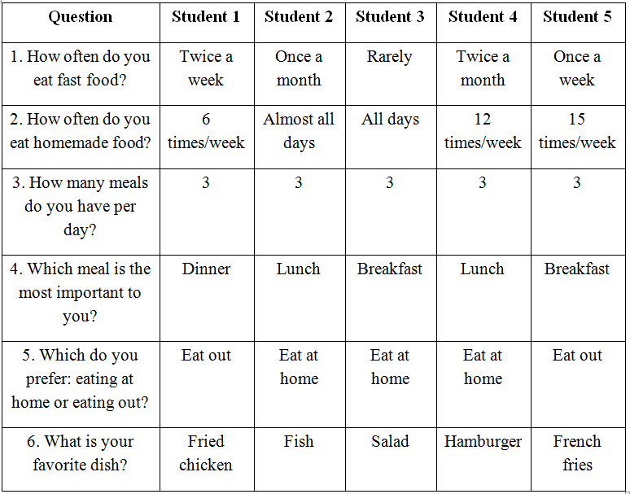
*Work in groups. Go to other classes and ask different students about their eating habits. Write the students' answers in the table.

Slide 10

*In general, do the students at your school have healthy eating habits? Present your group's findings to the class.
Good morning teacher and friends,
Today I want to present about eating habits of students in our school. According to our group’s findings, almost students in our school do not have healthy eating habits. Firstly, they like fast food so much, which are not good for health, and eat this kind of food quite regularly. Secondly, although eating out may bring many risks of bad food sanitation, they tend to prefer eating out to eating at home. The food cooked at home, which is cleaner and more nutritious, is not their cup of tea. Lastly, they tend to eat much for dinner and do not give enough care to the breakfast. Contrary to popular belief, it’s not the dinner but the breakfast that is the most important meal of the day so you should eat a big breakfast and just a little in the evening. In conclusion, I suggest that students in our school should improve a healthier eating habits.

Slide 11

HOMEWORK
- Learn by heart new words.
- Do all the exercises again
- Prepare unit 8: getting started

