Slide 1


Slide 2

1
REVIEW
2
FAMILY LIFE
Unit
LESSON 3
SKILLS (2)

Slide 3

Unit
1
1
FAMILY LIFE
Family Life
Unit
OBJECTIVES
1. Knowledge
Review the skills Reading and Writing learnt in Units 4, 5.
2. Core competence
- Develop critical thinking skills;
- Be collaborative and supportive in pair work and team work;
- Actively join in class activities.
3. Personal qualities
- Develop self-study skills.

Slide 4
LESSON 3
SKILLS (2)
WARM-UP
Guessing game
Task 1: Match the highlighted words with their meanings.
Task 2: Read and choose the best answers.
Task 3: Play with cards.
READING
WRITING
Task 1: Brainstorm.
Task 2: Complete the application letter.
CONSOLIDATION
Wrap-up
Home work

Slide 5
LESSON 3
SKILLS (2)
WARM-UP
Guessing game

Slide 6

WARM-UP
GUESSING GAME
Try to explain this word phrase.

Slide 7
LESSON 3
SKILLS (2)
WARM-UP
Guessing game
Task 1: Match the highlighted words with their meanings.
Task 2: Read and choose the best answers.
Task 3: Play with cards.
READING

Slide 8
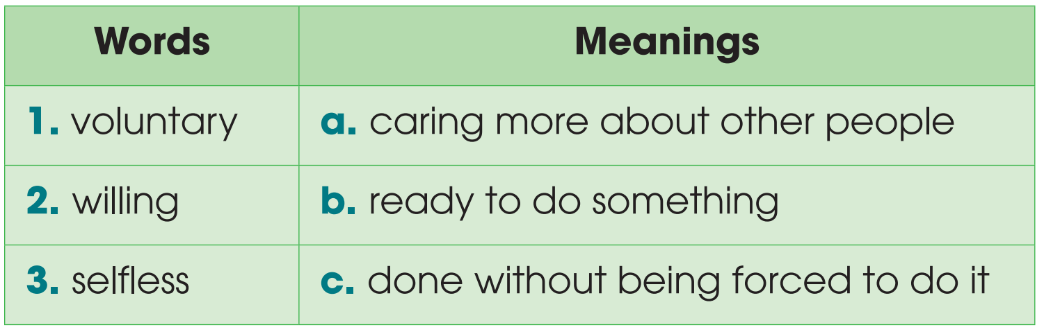
READING
1
Read the text. Match the highlighted words with their meanings

Slide 9
READING
2
Read the text again and choose the best answers.
1. Which is the best title for this text?
A. Community service as a punishment
B. Types of community service and the benefits of volunteering
C. Social skills in volunteering
2. According to the text, what is a benefit of volunteering?
A. Developing better English language skills
B. Meeting richer people
C. Better understanding of what you want in life
3. What can be inferred from the text?
A. Volunteers think about their needs as well as the needs of others.
B. Volunteers are selfless people who never expect anything in return.
C. People mainly volunteer to gain benefits.

Slide 10
READING
3
Play with cards.
- Work in pairs
- Prepare two quiz questions based on the reading text
- Write them on cards or pieces of paper, e.g. How many types of community service are there? Why does the writer think volunteering isn’t always selfless?
- Go to the board, pick a card, and answer the question.

Slide 11
LESSON 3
SKILLS (2)
WARM-UP
Guessing game
Task 1: Match the highlighted words with their meanings.
Task 2: Read and choose the best answers.
Task 3: Play with cards.
READING
WRITING
Task 1: Brainstorm.
Task 2: Complete the application letter.

Slide 12
WRITING
BRAINSTORM
Which skills and qualities are needed to be a volunteer for an organization collecting books for children?
fond of reading love helping others
love meeting new people develop social skills
good interpersonal skills be enthusiastic and helpful

Slide 13
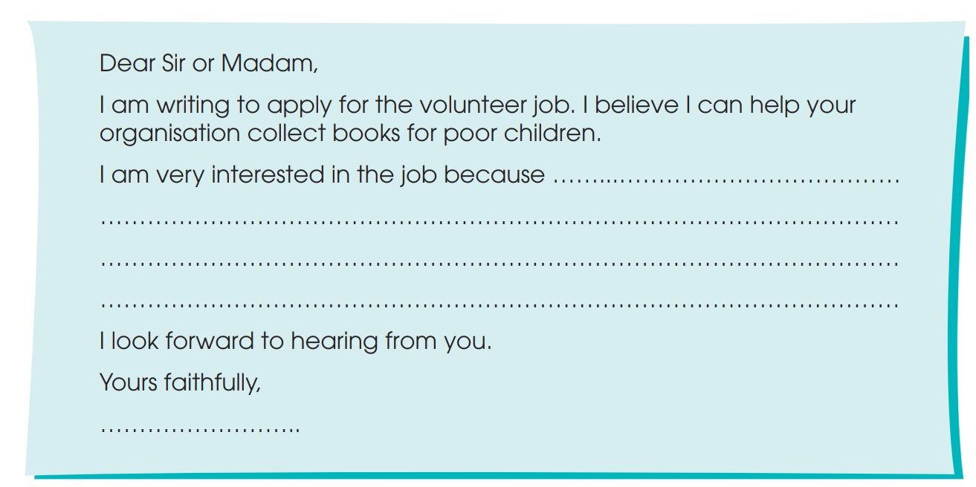
WRITING
Complete this application letter for a volunteer job by writing a short paragraph. You may use the ideas below to help you.
fond of reading love helping others
love meeting new people develop social skills

Slide 14
WRITING
Complete this application letter for a volunteer job by writing a short paragraph. You may use the ideas below to help you.
Sample answer:
I am very interested in the job because I am very fond of reading and I can sort books very well. I also love helping others and meeting new people, especially children. In fact reading books to children is my favorite hobby. I am also interested in this job because it will help me to develop my social skills, such as communication and teamwork skills.

Slide 15
LESSON 3
SKILLS (2)
WARM-UP
Guessing game
Task 1: Match the highlighted words with their meanings.
Task 2: Read and choose the best answers.
Task 3: Play with cards.
READING
WRITING
Task 1: Brainstorm.
Task 2: Complete the application letter.
CONSOLIDATION
Wrap-up
Home work

Slide 16
CONSOLIDATION
1
Wrap-up
1. Knowledge
Review the Reading and Writing skills learnt in Units 4, 5.
2. Core competence
- Develop critical thinking skills;
- Be collaborative and supportive in pair work and team work;
- Actively join in class activities.
3. Personal qualities
- Develop self-study skills.

Slide 17
CONSOLIDATION
2
Homework
Do exercises in the workbook
Prepare for the next lesson:
Unit 6 – Lesson 1: Getting Started

Slide 18

Website: hoclieu.vn
Fanpage: facebook.com/www.tienganhglobalsuccess.vn

