Slide 1

UNIT 5: GENDER EQUALITY
Lesson 3.1 – Listening & Reading
Page 44

Slide 2



Lesson 1.1
LESSSON OUTLINE
Consolidation

Slide 3

By the end of this lesson,
students will be able to:
- listen for gist and specific information.
- read about a famous woman for main ideas and specific details.

Slide 4



Slide 5
Work with a partner.
You two will write down the names of famous women as quickly as you can.
After 30 seconds, the pair with the most correct names will be the winner.
5
9
2
4
15
8
13
27
End
1
16
19
20
21
22
23
24
25
26
29
30
28
3
6
7
10
11
12
14
17
18

Slide 6

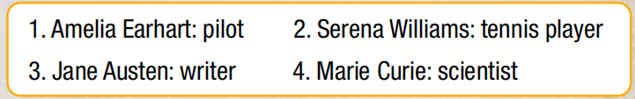
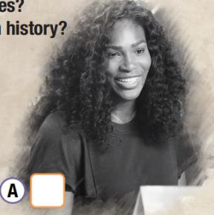
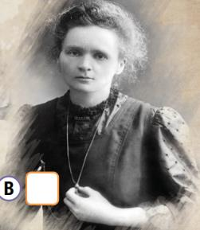
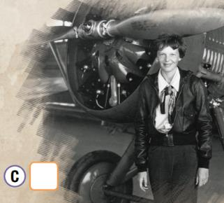
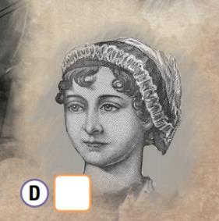
Work in pairs.
Can you match the names to the pictures?

Slide 7




Work in pairs
Can you match the names to the pictures?

Slide 8



Slide 9
Pre-Listening
Match the words on the right with their corresponding meanings on the left
A. the best or fastest ever done
B. a person in a vehivle who describes the direction in which the vehicle travels.
C. to go to a place where someone or something cannot be seen
D. a unit of 1.6 kilometers
E. a person who flies an aircraft.
F. alone; without other people
1. pilot /ˈpaɪ.lət/
2. record /rɪˈkɔːrd/
3. solo /ˈsoʊ.loʊ/
4. navigator
/ˈnæv.ə.ɡeɪ.t̬ɚ/
5. disappear /ˌdɪs.əˈpɪr/
6. mile /maɪl/

Slide 10

While-Listening
a. Listen to a talk about Amelia Earhart. Where is this talk taking place?

Slide 11
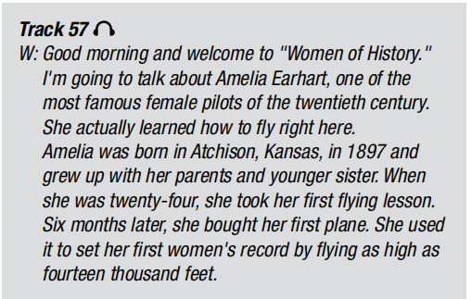
Listen again and check!
at the airport

Slide 12
b. Now, listen and fill in the blanks
in 1897
1. Amelia Earthart was born __________________.
2. When she ___________, she took her first flying lesson.
was 24
3. She set her first women’s record by flying as high as _______ feet.
14,000
4. In 1928, she became the first woman to fly across the ______________.
Atlantic Ocean
around the world
5. She wanted to be the first woman to fly ________________.
6. She is remembered for being one of the greatest ____________ of the 20th century.
female pilots

Slide 13
Post-Listening
a. Now, imagine as if you would meet Amelia Earhart, make 3 questions that you want to ask her.
b. Work in pairs. One will be an interviewer, and the other student will be Amelia Earhart. Ask her 3 questions that you have prepared. Then swap your roles.

Slide 14
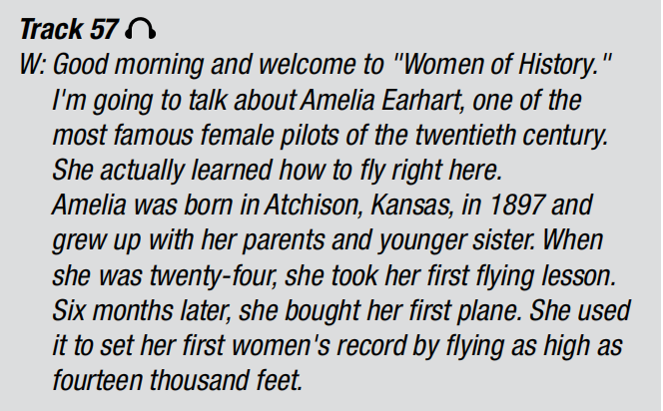
Listening Scripts
1
2
3

Slide 15
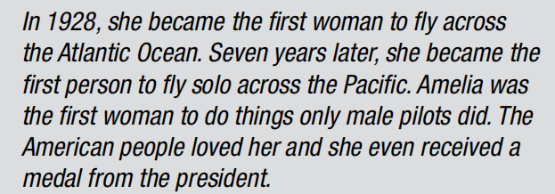
Listening Scripts
4
5
6

Slide 16
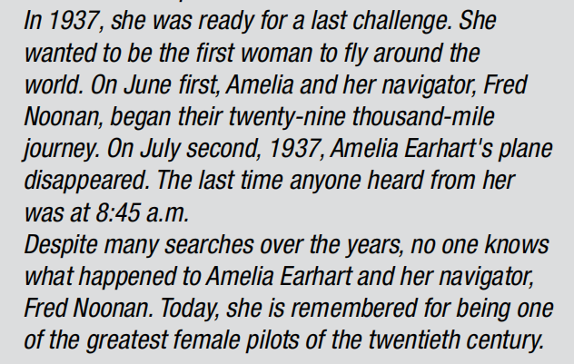
Listening Scripts
7
8
9
10

Slide 17



Slide 18
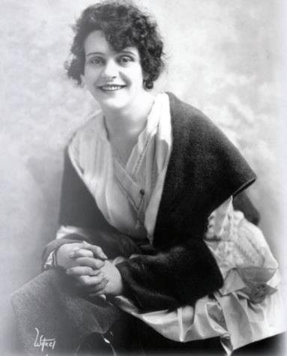
Pre-Reading
Answer the following questions
Do you know who this woman is?
What do you think her job was?
Write down three things you expect to read about her.

Slide 19

While- Reading
a. Read the text about Helen Gibson.
Did she live a long life?
Yes
No

Slide 20

b. Now, read and answer the questions.
=> She lived with her parents and four sisters.

Slide 21
b. Now, read and answer the questions.
=> in 1910

Slide 22

b. Now, read and answer the questions.
=> Ranch Girls on a Rampage

Slide 23
b. Now, read and answer the questions.
=> She was 85.

Slide 24

Post- Reading
Work in pairs.
Do you think you could be a stuntman or stuntwoman? Why (not)?
stuntman (n) /ˈstʌnt.mæn/ diễn viên đóng thế
Well, I think I couldn’t be a stuntwoman. It’s too dangerous.

Slide 25

Consolidation

Slide 26
a. Now, close your books and write down 5 things you can remember about Helen Gibson.
b. Work in pairs. Take turns to tell your friends about what you have written.
Did your partner remember correctly? Give him/her your correction.

Slide 27
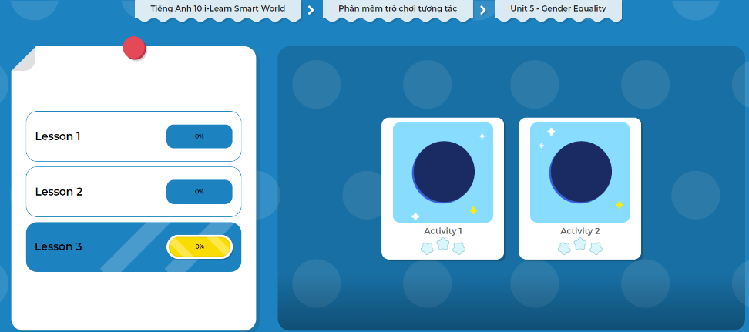
Let’s play!
Click here to play the games!

Slide 28
Consolidation
Today’s lesson
Vocabulary: Gender equality
Listening: for main idea and specific information
Reading: for main idea and specific information

Slide 29

Do listening and reading exercises in WB on page 30.
Prepare the next lesson - Grammar on page 45 in SB.
Do the exercise in Tiếng Anh 10 i-Learn Smart World Notebook (page 30)
Play the consolidation games in Tiếng Anh 10 i-Learn Smart World DHA on www.eduhome.com.vn

Slide 30

Have a nice day!

