Slide 2
Unit
8
1
Unit
FAMILY LIFE
NEW WAYS TO LEARN
LESSON 3
READING

Slide 3
Unit
1
1
FAMILY LIFE
Family Life
Unit
OBJECTIVES
1. Knowledge
Develop reading skills for general ideas and for specific information about types of learning
2. Core competence
- Develop communication skills and creativity
- Be collaborative and supportive in pair work and team work
- Develop presentation skills
- Actively join in class activities
3. Personal qualities
- Understand more about advantages and disadvantages of online and face-to-face learning, therefore, students can make use of the strong points of each method
- Develop self-study skills

Slide 4
LESSON 3
READING
Unit
GETTING STARTED
WARM-UP
Guessing game
PRE-READING
Task 1: Look at the photos and answer the questions.
WHILE-READING
Task 2: Read the texts. Choose the correct answer.
Task 3: Decide who mentions the following by putting a tick in the correct box.
POST-READING
Discussion
CONSOLIDATION
Wrap-up
Home work

Slide 5
LESSON 3
READING
Unit
GETTING STARTED
WARM-UP
Guessing game

Slide 6
WARM-UP
Game rules
- 2 teams.
3 sets of pictures (3 pictures/set)
If one team:
+ gets the correct answer after the 1st picture ➔ 3 points
+ gets the correct answer after the 2nd picture ➔ 2 points
+ gets the correct answer after the 3rd picture ➔ 1 point
- The team with more points will be the winner.

Slide 7
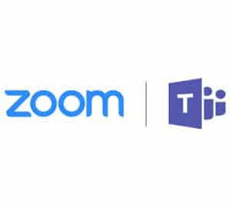
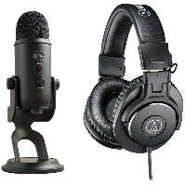
WARM-UP
Set 1
online learning

Slide 8
WARM-UP
Set 2
self-study

Slide 9
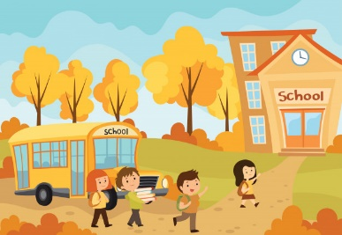
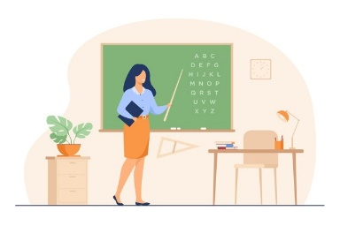
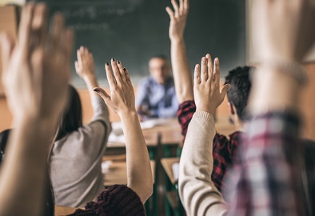
WARM-UP
Set 3
face-to-face learning

Slide 10
LESSON 3
READING
Unit
GETTING STARTED
WARM-UP
Guessing game
PRE-READING
Task 1: Look at the photos and answer the questions.

Slide 11
PRE-READING
1
Look at the photos and answer the questions.
a
b

Slide 12
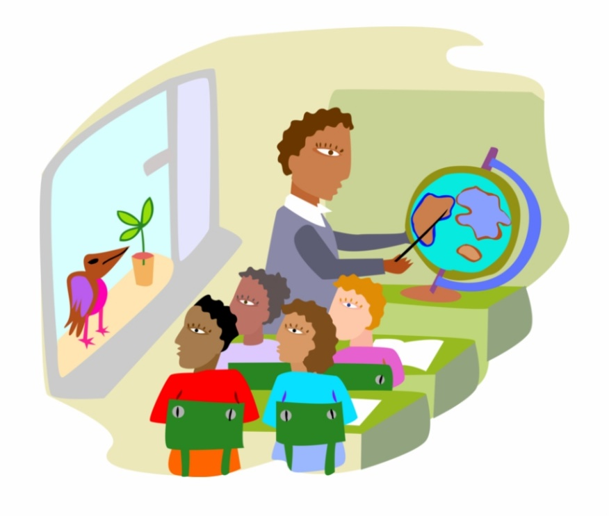
PRE-READING
distraction (n)
/dɪˈstrækʃən/
something that prevents someone from giving their attention to something else

Slide 13
PRE-READING
strategy (n)
/ˈstrætədʒi/
a way of doing something or dealing with something

Slide 14
PRE-READING
(to) exchange (v)
/ɪksˈtʃeɪndʒ/
to give something to someone and receive something from that person

Slide 15
PRE-READING
New words | Pronunciation | Meaning
distraction (n) | /dɪˈstrækʃən/ | something that prevents someone from giving their attention to something else
strategy (n) | /ˈstrætədʒi/ | a way of doing something or dealing with something
(to) exchange (v) | /ɪksˈtʃeɪndʒ/ | to give something to someone and receive something from that person

Slide 16
LESSON 3
READING
Unit
GETTING STARTED
WARM-UP
Guessing game
PRE-READING
Task 1: Look at the photos and answer the questions.
WHILE-READING
Task 2: Read the texts. Choose the correct answer.
Task 3: Decide who mentions the following by putting a tick in the correct box.

Slide 17
WHILE-READING
Fill in the blanks with suitable words or phrases to complete the steps of finding the main idea of a passage.
repetition identify first and last summarize
How to find the main idea of a passage?
- (1) _____________ the topic.
- (2) _____________ the passage in your own words.
- Check the (3) _________________ sentences.
- Look for (4) _______________ of ideas.
Identify
Summarize
first and last
repetition

Slide 18
WHILE-READING
Task 2. Read the texts. What are the two students talking about? Choose the correct answer.
Kim
A. Ways of helping students
B. Ways of learning
C. How to enjoy learning
I think face-to-face learning is better than online learning because I can communicate with teachers and other classmates immediately and directly when I have questions.
In class, I can work in groups and discuss with friends. This helps me understand the lessons better. When I have a problem, I can ask for answers or help immediately. I can’t do this in online classes. I have to email my teachers and wait for their reply. Learning in a traditional classroom also has fewer distractions than learning online. My teachers have many strategies to keep us focused on the lessons. I really enjoy my lessons and learn a lot.
Laura
I think online learning has more advantages than disadvantages. My school is trying to change from face-to-face to blended learning, so sometimes we have online classes. I don’t have to go to school, but I don’t feel I’m missing any lessons by taking online classes. Furthermore, I think I learn online as much as I learn in a traditional class. I can’t talk to my teacher and classmates, but I can email them at any time. I also have an online discussion board where I can exchange comments and ideas about my projects with my classmates. The only disadvantage is I really need to have a fast Internet connection.

Slide 19
WHILE-READING
Reorder the steps of reading for specific information:
1. Read the passage and scan for key words or synonyms/paraphrased expressions.
2. Compare and decide answers.
3. Underline key words in the questions.
4. Read the instructions.

Slide 20
WHILE-READING
WHILE-READING
Reorder the steps of reading for specific information: (key)
Read the instructions.
Underline key words in the questions.
Read the passage and scan for key words or synonyms/paraphrased expressions.
Compare and decide answers.

Slide 21
WHILE-READING
3
Decide who mentions the following by putting a tick in the correct box.
This person ….
1. thinks that online learning isn’t as good as face-to-face learning.
2. gains the same knowledge in both ways of learning.
3. has more direct conversations and discussions.
4. uses emails to contact classmates
5. can pay more attention in class.
6. needs to have access to high-speed Internet.
Kim | Laura

Slide 22
WHILE-READING
Kim
1. This person thinks that online learning isn’t as good as face-to-face learning.
I think face-to-face learning is better than online learning because I can communicate with teachers and other classmates immediately and directly when I have questions.
In class, I can work in groups and discuss with friends. This helps me understand the lessons better. When I have a problem, I can ask for answers or help immediately. I can’t do this in online classes. I have to email my teachers and wait for their reply. Learning in a traditional classroom also has fewer distractions than learning online. My teachers have many strategies to keep us focused on the lessons. I really enjoy my lessons and learn a lot.
Laura
I think online learning has more advantages than disadvantages. My school is trying to change from face-to-face to blended learning, so sometimes we have online classes. I don’t have to go to school, but I don’t feel I’m missing any lessons by taking online classes. Furthermore, I think I learn online as much as I learn in a traditional class. I can’t talk to my teacher and classmates, but I can email them at any time. I also have an online discussion board where I can exchange comments and ideas about my projects with my classmates. The only disadvantage is I really need to have a fast Internet connection.

Slide 23
WHILE-READING
Kim
2. This person gains the same knowledge in both ways of learning.
I think face-to-face learning is better than online learning because I can communicate with teachers and other classmates immediately and directly when I have questions.
In class, I can work in groups and discuss with friends. This helps me understand the lessons better. When I have a problem, I can ask for answers or help immediately. I can’t do this in online classes. I have to email my teachers and wait for their reply. Learning in a traditional classroom also has fewer distractions than learning online. My teachers have many strategies to keep us focused on the lessons. I really enjoy my lessons and learn a lot.
Laura
I think online learning has more advantages than disadvantages. My school is trying to change from face-to-face to blended learning, so sometimes we have online classes. I don’t have to go to school, but I don’t feel I’m missing any lessons by taking online classes. Furthermore, I think I learn online as much as I learn in a traditional class. I can’t talk to my teacher and classmates, but I can email them at any time. I also have an online discussion board where I can exchange comments and ideas about my projects with my classmates. The only disadvantage is I really need to have a fast Internet connection.

Slide 24
WHILE-READING
Kim
3. This person has more direct conversations and discussions.
I think face-to-face learning is better than online learning because I can communicate with teachers and other classmates immediately and directly when I have questions.
In class, I can work in groups and discuss with friends. This helps me understand the lessons better. When I have a problem, I can ask for answers or help immediately. I can’t do this in online classes. I have to email my teachers and wait for their reply. Learning in a traditional classroom also has fewer distractions than learning online. My teachers have many strategies to keep us focused on the lessons. I really enjoy my lessons and learn a lot.
Laura
I think online learning has more advantages than disadvantages. My school is trying to change from face-to-face to blended learning, so sometimes we have online classes. I don’t have to go to school, but I don’t feel I’m missing any lessons by taking online classes. Furthermore, I think I learn online as much as I learn in a traditional class. I can’t talk to my teacher and classmates, but I can email them at any time. I also have an online discussion board where I can exchange comments and ideas about my projects with my classmates. The only disadvantage is I really need to have a fast Internet connection.

Slide 25
WHILE-READING
Kim
4. This person uses emails to contact classmates.
I think face-to-face learning is better than online learning because I can communicate with teachers and other classmates immediately and directly when I have questions.
In class, I can work in groups and discuss with friends. This helps me understand the lessons better. When I have a problem, I can ask for answers or help immediately. I can’t do this in online classes. I have to email my teachers and wait for their reply. Learning in a traditional classroom also has fewer distractions than learning online. My teachers have many strategies to keep us focused on the lessons. I really enjoy my lessons and learn a lot.
Laura
I think online learning has more advantages than disadvantages. My school is trying to change from face-to-face to blended learning, so sometimes we have online classes. I don’t have to go to school, but I don’t feel I’m missing any lessons by taking online classes. Furthermore, I think I learn online as much as I learn in a traditional class. I can’t talk to my teacher and classmates, but I can email them at any time. I also have an online discussion board where I can exchange comments and ideas about my projects with my classmates. The only disadvantage is I really need to have a fast Internet connection.

Slide 26
WHILE-READING
Kim
5. This person can pay more attention in class.
I think face-to-face learning is better than online learning because I can communicate with teachers and other classmates immediately and directly when I have questions.
In class, I can work in groups and discuss with friends. This helps me understand the lessons better. When I have a problem, I can ask for answers or help immediately. I can’t do this in online classes. I have to email my teachers and wait for their reply. Learning in a traditional classroom also has fewer distractions than learning online. My teachers have many strategies to keep us focused on the lessons. I really enjoy my lessons and learn a lot.
Laura
I think online learning has more advantages than disadvantages. My school is trying to change from face-to-face to blended learning, so sometimes we have online classes. I don’t have to go to school, but I don’t feel I’m missing any lessons by taking online classes. Furthermore, I think I learn online as much as I learn in a traditional class. I can’t talk to my teacher and classmates, but I can email them at any time. I also have an online discussion board where I can exchange comments and ideas about my projects with my classmates. The only disadvantage is I really need to have a fast Internet connection.

Slide 27
WHILE-READING
Kim
6. This person needs to have access to high-speed Internet.
I think face-to-face learning is better than online learning because I can communicate with teachers and other classmates immediately and directly when I have questions.
In class, I can work in groups and discuss with friends. This helps me understand the lessons better. When I have a problem, I can ask for answers or help immediately. I can’t do this in online classes. I have to email my teachers and wait for their reply. Learning in a traditional classroom also has fewer distractions than learning online. My teachers have many strategies to keep us focused on the lessons. I really enjoy my lessons and learn a lot.
Laura
I think online learning has more advantages than disadvantages. My school is trying to change from face-to-face to blended learning, so sometimes we have online classes. I don’t have to go to school, but I don’t feel I’m missing any lessons by taking online classes. Furthermore, I think I learn online as much as I learn in a traditional class. I can’t talk to my teacher and classmates, but I can email them at any time. I also have an online discussion board where I can exchange comments and ideas about my projects with my classmates. The only disadvantage is I really need to have a fast Internet connection.

Slide 28
LESSON 3
READING
Unit
GETTING STARTED
WARM-UP
Guessing game
PRE-READING
Task 1: Look at the photos and answer the questions.
WHILE-READING
Task 2: Read the texts. Choose the correct answer.
Task 3: Decide who mentions the following by putting a tick in the correct box.
POST-READING
Discussion

Slide 29
POST-READING
Discussion
You are students who are taking part in a forum about educational innovations. The topic of the forum this year is: face-to-face learning or online learning? Raise your voice and express your personal viewpoint.

Slide 30
POST-READING
USEFUL EXPRESSIONS
Expressions to talk about advantages
Expressions to talk about disadvantages
- A positive aspect of …….
- A benefit of ……. is …..
- A good point about… is …
- An argument in favor of .. is …
- An advantage of … is …
- A negative aspect of…. is ……
- An argument against …. is …..
- A drawback of .… is ….
- A frequent criticism of … is …
- A downside of … is …

Slide 31
LESSON 3
READING
Unit
GETTING STARTED
WARM-UP
Guessing game
PRE-READING
Task 1: Look at the photos and answer the questions.
WHILE-READING
Task 2: Read the texts. Choose the correct answer.
Task 3: Decide who mentions the following by putting a tick in the correct box.
POST-READING
Discussion
CONSOLIDATION
Wrap-up
Home work

Slide 32
CONSOLIDATION
1
Wrap-up
1. Knowledge
Develop reading skills for general ideas and for specific information about types of learning
2. Core competence
- Develop communication skills and creativity
- Be collaborative and supportive in pair work and team work
- Develop presentation skills
- Actively join in class activities
3. Personal qualities
- Understand more about advantages and disadvantages of online and face-to-face learning, therefore, students can make use of the strong points of each method
- Develop self-study skills

Slide 33
CONSOLIDATION
2
Homework
Do exercises in the workbook
Prepare for the next lesson: Speaking

Slide 34
Website: hoclieu.vn
Fanpage: facebook.com/tienganhglobalsuccess.vn/

