Slide 1
Unit 1: Feelings
Lesson 1E: Word skills

Slide 2
www.phuongnam.edu.vn

Slide 3
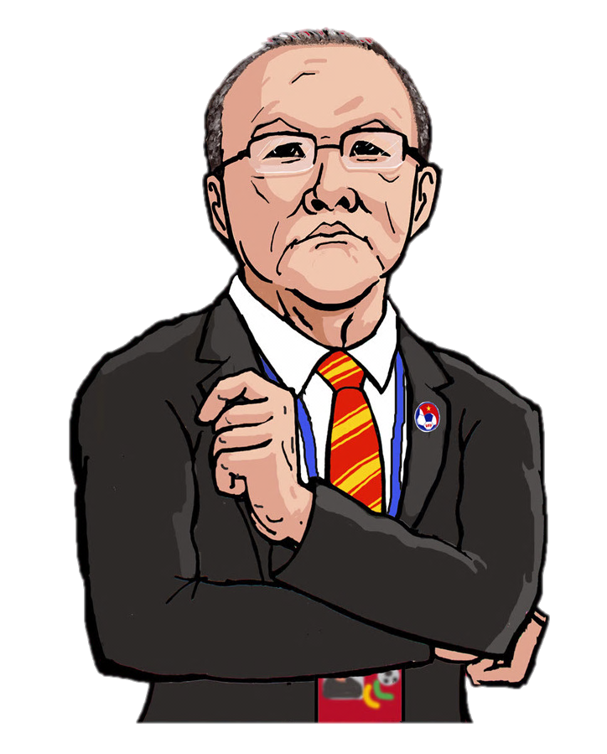
VIETNAM NUMBER 1
THE BEST GOALKEEPER

Slide 4
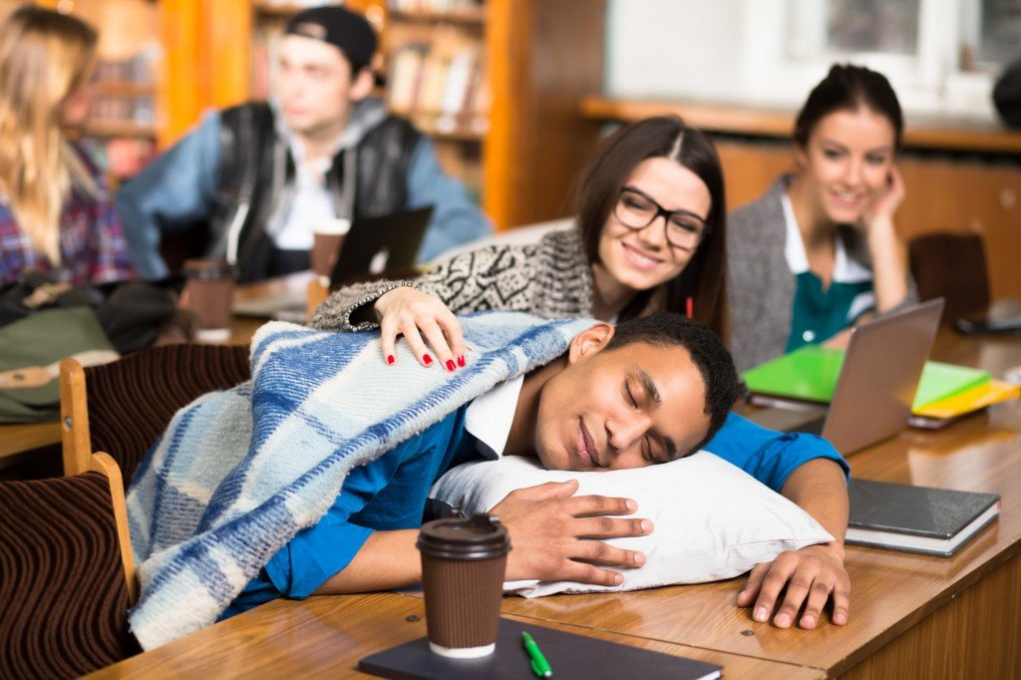
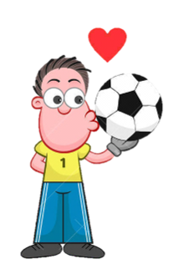
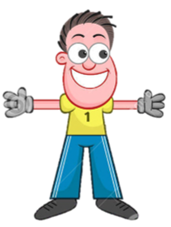
I was so _______ in that lesson; I almost fell asleep.
A. bored
B. interested
C. excited
D. scared

Slide 5
I could listen to his presentation for hours. He was so __.
A. disappointing
B. interesting
C. annoying
D. boring

Slide 6
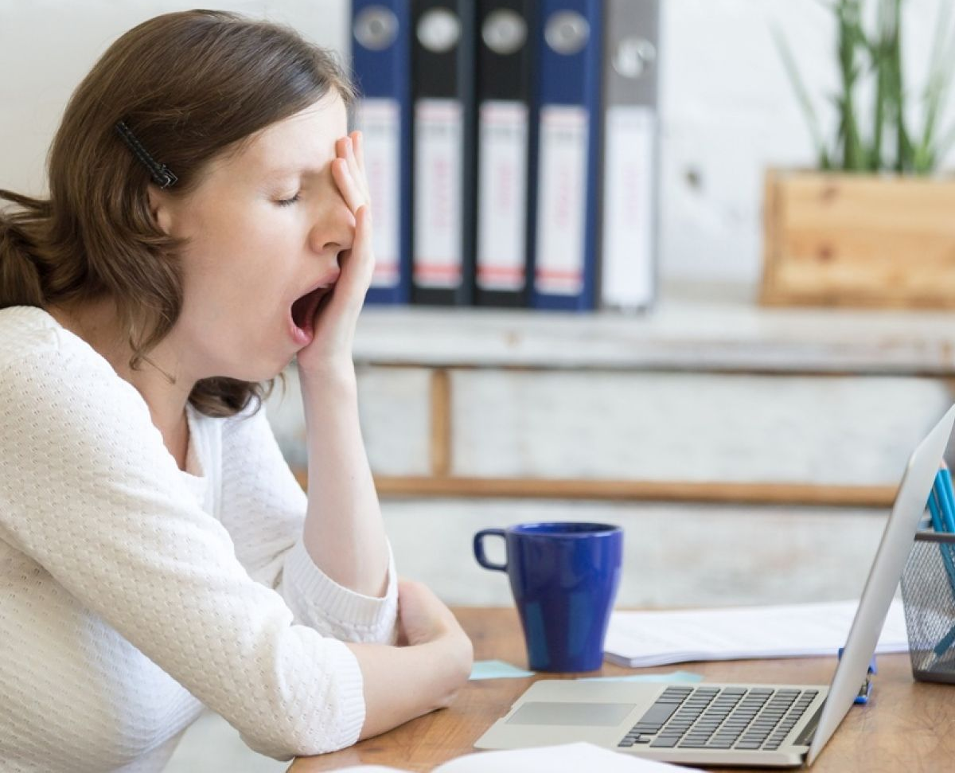
She was really _______ and went to bed early.
A. confused
B. embarrassed
C. tired
D. delighted

Slide 7
Have you seen that film? It's really ________.
A. relieving
B. confusing
C. embarrassing
D. frightening

Slide 8
So, what’s the difference between
adjectives ending in -ed
Adjectives ending in -ing
and
www.phuongnam.edu.vn

Slide 9
UNIT 1:
FEELINGS
www.phuongnam.edu.vn

Slide 10
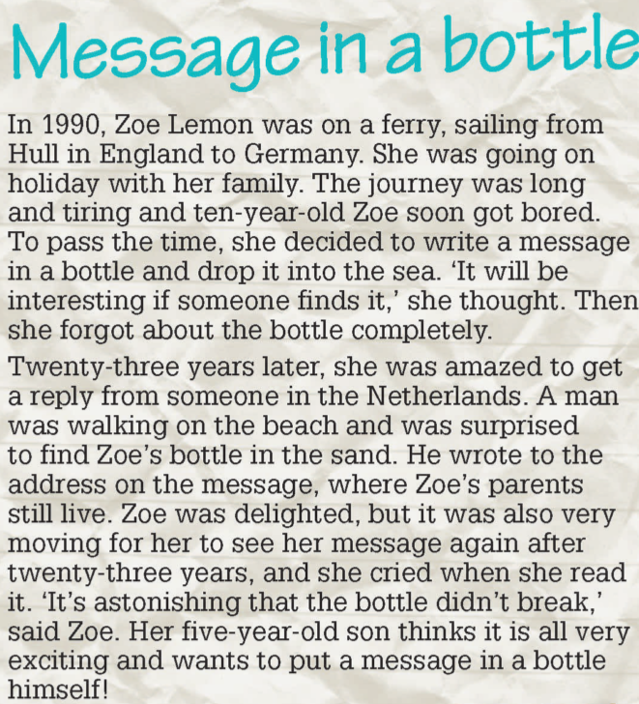
2. Read the text. Who replied to Zoe’s message? When did they reply, and from where?
A man replied to the message.
He replied in 2013 from the Netherlands.

Slide 11
3. Underline all the adjectives ending in –ed and –ing in the text.

Slide 12
-ed
-ing
www.phuongnam.edu.vn

Slide 13
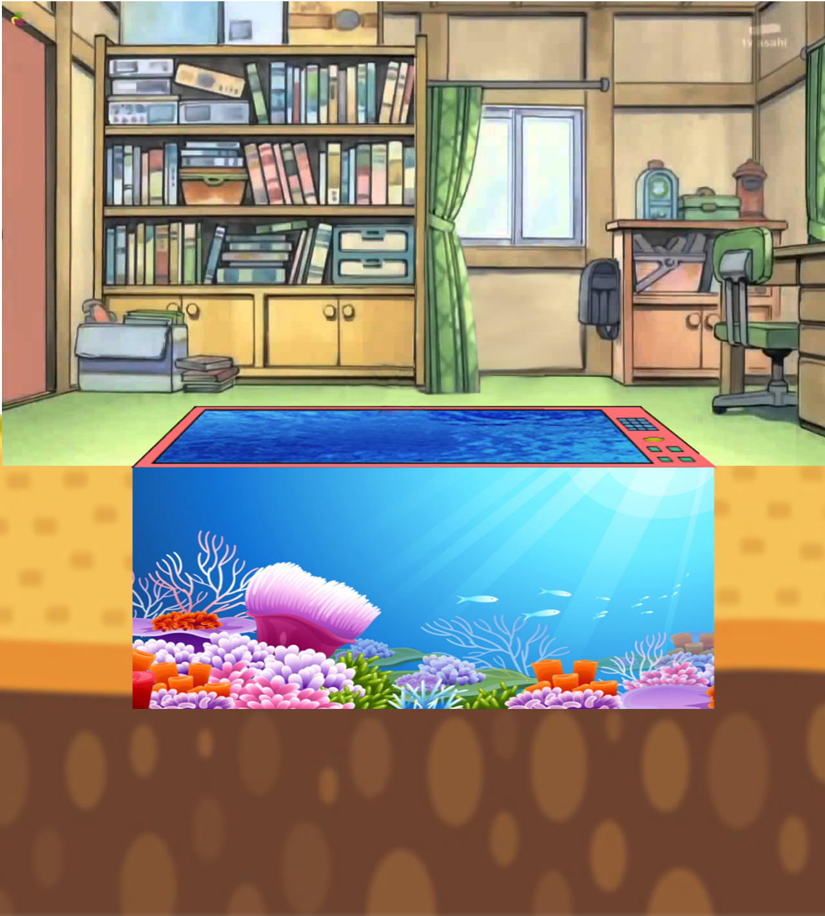
DORAEMON GOES FISHING
www.phuongnam.edu.vn

Slide 14
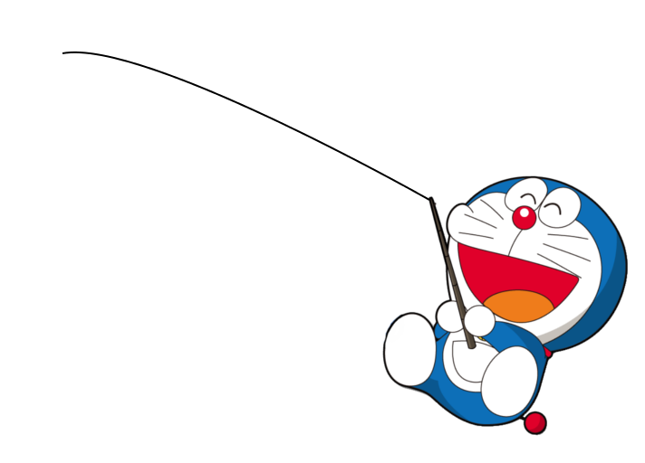
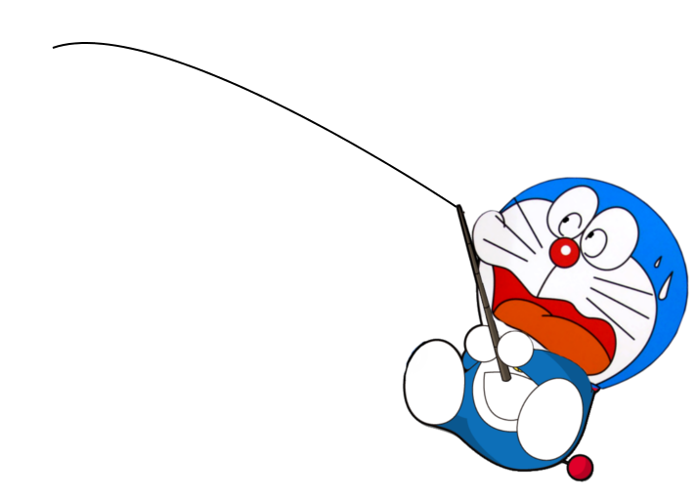
YAY!
GO!
OH NO!
TIME’S UP
I don’t find computer games very ______.
A. excited
B. exciting
www.phuongnam.edu.vn

Slide 15
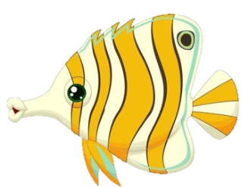
YAY!
GO!
OH NO!
TIME’S UP
Don’t be _____. The dog won’t bite.
A. frightening
B. frightened
www.phuongnam.edu.vn

Slide 16
YAY!
GO!
OH NO!
TIME’S UP
I was _____ when I heard the news.
A. shocked
B. shocking
www.phuongnam.edu.vn

Slide 17
YAY!
GO!
OH NO!
TIME’S UP
It’s really ______ when you interrupt.
A. annoyed
B. annoying
www.phuongnam.edu.vn

Slide 18
YAY!
GO!
OH NO!
TIME’S UP
Why are you looking so ______?
A. worried
B. worrying
www.phuongnam.edu.vn

Slide 19
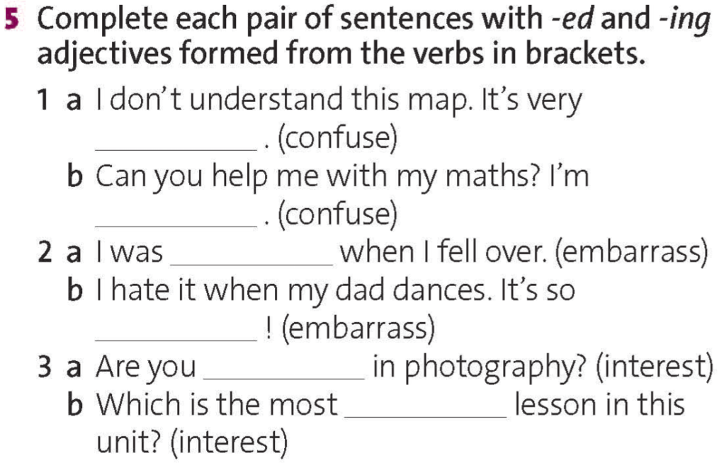
confusing
confused
embarrassed
embarrassing
interested
interesting
www.phuongnam.edu.vn

Slide 20
www.phuongnam.edu.vn

Slide 21
Pair-work
www.phuongnam.edu.vn

Slide 22
www.phuongnam.edu.vn

Slide 23
LUCKY NUMBERS
30
20
40
10
1
2
3
50
80
60
70
4
5
6
ROLL

Slide 24
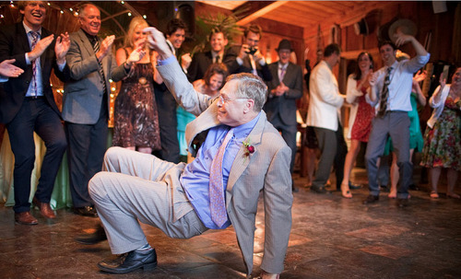
my dad / danced / my birthday party
My dad danced at my birthday party yesterday.
BACK

Slide 25
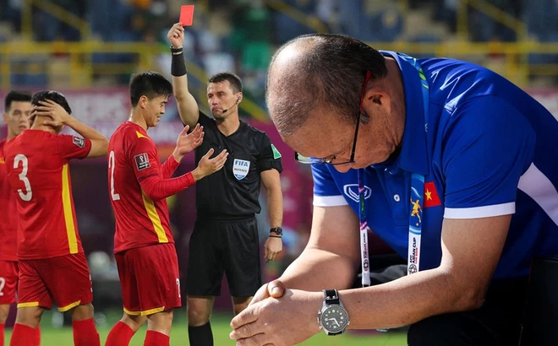
my favorite football team / lost / the weekend
My favorite football team lost the match at the weekend.
BACK

Slide 26
I / saw / a cockroach / and / it / started / flying
I saw a cockroach and it started flying toward me.
BACK

Slide 27
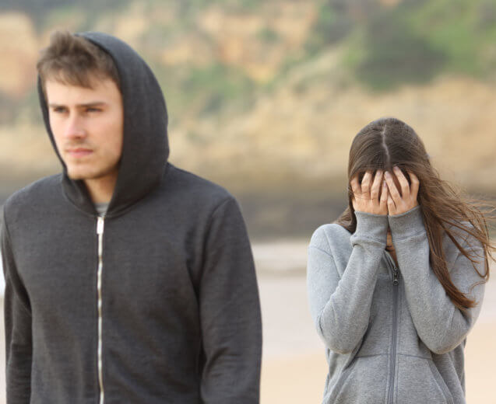
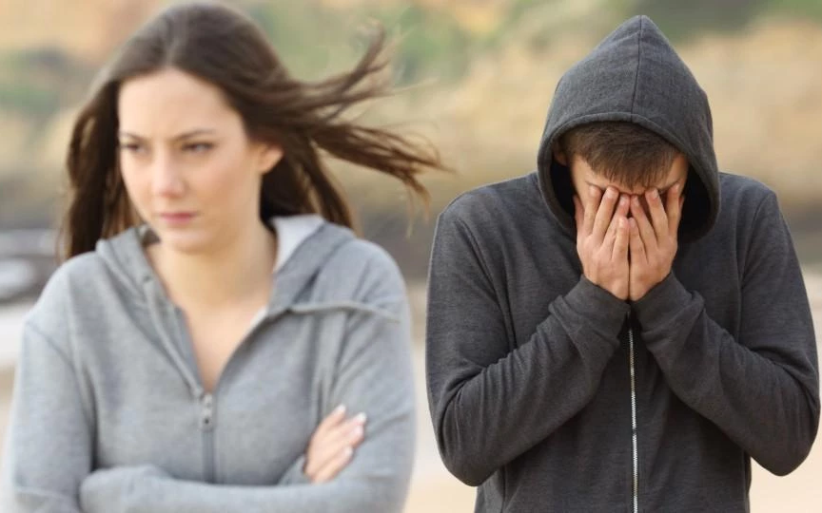
my girlfriend (boyfriend) / broke up / me
My girlfriend/boyfriend broke up with me.
BACK

Slide 28
I / won / free ticket / five-day trip / Japan
I won a free ticket for a five-day trip to Japan.
BACK

Slide 29
I / had / six exams / and / a lot of homework / last week
I had six exams and a lot of homework to do last week.
BACK

Slide 30
Homework
- Learn by heart the structures.
- Make sentences about your family using adjectives ending in –ed and –ing.
- Prepare for next lesson – Reading
www.phuongnam.edu.vn

Slide 31
www.phuongnam.edu.vn

Slide 32
Thank you!
CTCP ĐẦU TƯ VÀ PHÁT TRIỂN GIÁO DỤC PHƯƠNG NAM

